Slide 1
Path to Data Science
Shubha Tiwari

Slide 2
Agenda
1
SVM
2
Exercise

Slide 3
Last Class
KNN

Slide 4
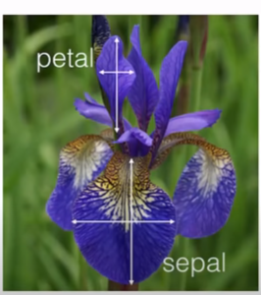

Support vector Machine
A Support Vector Machine (SVM) is a discriminative classifier formally defined by a separating hyperplane. In other words, given labeled training data (supervised learning), the algorithm outputs an optimal hyperplane which categorizes new examples. In two dimentional space this hyperplane is a line dividing a plane in two parts where in each class lay in either side.

Slide 5
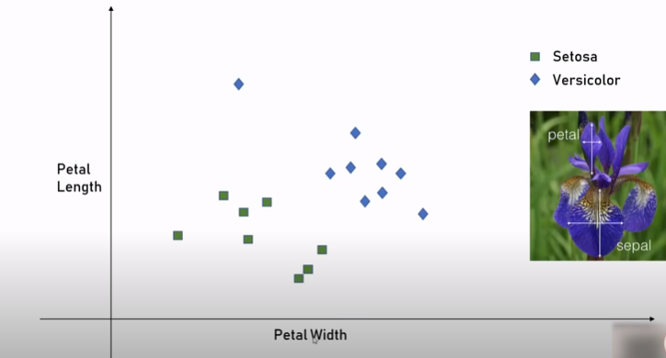

Slide 6
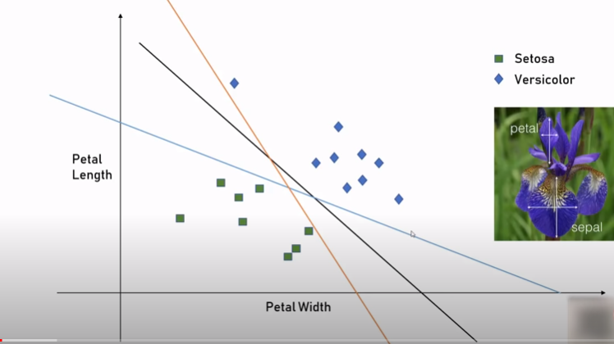

Slide 7
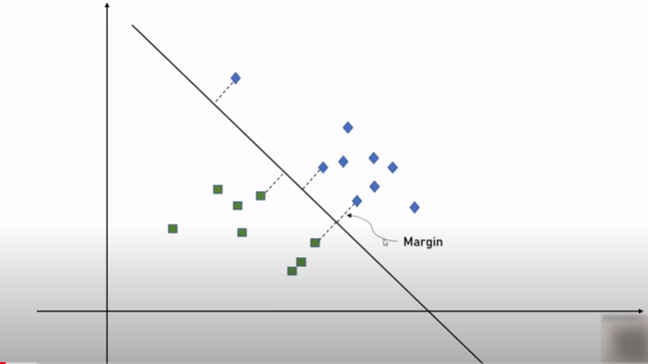

Slide 8
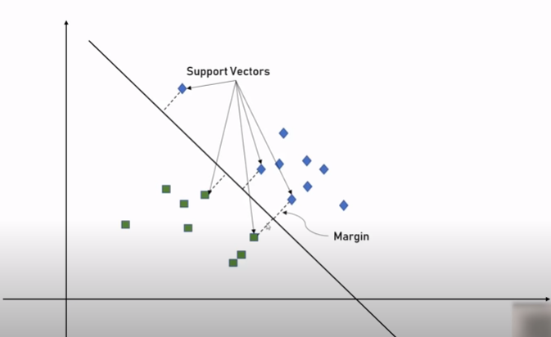

Slide 9
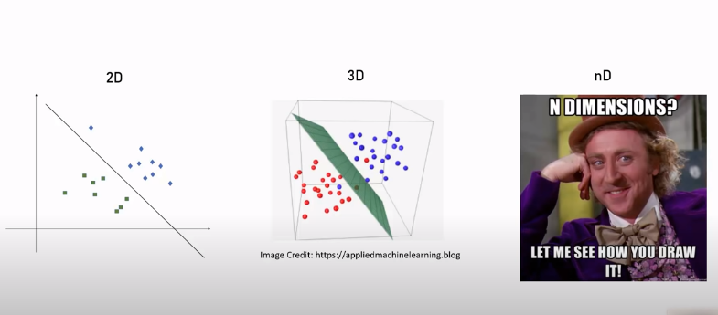

Slide 10
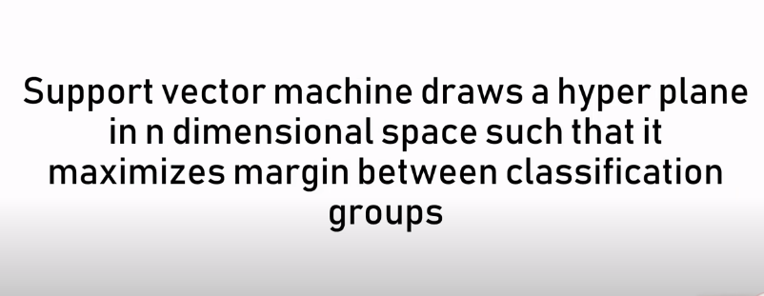

Slide 11
Gamma and Regularization

Slide 12
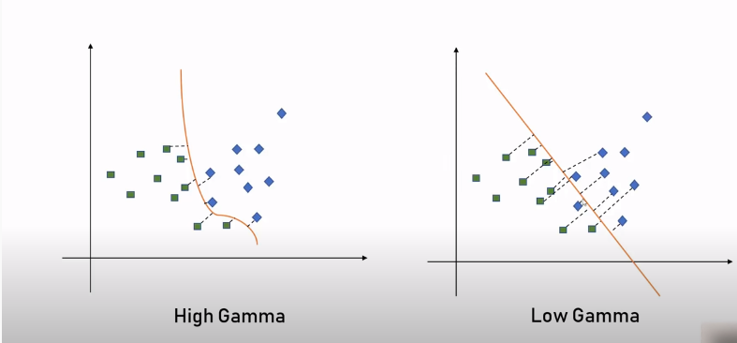
Gamma

Slide 13
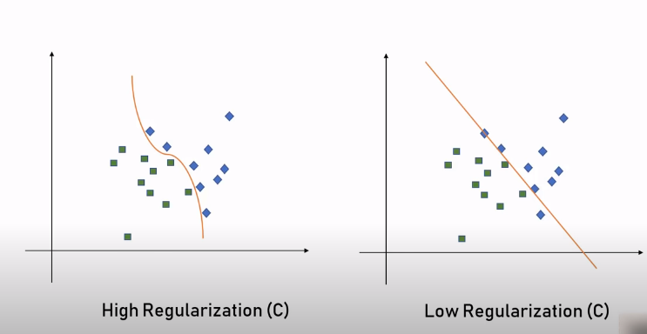
Regularization

Slide 14
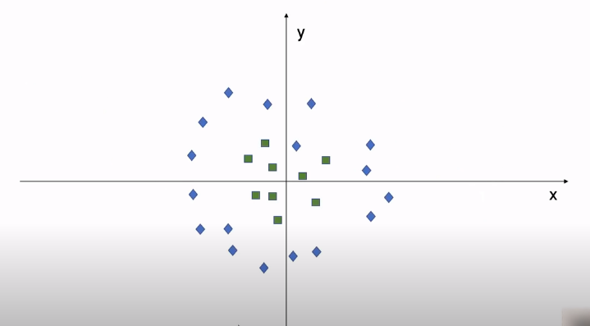

Slide 15
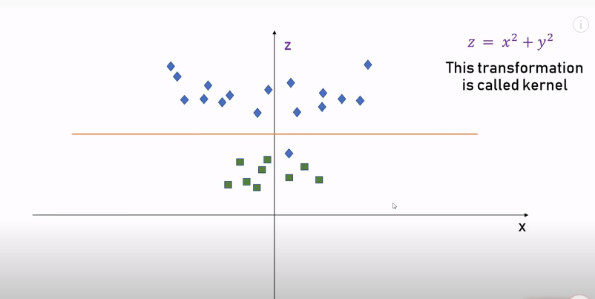

Slide 16
Exercise

Slide 17
Conclusion
SVM
Next class
Project – Wine Dataset

