Slide 1

An initiative to save lives
In Medision, we create the technology to overcome the barriers of manual diagnosis, with the help of our Autonomous AI software.
Industry:- MedTech, Healthcare, DeepTech
Stage:- MVP

Slide 2
PROBLEM WORTH SOLVING
Thousands of people die every day, because of misdiagnosis or delay in proper treatment.
Misdiagnosis by Radiologist and Doctors of Medical Images(like X-ray, MRIs etc..) is very common because of manually visualizing the image which is highly inaccurate and time consuming.

Slide 3
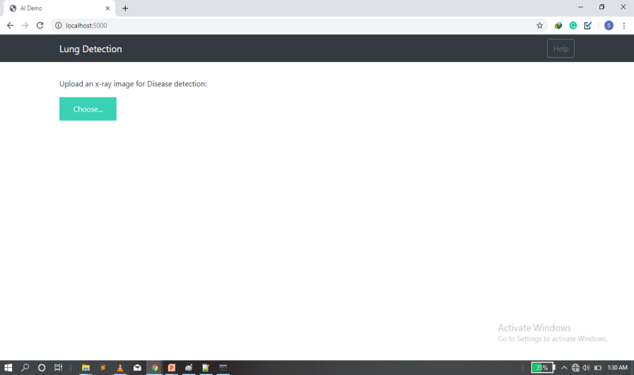
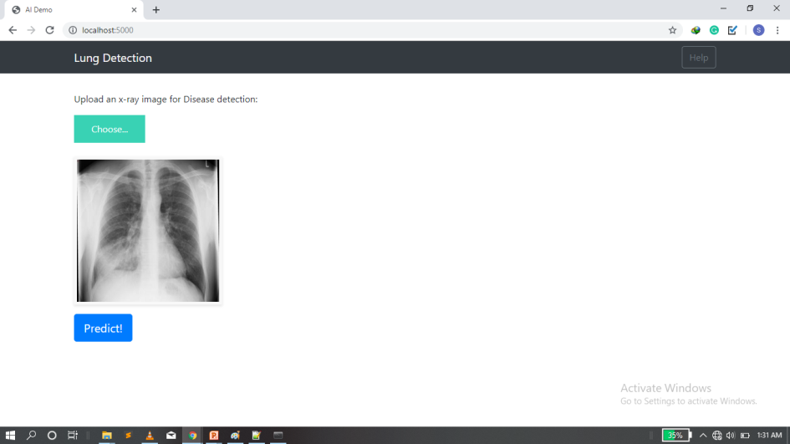
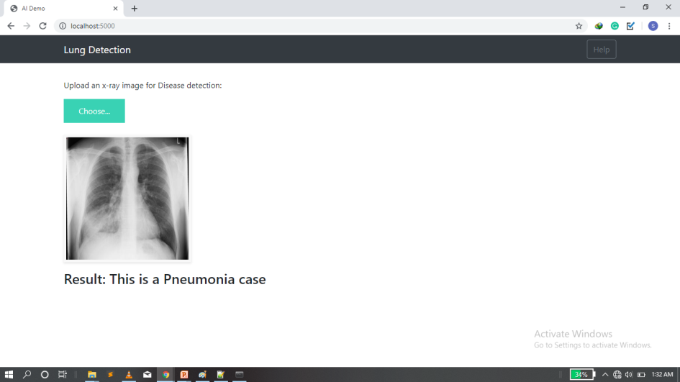
OUR SOLUTION
To help doctors and the radiologist, we have created an Artificially Intelligent Diagnostic tool.
Our Solution is even capable of detecting Pre-mature cancer symptoms even from an X-ray with an accuracy of above 90%.
It can detect Pneumonia, COPD(an incurable disease), Cancer, Pre-mature heart attack stages.
Here the Detection Accuracy is above 90%

Slide 4
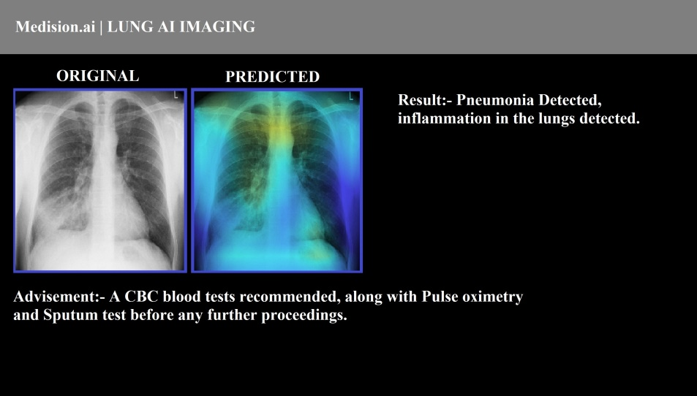
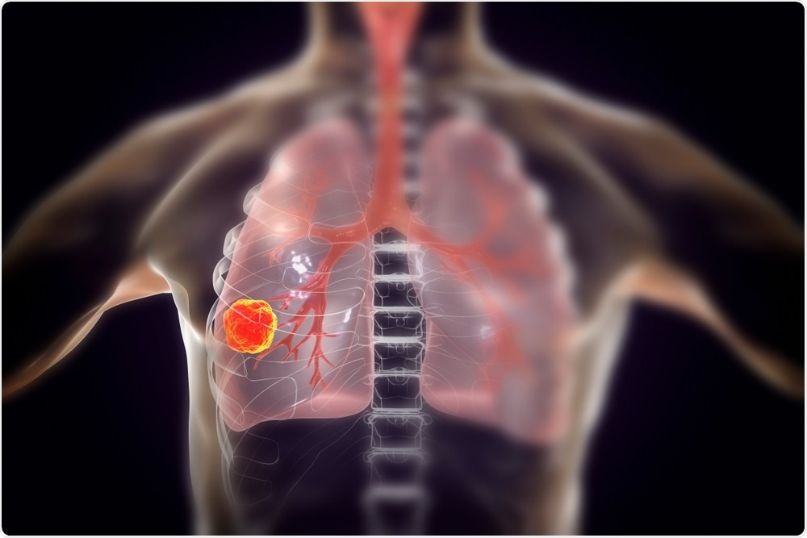
Prototypes
Product POC(Prototype V.2)
1. More Detailed result.
2. Shows in which part disease is detected.
3. Instruction on what to do next.
Prototype V.3(Ready Launch)
Early stage Lung Cancer Detection

Slide 5

INNOVATION AND INTELLECTUAL PROPERTY
For the development of this solution we are using our own neural network(using our own patented technology)
We designed our neural network to work on less amount of data to get the highest possible accuracy.
We have a multi-model system trained to different parameter to avoid false positive and negative.
Our patented system is called FUSED COHERENT DEEP NEURAL NETWORK(FCDNN) which is designed by us.
FAST
EFFICIENT
ACCURATE
100 times than Doctor
100 times than human
Above 90% accuracy
Patent no.: 202011016177

Slide 6
TARGET MARKET & SIZE
Rs. 4 trillion
Rs. 802 billion
Rs. 8.6 trillion
The target industry is expected to grow at 16% rate/year The Indian market is expected to grow at 18% rate/year

Slide 7
BUSINESS MODEL
We are going to follow a software license subscription model for the yearly renewal, our target customers are Hospitals and Diagnostic centres.
Business Model
50 k Diagnostics centers(In India)
Rs. 50 k
Weighted average fee
Rs. 3.5 Billion
Revenue Potential In India
20 K Hospital (in India)
For 2 year our laser focus market is only 5% of total market i.e.
Rs. 175 million/year

Slide 8
PRODUCT DEVELOPMENT MILESTONE
Quarter 1
Final Beta Testing and Team hiring
Quarter 3
Quarter 2
Multi-city product Expansion
Quarter 4
0
Product Launch and CDSCO certification
Adding new feature of CT scan analysis, and making presence in at least 20 cities
Completed Task
Patent Done
Radiologist approval done
Can detect up-to 5 disease

Slide 9
GO TO MARKET STRATEGY
For our market strategy we are going to follow the traditional approach of using MRs(Medical representatives) and also collaborating with hospitals for bulk selling.
Product Yearly Subscription
One on One marketing(slow but steady)
MR Go-to market model(Single unit selling)
One on One marketing to Diagnostic labs and single units
Product Yearly Licensing
Mass Collaboration
Hospital collaboration
Bulk Selling of units to hospitals
Strategy 1
Strategy 2

Slide 10
COMPETITION
Our training system is very different from our competitor, as they use millions of images because of traditional approach, but our self developed algorithm is capable of producing better results with very less data. Allowing us to add new diseases very fast.
Factors | Our Product(Medi-X) | Direct Competitor | Indirect Competitor(Manual analysis)
Price | Rs.10 per image | Starting at Rs. 90 per image | Standard fee( around Rs. 300)
Pre-mature lung cancer detection from X-ray | YES | NO | Sometimes if clearly visible
Web Integration | YES | YES
Low power device support(like smart phones) | YES | NO
Level of Seriousness | YES(can predict from level 1 to 4) | NO | Not without extra tests

Slide 11

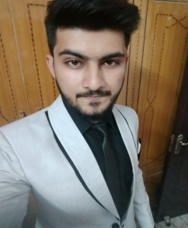
TEAM
I’m an AI scientist with a year’s experience in developing Artificial neural networks, and out of college, this is my second startup in the Heath sector.
Number of patents holding:- 1
Shubham Singh
Co-founder
I’m a Data analyst with a year’s experience in the field of handling data associated with the Health sector.
Number of patents holding:- 1
Ahraz Khan
Co-founder

Slide 12


MENTORS AND ADVISORS
We were the part of 2019 winter Cohort, in which we were mentored to get our product version 3 completed and also mentored during our patent filing.
Viridian accelerator
Mentors
We have an On-call support of doctors to help us validate our product. Including 1 Chief Medical officer of Indian Railways (can not disclose his name due to signed NDA)
Advisors

Slide 13
FUNDING REQUIRED AND FUND UTILIZATION
Funding Required: 50 Lakh
Bootstrapping funding available: 5 Lakh
Required Funding Breakup
Hired Man power( 4 AI scientist) Salary – | 35k each :- total 1.4 Lakh/month | 16.8 Lakh/year
Office/ infrastructure Rent | 50 k/month | 6 Lakh/year
CDSCO License filling + approval | 3 Lakh(one time cost) | 3 Lakh(one time)
Pre-mature beta testing( Clinical Trails) | 1 Lakh(one time) | 1 Lakh(one time)
Final Clinical testing before CDSCO | 1.5 Lakh(one time) | 1.5 Lakh(one time)
Server purchasing + Management | 2 Lakh/year | 2 Lakh/year
Heavy data storage + gathering + processing units + management | 5 Lakh/year | 5 Lakh/year
Note: The breakup is of 18 months burn rate.

Slide 14
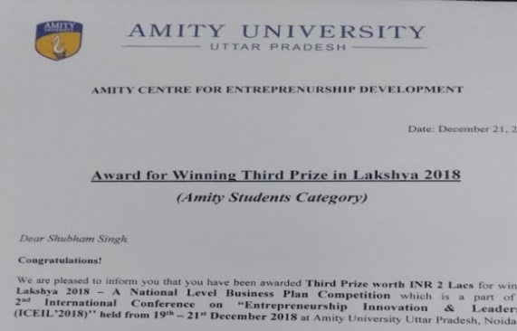
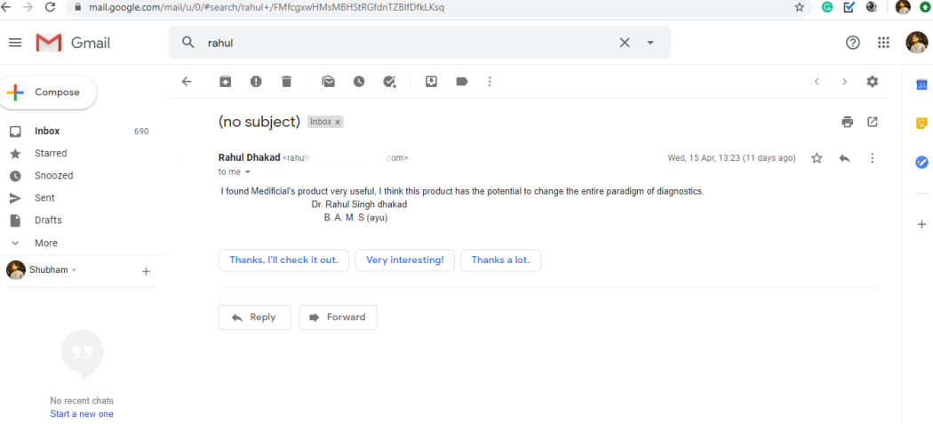
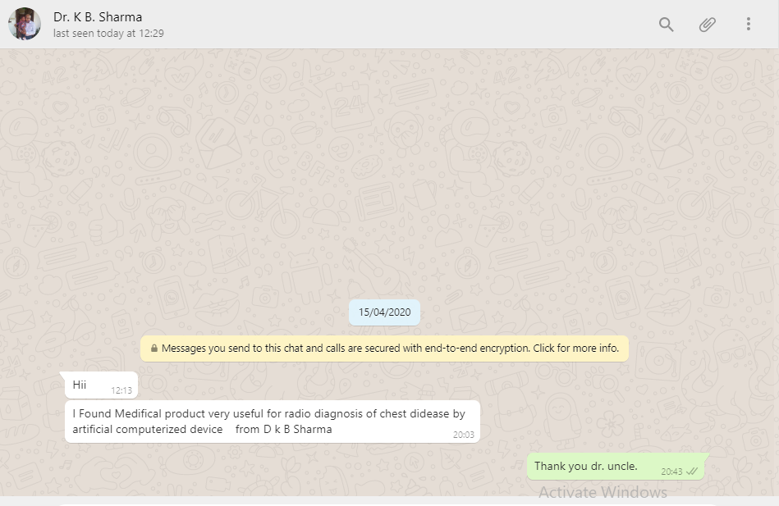
ACHIEVEMENTS AND RECOGNITION
Second Runner-up in National Business Plan competition, for same idea.
Lakshya B-plan Competition
December 2018
I found Medificial's product very useful, I think this product has the potential to change the entire paradigm of diagnostics. Dr. Rahul Singh dhakad
Medifical product is very useful for radio diagnosis of chest disease by artificial computerized devices.
from Dr. k B Sharma

Slide 15
Future
A Future Where No One Has To Say If I Had Known Sooner.
Thank You

