Slide 1

An initiative to save lives
In Medision, we create the technology to overcome the barriers of manual diagnosis, with the help of our Autonomous AI software.
Industry:- MedTech, Healthcare, DeepTech
Stage:- MVP
By Medificial HealthTech Services Pvt. Ltd.

Slide 2
PROBLEM WORTH SOLVING
Thousands of people die every day, because of misdiagnosis or delay in proper treatment.
Misdiagnosis by Radiologist and Doctors of Medical Images(like X-ray, MRIs etc..) is very common because of manually visualizing the image which is highly inaccurate and time consuming.

Slide 3
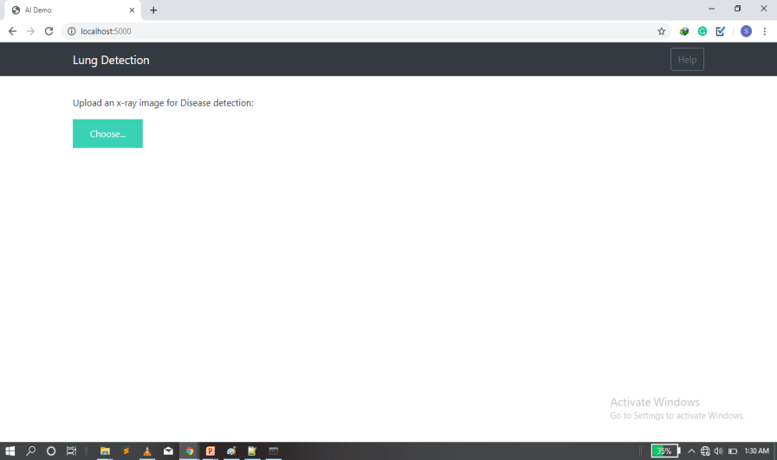
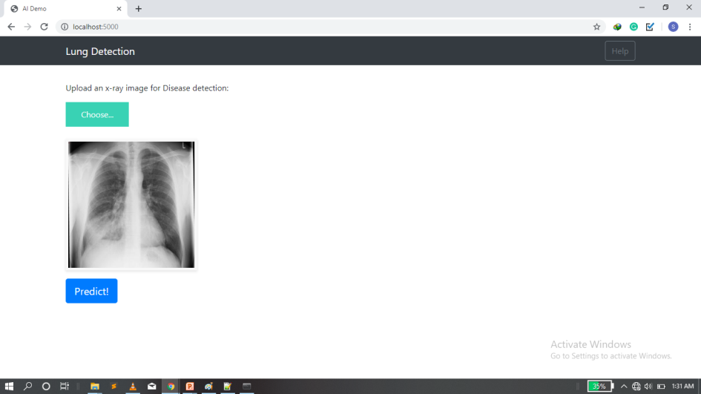
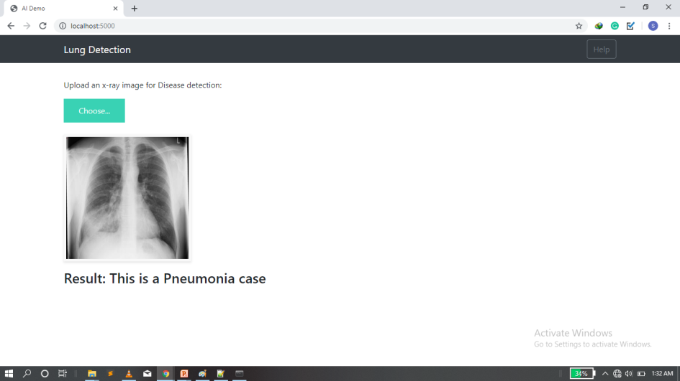
OUR SOLUTION
To help doctors and the radiologist, we have created an Artificially Intelligent Diagnostic tool.
Our Solution is even capable of detecting Pre-mature cancer symptoms even from an X-ray with an accuracy of above 90%.
It can detect Pneumonia, COPD(an incurable disease), Pre-mature Cancer symptoms, heart expansion, etc...
Here the Detection Accuracy is above 90%

Slide 4
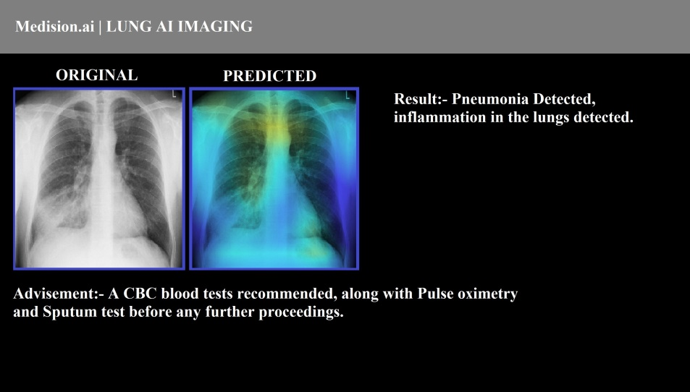
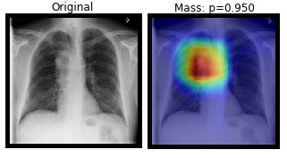
Prototypes
Product POC(Prototype V.2)
1. More Detailed result.
2. Shows in which part disease is detected.
3. Instruction on what to do next.
Prototype V.3(Ready to Launch)
Early stage Lung Cancer Detection

Slide 5
VALUE PROPOSITION
Note:- The proposition described is of target Indian Market
AI Cancer Detection
First to market to detect pre- mature cancer using AI
Can even predict the level of seriousness.
Remote areas availability
Can run on any device making it available through out.
In case of emergency can even run on smart phone.
Very Cheap
Our per image price is 9 times less than our competitors
No new Hardware Required
Our solution is SaaS system.
Making it available to everywhere to everyone
Patent no.: 202011016177

Slide 6
TARGET MARKET & SIZE
Rs. 4 trillion
Rs. 802 billion
Rs. 8.6 trillion
The target industry is expected to grow at 16% rate/year The Indian market is expected to grow at 18% rate/year

Slide 7
BUSINESS MODEL
We are going to follow a software license subscription model for the yearly renewal, our target customers are Hospitals and Diagnostic centres.
Business Model
50 k Diagnostics centers(In India)
Rs. 50 k
Weighted average fee
Rs. 3.5 Billion
Revenue Potential In India
20 K Hospital (in India)
For 2 year our laser focus market is only 5% of total market i.e.
Rs. 175 million/year

Slide 8
PRODUCT DEVELOPMENT MILESTONE
Quarter 1
Final Beta Testing and Team hiring
Quarter 3
Quarter 2
Multi-city product Expansion
Quarter 4
0
Product Launch and CDSCO certification
Adding new feature of CT scan analysis, and making presence in at least 20 cities
Completed Task
Patent Done
Radiologist approval done
Can detect up-to 5 disease

Slide 9
COMPETITION
Note:- The proposition described is of target Indian Market
Our training system is very different from our competitor, as they use millions of images because of traditional approach, but our self developed algorithm is capable of producing better results with very less data. Allowing us to add new diseases very fast.
COMPETITIVE ADVANTAGE
1. Complete Cloud based platform, no new hardware required.
2. Capability to run on low powered devices like smart phones.
3. Pre-mature cancer detection via. X-rays
4. Prioritizing scans from the level of seriousness(means which patients need early or immediate attention)
5. Comparing effective treatment report from X-rays(like one at time of admission another after some given treatment)

Slide 10

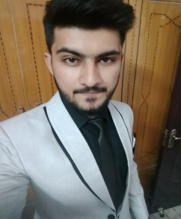
TEAM
I’m an AI scientist with a year’s experience in developing Artificial neural networks, and out of college, this is my second startup in the Heath sector.
Number of patents holding:- 1
Shubham Singh
Co-founder
I’m a Data analyst with a year’s experience in the field of handling data associated with the Health sector.
Number of patents holding:- 1
Ahraz Khan
Co-founder

Slide 11


MENTORS AND ADVISORS
We were the part of 2019 winter Cohort, in which we were mentored to get our product version 3 completed and also mentored during our patent filing.
Viridian accelerator
Mentors
We have an On-call support of doctors to help us validate our product. Including 1 Chief Medical officer of Indian Railways (can not disclose his name due to signed NDA)
Advisors

Slide 12
FUNDING REQUIRED AND FUND UTILIZATION
Funding Required: 25 Lakh in exchange for 2% equity
Bootstrapping funding available: 5 Lakh
Required Funding Breakup
Hired Man power( 4 AI scientist) Salary – | 25k each :- total 1 Lakh/month | 12 Lakh/year
Office/ infrastructure Rent | 25 k/month | 3 Lakh/year
CDSCO License filling + approval | 2 Lakh(one time cost) | 2 Lakh(one time)
Pre-mature beta testing( Clinical Trails) | 50 k(one time) | 50 k(one time)
Final Clinical testing before CDSCO | 50 k(one time) | 50 k(one time)
Server purchasing + Management | 1 Lakh/year | 1 Lakh/year
Heavy data storage + gathering + processing units + management | 1 Lakh/year | 1 Lakh/year
Note: The breakup is of 15 months burn rate.

Slide 13
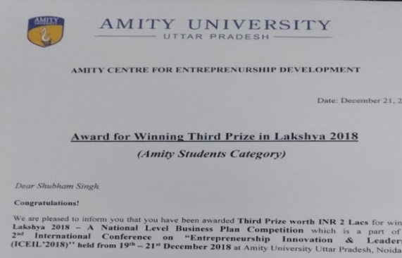
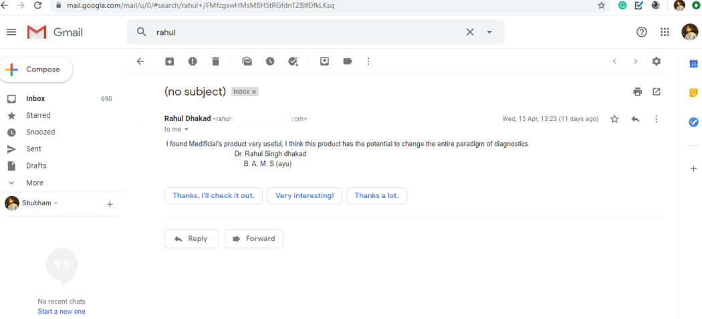
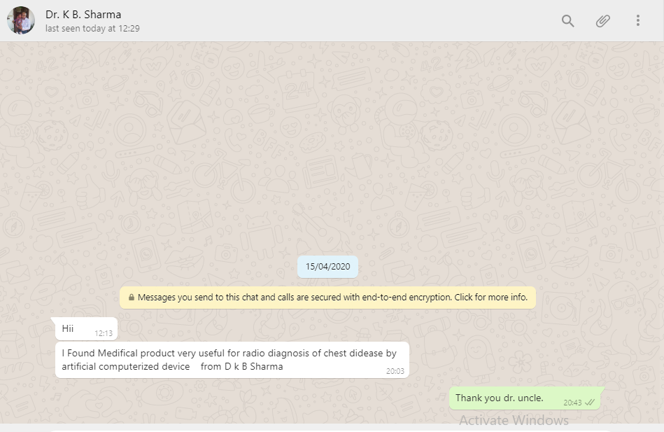
ACHIEVEMENTS AND RECOGNITION
Second Runner-up in National Business Plan competition, for same idea.
Lakshya B-plan Competition
December 2018
I found Medificial's product very useful, I think this product has the potential to change the entire paradigm of diagnostics. Dr. Rahul Singh dhakad
Medifical product is very useful for radio diagnosis of chest disease by artificial computerized devices.
from Dr. k B Sharma

Slide 14
Future
A Future Where No One Has To Say If I Had Known Sooner.
Thank You

