Slide 1


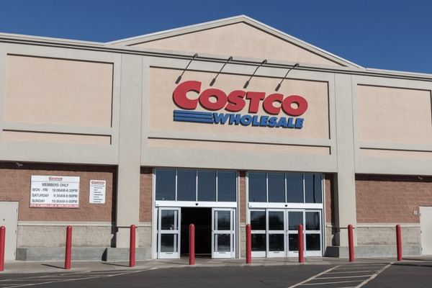
COSTCO
Group 3
Presented By :-
Neel
Ketan
Shubh
Rinkal

Slide 2

Objective
Transforming Costco’s data
Increase Flexibility: This flexibility is crucial for handling peak shopping seasons or unexpected spikes in online orders.
improving performance:
Scalability: Cloud architecture enables Costco to scale resources up or down based on demand.
Cost Optimization: Managing costs while maintaining high availability and performance is a constant concern

Slide 3

PROBLEM STATEMENT
Scalability and Performance:
Balancing performance with cost-effectiveness is a challenge.
Legacy Systems and Scalability:
As Costco expands globally and faces seasonal demand fluctuations, legacy systems struggle to handle increased workloads.

Slide 4

VISION VISUALISATION

Slide 5







Inventory Management
Stores
Cloud Server
Web Analytics
App and Website
Audit and Reporting
User Activity

Slide 6

Cloud Architecture

Slide 7
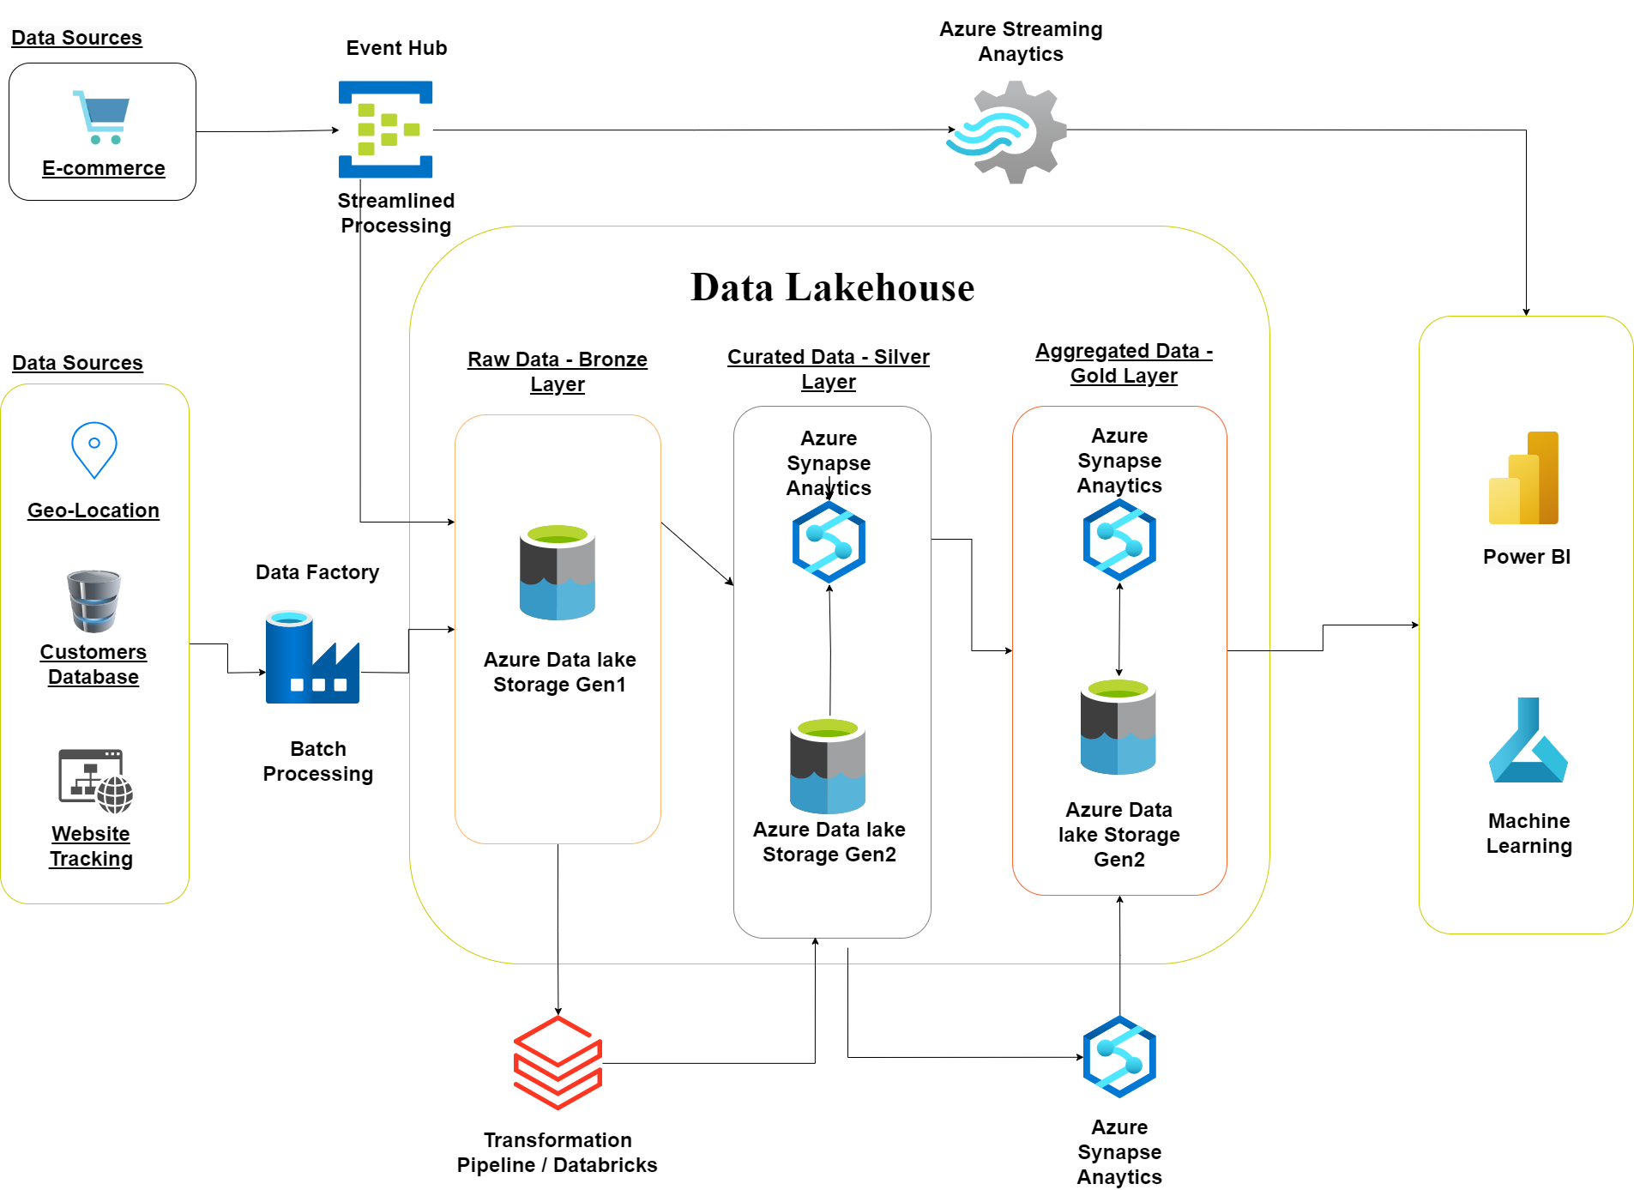

Slide 8

Data Pipeline

Slide 9
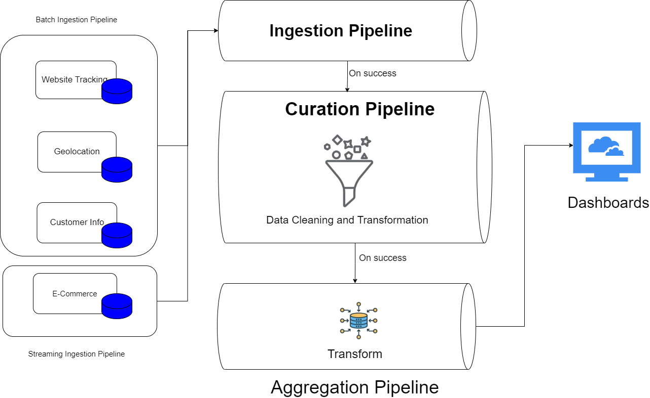

Slide 10
Pipeline Strategy
Data Ingestion
Data Storage
Data Analysis

Slide 11
Deployment Strategy
Containerization
Content Delivery Network

Slide 12

Thankyou

