Slide 1
Coffee Shop Management System

Slide 2
Introduction
Our project is a part of Procedure Oriented Programming(POP) in C programming language.
Our project is simple management system of coffee shop which facilitates the user and administrator.
Basically, it is based on the proper database management of food items, payments method etc. for customer as well as administrator.
We have used the basic concepts of C including graphics also.

Slide 3
Objectives
To become familiar with basic concept of POP such as function, structure, data types graphics etc.
To prepare user-friendly system with the help of C.
To implement the concept of managing database through programming.
To develop teamwork and interactive level between the students.
To develop proper skill and knowledge on the field of programming.

Slide 4
Design and Implementation
Started with basic keywords and data-types we created the database management in which we have used functions and control statements. The entered data are managed and used as per the requirement of the system. Then, graphics are used to enhance the design of the system. The source code was coded in C programming language.

Slide 5
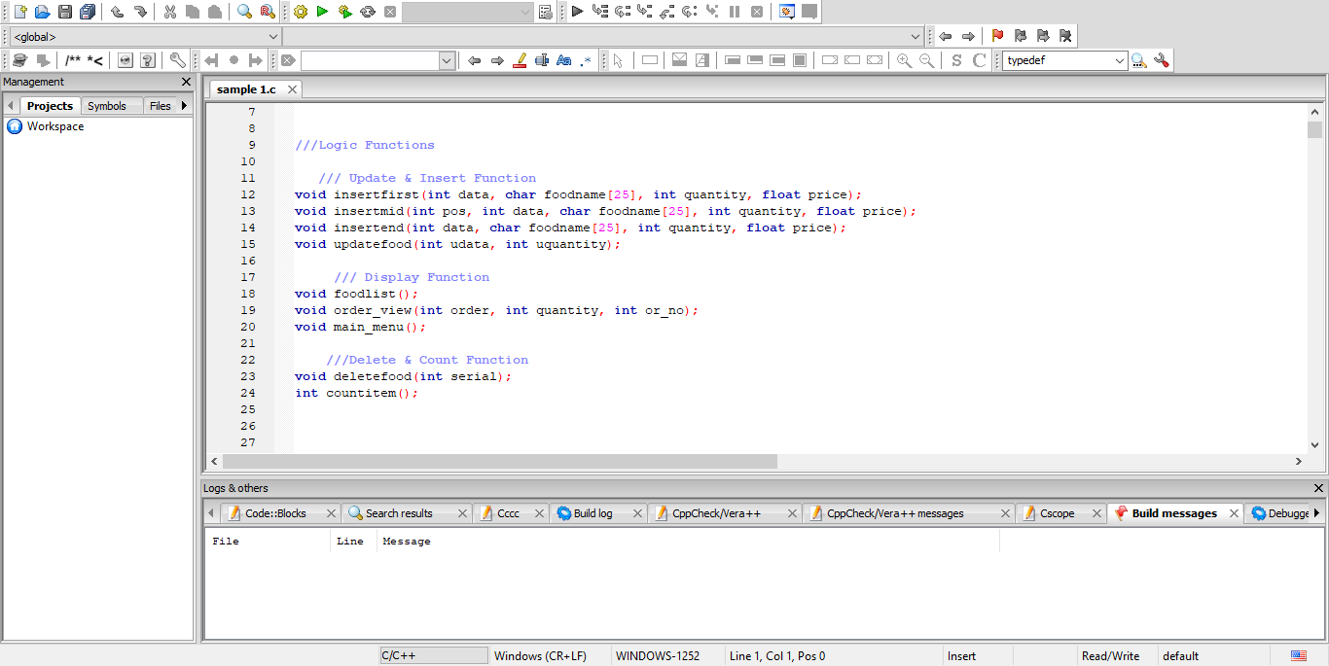

Slide 6
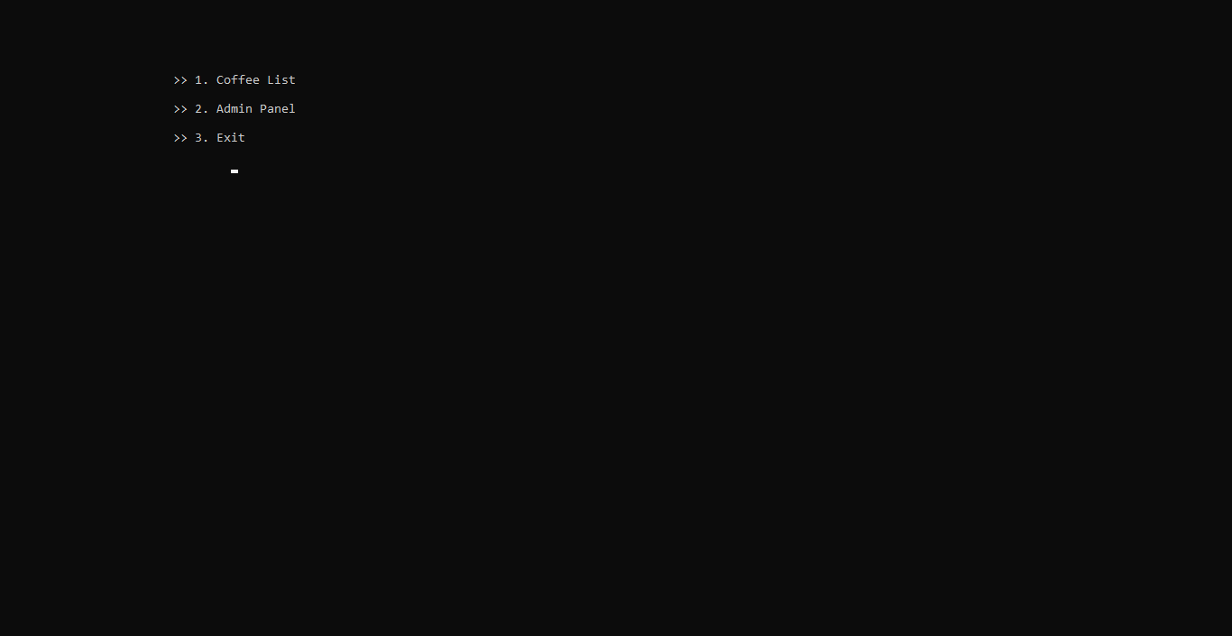
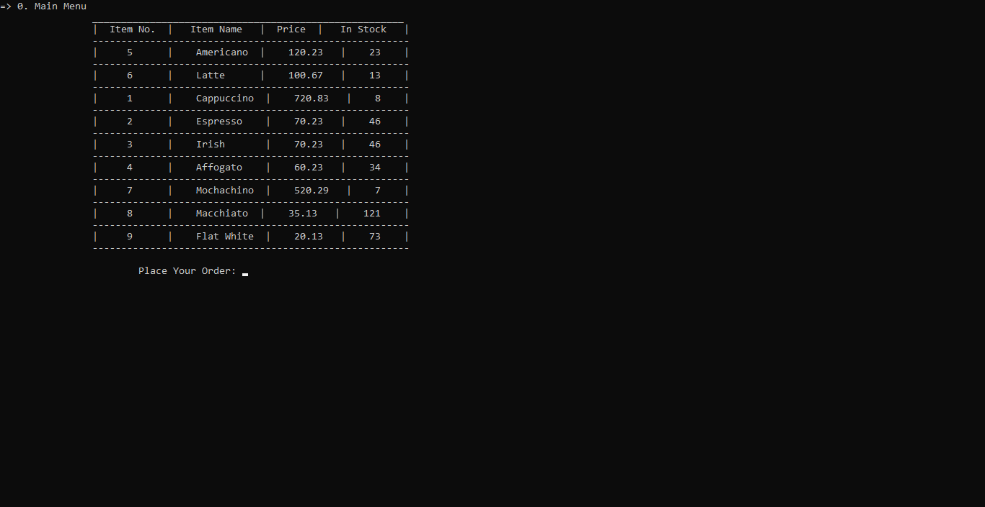

Slide 7
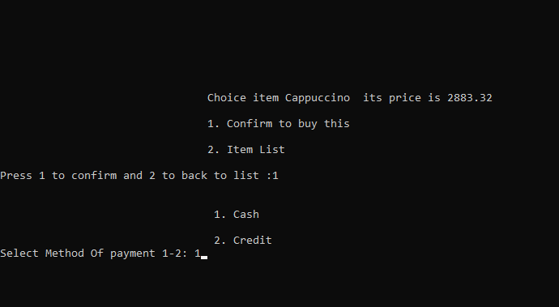
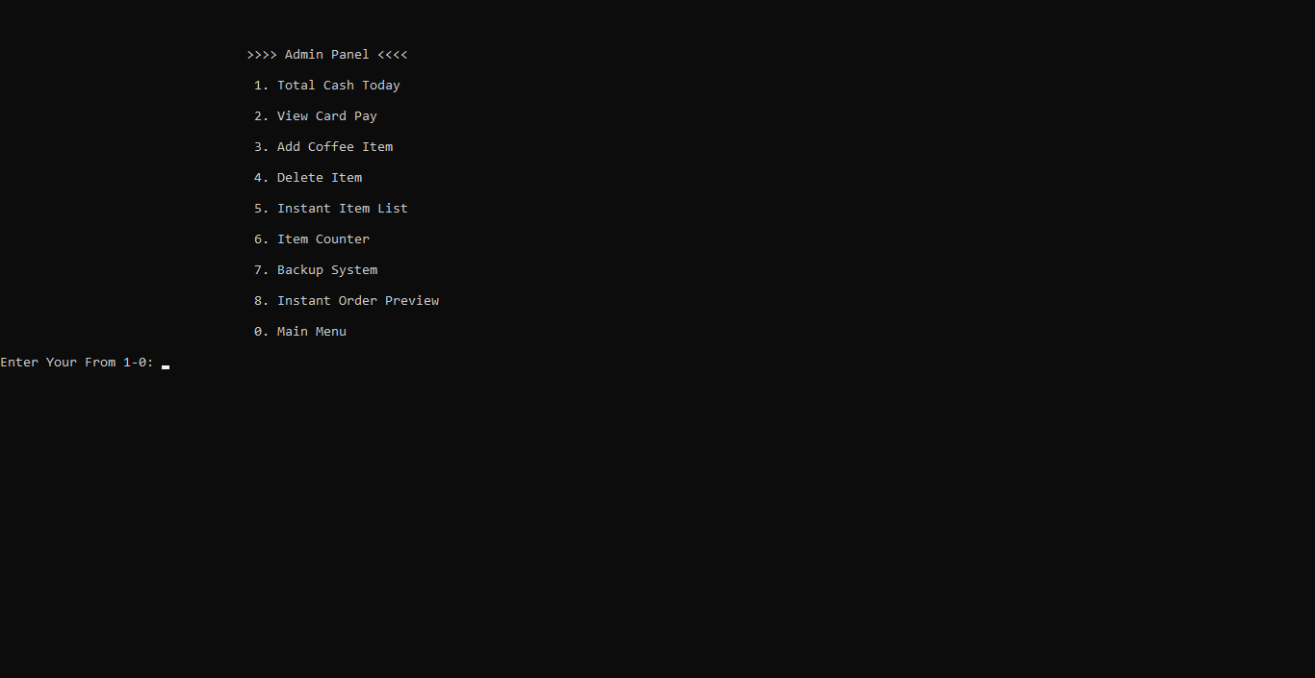

Slide 8
Limitation and Future Enhancements
It is only applicable for small area as it is simple database system
It may not be secure as if somebody get access to administration pane s/he may manipulate the data and code.
For future with advanced programming language, the system can be made more secure and organize.
Proper payment system through the networking can be implemented.

Slide 9
Conclusion
Hence, the project was completed with lots of effort and time with the help of guidance. Commercially can be used with better and proper enhancement, but it provides us deep and clear understanding on whole concept of POP and its enhanced features. As a whole, the project was a good learning experience and better teamwork for three of us.

