Slide 1
COMPUTER GRAPHICS PROJECT
Shubheksha Adhikari
Roll:71

Slide 2
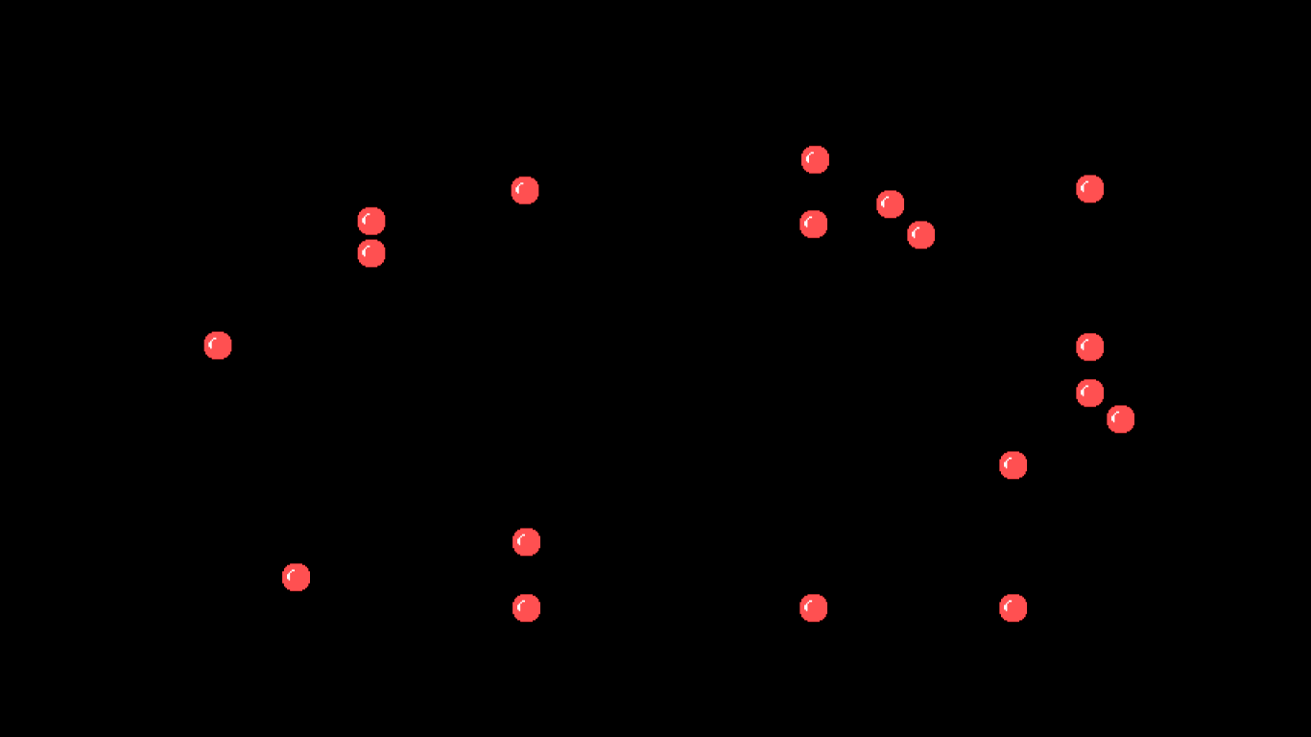
MOVING BALL SCREENSAVER
It is a simple moving ball screensaver, in which many balls are bounce back from the wall of the console.

Slide 3
Objectives
The main objectives of this project:
To learn primitive and graphics library tools
To manipulate and create images using pixels and make movements on the screen

Slide 4
TOOLS:
Use of Turbo C++ as compiler
Built-in function like
putpixel , getmaxx , getmaxy , getimage , putimage , sound , nosound.
User defined-functions like
state , condition.

Slide 5
THANK YOU

