Slide 1
Thermokarst Detection
Shubhendu Kumar Singh

Slide 2
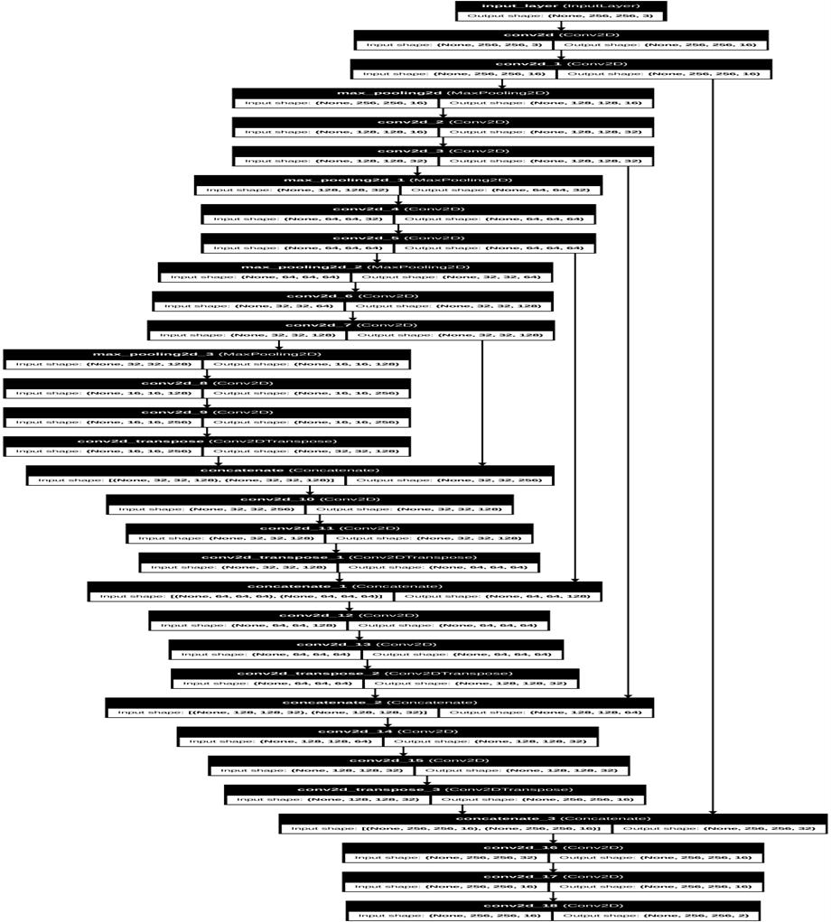
Thermokarst Detection
Total params: 1,941,124 (7.40 MB)
Trainable params: 1,941,122 (7.40 MB)
Non-trainable params: 0 (0.00 B)
Optimizer params: 2 (12.00 B)

Slide 3
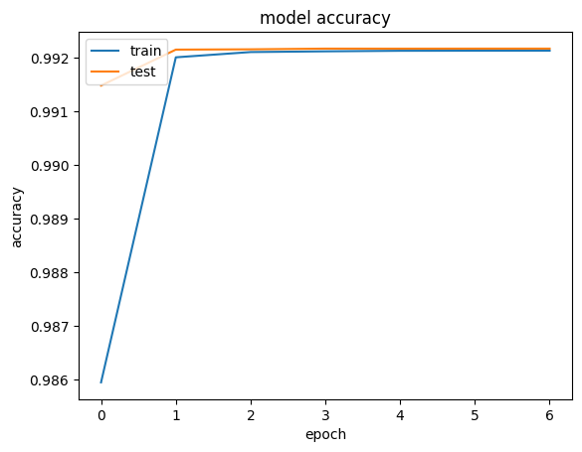
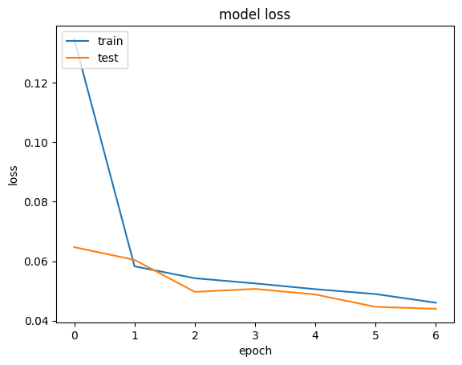
Trained UNet: Training Results
Accuracy: 0.9922
Loss: 0.0440

