Slide 1
Elliptic Curve Cryptosystems
(ECC)

Slide 2

Public-Key Cryptosystems
Authentication: Only A can
generate the encrypted message
Secrecy: Only B can Decrypt
the message
Notes:
Stallings Fig 9-4.
Here see various components of public-key schemes used for both secrecy and authentication. Note that separate key pairs are used for each of these – receiver owns and creates secrecy keys, sender owns and creates authentication keys.

Slide 3
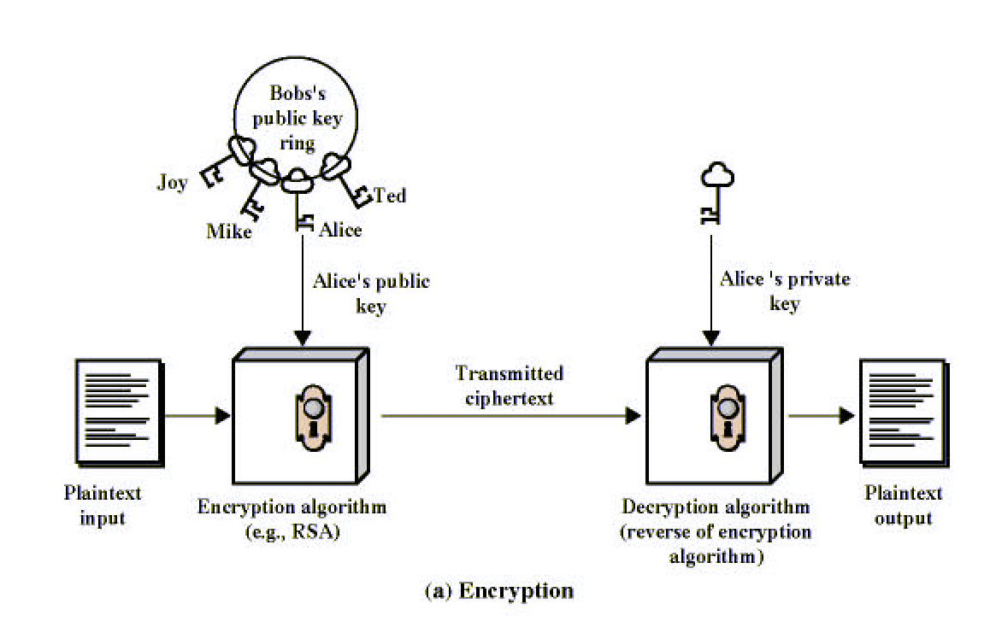
Public-Key Cryptography
Notes:
Stallings Fig 9-1.

Slide 4
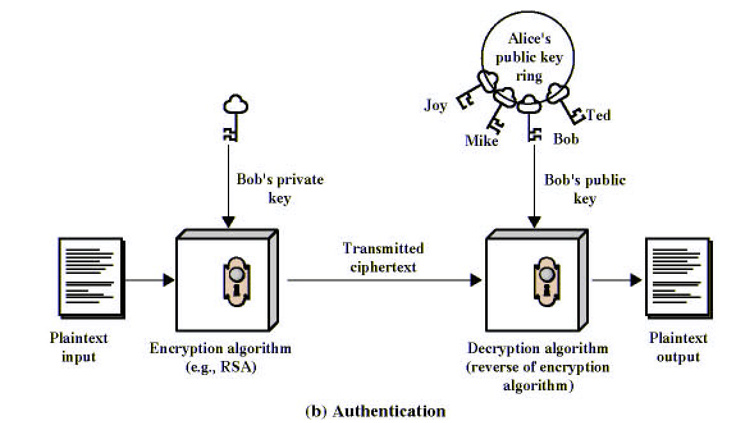
Public-Key Cryptography
Notes:
Stallings Fig 9-1.

Slide 5
What Is Elliptic Curve Cryptography (ECC)?
Elliptic curve cryptography [ECC] is a public-key cryptosystem just like RSA, Rabin, and El Gamal.
Every user has a public and a private key.
  Public key is used for encryption/signature verification.
  Private key is used for decryption/signature generation.
Elliptic curves are used as an extension to other current cryptosystems.
  Elliptic Curve Diffie-Hellman Key Exchange
  Elliptic Curve Digital Signature Algorithm

Slide 6
Using Elliptic Curves In Cryptography
The central part of any cryptosystem involving elliptic curves is the elliptic group.
All public-key cryptosystems have some underlying mathematical operation.
  RSA has exponentiation (raising the message or ciphertext to the public or private values)
  ECC has point multiplication (repeated addition of two points).

Slide 7
Generic Procedures of ECC
Both parties agree to some publicly-known data items
  The elliptic curve equation
    values of a and b
    prime, p
  The elliptic group computed from the elliptic curve equation
  A base point, B, taken from the elliptic group
    Similar to the generator used in current cryptosystems
Each user generates their public/private key pair
  Private Key = an integer, x, selected from the interval [1, p-1]
  Public Key = product, Q, of private key and base point
    (Q = x*B)

Slide 8
Example – Elliptic Curve Cryptosystem Analog to El Gamal
Suppose Alice wants to send to Bob an encrypted message.
  Both agree on a base point, B.
  Alice and Bob create public/private keys.
    Alice
      Private Key = a
      Public Key = P_{A} = a * B
    Bob
      Private Key = b
      Public Key = P_{B} = b * B
  Alice takes plaintext message, M, and encodes it onto a point, P_{M}, from the elliptic group

Slide 9
Example – Elliptic Curve Cryptosystem Analog to El Gamal
  Alice chooses another random integer, k from the interval [1, p-1]
  The ciphertext is a pair of points
    P_{C} = [ (kB), (P_{M} + kP_{B}) ]
  To decrypt, Bob computes the product of the first point from P_{C} and his private key, b
    b * (kB)
  Bob then takes this product and subtracts it from the second point from P_{C}
    (P_{M} + kP_{B}) – [b(kB)] = P_{M} + k(bB) – b(kB) = P_{M}
  Bob then decodes P_{M} to get the message, M.

Slide 10
Example – Compare to El Gamal
  The ciphertext is a pair of points
    P_{C} = [ (kB), (P_{M} + kP_{B}) ]
  The ciphertext in El Gamal is also a pair.
    C = (g^{k} mod p, mP_{B}^{k} mod p)
  --------------------------------------------------------------------------
  Bob then takes this product and subtracts it from the second point from P_{C}
    (P_{M} + kP_{B}) – [b(kB)] = P_{M} + k(bB) – b(kB) = P_{M}
  In El Gamal, Bob takes the quotient of the second value and the first value raised to Bob’s private value
    m = mP_{B}^{k} / (g^{k})^{b} = mg^{k*b} / g^{k*b} = m

Slide 11
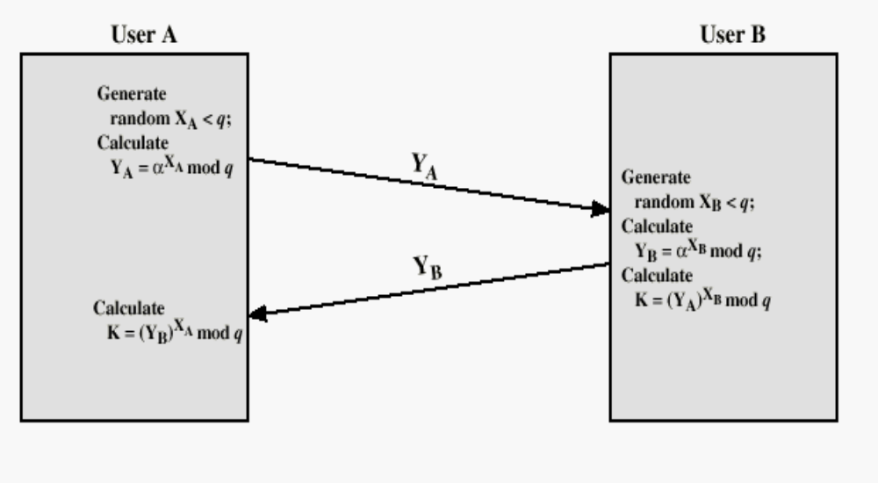
Diffie-Hellman (DH) Key Exchange

Slide 12
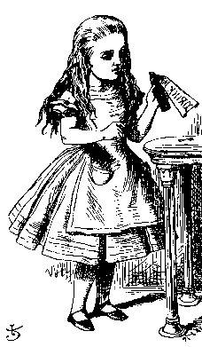
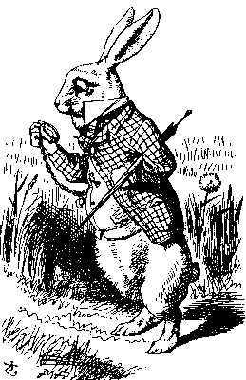
ECC Diffie-Hellman
Public: Elliptic curve and point B=(x,y) on curve
Secret: Alice’s a and Bob’s b
a(x,y)
b(x,y)
Alice, A
Bob, B
Alice computes a(b(x,y))
Bob computes b(a(x,y))
These are the same since ab = ba

Slide 13
Example – Elliptic Curve
Diffie-Hellman Exchange
Alice and Bob want to agree on a shared key.
  Alice and Bob compute their public and private keys.
    Alice
        Private Key = a
        Public Key = P_{A} = a * B
    Bob
        Private Key = b
        Public Key = P_{B} = b * B
  Alice and Bob send each other their public keys.
  Both take the product of their private key and the other user’s public key.
    Alice → K_{AB} = a(bB)
    Bob → K_{AB} = b(aB)
    Shared Secret Key = K_{AB} = abB

Slide 14
Why use ECC?
How do we analyze Cryptosystems?
  How difficult is the underlying problem that it is based upon
    RSA – Integer Factorization
    DH – Discrete Logarithms
    ECC - Elliptic Curve Discrete Logarithm problem
  How do we measure difficulty?
    We examine the algorithms used to solve these problems

Slide 15
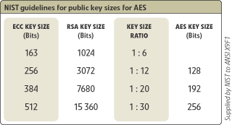
Security of ECC
To protect a 128 bit AES key it would take a:
  RSA Key Size: 3072 bits
  ECC Key Size: 256 bits
How do we strengthen RSA?
  Increase the key length
Impractical?

Slide 16
Applications of ECC
Many devices are small and have limited storage and computational power
Where can we apply ECC?
  Wireless communication devices
  Smart cards
  Web servers that need to handle many encryption sessions
  Any application where security is needed but lacks the power, storage and computational power that is necessary for our current cryptosystems

Slide 17
Benefits of ECC
Same benefits of the other cryptosystems: confidentiality, integrity, authentication and non-repudiation but…
Shorter key lengths
  Encryption, Decryption and Signature Verification speed up
  Storage and bandwidth savings

Slide 18
Summary of ECC
“Hard problem” analogous to discrete log
  Q=kP, where Q,P belong to a prime curve
  given k,P → “easy” to compute Q
  given Q,P → “hard” to find k
  known as the elliptic curve logarithm problem
    k must be large enough
ECC security relies on elliptic curve logarithm problem
  compared to factoring, can use much smaller key sizes than with RSA etc
      for similar security ECC offers significant
  computational advantages

Slide 19
Outline of the Talk…
Introduction to Elliptic Curves
Elliptic Curve Cryptosystems
Implementation of ECC in Binary Fields

