Slide 1
.Net Core Training (Beginner Level)
Notes:
I think we can start now and let me first give my introduction. I am Shubh Gupta, join landis gyr a year back and part of CC GDC Arch team. I have around 14 yrs of experience in Microsoft stack of technologies.
For next 1 hour, I will share beginner level information on .Net Core and Asp.Net Core Web API.

Slide 2
Content
Why Microsoft created .Net Core platform?
.Net Core
.Net Core Characteristics/Benefits
When to use .Net core
Introduction to .Net CLI
Project templates in .Net Core
How to implement REST API in .Net Core
Middleware and Dependency Injection Concept
QnA
Notes:
First, we try to understand, what was the reason of Microsoft launching a new .Net Core when they already has one of the popular software development platform of that time i.e. .Net framework
Then we will briefly discuss .Net Core and its characteristics and will also discuss when should we .Net core and where it still makes sense to use .Net framework.
We will jump and quickly discuss .Net CLI as it is important concept of .Net Core
Then we will briefly discuss Asp.Net Core Web Api and take a code walk through of default webapi project and default generated code.
We also discuss two important concept of Asp.Net Core platform that was not available within Asp.Net framework.
If time permit then we take a code walk through of sample web api code and learn one of a way to structure a loosely couple design of small to mid size backend rest api service.
Also I like to add one more point as we have to cover a lot of point in next 1 hour so I will appreciate, if anyone has any query kindly ping this to me in the chat and will can discuss it at the end of training.

Slide 3
.Prerequisites Basic Understanding
.NET Framework
Asp.Net MVC Api
C#
Rest Api
Notes:
Before we start, this is pre-requisite that you should have basic understanding on this topic to better grasp the content I going to present in the session

Slide 4
.Net Ecosystem
A comprehensive platform developed by Microsoft for building, deploying, and running various types of applications, including web applications, desktop applications, mobile applications, cloud-based services, and more:-
.NET Framework – first release was in 2002
.NET Core – first release was in 2016
Entity Framework/ Entity Framework Core
Xamarin/Maui
Blazor
Azure
Visual Studio/ Visual Studio Code
NuGet
C#/VB.Net/F# Languages
Notes:
Before starting the discussion on .Net Core let first quickly understand what all major platforms, frameworks, tool and IDE provided by Microsoft for building, deploying and running various types of applications, including web applications, desktop applications, mobile applications and cloud-based services and much more.
.NET Framework is the original software development framework for building software applications and first release was in 2002 and still in use and available under long term support.
.NET Core: Next is .Net Core that will discuss in detail in next slides. it is a new software development framework that was first release in 2016 after 14 years of .Net framework launch. USP of .Net core over .Net framework is that is cross-platform and, open-source framework that mean, It supports the development of applications for Windows, macOS, and Linux OS.
Entity Framework: Entity Framework is an object-relational mapping (ORM) framework that simplifies database interactions using .Net Objects.
Xamarin: Xamarin is a cross-platform mobile development framework that allows developers to create hybrid mobile applications for iOS and Android using C# and the .NET framework.
Blazor: Blazor is a framework for building to build client-side web applications with C# code that runs in the browser using WebAssembly.
Azure cloud: Microsoft Azure is a cloud computing platform that provides a wide range of services, including virtual machines, databases, storage, AI, and more, enabling developers to build, deploy, and scale applications in the cloud.
Visual Studio: Visual Studio & visual studio code are the integrated development environment (IDE) for .NET development. It provides a set of tools for coding, debugging, testing, and deploying applications across different platforms.
NuGet: NuGet is a package manager for .NET that simplifies the process of adding, updating, and managing third-party libraries and tools in your projects.
C# Language: C#, VB.Net and F# are programming language used in the .NET ecosystem for application development, but we will only do code walk through of sample application written in C# in this session.

Slide 5
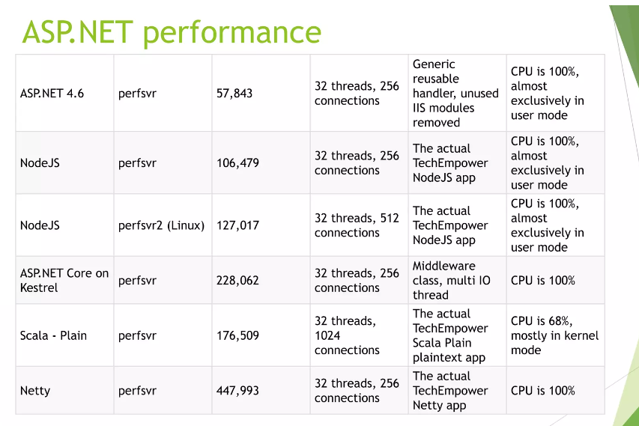
Why Microsoft created .Net Core platform?
Some of the key limitations in the traditional .NET Framework that led to the creation of .NET Core include:
Cross-Platform Support
Performance
Containerization and Microservices
Open Source and Community Involvement
https://github.com/dotnet/core
https://github.com/dotnet/aspnetcore
Notes:
Before learning .Net Core, we should first understand why Microsoft created it when it already has well settled .Net framework. Our command centre product is also majorly build using .Net framework. So what were the area where .Net framework lack.
During start of 2010 decade, boom of cloud platform and cloud service is on rise and Microsoft is also aggressively working on their own cloud platforms i.e. Azure, where they were clearly seeing that .Net framework is not cloud ready and they need a framework that work well in building cloud service and compete with other software development platform like java, python.
At that time they decided to build a new software development framework that is cloud ready and give better performance.
Some of the core limitations that they discover during that exercise are cross platform support, performance, containerization and microservices architecture support and open source and community involvement.
Let briefly discuss them
Cross-Platform Support: .NET Framework was primarily designed for Windows environments. With the increasing demand for cross-platform development (Linux and macOS), especially for server applications and cloud services, the need for a more platform-agnostic framework is felt by Microsoft that give rise to .NET Core that was introduced to provide cross-platform support, allowing developers to build and run applications on Windows, Linux, and macOS.
Performance If you see on the right side table performance metric of Asp.net is the lowest in comparison of Non Microsoft programming language. So NET Core was designed with a focus on performance improvements over .NET Framework. It is more modular, lightweight, and optimized for modern workloads and they re-written entire runtime from scratch for .Net core that is CoreCLR runtime and made other performance enhancements to get faster startup times and improved overall performance that is very important for cloud service.
Netty is an asynchronous event-driven network application framework for rapid development of maintainable high performance protocol servers & clients.
Containerization and Microservices During that time containerization using docker and Kubernetes are getting very popular and .Net framework does not support this at time, So .NET Core was developed by keeping this growing trend of containerization and microservices architectures in mind. This is crucial for modern cloud-native application development. Now .Net framework also support window container but still lack Linux based containerization and where .Net Core offers better support for container technologies like Docker, making it easier to package and deploy applications in isolated environments.
Open Source and Community Involvement. Industries interest toward open source technologies is also gaining popularity like python, mongodb, Hadoop, nodejs, angular, react and postgres. NET Core marked a significant shift towards open-source development. The entire .NET Core stack was made open source, allowing developers to contribute to its development and enabling a more vibrant and collaborative community.

Slide 6
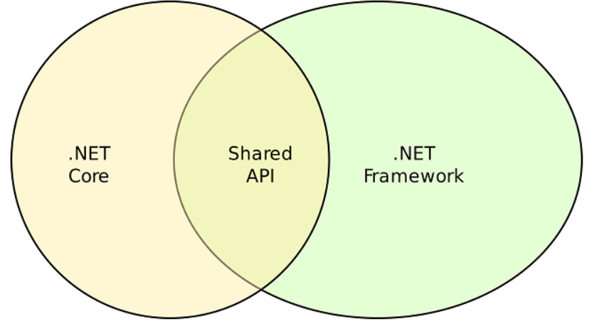
.Net Core
.Net Core is rewrite of the .Net Framework.
.Net Framework is not going away and Microsoft will be going to support it and will continue to be distributed with future releases of Windows.
.NET Core is an open-source, cross-platform framework developed by Microsoft for building modern, high-performance, and scalable applications.
CoreCLR is a .Net execution engine that includes garbage collector and assimilation of machine code in .Net Core.
Due to sky scraping performance of .Net core development, it is considered as an advanced version of the .Net Framework for building microservices.
Microsoft maintains both runtimes for building applications while sharing many of the same APIS called .Net Standard
Notes:
Let briefly discuss .Net core platform in this slide
.Net core platform is re-written from scratch and not an upgrade of .Net framework
And even though .Net core has several advantages over .Net framework but is does not mean .net framework is going away. .Net framework will continue to exist with .Net core and Microsoft will be going to support it and will continue to be distributed with future releases of Windows.
As we previously discussed, .NET Core is an open-source, cross-platform framework developed for building modern, high-performance, and scalable distributed applications and we will discuss this aspect of .Net core in details in next slide.
CoreCLR is a .Net runtime execution engine of .Net core that includes garbage collector and assimilation of machine code and provide similar functionality and capabilities that provide by CLR in .Net framework.
Due to sky scraping performance of .Net core over .Net framework that we discussed in last slide, it is considered as an advanced version of the .Net Framework for building microservices.
Microsoft maintains both runtimes for building applications and when we need to share common APIs between these two then we can build library in .Net Standard that is sharable among these two platforms.

Slide 7
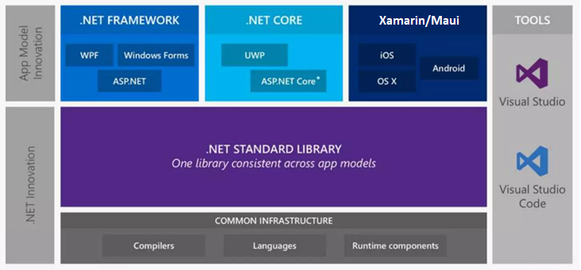
.Net future innovation
Notes:
This diagram will give you a better understanding of what framework component seat at which layer
With .Net 5 release, Microsoft combine the capabilities of both .Net framework and .Net core into a single platform

Slide 8
.Net Core Characteristics/Benefit
Open-Source Framework
Cross-Platform
Consistent across Architecture
Wide-range of applications
Supports Multiple Languages
Modular Architecture
CLI Tools
Flexible Deployment
High Performance
Unified Platform
Notes:
Let quickly discuss this .Net core characteristics one by one:
1-Open-Source Framework
The .NET Core platform is free and open source that we already discussed. .NET Core source code project is available on GitHub. Any developer can get involved in .NET Core development. and Thousands of active developers already participating in .NET Core development - improving features, adding new features, and fixing bugs and issues.
An independent non-profit organization manages .NET Core called the .NET Foundation. More than 60,000 developers and 3,700 companies are contributing to the .NET ecosystem.
.NET Core is free and licensed under MIT and Apache licenses.
2-Cross-Platform
A single code that is developed in .Net core can run on various operating systems like Windows, Linux, and macOS. This cross-platform compatibility ensures that applications built on .NET Core can be deployed and run consistently across different environments.
3-Consistent across Architecture
NET Core abstracts away many platform-specific details, providing a consistent API regardless of the underlying machine architecture i.e. whether it is 32 bit, 64 bit machines or ARM based
This abstraction allows developers to write code against a unified set of libraries and APIs.
4-Wide-range of applications
Using this .Net platform, we can build any type of application whether we need web application, mobile, cloud based service, window application, games, IOT, Machine learning
5-Supports Multiple Languages
Like .Net framework it also supports many popular languages for the application development like C#, F#, VB.net
6-Modular Architecture
.Net core support modern architecture like microservices and containerized application. It supports containerization through docker and Kubernetes. And it supports microservices architecture because of all the characteristics that we discussed so far. Managing microservices is tedious task and popular way to manage it deployment is through Kubernetes where preferred container OS is linux and deployment environment is cloud as it make it easy to scale and distribute globally. .Net core support all of this
7-CLI
Inbuilt .Net CLI tool is provided with .Net core platform that we can use to manage our .Net core application
8-Flexible Deployment
With .NET Core, developers can maintain a single codebase for their applications while deploying them to different platforms and architectures. This reduces the effort required to support multiple environments and ensures consistency in application behaviour.
9-High Performance
As we discussed earlier, .NET Core is designed to be efficient and performant, and optimizations are applied consistently across architectures. This ensures that applications built on .NET Core can benefit from performance improvements regardless of the underlying hardware.
10-Unified Platform
. NET Core 5.0 unifies .NET Framework, .NET Core, and Xamarin into a single platform, simplifying further development efforts

Slide 9
.NET and .NET Core release lifecycle
Version | Release date | Latest version | End of support | Support phase | Major Changes
.NET 8 | November 14, 2023 | 8.0.0 | November 10, 2026 | Active | Improvement in Blazor, Signal R, Minimal APIs, Kestrel servers, ASP.NET Core Identity etc.
.NET 7 | November 8, 2022 | 7.0.14 | May 14, 2024 | Active | ML.NET and .NET MAUI Updates, Asp.Net Core update -Output caching middleware, Rate-limiting middleware, Request decompression middleware
.NET 6 | November 8, 2021 | 6.0.25 | November 12, 2024 | Active | C# 10.0 support Hot Reload for editing code while the application is running MAUI (Multi-platform App UI) Preview Performance improvements
.NET 5 | November 10, 2020 | 5.0.17 | May 10, 2022 | Expire | Unification of .NET Core, .NET Framework, and Xamarin into a single platform (.NET 5) Support for Windows, macOS, Linux, iOS, Android, and more C# 9.0 support, Performance improvements
.NET Core 3.1 | December 3, 2019 | 3.1.32 | December 13, 2022 | Expire | Improved performance, Support for C# 8.0 features, Enhanced JSON APIs
.NET Core 3.0 | September 23, 2019 | 3.0.3 | March 3, 2020 | Expire | C# 8.0 support, Improved performance, Windows Desktop support (WinForms and WPF), ASP.NET Core updates
.NET Core 2.2 | December 4, 2018 | 2.2.8 | December 23, 2019 | Expire | Improved performance, Runtime Diagnostics improvement, New features in ASP.NET Core, Enhanced Azure integration
.NET Core 2.1 | May 30, 2018 | 2.1.30 | August 21, 2021 | Expire | SignalR, Improved performance, HttpClientFactory, ASP.NET Core updates
.NET Core 2.0 | August 14, 2017 | 2.0.9 | October 1, 2018 | Expire | .NET Standard 2.0 support, Improved performance, Windows 10 Fall Creators Update support, Azure integration improvements
.NET Core 1.1 | November 16, 2016 | 1.1.13 | June 27, 2019 | Expire | ASP.NET Core updates, Kestrel Server, Azure Support, new APIs addition
.NET Core 1.0 | June 27, 2016 | 1.0.16 | June 27, 2019 | Expire | Cross-platform support (Windows, macOS, and Linux) ASP.NET Core, Cli-tool, UWP, Xamarin.Forms, Open Source Entity Framework Core
https://learn.microsoft.com/en-us/aspnet/core/release-notes/aspnetcore-8.0?view=aspnetcore-8.0

Slide 10
When to use .Net core
.Net core is properly used for cloud applications or refactoring large enterprise applications into microservices.
We should use .Net Core when:
Cross-Platform Support needed
Using Microservices
Working with Docker containers
High-performance and scalable system needs
Need to run multiple .Net version side-by-side
Want to use command line interface (CLI)

Slide 11
.NET Framework technologies unavailable on .NET
Below are some features that were traditionally associated with .NET Framework but were not part of .NET Core:
Application Domain
.Net Remoting
ASP.NET Web Forms
Code Access Security
WF (Windows Workflow Foundation)
WCF (Windows Communication Foundation) – Some support of WCF added in .Net by CoreWCF Nuget package.
https://github.com/CoreWCF/CoreWCF
Window form/WPF (Supported added from .Net 3, but application only run on window platform)
Notes:
Code Access Security
One main function of Code Access Security is to ensure that only trusted code can execute on a computer.
The publisher must sign the .Net assembly using a strong name key file (snk file) or by using a strong name.
The .Net assembly must be present in the Global Assembly Cache (GAC).

Slide 12
Introduction to .Net CLI
The .NET CLI is a set of cross-platform tools for developing, building, running, and publishing .NET applications.
Key Components:
dotnet Command
Project Files
Basic Commands:
dotnet new: Create a new project or file.
dotnet build: Build the project.
dotnet run: Run the application.
dotnet test: Run unit tests.
dotnet publish: Publish the application for deployment.
dotnet restore: Restore project dependencies.
https://learn.microsoft.com/en-us/dotnet/core/tools/
Notes:
The .NET Command-Line Interface (CLI) is a cross-platform tools for developing, building, running, and publishing .NET applications that mean it can run on all popular operating system like window, Linux and Macintosh. It provides a command-line interface that allows developers to manage their .NET projects and workflows without relying on a specific Integrated Development Environment (IDE).
It's an essential tool for developers who prefer command-line interfaces or work in environments where GUI-based tools are not available.
Key Components:
dotnet Command:
The primary command for interacting with the .NET CLI is dotnet. It serves as the entry point for running various commands related to project management, build, test, and more.
Project Files:
.NET CLI projects are typically defined using a file named project.csproj for C# projects or project.fsproj for F# projects. These project files include metadata about the project, its dependencies, and build settings.

Slide 13
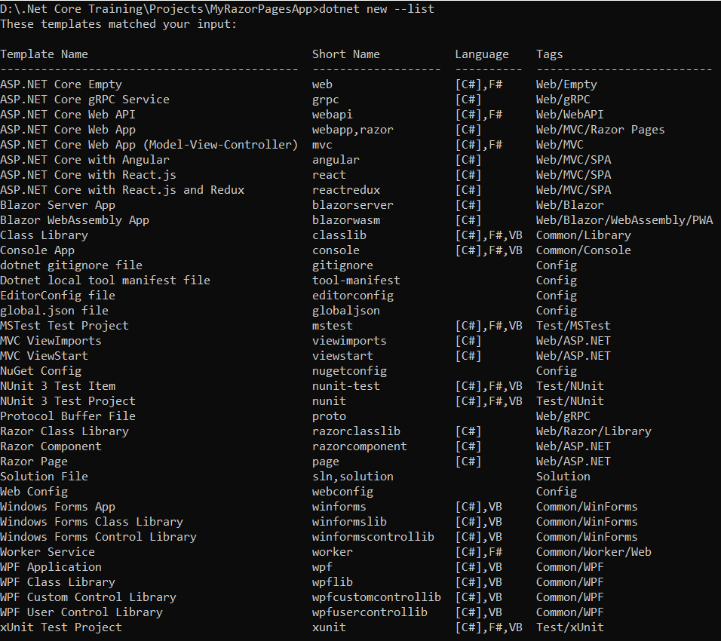
Project templates in .Net Core
In .NET Core, project templates serve as starting points for creating different types of applications.
Below are some of the default project templates available in .NET Core:
Console Application
dotnet new console -n MyConsoleApp
Class Library
dotnet new classlib -n MyLibrary
ASP.NET Core API Application
dotnet new webapi -n MyApi
Razor Pages Web Application
dotnet new webapp -n MyRazorPagesApp
MVC (Model-View-Controller) Web Application
dotnet new mvc -n MyMvcApp
Angular with ASP.NET Core Web Application
dotnet new angular -n MyAngularApp
Notes:
In .NET Core, project templates serve as starting points for creating different types of applications. When we create a new project, we can use a default project template that provides a basic structure and configuration for that specific application type. These templates basically help developers to get started quickly without having to manually set up the initial project structure.
Let quickly discuss some of common project templates available in .NET Core:
1. Console Application:
Template: console
Description: It is use to creates a simple console application with a basic Program.cs file containing the Main method. This template is suitable for building command-line tools or utilities.
dotnet new console -n MyConsoleApp
2. Class Library:
Template: classlib
Description: it is used to sets up the basic structure for a class library. This template is used when creating reusable libraries that can be referenced by other projects.
dotnet new classlib -n MyLibrary
3. ASP.NET Core API Application:
Template: webapi
Description: It is a starting point for building a REST APIs service. It includes a controller, startup class and configuration file
dotnet new webapi -n MyApi
4. Razor Pages Web Application:
Template: webapp
Description: Creates an ASP.NET Core web application using Razor Pages. Razor Pages is a lightweight framework for building dynamic web pages.
dotnet new angular -n MyAngularApp
5. MVC (Model-View-Controller) Web Application:
Template: mvc
Description: It's a starting point for building a dynamic web application using the Model-View-Controller design pattern.
dotnet new mvc -n MyMvcApp
6. Angular with ASP.NET Core Web Application:
Template: angular
Description: Combines ASP.NET Core with an Angular frontend. It sets up a project structure that includes both the server-side ASP.NET Core application and the client-side Angular application.
dotnet new angular -n MyAngularApp

Slide 14
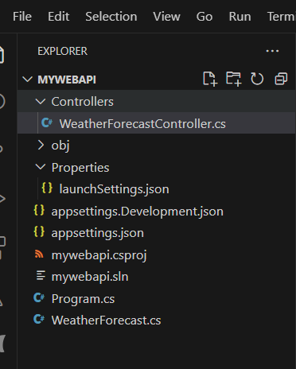
Asp.Net Core Web Api Project Template
Controllers
WeatherForecastController.cs
Obj
Debug
Release
Properties
launchSettings.json
appSettings.json
Appsettings.Development.json
Mywebapi.csproj
Program.cs
WeatherForecast.cs
Notes:
Controller
First folder that you see is the “Controller” folder intended to hold all the API controllers class in this project. If you expand this folder, you will see default “WeatherForeastController” api controller with default Get Http method with default sample code.
Obj
The compiler generates one object file for each source file, and those files are placed into the obj folder.
Each of these folders are further subdivided into Debug and Release folders, which simply correspond to the project's build configurations
Actually, C# compilation is a two-step process, see the below diagram for more details:
Compiling: In compiling phase individual C# code files are compiled into individual compiled units. These individual compiled code files go in the OBJ directory. The obj folder holds object, or intermediate, files, which are compiled binary files that haven't been linked yet.
Linking: In the linking phase these individual compiled code files are linked to create single unit DLL and EXE. This goes in the BIN directory.
Properties
The Properties node includes launchSettings.json file which includes Visual Studio profiles of debug settings. launchSettings.json helps developers to configure the debugging and launch profiles of their project for different environments such as development, staging, production, etc.
Each profile defines how to run your project when you click on the “Run” button in Visual Studio.
Appsettings
The appsettings.json file is a configuration file commonly used to store application-specific configuration settings and parameters. It allows developers to use JSON format for the configurations instead of code, which makes it easier to add or update settings without modifying the application's source code.
By default, in addition to “appsettings.json”, the ASP.NET Core template also includes an “appsettings.Development.json” file. The settings defined in this file are loaded only into the Development environment and are not available in production.
Project File
‘myapi.csproj’ is the project file.
Project Sdk="Microsoft.NET.Sdk": Specifies that this project is using the .NET SDK.
<OutputType>: Specifies the type of output, such as "Exe" for an executable.
<TargetFramework>: Specifies the target framework version.
<Nullable>: Specifies whether nullable reference types are enabled.
<LangVersion>: Specifies the language version.
Program.cs
The last file 'program.cs' is an entry point of an application. ASP.NET Core web application is a console application that builds and launches a web application.
This file uses the top-level statements so when the application starts, it starts executing code from top to bottom.
Top-level statements in C# are a feature introduced in C# 9.0 to simplify the structure of your C# code by allowing us to write statements outside of traditional class and method definitions. With top-level statements, you can write C# code at the top level of a file without the need for a containing class or method
This file serves three main purposes:
It performs all initialization tasks (setting application-wide constants, DB seeding, migrations, etc.).
It registers all services used in this project in the DI Container
It defines the middleware pipeline of our web application.
Connected Services
The 'Connected Services' node contains the list of external services, APIs, and other data sources. It helps in the integration with various service providers, such as Azure, AWS, Google Cloud, and third-party services like authentication providers or databases. We are not using any service yet so it will be empty for now.
Dependencies
The Dependencies node contains the list of all the dependencies that our project relies on, including NuGet packages, project references, and framework dependencies.
It contains two nodes, Analyzers and Frameworks.
Analyzers are extensions for static code analysis. They help you to enforce coding standards, identify code quality issues, and detect potential problems in your code. Analyzers can be custom rules or third-party analyzers provided by NuGet packages.
Frameworks node contains the target framework that your project is designed to run on. We have created an ASP.NET Core MVC application. So, it contains two frameworks, the .NET Core (Microsoft.NETCore.App) and ASP.NET Core (Microsoft.AspNetCore.App) framework. Click on any node and press F4 to see it's version, file path, etc.
We can expand each node to see all the assemblies it contains. In the future, whatever NuGet packages you install, all will be displayed under the dependency’s node. So that you can uninstall it when you don't use it.

Slide 15
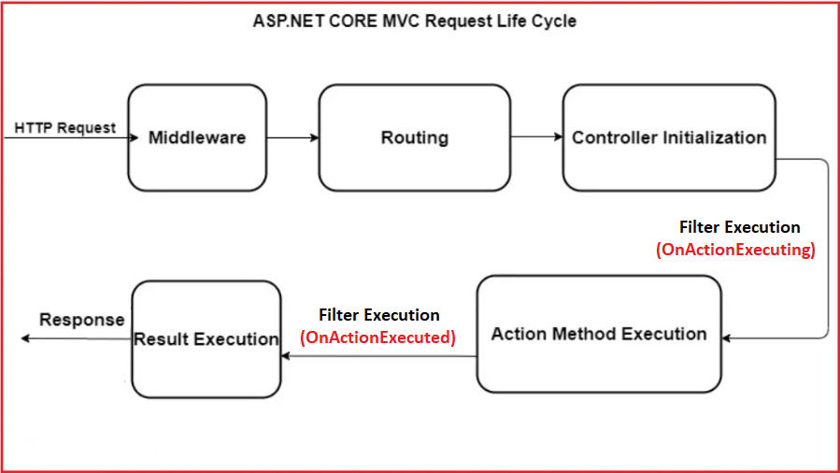
How to implement REST API in .Net Core
Implementing a REST API in ASP.NET Core involves creating controllers, defining routes, handling HTTP requests and responses, and configuring the application to handle RESTful operations.
Below is a step-by-step guide to creating a simple REST API in ASP.NET Core.
Step 1: Create a new ASP.NET Core Project
dotnet new webapi -n MyApi
cd MyApi
Step 2: Create a Controller
Step 3: Define Action Method
Step 4: Run the Application
dotnet build
dotnet run
Your API will be available at https://localhost:7012/swagger.

Slide 16
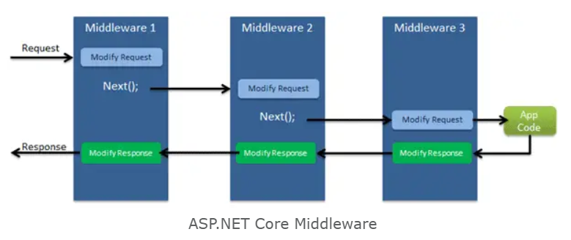
Middleware and Dependency Injection Concept
Middleware and Dependency Injection are two fundamental concepts in ASP.NET Core that play crucial roles in building modular, extensible, and maintainable web applications.
Middleware
Middleware in ASP.NET Core is software components that are arranged in a pipeline to process requests and responses.
Each middleware component in the pipeline performs a specific task, such as authentication, routing, logging, etc.
Keys concepts:
Middleware Components
Middleware Pipeline
Order of Execution
Request Processing
Short-Circuiting
Middleware registration
Use
Run
Notes:
Middleware in ASP.NET Core is software components that are arranged in a pipeline to process requests and responses.
Each middleware component in the pipeline performs a specific task, such as authentication, routing, logging, etc.
Keys concepts:
Middleware Components-
Middleware components are classes that implement the business logic need to perform in the http request pipeline and they have a method called InvokeAsync or Invoke that is called to handle a request.
Middleware Pipeline
The middleware pipeline is configured in the Configure method of the Startup class.
Order of Execution
Middleware components are executed in the order in which they are added to the pipeline. The first middleware added is the first to execute, and the last middleware added is the last to execute.
Request Processing
When a request is received, it travels through the middleware pipeline, and each middleware component has the opportunity to process the request or response.
Short-Circuiting
Middleware components can short-circuit the pipeline by not calling the next middleware in the sequence. This is useful for handling requests early and bypassing unnecessary processing.
Middleware registration
Use
Run
Run() is an extension method on IApplicationBuilder instance which adds a terminal middleware to the application's request pipeline. The above configured middleware returns a response with a string "Hello World!" for each request.
public delegate Task RequestDelegate(HttpContext context);

Slide 17
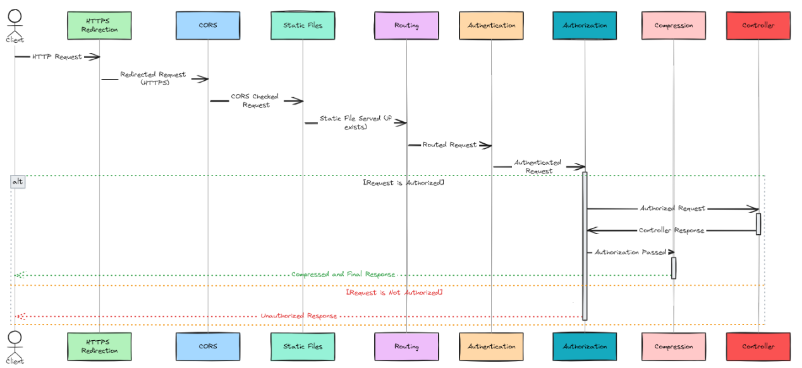
Built in Middleware
Notes:
Authentication:Adds authentication support.
CORS:Configures Cross-Origin Resource Sharing.
Routing:Adds routing capabilities for MVC or web form
Session:Adds support for user session.
StaticFiles:Adds support for serving static files and directory browsing.
Diagnostics:Adds support for reporting and handling exceptions and errors.

Slide 18
Dependency Injection
Dependency Injection
Dependency Injection in ASP.NET Core is a design pattern and a built-in framework for managing the dependencies of an application.
It promotes the separation of concerns by allowing components to be loosely coupled.
Services (dependencies) are registered in the DI container during application startup, and they can be injected into other components, such as controllers, middleware, or services.
Key concepts:
Service
Service Container (DI Container)
Basic Service registration
Transient: A new instance is created every time the service is requested.
Scoped: A single instance is created per request.
Singleton: A single instance is created for the lifetime of the application.
Notes:
Dependency Injection (DI) in Asp.Net Core is a design pattern and a built-in framework for managing the dependencies of an application that provides a way to achieve dependency Inversion principle.
Services (dependencies) are registered in the DI container during application startup, and they can be injected into other classes, such as controllers, middleware, or services rather than being created within the class itself.
This pattern helps improve the maintainability, testability, and flexibility of applications.
Key Concepts in ASP.NET Core Dependency Injection:
Service:
A service is a component that provides specific functionality and is often used by other parts of the application.
Service Container (DI Container):
The DI container is responsible for managing the lifetime and dependencies of services. In ASP.NET Core, the built-in DI container is highly configurable and provides various options for service registration and lifetime management.

Slide 19
Dependency Injection (Continue…)
Other ways of Service Registration:
By Configuration:
services.Configure<AppSettings>(Configuration.GetSection("AppSettings"));
By Custom Logic:
services.AddTransient<IService>(sp =>
{
// Custom logic to create and return the service instance
return new CustomService();
});
By Options Pattern:
services.Configure<ServiceOptions>(Configuration.GetSection("ServiceOptions"));
Service injection in Controller
Constructer
FromService attribute
RequestServices method of HttpContext
Notes:
Option Pattern:
Options Pattern is used to bind a section of configuration settings to the strongly types options classes and add it to the Asp.Net Core Dependency Injection Service Container as singleton lifetime using the "Configure" method of IServiceCollection interface. Once configured, strongly typed Options class can be injected into any service or controller via Dependency Injection using one of available generic Options interfaces IOptions<T>, IOptionsSnapshot<T> and IOptionsMonitor<T>.
IOptions<T>
The IOptions service is used to bind strongly types of options class to configuration section and registers it to the Asp.Net Core Dependency Injection Service Container as singleton lifetime. It exposes a Value property which contains your configured TOptions class.
IOptionsSnapshot<TOptions>
IOptionsSnapshot service is another optional feature that is used to bind strongly types options class to configuration section and registers it to the Asp.Net Core Dependency Injection Service Container as scoped lifetime. It means it supports feature automatic reloading of configuration in the case that configuration settings are changed while the application is running.
IOptionsMonitor<TOptions>
IOptionsMonitor service is another option feature that is also used to bind strongly types options class to configuration section and registers it to the Asp.Net Core Dependency Injection Service Container as singleton lifetime like IOptions interface.
IOptionsMonitor also provides an event called OnChange and a way to register a listener, that gets called whenever the TOptions instance is updated.
Why we need IOptionsMonitor when we have options as a singleton lifetime?
Before understanding why IOptionsMonitor required when we have IOptions service as a singleton lifetime registered, let's understand "What is Scoped Validation?". Since IOptionsSnapshot service provides us an automatic reloading feature and it is registered with the dependency injection container as a scope service, so we can not consume a scoped service from a singleton service. This is a safety feature of Asp.Net Dependency Injection Container called "Scoped Validation".
Since IOptions is registered as a single lifetime and it does not provide automatic reloading feature, so to get an automatic reloading feature like IOptionsSnapshot and to overcome "scoped validation" problem, we need IOptionsMonitor service.

Slide 20
Thank You

