Slide 1
Design Patterns

Slide 2
Content
Design Principle Vs Design Pattern
Solid Principles
GOF Design Patterns
Creation Patterns
Singleton Pattern
Factory Pattern
Structural Patterns
Decorator
Adaptor
Behavioural Patterns
Chain of Responsibilities
Observer
Repository Design Pattern
QnA

Slide 3
Prerequisites Understanding
Oops Programming
Notes:
Before we start, this is pre-requisite that you should have basic understanding on this topic to better grasp the content I going to present in the session

Slide 4
Design Principle Vs Design Pattern
Design Principle
Design principles provide high level guidelines to design better software applications.
Solid
Design Pattern
Design patterns are low level coding solutions for complex designs.
GOF Design Patterns
They do not provide implementation guidelines and are not bound to any programming language.
KISS
Dry
Repository Pattern
These solutions were obtained by trial and error by numerous software developers over quite a substantial period of time.
Notes:
Design Principles are general (high-level) guidelines that help inform good software design. You should have a very good reason every time you decide not to follow principles.
Design Patterns are specific (low-level) solutions to specific problems. You should have a very good reason every time you decide to implement a pattern.
Both concepts are important for building high-quality software, and they can be used in conjunction to create robust and maintainable systems.
Benefit of Design Patterns:
Blueprints for Problem Solving: Imagine Design patterns are like those handy instruction booklets, guiding you step by step. They offer tried-and-true solutions to common challenges, ensuring you don't get lost in the coding wilderness. By studying them, you get a direct line into understanding the principles of object-oriented design: encapsulation, inheritance, polymorphism, and abstraction.
Spotlight on Best Practices: There's coding, and then there is efficient coding. Design patterns are the culmination of collective wisdom from seasoned developers. They embody best practices in object-oriented design. So, by diving into patterns, you are not just learning to code, you are learning to code correctly. It is like getting tips straight from the pros.
Enhanced Code Reusability: Remember the joy of recycling Lego pieces to create something new? That's what design patterns offer. They emphasize modular and reusable code. By understanding patterns, you will find yourself writing code that's more adaptable and can be reused in various scenarios.
Boosted Communication: Here's a game-changer: design patterns give you a shared vocabulary. Instead of saying, "I've set up this system where objects can handle a request or pass it on to another object," you can just say, "I've implemented the Chain of Responsibility pattern." It's like having a secret handshake with fellow developers. Studying patterns, therefore, is not just about coding, it is also about enhancing collaboration and clarity.
Predictable System Design: With design patterns, there is an element of predictability. When you recognize a pattern in play, you get a good sense of the system's behavior and structure. It's akin to recognizing a familiar melody in a song. By diving deep into patterns, you're training your brain to spot these melodies, making it easier to navigate and understand object-oriented systems.
Enhancing Adaptability: Design patterns are all about flexibility. They ensure your system can evolve and adapt without monumental overhauls. By internalizing patterns, you learn the art of crafting systems that can weather changes. It's like building a ship that not only sails smoothly but can also handle stormy seas.

Slide 5
Solid Principles
S
Single Responsibility Principle
One class should have one and only one responsibility
O
Open Closed Principle
Objects or entities should be open for extension but closed for modification.
L
Liskov Substitution Principle
Derived types must be completely substitutable for their base types.
I
Interface Segregation principle
A client should not be forced to depend on interfaces it does not use.
D
Dependency Inversion Principle
Entities must depend on abstractions not on concretions.
Notes:
Single Responsibility Principle
The single responsibility principle states that every class should have only one responsibility and that responsibility should be entirely encapsulated by the class.
All its services of this class should be narrowly aligned with that responsibility.
Code that adheres to SRP is better structure, readable, higher degree of code reusability and reduce chances of code duplicity.
The advantages of following the Single Responsibility Principle (SRP) include the following:
Better code organization and maintainability.
Improved readability and understanding of code.
Easier debugging and testing of code.
A higher degree of code reusability.
Facilitation of parallel development and implementation of new features.
Ability to make changes to code with less risk of introducing bugs.
Some of the disadvantages of the Single Responsibility Principle (SRP) include the following:
Potential for over-engineering, leading to too much abstraction and unnecessary code.
Difficulties in determining the appropriate granularity of responsibilities.
Open Closed Principle
It states that software entities (classes, modules, functions, etc.) should be open for extension, but closed for modification.
It mean When applications requirements change, we should be able to expand the module.
In other words, we should have the ability to extend classes, making them more functional. At the same time, the behavior of the old methods does not change, and class itself is not changing to.
Code that adheres to OCP is better Maintainable as the closed nature of the modules ensures that changes to one part of the software code don't affect other parts.
This will reduce the likelihood of unintended bugs or complexity and make the system easier to maintain.
Liskov Substitution Principle
Derived types must be completely substitutable for their base types that mean, if S is a subtype of T, then objects of type T in a program may be replaceable with objects of type S without altering any of the desirable properties of that program or without affecting the correctness of the system.
It specifically deals with the concept of subtyping and inheritance in OOP.
Code that adheres to LSP is loosely dependent to each other and encourages code reusability.
Interface Segregation Principle
Interface segregation principle (ISP) states that no class code should be forced to depend on methods it does not use.
ISP splits interfaces that are very large into smaller and emphasis on Smaller, Focused Interfaces. Each interface represents a cohesive set of related methods. When classes implement these smaller interfaces, they only depend on the methods they need, avoiding unnecessary and unused functionalities. This selective implementation reduces dependencies and coupling between classes.
ISP is intended to keep a system decoupled and thus make it easier to refactor, change, and redeploy.
Dependency Inversion Principle
Dependency inversion talks about the coupling between the different classes or modules.
The main motto of the dependency inversion is any higher classes should always depend upon the abstraction of the class rather than the detail.
This aims is to reduce the coupling between the classes is achieved by introducing abstraction between the layer, thus doesn’t care about the real implementation.
The principle states:
High-level modules should not depend on low-level modules. Instead both should depend on abstractions.
Along with that Abstractions should not depend on details. But Details should depend on abstractions.
Pros of Dependency Injection
1. Better Testability
One of the main advantages of using dependency injection is that it can greatly improve the testability of your code. By separating dependencies from the class that uses them, it’s much easier to create unit tests for that class. You can simply create a mock object to simulate the behavior of the dependency, rather than having to create a real instance of it. This makes it easier to write tests that are isolated and repeatable.
2. Easier to Maintain
Another advantage of dependency injection is that it can make your code easier to maintain. By separating dependencies from the class that uses them, you can make changes to those dependencies without having to change the class itself. This can reduce the risk of introducing bugs and make it easier to modify your code as your application evolves.
3. Better Code Reusability
Dependency injection can also make it easier to reuse code across multiple applications. By creating reusable classes and interfaces, you can inject them into different classes and applications without having to duplicate code. This can save time and reduce the amount of code you need to maintain.
4. Reduced Coupling
Dependency injection can help reduce coupling between classes in your application. Coupling refers to the degree to which one class depends on another. When a class creates its own dependencies, it’s tightly coupled to those dependencies. By using dependency injection, you can reduce that coupling by creating a separation between the class and its dependencies.
Cons of Dependency Injection
1. Increased Complexity
One potential downside of dependency injection is that it can add complexity to your code. When you use DI, you’re creating additional classes and interfaces to manage your dependencies. This can make your code harder to understand and more difficult to maintain.
2. Performance Overhead
Another potential downside of dependency injection is that it can add some performance overhead. When you use DI, you’re creating additional objects and interfaces that need to be managed by the .NET runtime. This can slow down your application, especially if you have a large number of dependencies.

Slide 6
GOF Design Patterns
Creational
Singleton
Decorator pattern
Behavioural
Chain of Responsibility
Structural
Factory
Prototype
Builder
Observer
Interpreter
Iterator
Mediator
Memento
State
Strategy
Template
Visitor
Composite pattern
Bridge pattern
Fascade pattern
Flyweight pattern
Proxy pattern
Abstract Factory
Adapter pattern
Command
Notes:
The Gang of Four Design Patterns is a set of solutions to common problems we encounter in software design and development. They were first introduced in the book Design Patterns: Elements of Reusable Object-Oriented Software, published in 1994. The book was written by Erich Gamma, Richard Helm, Ralph Johnson, and John Vlissides, who are collectively known as Gang of Four.
Creational Design Patterns provide a way to create objects while hiding the creation logic, rather than instantiating objects directly using new operator. This gives program more flexibility in deciding which objects need to be created for a given use case.
Structural design patterns are concerned with how classes and objects can be composed, to form larger structures. The structural design patterns simplifies the structure by identifying the relationships. These patterns focus on, how the classes inherit from each other and how they are composed from other classes.
Behavioral design patterns are concerned with the interaction and responsibility of objects. In these design patterns,the interaction between the objects should be in such a way that they can easily talk to each other and still should be loosely coupled. That means the implementation and the client should be loosely coupled in order to avoid hard coding and dependencies.

Slide 7
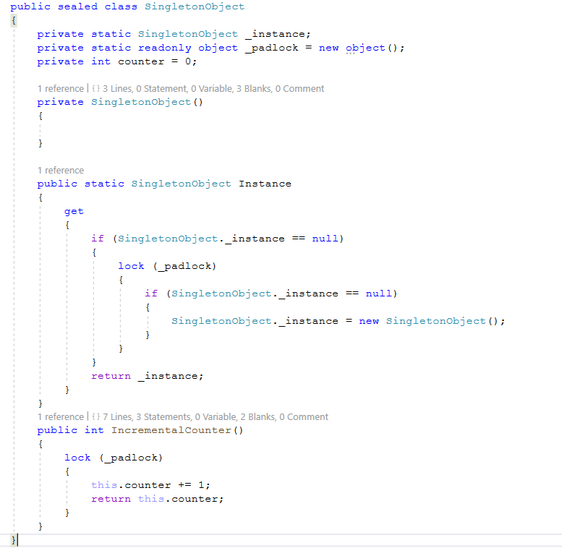
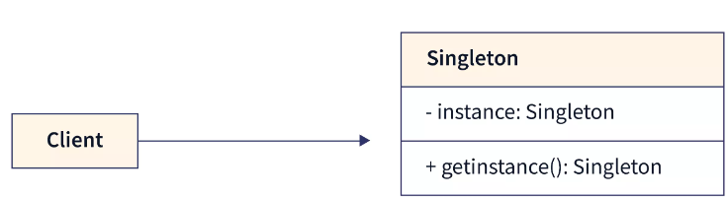
Creational – Singleton Pattern
A class with only one single possible instance.
Private constructor
Global access
UML Diagram
Thread safe implementation for multi-threading use
Lazy instantiation
Early instantiation
Common Use Cases
Logging Service
Managing Database Connection
Managing global state/resource/setting
Caching Service
Notes:
Similarities between Singleton and Static
Both Static and Singleton classes can have only one instance available in the memory.
Both classes can be used for holding the global state of an application.
Differences between Singleton and Static
A Singleton class supports interface implementation, while static classes cannot implement interfaces.
A Singleton class supports inheritance, while a Static class is a sealed class, and therefore cannot be inherited.
A Singleton class can be instantiated using the new keyword, while static can not be instantiated (static class can be used directly).
Both Singleton and static are stored on the Heap memory, but static classes are stored in a special area of the Heap Memory called the High-Frequency Heap (Objects in High Frequency Heap are not garbage collected by GC, and hence static members are available throughout the application lifetime).
A Singleton class can Dispose, while a static class can not.
A Singleton class can have a constructor, while a static class can only have a private static parameterless constructor and cannot have instance constructors.
A Static class has better performance since static methods are bonded on compile time.
A Singleton class can be lazy loaded when needed, while static classes are always loaded. Static classes are loaded automatically by the .NET Framework common language runtime (CLR) when the program or namespace containing the class is loaded.
Conclusion
Static classes can be used when you need to implement some kind of utility classes that do not need many modifications, classes such as extension, helper, constant, etc. As Static classes don’t allow instantiation, there will be no duplicate objects, avoiding extra usage of memory.
Singleton classes can be used when only one instance of a particular class needs to be created, and then a simple global access to that instance is going to be provided for the entire application, for example when you have some service proxies, a Logger class, caching, database connections, etc.

Slide 8
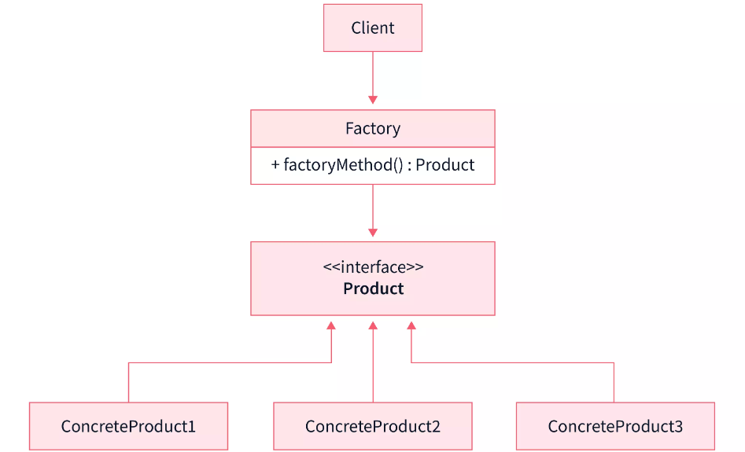
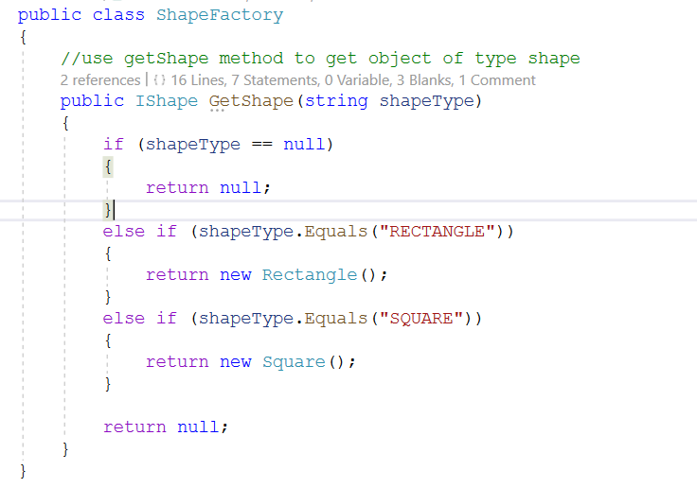
Creational – Factory Pattern
Factory design pattern separates the logic of creating objects from the client code and delegates this responsibility of creating objects to a factory class. Factory class has a factory method responsible for creating the requested object.
UML Diagram
When To Use A Factory Pattern
When we need to return different instances of an object depending on some dynamic factors or application configuration.
When a class can’t determine the subclass, it must create.
When we need to create different small objects that belong to same family and share some properties.
Notes:
Factory Design Pattern:
Intent:
The Factory pattern provides an interface for creating objects in a super class, but allows subclasses to alter the type of objects that will be created.
It is focused on creating a single type of object, and the responsibility of the factory is to instantiate objects based on certain conditions or parameters.
Usage:
Suitable when you have a super class with multiple sub-classes and, based on a parameter or condition, you need to return one class instance.
Example: Creating different shapes (circles, rectangles, squares) based on user input.
Flexibility:
Provides a centralized point for object creation, making it easier to modify or extend the instantiation process without modifying client code.

Slide 9
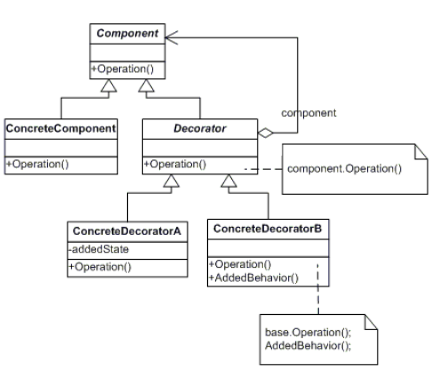
Structural – Decorator Pattern
The Decorator Pattern allows behavior to be added to an individual object, either statically or dynamically, without affecting the behavior of other objects from the same class.
It is achieved by creating a set of decorator classes that are used to wrap concrete components. These decorators add new functionality to the objects they decorate.
UML Diagram
Key Components
Component
ConcreteComponent
Decorator
ConcreteDecorator
ref.: https://refactoring.guru/design-patterns/decorator
Notes:
Intent: Decorator is a structural design pattern that lets you attach new behaviours to objects by placing these objects inside special wrapper objects that contain the behaviors.
Here are the key components and concepts associated with the Decorator Pattern:
Component: This is an interface or an abstract class that defines the interface for objects that can have responsibilities added to them dynamically. In other words, it represents the core functionality that decorators enhance.
ConcreteComponent: This is a concrete implementation of the Component interface. It defines the base behavior to which decorators can add functionality.
Decorator: This is an abstract class that also conforms to the Component interface. It has a reference to a Component object and defines an interface that conforms to Component. Decorators maintain a reference to the wrapped component and can alter its behavior or add new behavior.
ConcreteDecorator: This is a concrete implementation of the Decorator class. It adds specific functionality to the components it decorates.
Example:
The classes, interfaces, and objects in the above class diagram can be identified as follows:
Vehicle - Component Interface.
HondaCity- ConcreteComponent class.
VehicleDecorator- Decorator Class.
Special Offer- ConcreteDecorator class.
When to use it?
Add additional state or behavior to an object dynamically.
Make changes to some objects in a class without affecting others.

Slide 10
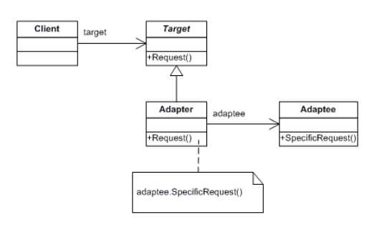
Structural – Adapter Pattern
The Adapter design pattern converts the interface of a class into another interface clients expect. This design pattern lets classes work together that couldn‘t otherwise because of incompatible interfaces.
An adapter design pattern acts as a link between two different interfaces.
UML Diagram
Key Components
Target
Adapter
Adaptee
Client
ref.: https://refactoring.guru/design-patterns/adapter
Notes:
Intent -Adapter is a structural design pattern that allows objects with incompatible interfaces to collaborate.
The classes and objects participating in this pattern include:
Target
defines the domain-specific interface that Client uses.
Adapter
adapts the interface Adaptee to the Target interface.
Adaptee
defines an existing interface that needs adapting.
Client
collaborates with objects conforming to the Target interface.
When Will We Need Adapter Design Pattern?
As said earlier, an adapter design pattern acts as a link between two different interfaces. Lets us take a few examples to understand this:
A card reader acts as an adapter between a memory card and a laptop. You plugins the memory card into card reader and card reader into the laptop so that memory card can be read via laptop..
Another example will be a charging adapter that acts as a link between a device and the charging port.
Now let's take an example and try to see how can we implement an adapter design pattern to solve that problem.
Who is what?
The classes, interfaces, and objects in the above class diagram can be identified as follows:
ITraget - Target interface
Employee Adapter- Adapter Class
HR System- Adaptee Class
ThirdPartyBillingSystem - Client
When to use it?
Allow a system to use classes of another system that is incompatible with it.
Allow communication between a new and already existing system which are independent of each other
Ado.Net SqlAdapter, OracleAdapter, MySqlAdapter are the best example of Adapter Pattern.

Slide 11
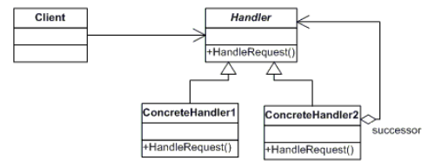
Behavioural – Chain of Responsibilities Pattern
The Chain of Responsibility design pattern avoids coupling the sender of a request to its receiver by giving more than one object a chance to handle the request. This pattern chains the receiving objects and passes the request along the chain until an object handles it.
UML Diagram
Key components:
Handler
ConcreteHandler
Client
ref: https://refactoring.guru/design-patterns/chain-of-responsibility
Notes:
Intent : Chain of Responsibility is a behavioral design pattern that lets you pass requests along a chain of handlers. Upon receiving a request, each handler decides either to process the request or to pass it to the next handler in the chain.
This pattern decouples sender and receiver of a request based on the type of request.
In this pattern, normally each receiver (handler) contains a reference to another receiver. If one receiver cannot handle the request then it passes the same to the next receiver and so on
Here are the key components of the Chain of Responsibility Pattern:
Handler: This is an interface or an abstract class that declares a method for handling requests. It also usually contains a reference to the next handler in the chain.
ConcreteHandler: This is a concrete implementation of the Handler interface. It contains the logic to handle requests and may also pass the request to the next handler in the chain.
Client: This is the object that initiates the request. It is unaware of the chain structure and is only aware of the first handler in the chain.
Who is what?
The classes, interfaces, and objects in the above class diagram can be identified as follows:
Approver- Handler abstract class.
Clerk, Assistant Manager & Manager - ConcreteHandler classes.
Loan & LoanEventArgs - These classes are used for internal processing and hold request details.
When to use it?
A set of handlers to handle a request.
A scenario within you needs to pass a request to one handler among a list of handlers at run-time based on certain conditions.
Exception handling system in C# is a good example of this pattern. Since an exception thrown by a piece of code in C# is handled by a set of try-catch block. Here catch blocks act as possible handlers to handle the exception.

Slide 12
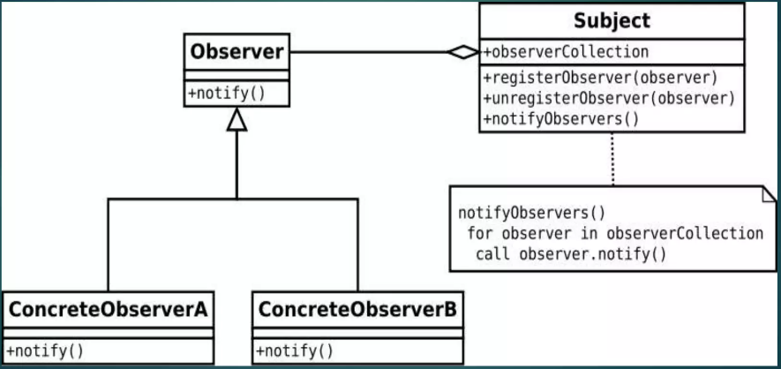
Behavioural – Observer Pattern
The Observer Pattern is a behavioral design pattern that defines a one-to-many dependency between objects so that when one object changes state, all its dependents are notified and updated automatically. It is also known as the Publish-Subscribe pattern.
UML Diagram
Key components:
Subject
Observer
ConcreteSubject
ConcreteObserver
Notes:
Intent : Observer is a behavioural design pattern that lets you define a subscription mechanism to notify multiple objects about any events that happen to the object they’re observing.
This pattern is used when there is one too many relationships between objects such as if one object is modified, its dependent objects are to be notified automatically
Here are the key components of the Observer Pattern:
Subject: This is the object that holds the state and triggers the notification to the observers when the state changes. The subject maintains a collection of observers.
Observer: This is the interface that defines the method (usually update()) that is called by the subject to notify the observer of a state change. Observers register with the subject to receive updates.
ConcreteSubject: This is the concrete implementation of the subject. It maintains the state and sends notifications to its observers when the state changes.
ConcreteObserver: This is the concrete implementation of the observer. It registers with a subject to receive updates and implements the update method to react to changes in the subject.
When to use it?
Changes in the state of an object need to be notified to a set of dependent objects, not all of them.
Notification capability is required.
The object sending the notification does not need to know about the receivers objects.

Slide 13
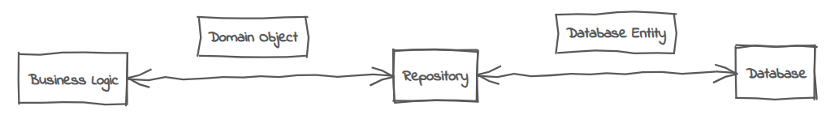
Repository Design Pattern
Not a GoF pattern but was introduced in Domain Driven Design by Eric Evan.
Repository pattern is a widely adopted architectural design pattern to facilitate the separation of concerns between the data access layer and the business logic layer.
By abstracting data persistence and retrieval, the repository pattern promotes code maintainability, testability, and scalability.
By employing the Repository Pattern, you can easily switch between different data storage implementations (e.g., swapping a SQL database with a NoSQL database) without affecting the rest of the application.
Key components:
Repository Interface
Concrete Repository
Client Or Service
Notes:
Here are the key components of the Repository Pattern:
Repository Interface: Defines the contract for data access operations. It typically includes methods such as GetById, GetAll, Add, Update, and Delete. This interface abstracts the data access layer and allows the application to work with data without knowing the details of how the data is stored.
Concrete Repository: Implements the repository interface and provides the actual implementation for data access. It interacts with the underlying data source (e.g., a database) to perform CRUD (Create, Read, Update, Delete) operations.
Client or Service: The application components that use the repository to access and manipulate data. Clients interact with the repository through the repository interface, and they are shielded from the details of the data storage.
Repository Design Pattern in C# with an Example from the context of Entity Framework and ASP.NET MVC application
The repository pattern acts as an intermediary between the DAL and BAL, providing a consistent and centralized approach to handle CRUD (Create, Read, Update, Delete) operations. By decoupling the business logic from the data access logic, it promotes maintainability, testability, and flexibility in software development.
Repository Pattern Implementation:
3.1 Define the Repository Interface: First, create an interface that defines the contract for data access operations. This interface should include methods for common operations like GetById, GetAll, Add, Update, and Delete.
3.2 Implement the Repository: Next, create concrete repository classes that implement the repository interface. These classes interact with the underlying data storage and provide the necessary operations for data retrieval and manipulation.
3.3 Dependency Injection: To utilize the repository within the business logic layer, employ dependency injection. By injecting the repository interface into your business logic classes, you decouple them from the specific repository implementation, making it easier to switch repositories or mock them during testing.
3.4 Unit of Work: Consider implementing the Unit of Work pattern alongside the repository pattern to manage transactional operations that involve multiple repositories. The Unit of Work pattern allows you to group related repository operations within a single transaction, ensuring atomicity and consistency. This pattern helps maintain data integrity and simplifies error handling. However, its implementation depends on the specific requirements of your application.

Slide 14
Thank You

