Slide 1
Introduction to Microservices

Slide 2
Agenda
Introduction to Microservices
Microservices Principles
Monolithic vs. N-Layer vs. SOA vs. Microservices
Microservices Architecture
When to use Microservices Architecture
Challenges of Microservices
Tools/Platform For Building Microservices
Microservices API Gateways
Design Patterns for Microservices

Slide 3
Introduction to Microservices
Microservice is a small unit that has only one responsibility or single logic which solve a specific problem.
Microservices are the evolution of service-oriented architecture.
Microservices are small and independent services that work together.
A style of engineering to build highly automated, independent and evolving software.
Each Microservice can be deployed independently.
A Microservice itself persist its own data or external state.
All services don’t need to share the same technology stack, libraries, or frameworks.

Slide 4
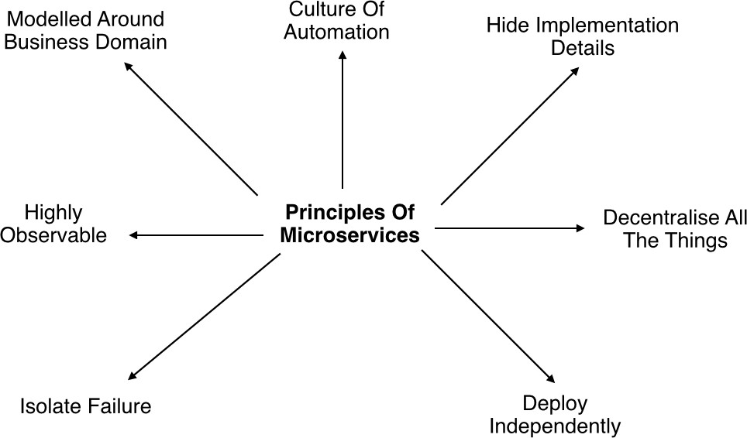
Microservices Principles

Slide 5
Microservices Principles Contd..
Modelled around business domain : Separate system capability into different domains and each domain will focus on one thing and its associated logic.
Culture of Automation : Follow the culture of automation by designing it for continues integration and continuous delivery.
Hide implementation details : Hiding the internal details reduce the coupling and helps to do changes and improvement without affecting the overall architecture.
Decentralization : There is no centralized database, usually each service is designed to manage its own database.

Slide 6
Microservices Principles Contd..
Deploy Independently : Each service can be deployed independently.
Failure Isolation : The impact of a failure is less in microservice architecture compares to monolithic type as it will only affect that particular service and its associates. Other services can keep running.
Highly Observable : The services should collect as much information to analyse what is happening within each of them like log events and stats.

Slide 7
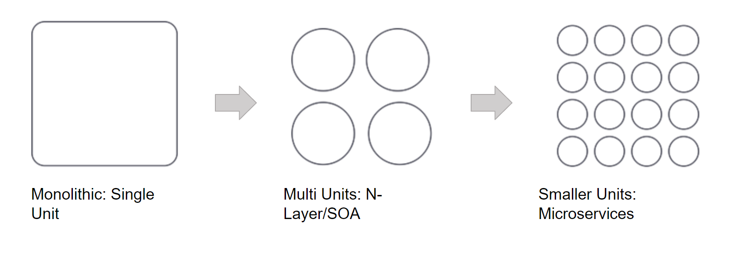
Monolithic vs. N-Layer vs. SOA vs. Microservices

Slide 8
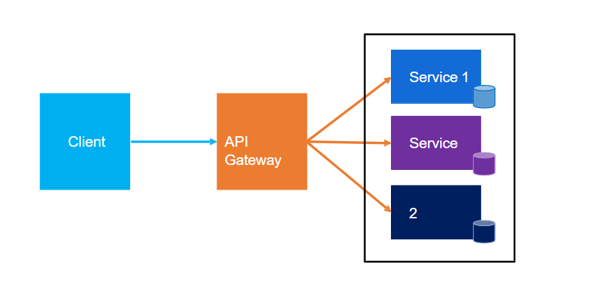
Microservices Architecture

Slide 9
When to use Microservices Architecture
Large applications that require a high release velocity.
Complex applications that need to be highly scalable.
Applications with rich domains or many subdomains.
An organization that consists of small development teams.

Slide 10
Advantages of Microservices
Language independent and framework independent.
Independently develop, deploy, redeploy, version and scale component services in seconds without compromising the integrity of an application
Better fault isolation keeps other services to work even on failure.
Zero downtime upgrades.
Services can be of from different servers or even from different datacentres.
Reliable and self-healing.
Supports continuous integration and delivery.
Easy to integrate with third parties.

Slide 11
Challenges of Microservices
Complexity - A microservices application is more complex as compared to the equivalent monolithic application.
Development and testing - Building and testing a service that relies on other services need domains understanding and refactoring them can be difficult.
Lack of governance - The decentralized approach to building microservices has advantages, but it also lead to so many problems like maintenance because of many different languages and frameworks.
Network congestion and latency - The use of many small, services can result into additional latency because of interservice communication and a long chain of service dependencies. So design APIs carefully and use asynchronous communication patterns.

Slide 12
Challenges of Microservices Contd..
Data Integrity - Each microservice is responsible for its own data persistence. As a result, data consistency can be a challenge.
Management - To be successful with microservices requires a mature DevOps culture. Correlated logging across services can be challenging for a single user operation.
Versioning - Be careful while updating a service. It must not break services that depend on it. So without careful design, you might have problems with backward or forward compatibility.
Skillset - Microservices are highly distributed systems. So need a skilled and experience team to implement it.

Slide 13
Tools/IDE
Getting started with Microservices

Slide 14

Development Frameworks

Slide 15

Development Tools

Slide 16
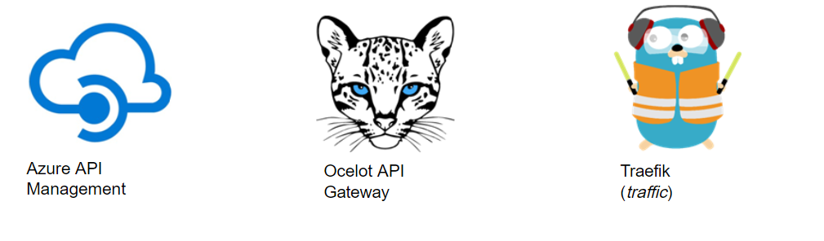
Microservice API Gateways

Slide 17
Ocelot
Ocelot is a .NET API Gateway.
https://github.com/ThreeMammals/Ocelot
https://github.com/ThreeMammals/Ocelot#features

Slide 18
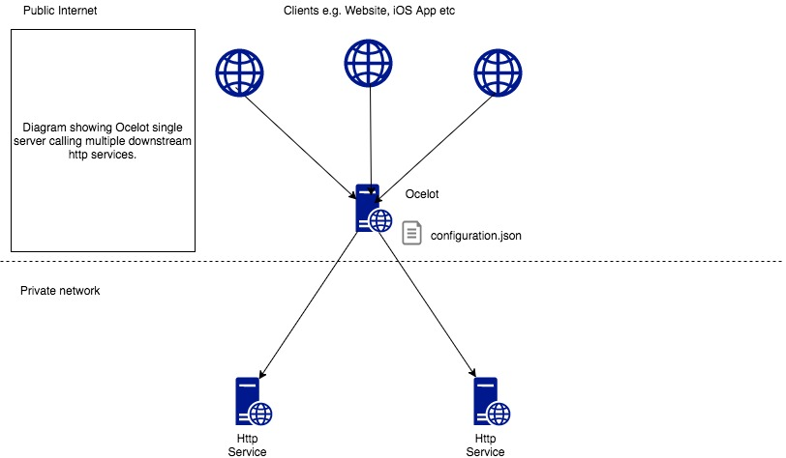
Ocelot – Basic Implementation

Slide 19
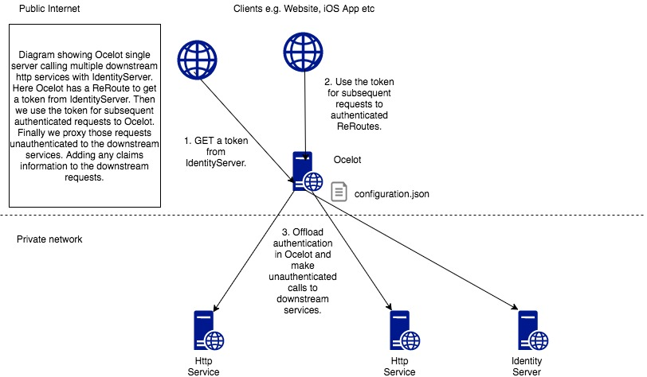
Ocelot – With IdentityServer

Slide 20
Traefik
Traefik (pronounced traffic) is a modern HTTP reverse proxy and load balancer that makes deploying microservices easy. Traefik integrates with your existing infrastructure components (Docker, Swarm mode, Kubernetes, Amazon ECS, ...) and configures itself automatically and dynamically. Pointing Traefik at your orchestrator should be the only configuration step you need.
https://github.com/traefik/traefik
https://github.com/traefik/traefik#features

Slide 21
Design Patterns of Microservice
https://microservices.io/patterns/index.html
Decomposition Patterns
Decompose by Business Capability
Decompose by Subdomain
Strangler Pattern
Service Per Team
Integration Patterns
API Gateway Pattern
Aggregator Pattern
Client-Side UI Composition Pattern
Database Patterns
Database per Service
Shared Database per Service
CQRS Pattern
Saga Pattern
Communication Patterns
Request/Response Pattern
Messaging Pattern
Event Driven Pattern
Client-Side UI Composition Pattern

Slide 22
Design Patterns of Microservice contd..
https://microservices.io/patterns/index.html
Deployment Patterns
Multiple Service Instances per Host
Service Instance per Host
Serverless Deployment
Service Deployment Platform
Observability Patterns
Log Aggregation
Performance Metrics
Distributed Tracing
Health Check
Cross-Cutting Concern Patterns
Externalized Configuration
Service Discovery Pattern
Circuit Breaker Pattern

Slide 23
Thank You..

