Slide 1
DBMS PROJECT BASED LEARNING
RetailDesk
Retail Inventory & Sales Management System
A full-stack web application built around a normalised MySQL database.
Database Management Systems • PBL Final Presentation
Group Members: Add names & roll numbers | Academic Year: 2026–27

Slide 2
RETAILDESK
1. Problem & Motivation
Why a retail store needs a proper DBMS
Problems in manual / spreadsheet-based retail
What RetailDesk solves
• Manual stock updates become inaccurate and can allow overselling.
• Supplier, category and customer information gets repeated and inconsistent.
• Deleting records can create broken or dangling references.
• Low-stock items are easy to miss without alerts.
• Manual totals and invoices can contain calculation errors.
• Managers need fast answers about sales, best sellers and customers.
• Centralised inventory, sales, customer, supplier and payment data.
• 3NF design reduces duplication and improves consistency.
• Constraints and transactions protect data integrity.
• Dashboard + reports turn stored data into useful information.
• Role-based access separates Admin, Manager and Cashier actions.
• POS workflow updates stock automatically when a sale is recorded.
DBMS PBL • Retail Inventory & Sales Management System 2

Slide 3
RETAILDESK
2. Objectives, Scope & Users
11 + 1
3NF
3
9
Tables + one database view
Normalised relational design
User roles
Business reports
Core objectives
Intended users & scope
• Design and normalise the retail database to 3NF.
• Implement keys, constraints, indexes and a view in MySQL 8.
• Demonstrate DML/DQL, joins, aggregates and transactions.
• Provide POS, CRUD, invoices, payments, reports and dashboards.
• Admin — full access and store settings.
• Manager — catalogue, suppliers, stock, payments and reports.
• Cashier — POS sales, customers and viewing; no catalogue deletion.
• Scope: single-store retail operation in INR with GST.
DBMS PBL • Retail Inventory & Sales Management System 3

Slide 4
RETAILDESK
3. Solution & System Architecture
How the website, API and database work together
Browser
React 18 + Vite 5
REST API
Node.js + Express
Data Access
mysql2 pool + SQL
Database
MySQL 8 • InnoDB
Data flow
Why this architecture?
• React handles screens, forms, routing, charts and client validation.
• Express handles authentication, authorisation, validation and business rules.
• The browser never talks directly to MySQL.
• Raw parameterised SQL keeps DBMS queries visible and explainable.
• JWT secures authenticated requests; bcrypt stores password hashes.
• Vite forwards /api calls to the Express server during development.
DBMS PBL • Retail Inventory & Sales Management System 4

Slide 5
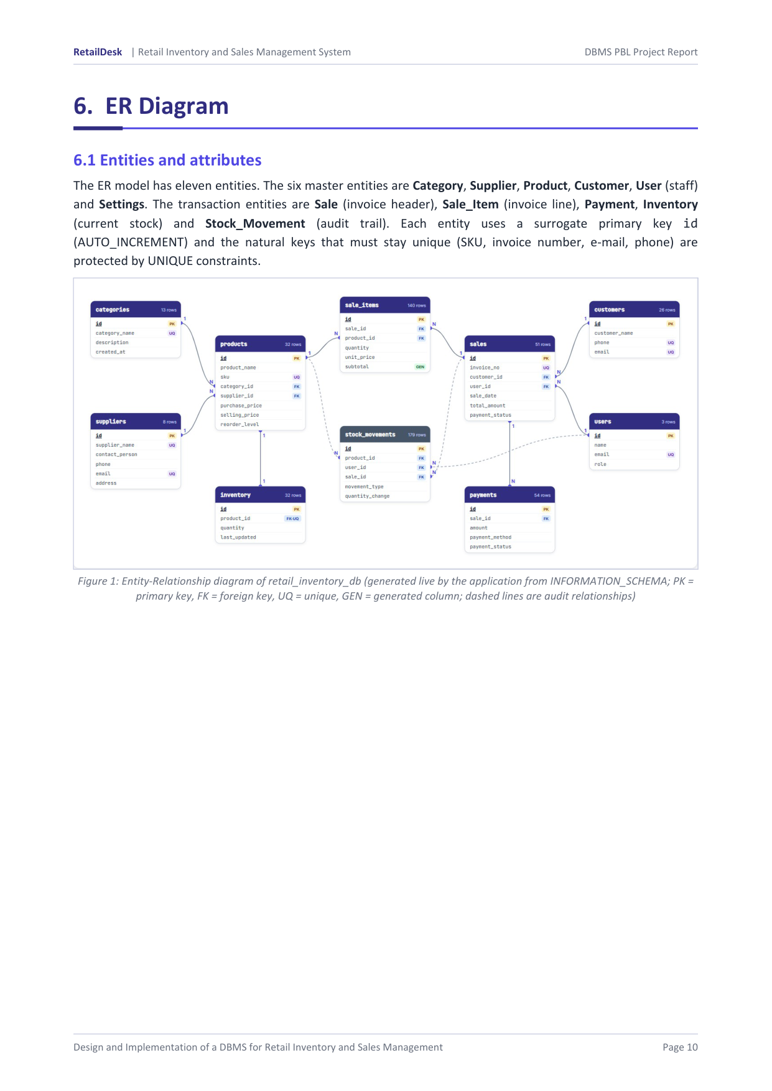
RETAILDESK
4. ER Diagram
Entities, keys and relationships
Key points
• 11 entities in the ER model.
• Master data: Category, Supplier, Product, Customer, User, Settings.
• Transactions: Sale, Sale_Item, Payment, Inventory, Stock_Movement.
• Primary keys use AUTO_INCREMENT surrogate IDs.
• Natural identifiers such as SKU and invoice number are protected by UNIQUE constraints.
• Foreign keys define the business relationships.
DBMS PBL • Retail Inventory & Sales Management System 5

Slide 6
RETAILDESK
5. Relational Schema & 3NF
Turning the ER model into reliable tables
Relational schema — selected relations
Why the design is in 3NF
• users(id, name, email, password, role, created_at)
• categories(id, category_name, description, created_at)
• suppliers(id, supplier_name, contact_person, phone, email, address, created_at)
• products(id, product_name, sku, category_id*, supplier_id*, prices, reorder_level, …)
• inventory(id, product_id*, quantity, last_updated)
• customers(id, customer_name, phone, email, address, created_at)
• sales / sale_items / payments / stock_movements / settings
• v_product_stock — derived database view
• 1NF — every attribute is atomic; invoice products are separate sale_items rows.
• 2NF — no partial dependencies; surrogate keys are used.
• 3NF — non-key attributes do not depend on other non-key attributes.
• Category and supplier details are stored once and referenced by foreign keys.
• Stock quantity is separated from product master data.
• Historical sale price is intentionally stored because old invoices must not change.
DBMS PBL • Retail Inventory & Sales Management System 6

Slide 7
RETAILDESK
6. Database & SQL Demonstration
DDL, DML, joins and analytical queries
22
11
1
3NF
Documented SQL queries
Tables
Derived view
Normalised schema
SELECT p.product_name, c.category_name,
p.selling_price
FROM products p
JOIN categories c
ON p.category_id = c.id;
What to explain while running SQL
• DDL: CREATE DATABASE, tables, keys, constraints, indexes and view.
• DML/DQL: INSERT, UPDATE, DELETE, SELECT.
• Queries demonstrate JOIN, GROUP BY / HAVING, aggregates, subqueries, ROLLUP and a window function.
• Use the live MySQL Workbench during the demo.
DBMS PBL • Retail Inventory & Sales Management System 7

Slide 8
RETAILDESK
7. The Most Important DBMS Feature: Sale Transaction
ACID + locking prevents inconsistent stock
START
Begin transaction
LOCK
SELECT ... FOR UPDATE
VALIDATE
Check stock & totals
WRITE
Sale + items + stock + payment
COMMIT
Commit all changes
If everything succeeds
If something fails
• A sale writes to five related tables in one ACID transaction.
• Row-level locking prevents two concurrent sales from consuming the same stock.
• A guarded UPDATE refuses an oversell.
• If any step throws an error, the transaction performs ROLLBACK.
• This prevents half-completed sales and keeps inventory consistent.
• This is the key DBMS concept to highlight in the viva.
DBMS PBL • Retail Inventory & Sales Management System 8

Slide 9
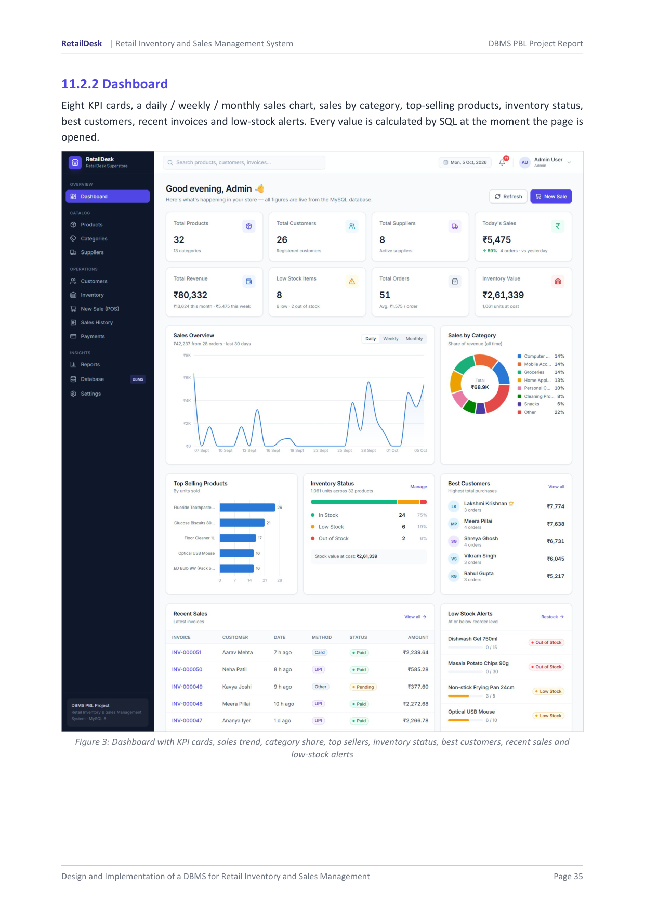
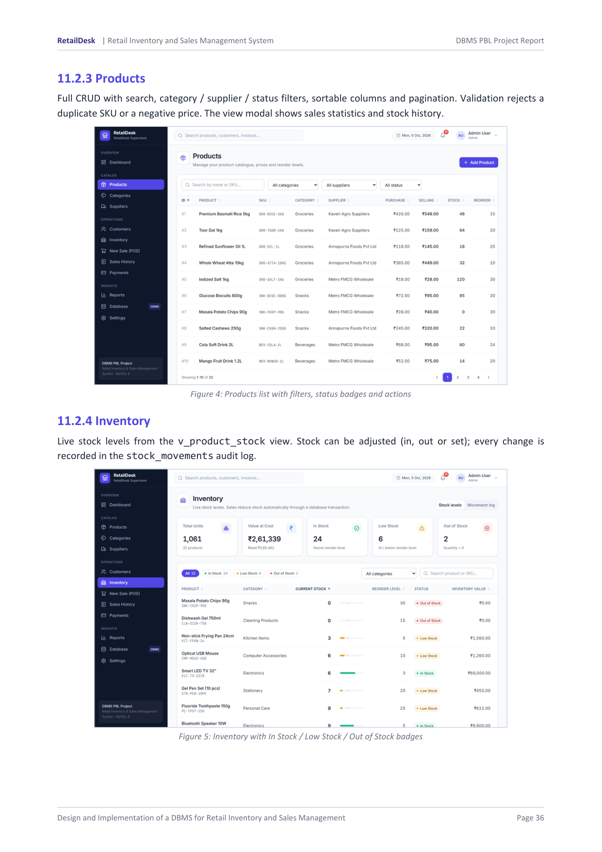
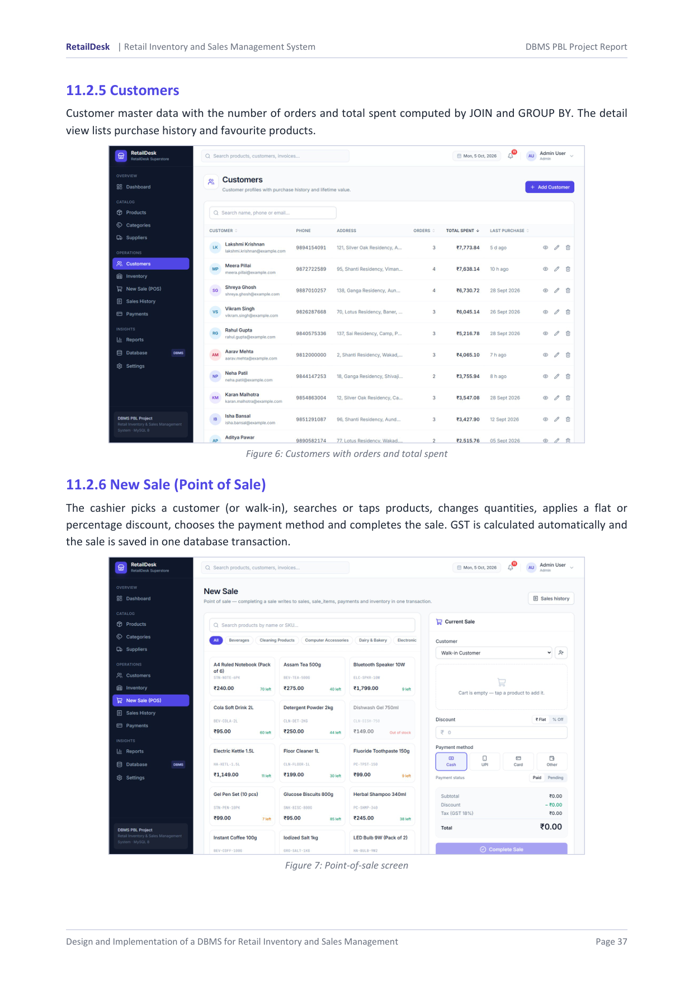
RETAILDESK
8. User Interface
The working web application
Dashboard / overview
Products & inventory
Point of Sale
DBMS PBL • Retail Inventory & Sales Management System 9

Slide 10
RETAILDESK
9. Live Demo — Prove UI ↔ Database Connectivity
Keep Chrome, MySQL Workbench and VS Code ready
1
Open RetailDesk
Chrome → http://localhost:5173
2
Login
Use the Admin demo account
3
Insert
Add a product from the UI
4
Verify
SELECT the new product in MySQL
5
Sell
Create a POS sale
6
Verify stock
Query inventory and show quantity changed
Best proof: UI action → MySQL query
DBMS PBL • Retail Inventory & Sales Management System 10

Slide 11
RETAILDESK
10. Security & Data Integrity
How the system protects the data
Security & integrity
Technology stack
• Passwords are stored as bcrypt hashes.
• JWT is used for authentication and role-based authorisation.
• Server-side validation complements database constraints.
• Parameterized SQL with ? placeholders helps prevent SQL injection.
• Primary, foreign, UNIQUE and CHECK constraints enforce integrity.
• Referential actions use RESTRICT, SET NULL and CASCADE intentionally.
• React 18 + React Router + Tailwind CSS + Recharts.
• Node.js 18+ + Express REST API.
• mysql2 connection pool with raw SQL.
• MySQL 8 / InnoDB for storage, transactions and indexes.
• Vite provides the development server and /api proxy.
• The API validates the request before executing SQL.
DBMS PBL • Retail Inventory & Sales Management System 11

Slide 12
RETAILDESK
11. Testing & Results
Evidence that the system behaves as designed
111
111 / 111
0
Automated API checks
Passed
Failed
What was tested
Key evidence
• Authentication and read endpoints
• CRUD + referential integrity
• Product validation and inventory adjustment
• Sale transaction and stock validation
• Payments and reports
• Role permissions and cleanup
• 22 documented SQL demonstration queries were executed.
• Tests use a real HTTP API connected to a real MySQL database.
• Important checks include rollback, overselling refusal and referential actions.
DBMS PBL • Retail Inventory & Sales Management System 12

Slide 13
RETAILDESK
12. Conclusion & Future Enhancements
Conclusion
Future enhancements
• RetailDesk achieves the goal of a complete retail inventory and sales management system.
• The 11-table + 1-view schema is normalised to 3NF.
• Database constraints and ACID transactions protect business data.
• SQL queries power dashboards, reports, invoices and POS workflows.
• The automated API suite passed all 111 checks.
• Purchase orders and goods-received notes.
• Barcode scanning and label printing.
• Returns / refunds and reverse stock movements.
• Batch / expiry tracking and multi-store inventory.
• Per-product GST slabs and GST reporting.
• Payment gateway integration, backups and stronger audit tooling.
DBMS PBL • Retail Inventory & Sales Management System 13

Slide 14
Thank You
Questions & Viva
References
RETAILDESK
Inventory • Sales • Database
• Oracle — MySQL 8.0 Reference Manual
• Elmasri & Navathe — Fundamentals of Database Systems
• Silberschatz, Korth & Sudarshan — Database System Concepts
• Codd — Relational Model of Data for Large Shared Data Banks
• Chen — The Entity-Relationship Model
• Express.js, Node.js, mysql2 and React documentation
Built with React + Node.js + MySQL

