Slide 1
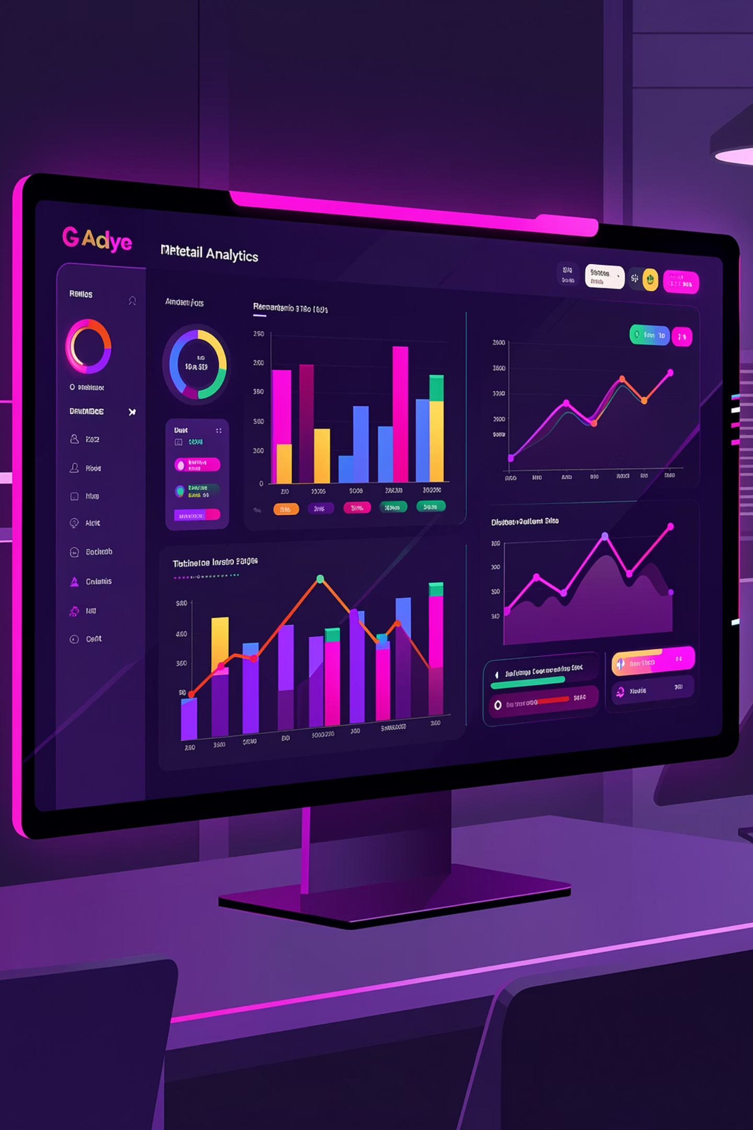
Customer Shopping Behavior Analytics
Transforming raw data into strategic insights for retail optimization

Slide 2
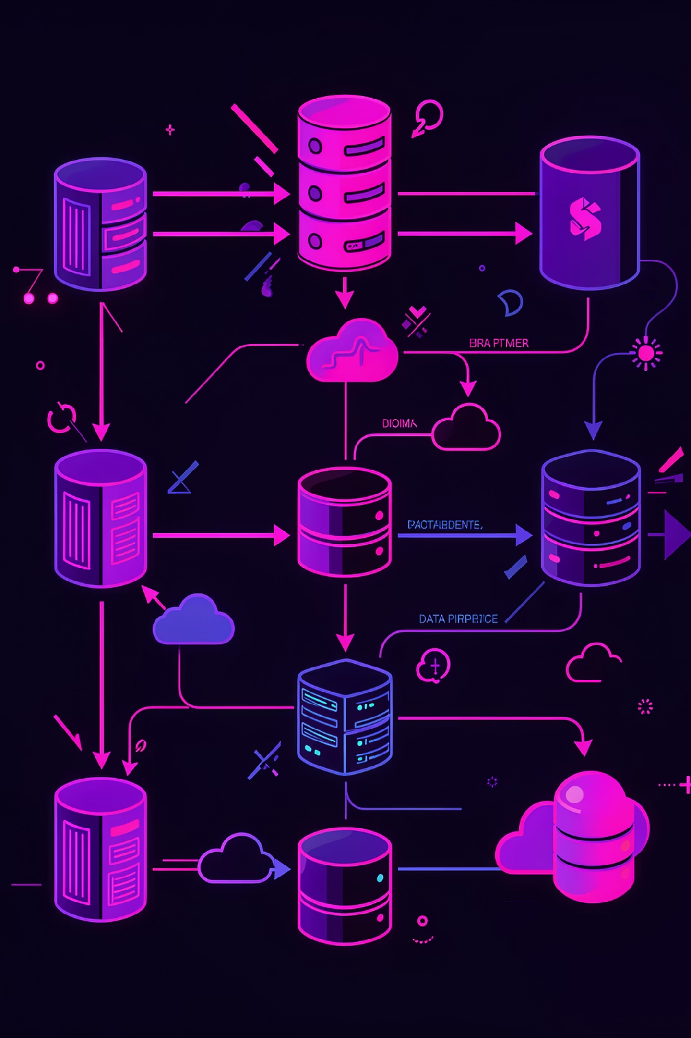
Project Overview
End-to-end data analysis on retail consumer shopping data to uncover actionable insights for marketing, product strategy, and customer engagement.
3,900
Customer Records
Unique customer profiles analyzed
19
Features Analyzed
Data dimensions explored
4
Product Categories
Clothing, Footwear, Outerwear, Accessories
10
SQL Queries
Business questions answered

Slide 3






Dataset Structure
19 columns spanning 5 attribute groups provide comprehensive customer insights
Demographics
Product Info
Transaction
Customer ID, age, gender, location, age group
Item purchased, category, size, color, season
Purchase amount, payment method, discount applied
Behavior
Engagement
Previous purchases, frequency, purchase frequency days
Review rating, subscription status, shipping type

Slide 4
Technology Stack
Python
SQL (MySQL)
Power BI
Pandas, NumPy, Matplotlib, Seaborn for data cleaning, transformation, EDA, and statistical visualization
Querying structured data to answer 10 targeted business questions with CTEs and window functions
Interactive dashboard for KPI tracking, trend analysis, and segment insights with dynamic filtering

Slide 5

Python: Data Cleaning & EDA
Key Activities
Removed duplicates and handled missing values
Standardized column formats
Engineered derived features: age_group and purchase_frequency_days
Conducted EDA via histograms, box plots, correlation heatmaps
Exported cleaned dataset for downstream consumption

Slide 6

SQL: Business Intelligence Queries
01
02
Data Loading
Query Development
Cleaned CSV loaded into MySQL table (customer_shopping_behavior_cleaned)
Authored 10 analytical queries covering revenue, segmentation, and product performance
03
Advanced Segmentation
Used CTEs, window functions (ROW_NUMBER), and CASE logic for complex analysis

Slide 7
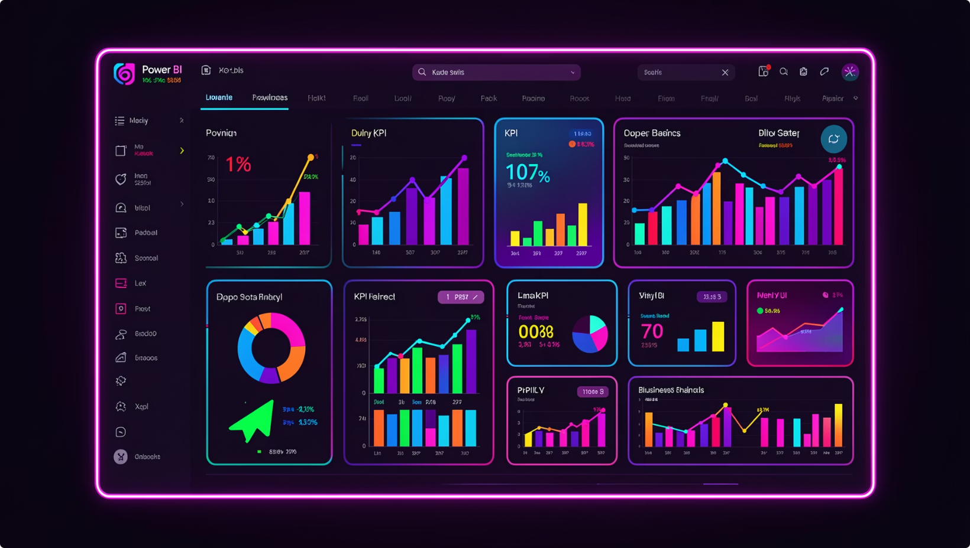
Power BI: Interactive Dashboard
Dashboard Capabilities
Imported cleaned dataset with modeled relationships
Built KPI cards, bar charts, donut charts, trend lines
Enabled dynamic filtering by gender, category, season, subscription status, age group

Slide 8
Key Findings Summary
Gender Revenue
Discount Users
Male customers (68% of base) generated higher total revenue
Notable subset exceeded average purchase amount despite discounts
Top Products
Shipping Spend
Five highest-rated items identified for featured placements
Express vs. Standard shipping behavior compared
Subscriber Value
Discount Dependency
Subscribers (27% of base) showed higher average spend
Products with highest discount rates identified for margin review

Slide 9

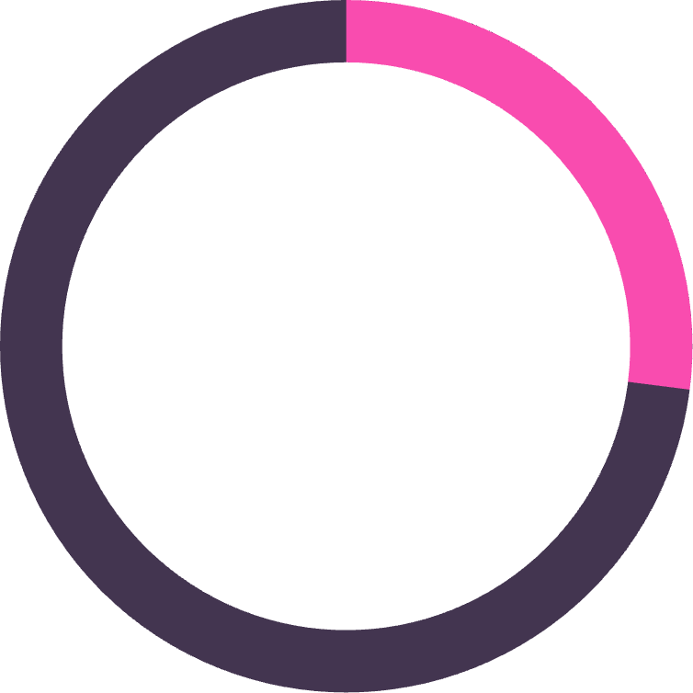



Customer Segmentation Insights
68%
27%
Male Customers
Subscribers
Skews male — target female segment
Higher spend per head
New
Returning
Loyal
First-time buyers
Multiple purchases
High-frequency buyers
Repeat buyers (>5 purchases) show subscription propensity — activate targeted conversion flows

Slide 10
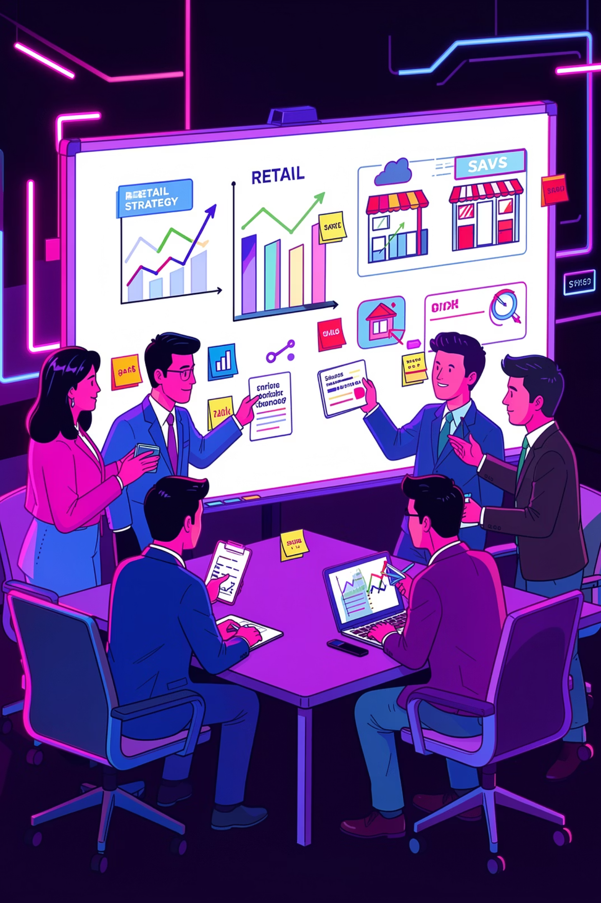
Strategic Recommendations
Customer Segmentation
Product Strategy
Target underrepresented female segment
Launch subscription campaigns for loyal customers
Tailor premium products to middle-aged adults
Promote top-rated products prominently
Reassess discount strategies for margin items
Invest in top 3 best-sellers per category
Marketing & Engagement
Grow subscriber base with loyalty perks
Activate conversion flows for repeat buyers
Use seasonal filters for real-time campaigns

