Slide 1
SAP- 1
(Implemented and verified using Verilog)
Shubhi Agrawal
M.Chandra hasini
K.Ajitha
Date: 04th October 2020

Slide 2
Content
SAP-1 Architecture
SAP-1 control signal description
SAP-1 Program
Flowchart
Fetch cycle
Operation cycle
Simulation results
Conclusion
2

Slide 3
SAP-1 Architecture
W bus
Ep
Cp
clk
clr
8
bits
Program Counter
4-bits
Accumulator
!Ea
8 bits
clk
!Lm
clk!
Input and MAR
4-bits
La
8
4-bits
Adder/Subtractor
Sv
Sv
Ev
8
16*8 RAM
Ev
!Ce
8-bits
8
clr
Instruction register
8-bits
B register
clk
!Lb
clk
clk
8-bits
!Ei
4-bits
Li
Lb
4-bits
controller
8-bits
Output register
!Lo
clr
clk
clk
8
Cp Ep Lm Ce Li Ei Ea La Lb Lo Sv Ev
3

Slide 4
SAP-1 control signals description
Program Counter | Cp – Active high – Increment the program counter. Ep – Active high – Send count on Wbus.
Input and MAR | Lm – Active low – Load data from Wbus.
RAM | CE – Active low – Enables the memory.
Instruction Register | Li – Active high – Load data from Wbus. Ei – Active low – Send Address to Wbus.
Accumulator | La – Active low – Load 8 bit data from Wbus. Ea – Active high – Send 8 bit data to Wbus
Adder/Subtractor | Sv – Active high – Perform subtraction operation. Ev – Active high – Send 8 bit result to Wbus.
B register | Lb – Active low – Load 8 bit data from Wbus.
Output register | Lo – Active low – Load 8 bit data from Wbus.
4

Slide 5
SAP-1 functional units description
Program Counter: The program counter generate the 4-bit address.
Input And MAR: The MAR stores the(4-bit) address of data and instruction which are placed in memory.
16 × 8 RAM: 16 × 8 means there are 16 memory locations(0 to 15) and each location contains an 8-bit of data/instruction. Before the computer run, we write the data/instruction in the RAM.
5

Slide 6
SAP-1 functional units description
Instruction Register: When the instruction is placed in the W-bus from the memory, the Instruction Register stores this instruction.
Accumulator: It has one 8-bit input and two 8-bit outputs. It stores loaded values as well as the output of the adder/subtractor.
B register: When adding/subtracting two numbers A and B, the B register
temporarily stores the number B.
6

Slide 7
SAP-1 functional units description
Output Register: This is a 8-bit register which shows the loaded data of accumulator after the execution of operation.
Controller: The 12-bits coming out of the controller form a word that controls the functioning of the computer.
CON = Cp Ep Lm Ce Li Ei La Ea Sv Ev Lb Lo
7

Slide 8
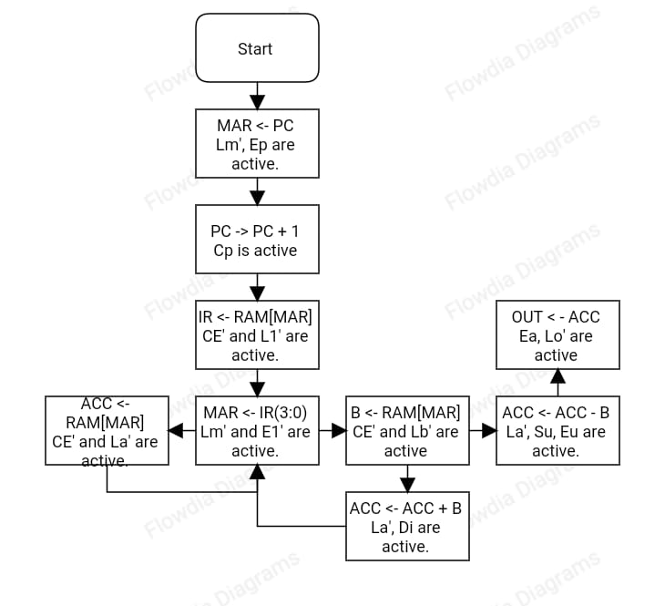
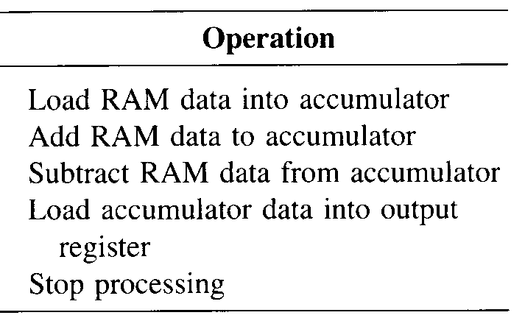
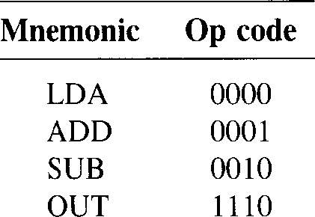

Flowchart of Fetch & Execution Cycle
Reset
PC->MAR
PC->PC+1
RAM[MAR]->IR
IR [7:4]
LDA
ADD
SUB
OUT
HLT
4’b0000
4’b0001
4’b0010
4’b1110
4’b1111
8

Slide 9
Fetch Cycle
Fetch Cycle is same for all Instructions.
E_{p}
PC
Accumulator
C_{p}
PC
BUS
PC
BUS
Accumulator
BUS
Accumulator
0000
0000
0001
_{Lm}
0000
MAR
Add/sub
MAR
MAR
Add/sub
Add/sub
0000
RAM
B register
RAM
B register
CE
RAM
8-bit
B register
IR
Output register
IR
Output register
L_{I}
IR
Output register
controller
controller
controller
5E3
BE3
263
T1 State
4-bit address generated by program counter is then stored into the MAR through W bus.
T2 State
Program counter address value incremented by 1.
T3 State
MAR applies this 4-bit address to the RAM, where data or instruction is read from RAM.
9

Slide 10
LDA Execution cycle
EFH
Accumulator
PC
BUS
Accumulator
PC
BUS
L_{A}
PC
BUS
Accumulator
L_{M}
MAR
Add/sub
MAR
Add/sub
MAR
Add/sub
RAM
9H
B register
Ce
RAM
B register
RAM
B register
EFH
09H
E_{I}
IR
9H
Output register
IR
Output register
IR
Output register
9H
0H
controller
controller
controller
1A3
2C3
3E3
T4 State
The contents of the instruction register are splits into two nibbles. Upper nibbles goes directly to the controller. Lower nibbles goes into MAR via Wbus.
T5 State
Accumulator stored the RAM data through w-bus
T6 State
No operation
10

Slide 11
ADD/SUB Execution Cycle
Accumulator
Accumulator
F6H
PC
BUS
PC
BUS
PC
BUS
Accumulator
L_{A}
MAR
MAR
MAR
EFH
E_{U}
mLm
Add/sub
Add/sub
F6H
Add/sub
AH
07H
Sv
RAM
AH
RAM
B register
Ce
RAM
07H
B register
L_{B}
B register
07H
1AH
IR
E_{I}
IR
Output register
IR
Output register
Output register
AH
1H
controller
controller
controller
1A3
2E1
3C7/3CF
T4 State
The contents of the instruction register are splits into two nibbles. Upper nibbles goes directly to the controller. Lower nibbles goes into MAR via Wbus.
T5 State
B Register take the addressed RAM word
T6 State
Accumulator send the number A and B-register send the number B in adder/subtractor. Then, Accumulator stores the output of adder/subtractor through w-bus
11

Slide 12
OUT Execution cycle
PC
BUS
Accumulator
E_{A}
F2H
F2H
MAR
Add/sub
T4 State
Accumulator data loaded into output register through wbus.
RAM
B register
IR
Output register
L_{O}
controller
3F2
12

Slide 13
SAP-1 Program
Program to be executed: -
Address | Instruction
0H | LDA 9H
1H | ADD AH
2H | ADD BH
3H | SUB CH
4H | OUT FH
5H | HLT 0H
6H | XXH
7H | XXH
8H | XXH
9H | EFH
AH | 07H
BH | 48H
CH | 18H
DH | XXH
13

Slide 14
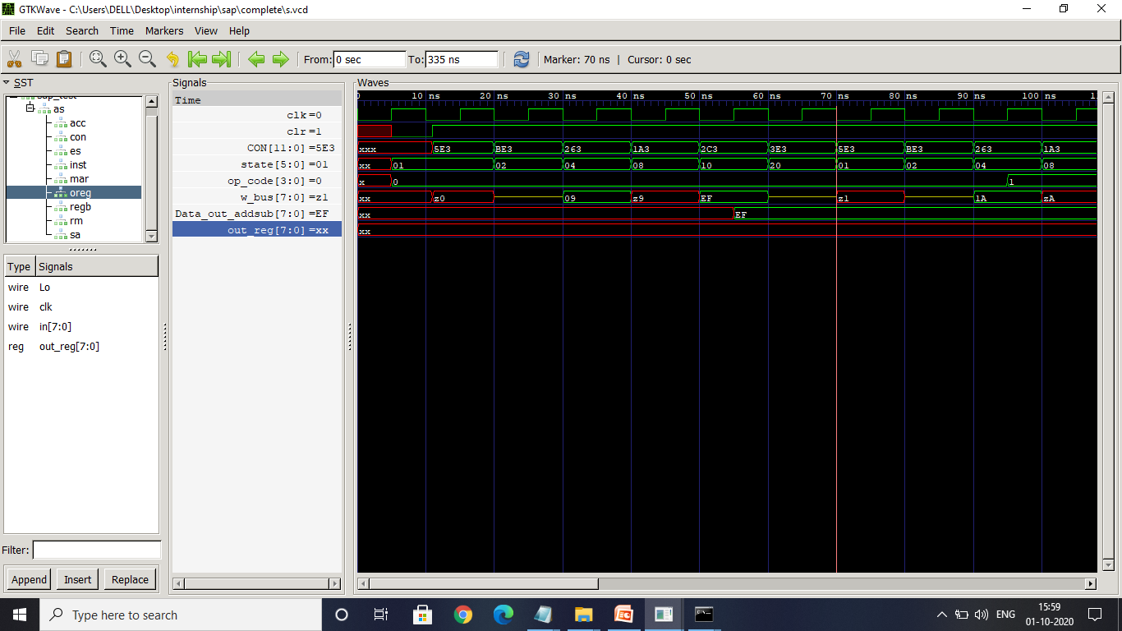
LDA Simulation output
Operation: LDA 9H
Memory Location:
0H = 09H
9H = EFH
Fetching Cycle
Execution Cycle
LDA operation
T1 state T2 state T3 state T4 state T5 state
14

Slide 15
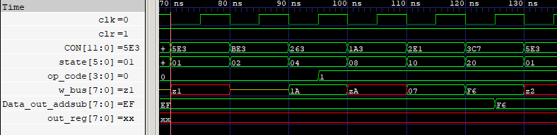
ADD Simulation Output
Operation: ADD AH
Memory Location:
2H = 1AH
AH = 07H
Fetching Cycle
Execution Cycle
T6 state
ADD Result
T1 state T2 state T3 state T4 state T5 state
15

Slide 16
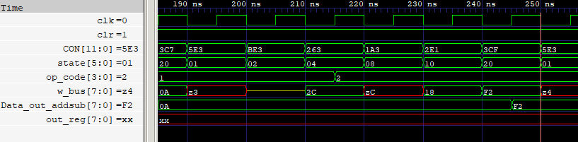
SUB Simulation Output
Operation: SUB CH
Memory Location:
3H = 2CH
CH = 18H
Fetching Cycle
Execution Cycle
SUB result
T1 state T2 state T3 state T4 state T5 state
T6 state
16

Slide 17
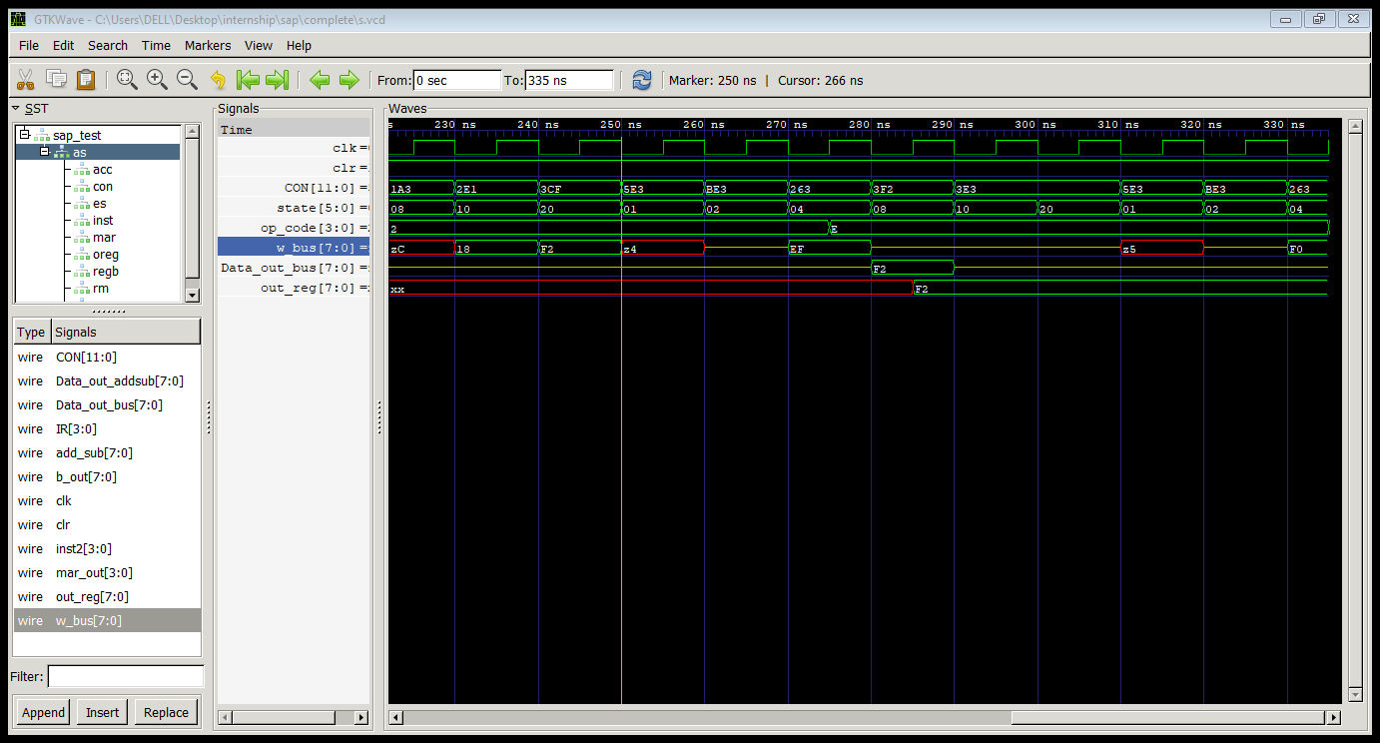
OUT Simulation Output
Operation: OUT FH
Memory Location:
4H = EFH
Fetching Cycle
Execution Cycle
OUT Result
T1 state T2 state T3 state T4 state
17

Slide 18
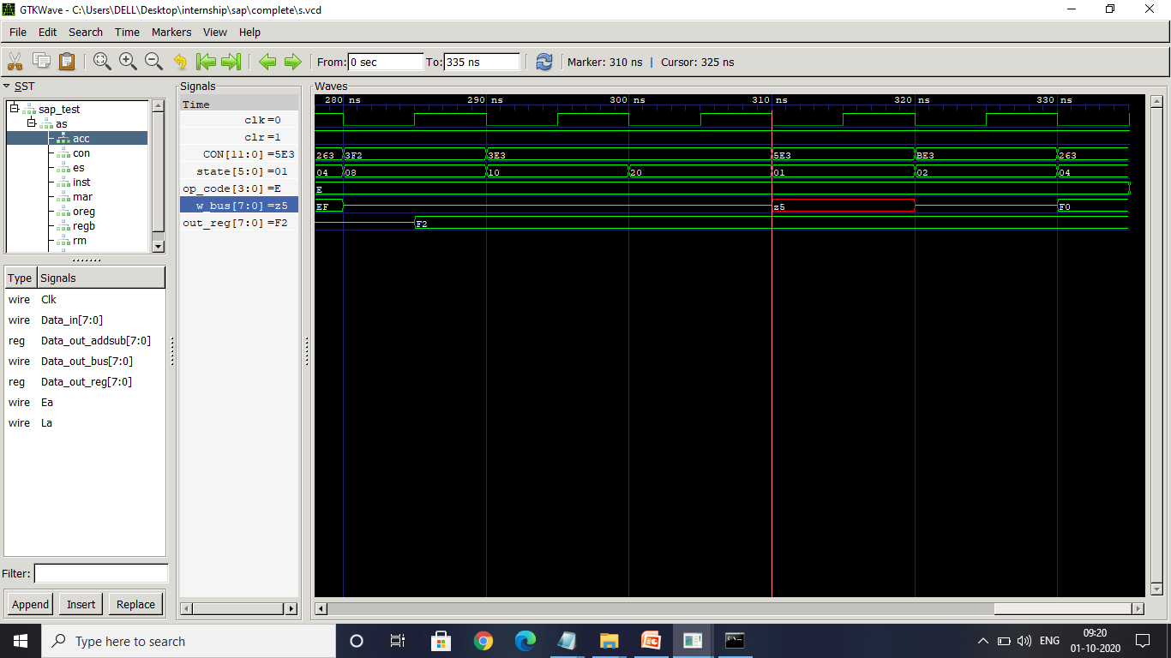
HLT Simulation Output
Operation: HLT 0H
Memory Location:
5H = F0H
Fetching Cycle
Stop Operation
T1 state T2 state T3 state
18

Slide 19
Conclusion
Learned SAP-1 Architecture.
Designed and simulation of SAP-1 are verified successfully.
19

Slide 20
Reference
Digital Computer Electronics by Albert Paul Malvino Brown.
20

