Slide 1

MINI-PROJECT (2021-2022)
Submitted by: Submitted To:
Shubhi Agrawal Ms. Ruchi Gupta
Sakshi Garg
Priya

Slide 2

Eat-o-fit

Slide 3
Eat-o-Fit is a knowledge based website designed to provide user with a health chart and diet plan for different diseases and ailments. It will also provide exercise and Yoga for a healthy lifestyle .
The website also has feature of a Chabot where user can communicate with professionals to ask his/her questions regarding their health.

Slide 4
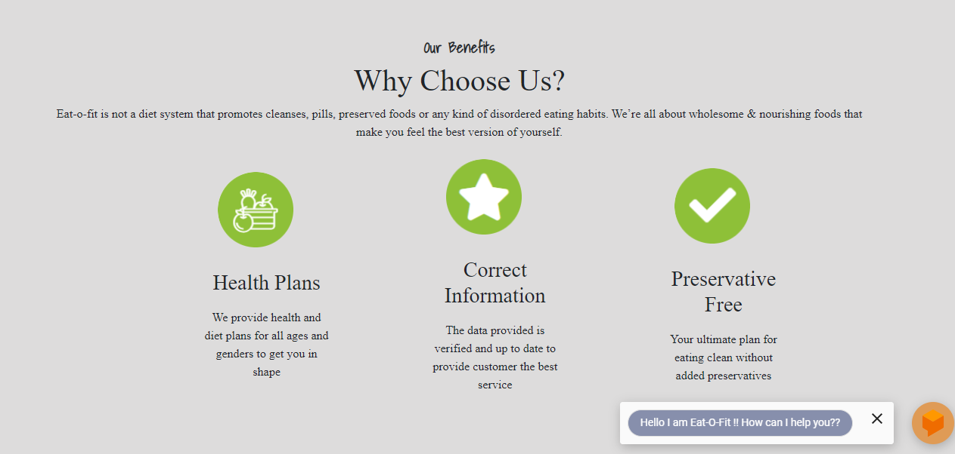
Our site provide user with health advisory

Slide 5
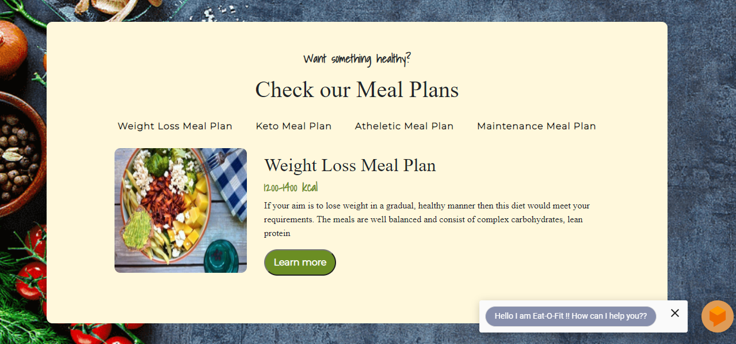
Eat-o-fit provides various categories for user to plan their diet

Slide 6
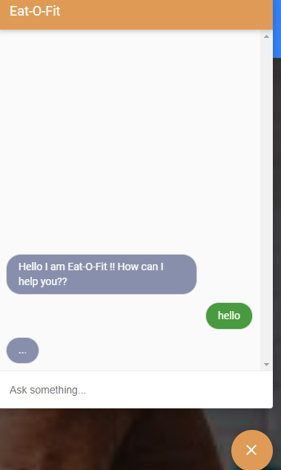
User can chat with us using our Chabot

Slide 7
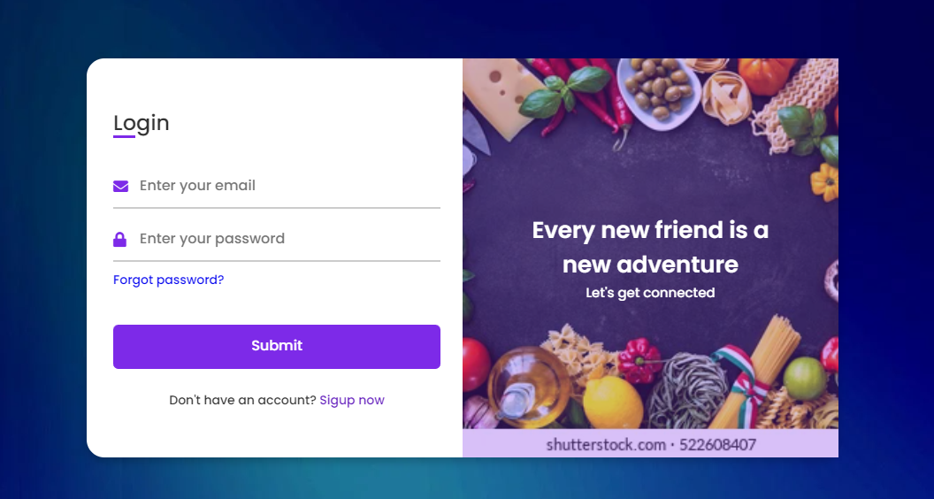
User can login/sign-in to register themselves with Eat-o-fit

Slide 8
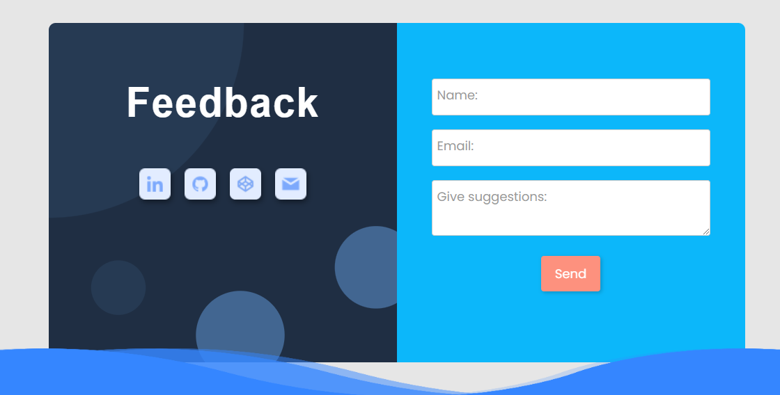
We value customer feedback

Slide 9

User can watch exercise videos to improve their fitness routine

Slide 10
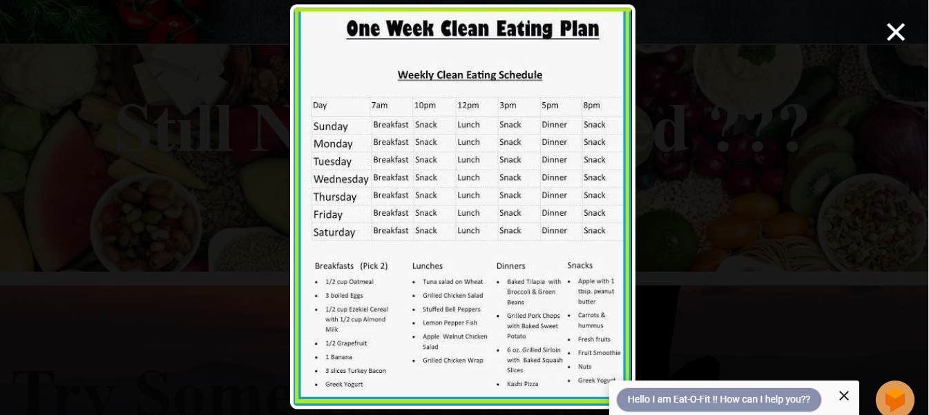
If you want to try a demo we provide a one week plan too

Slide 11
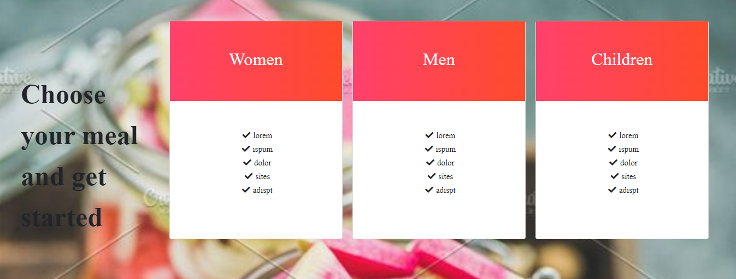
Meal plans include categories for all men, women and children

Slide 12
Conclusion
This project is only a humble venture to satisfy the need of balanced diet and exercise in daily life especially after pandemic . Several user friendly coding have also adopted. This package shall prove to be a powerful package in satisfying all the requirements of the organization. The objective of software planning is to provide a frame work that enables the manager to make reasonable estimates made within a limited time frame at the beginning of the software project and should be updated regularly as the project progresses.

Slide 13

Presented by:
Shubhi Agrawal
University Rollno:191500805
Sakshi Garg
University Rollno:191500699
Priya
University Rollno:191500599

Slide 14


