Slide 1
India–CPTPP Trade Integration
An Analysis of Potential Trading Opportunity
Group 11
Pakshal Jain 190581
Shubham Indoliya 190830
Sparsh Neema 190859
Nandita Gupta 180462
Srujith Reddy 190332

Slide 2

Introduction
CPTPP (Comprehensive and Progressive Agreement for Trans-Pacific Partnership) is a Free Trade Agreement between countries on the Pacific Rim
Includes Canada, Mexico, Peru, Chile, New Zealand, Australia, Brunei, Singapore, Malaysia, Vietnam, and Japan
Signed in December 2018
Aims to remove almost all tariff barriers
Covers nearly all goods ranging from financial services to telecommunications to food
13.4% (US$13.5 trillion) of global GDP and 15% of global trade
One of the world’s largest FTA by GDP with a population of 500 million people

Slide 3
India & CPTPP Trade in Figures
India refrained from joining CPTPP as it placed relatively higher labour and environmental standards.
The FTA’s draft includes narrowly detailed qualifications on standards for investment protection, provisions to protect the host country's right to regulate trade, and imposition of detailed transparency requirements.
Imports
US $58 billion
Mainly Oil & mineral Fuels, Precious Stones & metals and Metal Ores
Exports
US$41 billion
Mainly Precious Stones, Oil & Mineral Fuels and industrial Machinery
Trade Deficit
US$17 billion

Slide 4
Objective of Study & Methods Employed
Through this project, we aim to find solutions to the following questions:
How would trade value and volume change if India were to join the CPTPP group?
How would such an agreement affect trade amongst existing CPTPP members?
Following are some of the methods, we wish to employ for gravity model estimation:
Two-way fixed effects methodology
Poisson Pseudo Maximum Likelihood estimation
Non -Linear Least Squares Estimator
Further based on the study we will also try to prescribe policies related to India’s trade with other partners

Slide 5
Participation of India in CPTPP will lead to welfare gains in India especially in software, finance and capital sectors. Non-participation will have an adverse impact on Indian Textile Industry
Laihui Xie et al
Mercury is the closest planet to the Sun and the smallest one
Tianguo Li et alGravity Model
Higher trade barriers against third-party countries in RCEP, makes the trade diversion effect in RCEP higher than trade diversion in CPTPP. Countries not part of FTA will face trade-diversion and welfare loss.
Dan Ciuriak
Mars is actually a cold place. It’s full of iron oxide dust
Tianguo Li et al
Literature Review
Used GTAP to conclude that if CPTPP countries opt for deeper integration, then South-Asian countries especially India would risk losing most in term of Real GDP and welfare compared to others
Rahman and Ara
Jupiter is a gas giant and the biggest planet in the Solar System
CPTPP countries will experience an increase in FDI inflow due to GDP growth and liberalisation of trade while rest of world will face obstacles in attracting FDI, leading to lower incomes
Petri and Plummer
Petri and Plummer

Slide 6
Data Requirements
International Monetary Fund (IMF)
World Integrated Trade Sources (WITS)
United Nations Conference on Trade and Development (UNCTAD)
CEPII
United Nations Conference on Trade and Development (UNCTAD)
United Nations Conference on Trade and Development (UNCTAD)
Importer GDP
Import Value
Distance between countries
Tariff Rate
Technical Barriers to Trade for importer and exporter
Technical Barriers to Trade for importer and exporter
Exporter
GDP

Slide 7
Methodology
We will be estimating structural gravity model to analyse current trade scenario between India and CPTPP nations using three methods.
Two-way fixed effects methodology
poisson pseudo maximum likelihood estimation
non-linear least squares
logX_{ij} = β₁log(gdp_{exp})+ β₂log(gdp_{imp}) + β₃log(distance_{ij}) + β₄border_{ij} + β₅t_{ij} + β₅TB_{i} + β₆TB_{j} + β₇language_{ij} + Σa_{k}Imp_{k} + Σb_{k}Exp_{k} + ξ_{ij,t}
GDP_{exp}, GDP_{imp} Exporter and importer nations GDP respectively
t_{ij} Tariff rate between countries i and j.
TB_{i} , TB_{j} Technical barriers to trade present in country i and j respectively
border_{ij},distance_{ij} variables accounting for if there exists a land border b/w i,j nations, and distance b/w i,j
language_{ij} whether the nations i,j speak common language
Imp_{k} Importer dummies, take value 1 if k^{th} nation is importer, 0 otherwise for k∈[1,12]
Exp_{k} Exporter dummies, take value 1 if k^{th} nation is exporter, 0 otherwise for k∈[1,12]
Imp_{k} and exp_{k} account for multilateral trade resistance

Slide 8
And to analyse trade creation and trade diversion effects by two way fixed effects method when India joins CPTPP(i.e CPTPP+) we will using following log-linear specification of gravity model
logX_{ij} = β₁log(gdp_{exp})+β₂log(gdp_{imp}) +β₃log(distance_{ij})+β₄border_{ij} +β₅t_{ij}+β₅TB_{i}+β₆TB_{j} + β₅t_{ij} + β₇language_{ij} + β₈otherRTA_{ij}+ β₉TC_{ij}+ β₁₀TD_1_{j} + β₁₁TD_2_{i} + Σa_{k}Imp_{k} + Σb_{k}Exp_{k} _{i} + ξ_{ij,t}
Some Dummy variables used in order to capture trade diversion and trade creation are as follows:
TC_{ij} measure of trade creation, 1 if both i,j are part of agreement,0 otherwise
TD_{1i} measure of importer’s trade diversion,
=1 if importer is part of agreement and exporter is not,
=0 otherwise
TD_{2j} measure of exporter’s trade diversion,
= 1 if exporter is part of agreement and importer is not,
= 0 otherwise
We will only focus on merchandise trade between countries, as data related to services for countries of interest was unavailable.

Slide 9
Poisson Pseudo - Maximum Likelihood Method
The PPML estimator is a generalised linear model and can be used to estimate the gravity model in its multiplicative form. This model is given by
λ_{ij} = β₁gdp_{exp}+β₂gdp_{imp}+β₃distance_{ij} + β₄border_{ij} +β₅t_{ij}+ β₅TB_{i} + β₆TB_{j}
+β₇language_{ij} + β₉TC_{ij}+ β₁₀TD_1_{j} + β₁₁TD_2_{i} + Σa_{k}Imp_{k} + Σb_{k}Exp_{k} + ξ_{ij,t}
This specification will be used to estimate trade diversion and trade creation effects using PPML estimator. Some Dummy variables used in order to capture trade diversion and trade creation are:
TC_{ij} measure of trade creation, 1 if both i,j are part of agreement,0 otherwise
TD_{1i} measure of importer’s trade diversion,
=1 if importer is part of agreement and exporter is not,
=0 otherwise
TD_{2j} measure of exporter’s trade diversion,
= 1 if exporter is part of agreement and importer is not,
= 0 otherwise

Slide 10
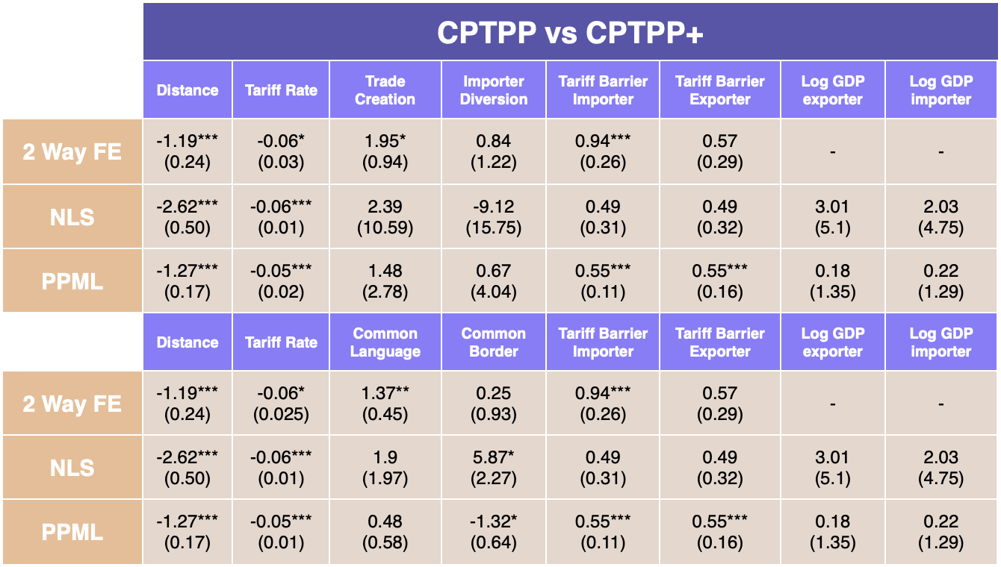
RESULTS
CPTPP+
2.05
(3.07)
3.47
(3.8)
CPTPP
2.05
(3.07)
3.47
(3.8)

Slide 11
Conclusion
Gravity model estimation for CPTPP group
In each of three estimation methods, the correlation between distance and imports is negative which is inline with theory of what expect from gravity model.
Relation between importer and exporter GDP is also according to what we expect from gravity model i.e positive.
All three estimation methods, estimate a negative correlation between tariff rates and imports.
Other trade barriers like common language, common border have also have positive effect on trade.

Slide 12

Counterfactual if India joins CPTPP trade alliance
Estimates of Exporter and Importer GDP, distance between countries, tariff rates and geographical and social barriers affect import values in a similar manner to that of our model estimation with CPTPP countries and is inline with the gravity model theory.
Coefficient of trade creation dummy is positive implying an increase value of trade between CPTPP+ countries. This was expected as countries which were producing some goods at high price in their country will begin importing cheaply products from India.
For importer diversion dummies, 2 way Fixed Effects and PPML give a positive relation which justifies the theory as trade with non-member countries will shift to member countries. However, NLS estimate shows a negative relation with imports.
Estimates for some variables are not available due to correlation between the independent variables

Slide 13
References
Anderson, James, E., and Eric van Wincoop. 2003. "Gravity with Gravitas: A Solution to the Border Puzzle ." American Economic Review, 93 (1): 170-192.
Thapa, Sujit & Chakma, Dhiraj. (2019). Mega Regional Trade Agreements: CPTPP and the Indian Economy.
Loganathan, S., Karakunnel, J. J., & Victor, V. (2021). India–European Union Trade Integration: An Analysis of Current and Future Trajectories. Margin: The Journal of Applied Economic Research, 15(4), 484–504.

Slide 14
https://docs.google.com/document/d/1V-T9F7_wBAx4rPa6Dz2BLrRK633A5hcd5elcCk82P-I/edit?usp=sharing

