Slide 1

Presented by:
Garvit Dadheech
Shubh Kesharwani
Solana Local Explorer
A self-hosted, one-command block explorer and real-time transaction indexer for private Solana validators
BSc CS (2025-2026)
Under the guidance of
Dharma Teja
Notes:
Solana Local Explorer — a self-hosted block explorer and real-time indexer for a private Solana validator. Presented by Garvit Dadheech and Shubh Kesharwani under the guidance of Dharma Teja.

Slide 2
Problem Statement
Background of the problem
Every Solana team develops against solana-test-validator — a complete chain that runs on their own machine.
Debugging a program means reading transactions: which accounts it touched, what it cost, and why it failed.
Gap in existing systems
Public explorers (Solana Explorer, Solscan, SolanaFM) index public clusters only — they structurally cannot see a private ledger.
RPC polling is address-scoped, adds latency proportional to its interval, and loads the node being observed.
Yellowstone gRPC streams the data, but stores nothing, indexes nothing and answers no queries.
Impact
Building your own explorer needs gRPC, database and frontend skills at once — a multi-day task every team repeats independently.
The usual workaround, deploying to devnet just to get explorer visibility, breaks the fast local loop and publishes unreleased work.
Notes:
The key point: this is not a missing feature in Solscan — it is structural. A ledger inside one laptop can never reach a hosted explorer.

Slide 3
Objectives & Scope
Objectives
OBJ-1 Containerise a Solana test validator running the Yellowstone gRPC Geyser plugin, compiled against a matching validator version.
OBJ-2 Build a resilient indexer that decodes every field of the gRPC payload and persists it without duplicating on replay or restart.
OBJ-3 Design a normalised, migrated and indexed PostgreSQL schema for transactions, failures, accounts and per-transaction balance changes.
OBJ-4 Expose the data through a documented REST API and an interactive explorer interface.
OBJ-5 Orchestrate the whole stack with Docker Compose — one command to start, one to reset.
OBJ-6 Validate with an automated unit suite plus a documented, reproducible functional test plan.
In scope
Streaming ingestion and durable storage
REST API, explorer UI, search and filtering
One-command deployment and clean reset
Out of scope
Instruction decoding by program IDL
SPL token and NFT semantics
Historical backfill; authentication
Notes:
Six objectives; Chapter 7 of the report assesses each one against evidence. All six are met.

Slide 4
Existing System / Literature Review
Four families of approach were evaluated against the requirements of a private validator.
Approach | Private ledger | Push- based | Durable & queryable | Self- hosted | Ready- made UI | Setup
Hosted explorers — Solscan, SolanaFM | ✗ | n/a | ✓ | ✗ | ✓ | None
RPC polling scripts | ✓ | ✗ | Partial | ✓ | ✗ | Per query
Raw Yellowstone gRPC stream | ✓ | ✓ | ✗ | ✓ | ✗ | High
Managed platforms — Helius, Dune | ✗ | ✓ | ✓ | ✗ | Partial | Low
Solana Local Explorer (this project) | ✓ | ✓ | ✓ | ✓ | ✓ | 1 command
Research gap
Every component already exists and is mature — Geyser exposes the events, Yellowstone transports them, PostgreSQL can store them.
What does not exist is an integrated, self-hosted, one-command assembly of those pieces aimed at a private validator.
The contribution of this work is integration, not invention.
Notes:
Note the first column: hosted explorers and managed platforms fail it absolutely, and no amount of engineering fixes that.

Slide 5
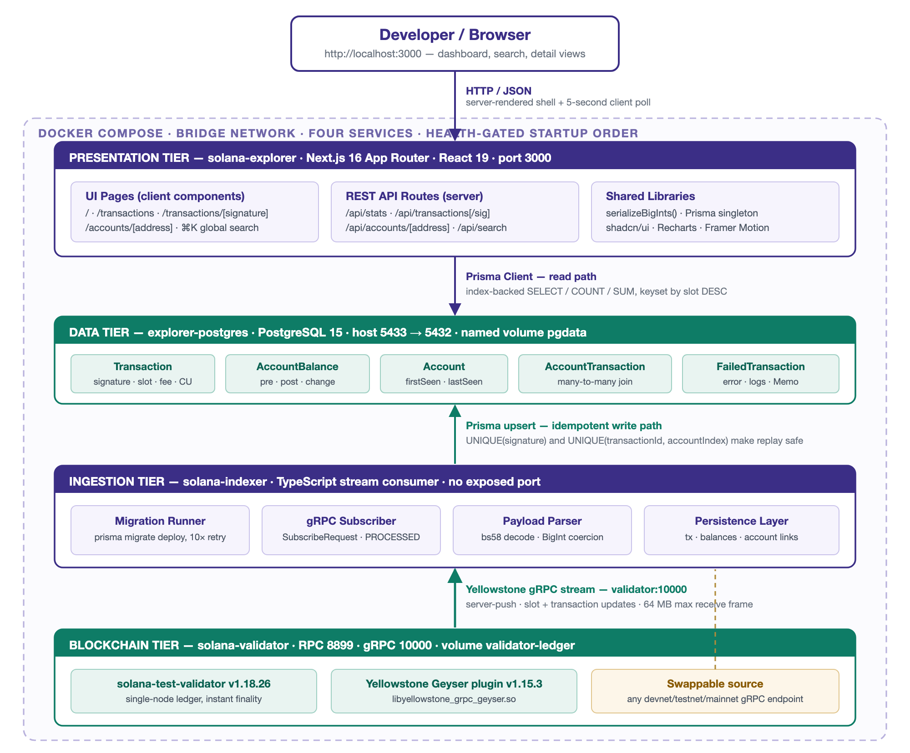
Proposed System Architecture
Four tiers, four containers, one Docker Compose network. Data flows strictly upward.
Notes:
Bottom to top: the validator produces events, the indexer normalises them, PostgreSQL stores them, Next.js serves them. Each tier talks to its neighbour over exactly one protocol, so the data source is substitutable.

Slide 6
Tools & Technologies
Blockchain & streaming
solana-test-validator 1.18.26
Yellowstone gRPC Geyser plugin 1.15.3
@triton-one/yellowstone-grpc, bs58
Indexer
Node.js 22 · TypeScript 5.9
Prisma 5.22 ORM with checked-in migrations
Database
PostgreSQL 15 — 64-bit integers, arrays, JSONB
Six entities · eleven purpose-built indexes
Web application
Next.js 16 App Router · React 19
Tailwind CSS 4 · shadcn/ui (Radix)
Recharts · Framer Motion
Testing
Vitest 4.1.11 — 38 automated unit tests
Tooling & deployment
Docker Compose v2 — health-gated ordering
pnpm 10.27 with a committed lockfile
Multi-stage builds; Next.js standalone output
Notes:
TypeScript end to end means the indexer and the explorer share one generated Prisma client, so a schema change breaks the build rather than production.

Slide 7
Implementation — Key Features
Feature 1 — Push-based ingestion
Subscribes to slots and all transactions at PROCESSED commitment; no polling and no RPC round trip on the write path.
Feature 2 — Idempotence by construction
Unique constraints on the signature and on (transactionId, accountIndex) make stream replay and indexer restarts harmless.
Feature 3 — Lossless 64-bit handling
Slots, fees and lamport balances stay BigInt end to end and become strings only at the API boundary — JSON cannot silently truncate them.
Feature 4 — Balance history with amount filtering
Pre-balance, post-balance and net change per account key index; filterable by field, unit and exact value or range.
Feature 5 — One-command, health-gated deployment
The indexer starts only after the validator and database report healthy, then migrates with a bounded retry loop.
Notes:
Feature 3 is the one worth pausing on: JSON.stringify throws on BigInt, and coercing to Number silently corrupts balances above 2^53.

Slide 8
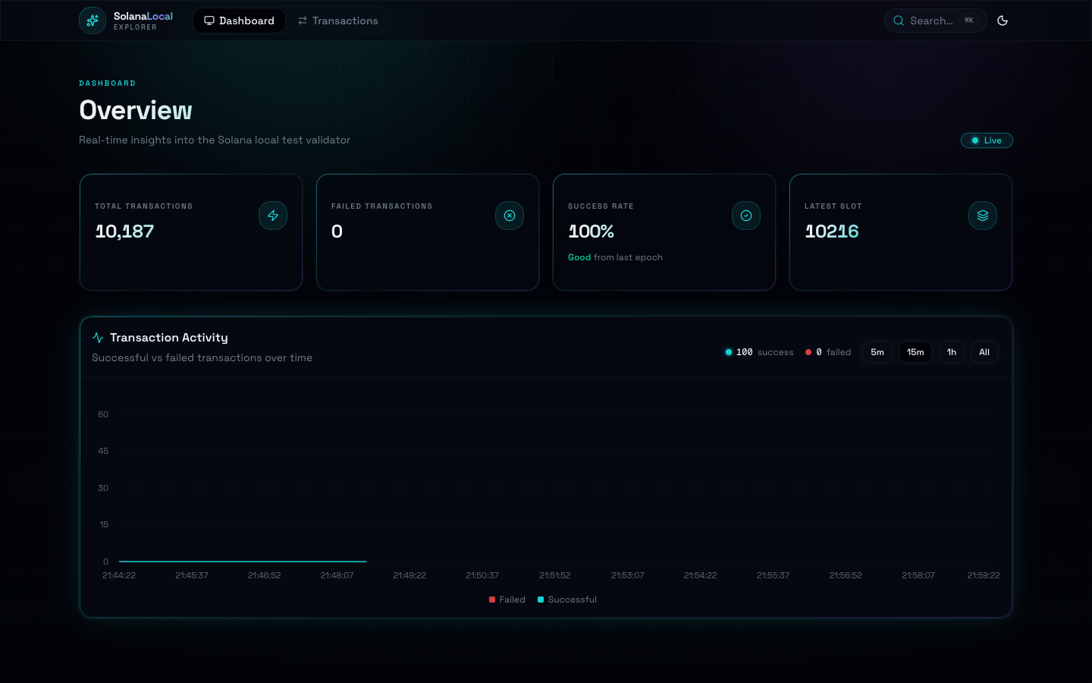
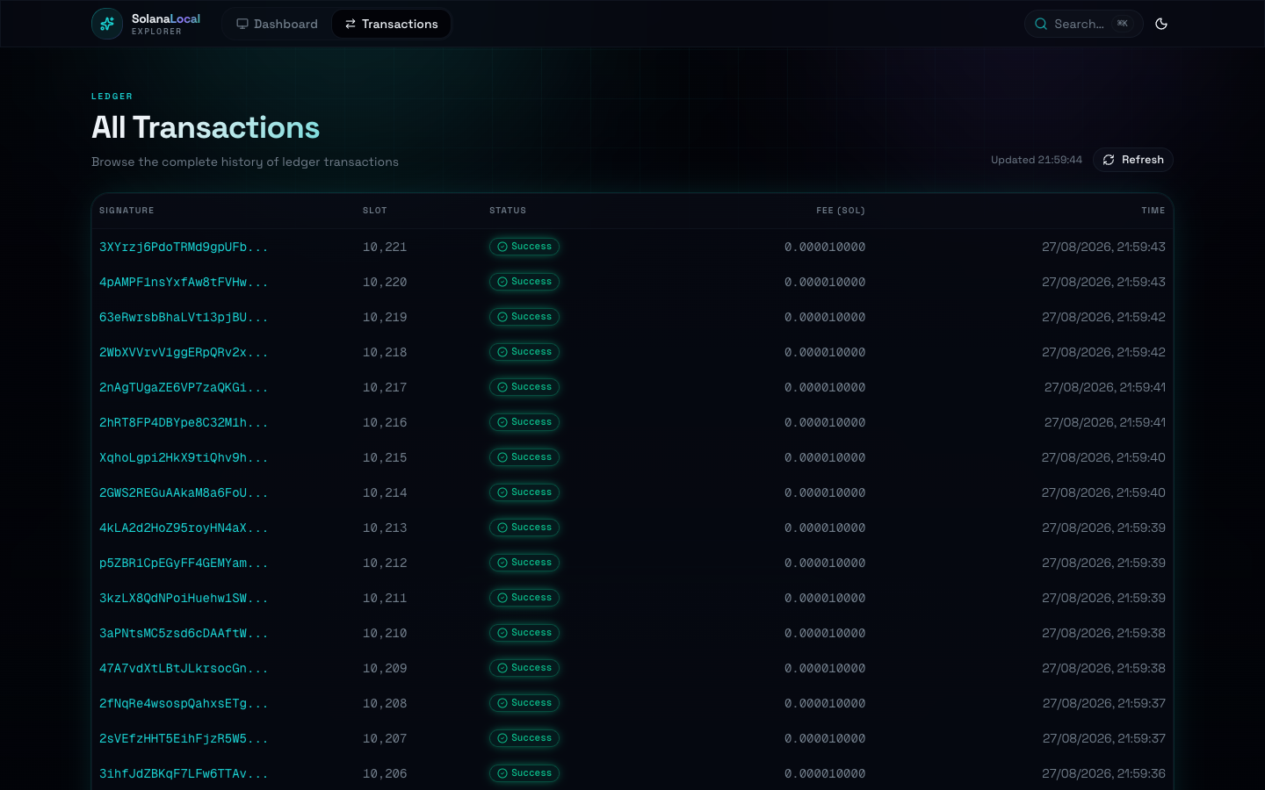
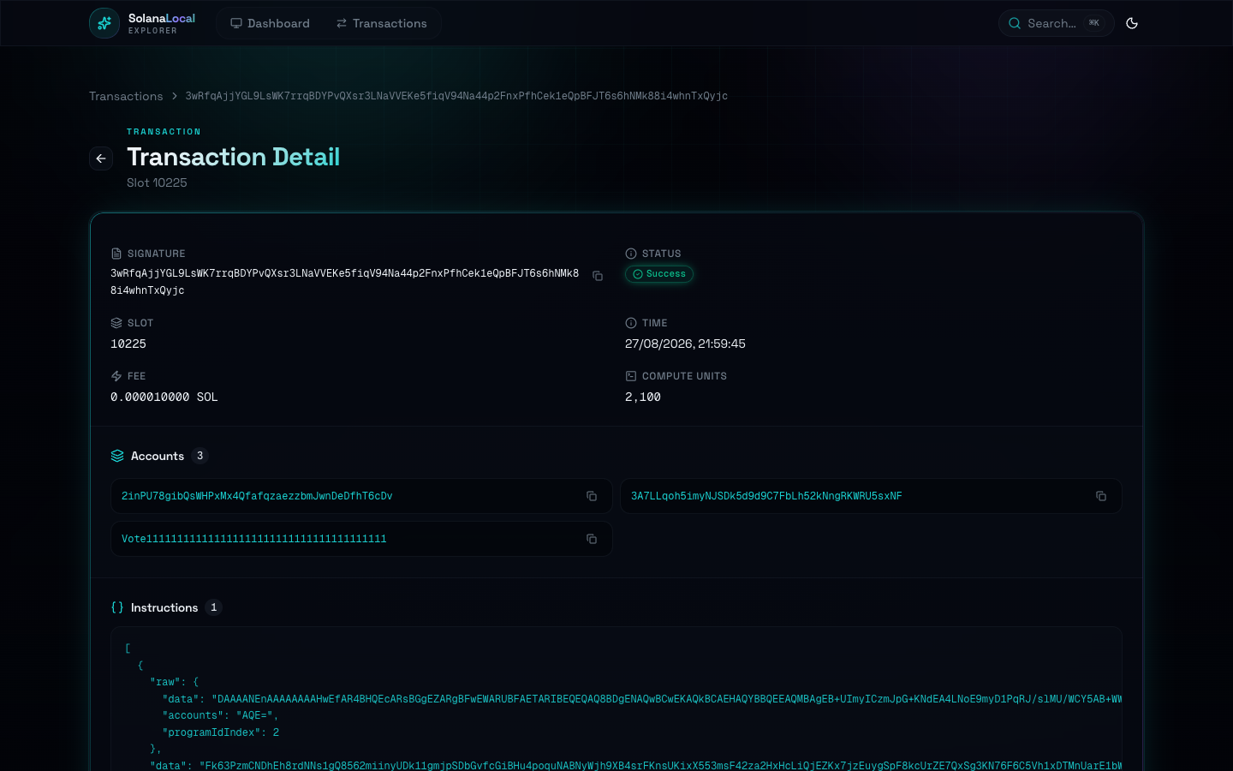
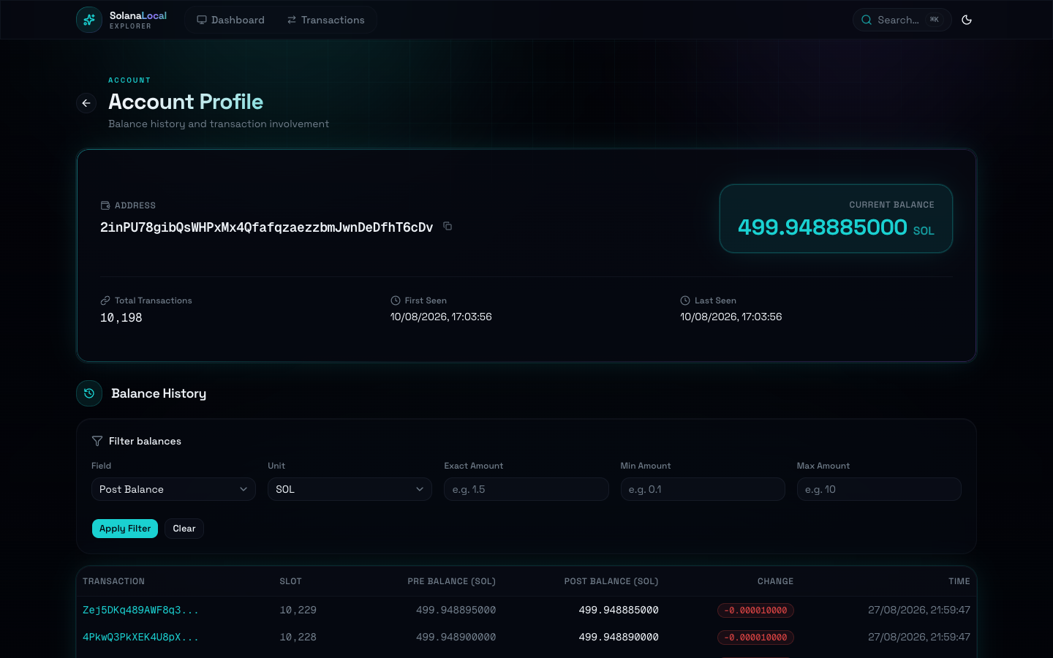
Demo — The Explorer
Dashboard — live stats and activity chart
Transaction list — paginated browsing
Transaction detail — accounts, instructions, logs
Account detail — balance history and filtering
Notes:
Live demo: start the stack, send a transfer from inside the validator container, and watch it appear on the dashboard within five seconds.

Slide 9
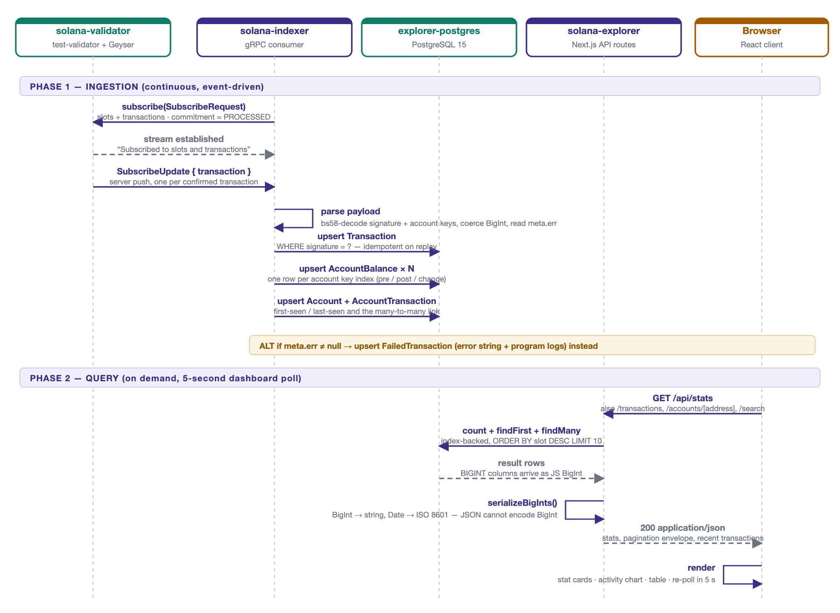
Flow Diagram — Ingestion and Query
Phase 1 is push-driven ingestion; phase 2 is the on-demand query path taken by every page and API call.
Notes:
The two phases share only the database. Ingestion is driven by the validator; queries are driven by the user.

Slide 10
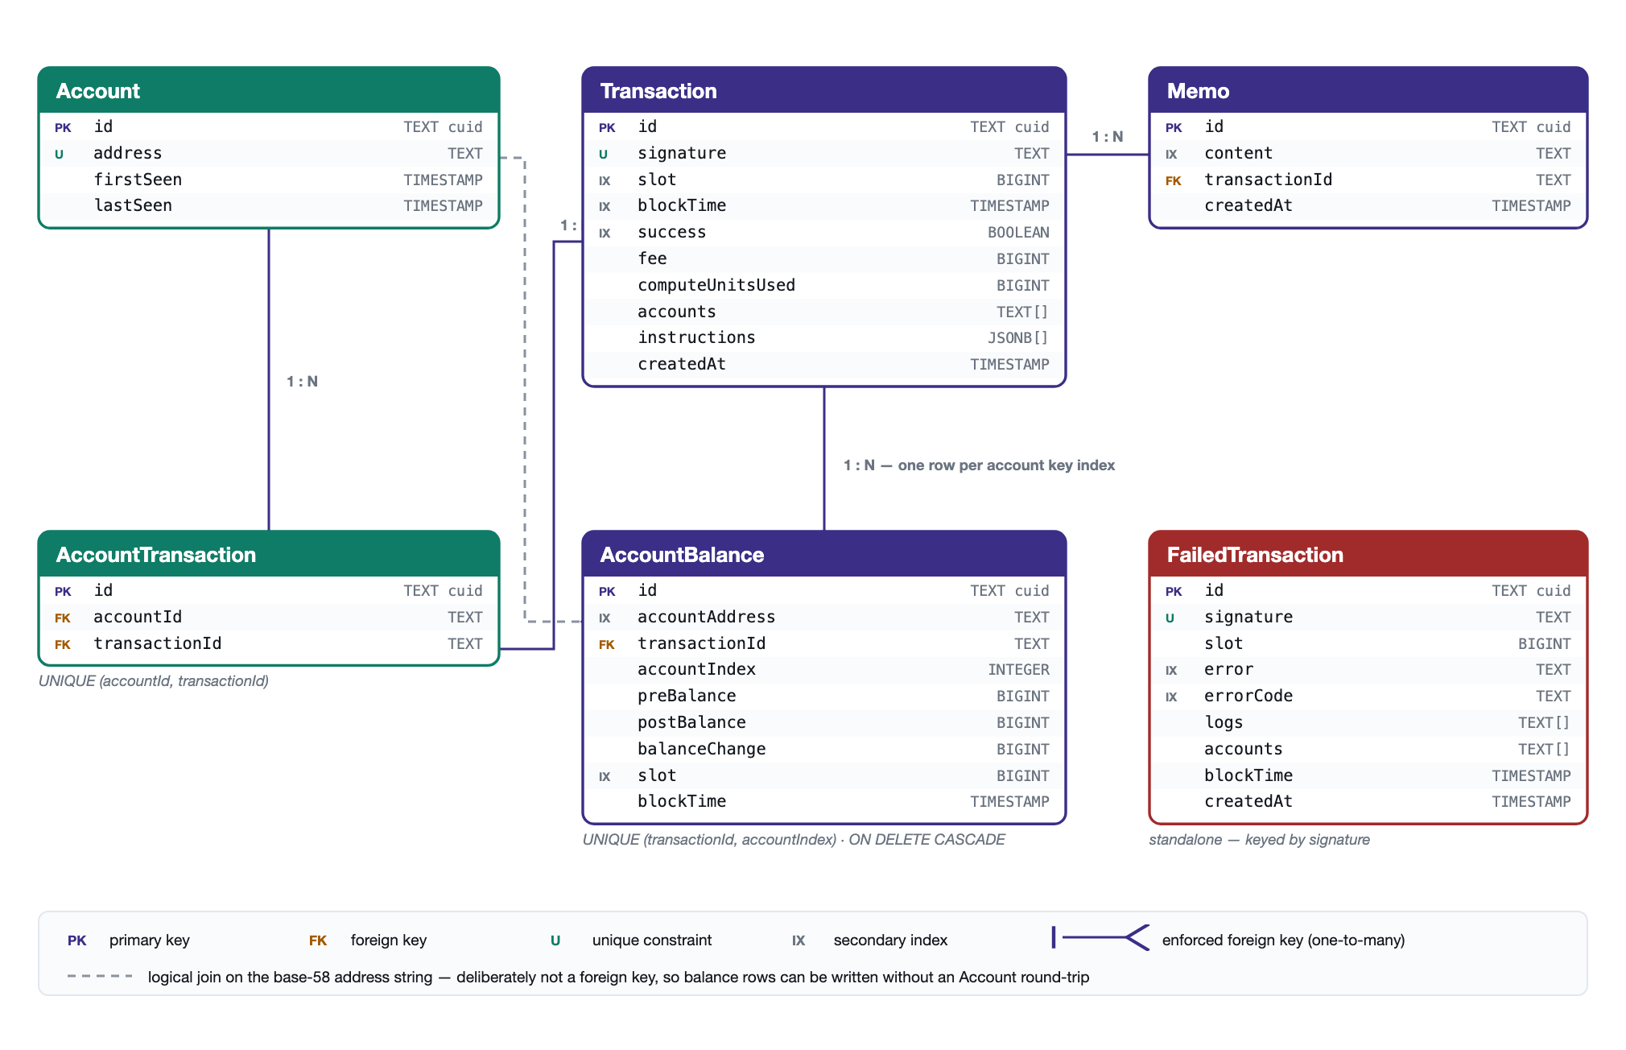
Data Model
Six entities. The dashed link is a deliberate logical join on the address string, so balance rows write in a single pass.
Notes:
AccountBalance stores one row per account key index, because Solana's preBalances/postBalances arrays are positional — element i belongs to account key i.

Slide 11
Results & Analysis
4
CONTAINERS
1
COMMAND TO START
5
REST ENDPOINTS
6/6
OBJECTIVES MET
< 5 s
TX TO SCREEN
Delivered outcome
A working four-container stack that indexes a private Solana ledger and serves it as a browsable explorer and a REST API.
All six objectives met; 38 of 38 automated tests pass; two defects documented as open rather than hidden.
Performance characteristics
Characteristic | Behaviour | Mechanism
Ingestion latency | Sub-second | Push-based Geyser delivery at PROCESSED commitment
Visible latency | ≤ 5 s | Bounded by the dashboard poll, not the pipeline
List query cost | Index scan | ORDER BY slot DESC served by Transaction(slot)
Account query cost | 4 concurrent reads | Composite index (accountAddress, slot)
Payload size | Bounded | Page size clamped to 100; dashboard takes 10
Notes:
These are architectural claims, each tied to the mechanism that produces it — not a benchmark. The report says so explicitly.

Slide 12
Testing & Validation
92
TEST CASES
38
AUTOMATED
38
PASSED
0
FAILED
2
OPEN DEFECTS
Level | Method | Cases | What it protects
Unit — gRPC parsing | Automated | 29 | Decoding of every payload field, including malformed input
Unit — serialisation | Automated | 9 | Lossless BigInt and Date conversion to JSON
Integration | Manual | 12 | Health, start-up ordering, migration, end-to-end persistence
API | Manual | 18 | Contracts, pagination, filtering, search, error codes
Interface | Manual | 16 | Navigation, live refresh, filters, empty and error states
Non-functional | Manual | 8 | Latency, restart, idempotence, portability, reset
38 automated tests execute in under a second with no validator, database or network — the two layers where a silent bug would corrupt data.
The other 54 cases are documented procedures with exact commands, so an examiner can reproduce every one independently.
Every requirement traces to at least one test case; no orphans either way.
Notes:
Be explicit at viva: only the 38 automated results are machine-checkable. The other 54 are scripted procedures, documented so they can be re-run.

Slide 13
Challenges & Limitations
Technical challenges encountered
Version coupling — the Geyser interface is a Rust ABI, so the plugin must match the validator exactly. Fix: pin both, with a fallback tag.
64-bit values in JavaScript — JSON.stringify throws on BigInt and Number truncates above 2⁵³. Fix: one recursive serialiser, nine unit tests.
Start-up races — depends_on waits for start, not readiness. Fix: health gates plus a bounded migration retry loop plus a restart policy.
A stream that must not stop — one malformed message would kill a long-lived consumer. Fix: every extractor degrades to a safe default; 29 tests.
Limitations that remain
No historical backfill — indexing is forward-only from connection time.
Instructions stored raw; not decoded into named methods (needs IDLs). Lamports only — no SPL token semantics.
Single indexer instance, no authentication — a trusted-network tool.
Notes:
Two defects are open and disclosed: D-06, a zero compute-unit value stored as unknown; and D-09, accounts predating the balance-tracking migration.

Slide 14
Conclusion & Future Work
Conclusion
Solana Local Explorer reduces observability for a private Solana network from a multi-day engineering task to a single command.
Three properties make it usable rather than merely demonstrable: idempotence by construction, precision by discipline, and a substitutable data source behind one environment variable.
Working end to end, tested, and documented with a reproducible validation procedure.
Future work
Close defect D-06 and point the parsing tests at the production code path instead of its documented mirror.
Replace the five-second dashboard poll with server-sent events.
IDL registry for instruction decoding — additive, no re-indexing needed.
SPL token balance tracking from metadata already present in the payload.
Opt-in historical backfill worker using the same idempotent upserts.
CI running both suites plus a Compose smoke test on every push.
Notes:
Close on the value proposition: this is the tool for the chain nobody else can see.

