Slide 1
Assumptions
Comments doesn’t exist without post
Using same comment_id and same type of object for all types of comments
“ParentComment” of all direct comments to a post are set to null
To get the comments passing commentId – set to -1 for post.
New comments will be shown only when they are requested, so https protocol is the best suited protocol for them.
A user can only like like/dislike once
A user can comment multiple times

Slide 2
Features
User can do these functionalities :
Post
Add Comment to Post
Add Comment to a Comment of Post
Like/DisLike a Post/Comment/CommentOfComment
Get N Posts from a particular offset (Pagination)
Get N Comments of a post from a particular offset (Pagination)
Get N Relies (nested comment) of a Comment from a particular offset (Pagination)
Get list of Users who have Likes/Disliked the Post/Comment

Slide 3
Comment APIs
POST /v1/comment/addCommentToPost? Postid={{postId}} & user={{user}}
POST /v1/comment /addCommentToComment? Postid={{postId}} & user={{user}} & parentCommentId={{parentCommentId}}
POST /v1/comment /likeComment ? commentId={{commentId}} & user={{user}}
POST /v1/comment /disLikeComment? commentId={{commentId}} & user={{user}}
GET /v1/comment /getComments? Postid={{PostId}} & commentId={{commentId}}& offset={{offset}} & n={{n}}
GET /v1/comment /getCommentLikesUsers?commentId={{commentId}}
GET /v1/comment / getCommentDisLikesUsers ?commentId={{commentId}}

Slide 4
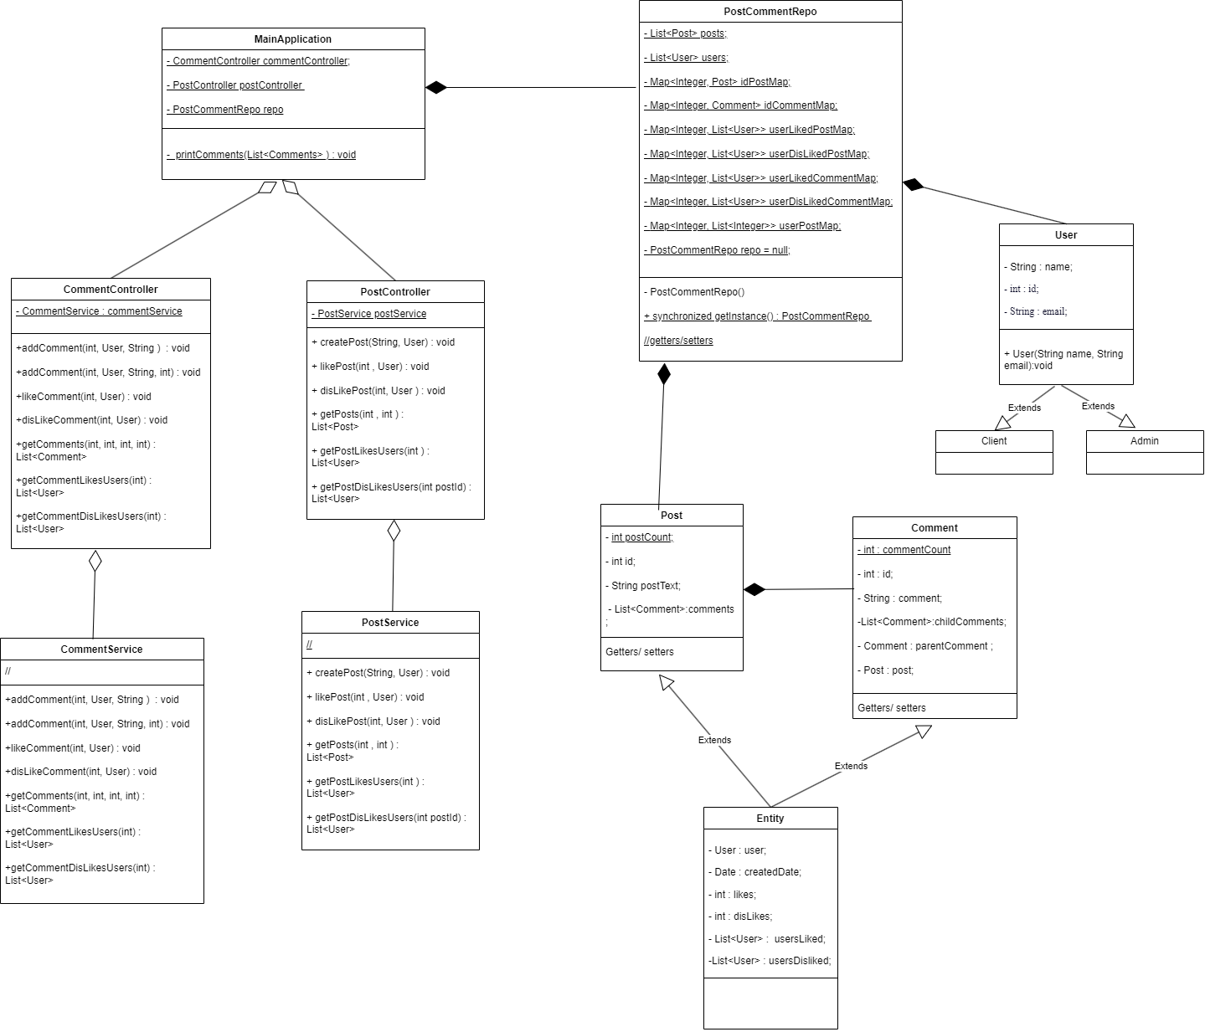

Slide 5
