Slide 1
Commercial lending application with secured and protected internal features.
Commercial Lending Domain Functionality
Use cases for all roles
Cyber security-(MacAddress and VPN code)
Object Model

Slide 2
Commercial Lending domain Functionality
This application provides commercial loans to corporate organizations from Commercial Bank and its subsidiaries.
It simplifies customer’s financial life by giving more insight on their finances.
It handles loans from initiation till closure including collateral management.
The whole eco-system will serve as communication system between subsidiaries of commercial bank for handling commercial loans.

Slide 3
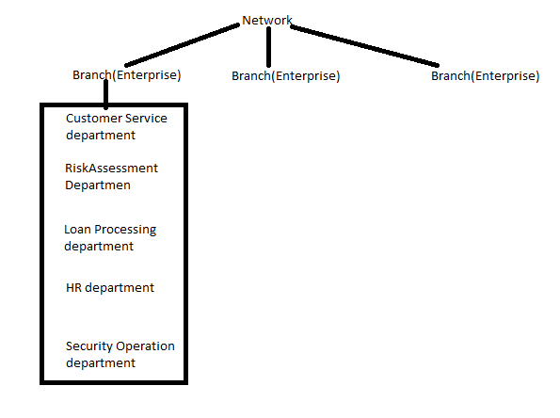
Ecosystem structure:

Slide 4
Active Roles:
Customer-(Enterprise level)
System Admin-handles all enterprises under his network.
Branch Manager- handles all departments under branch
Customer service employee
Risk assessment employee
Loan Processing employee
HR managers
Security Operation employees.

Slide 5
Use cases for all Roles:
System Admin :
1.Able to login through secured authentication.
2.Create and manage network.
3.Create and manage enterprise.
4.Create branch manager profile and user accounts
5.Can View the customer directory of all the enterprises.

Slide 6
Branch Manager
1.Manage and create departments.
2.Create and manage profiles of all the employees under each departments
3.Create and manage user accounts of all employees under each department.
4.Create customer profiles and assigning them temporary username and password.
5.Assign customers secured soft tokens for secured authentication.
5.View customer directory of all the branches.

Slide 7
Customer
3 main functionalities:
1.Banking
2.Borrowing
3.Account servicing.

Slide 8
Banking
1.Bank Account opening –(Saving and checking)(Maximum 2 accounts with Bank)
2.View Account details.

Slide 9
Borrowing:
1.Apply Loan(Standalone/Future Takedown)
2.Track loan status –(Approved/declined/disbursed/repayed/closed/escalated)
3.Repayment:
Repay installments
Track status of repayment:(No of installments paid/unpaid)

Slide 10
Account servicing:
1.View/update personal details.
2.View/update username and password.

Slide 11
Customer service manager
He manages and serve account opening requests.
1.Approve/decline account opening requests based on business rules
2.View approved requests.
3.View declined requests.

Slide 12
Risk assessment manager
He manages credit score calculation of customers and collateral evaluation.
1.Calculate PD(Probability of default) of customer.
2.Calculate LGD(Loss gain default) for collateral.(based on business rules)
3.Based on this 2 parameters, he can approve/decline the loan.
4.View Approved loan request details.
5.View declined loan requests details.

Slide 13
Loan Processing manager:
He handles disbursement management and repayment management.
1.Disburse the approved loan based on their types.
2.Close the loan if repayment received
3.Escalate if repayment not received.

Slide 14
Hr manager:
Handles employee management of whole branch.
1.View employee details of branch.
2.View Salary reports of all the employees of branch

Slide 15
Security Operation manager:
Handles all the security violation alerts across branch.
1.View interdepartmental alerts(Employee of one department cant login through server other than assigned server to that department).In case of attempt, alert will be sent to security department.
2.Inter-department activities can be restricted by assigning list of MAC address for each department. While authorizing the user, MAC address of the system through which he logins is also authenticated. If it belongs to the group of Mac assigned to that department, then only user will be able to login.

Slide 16
Employee session management:
Maintains log files of all the employees across complete branch
Maintaining login /logout time, macaddress and vpn code for each login session of employees.

Slide 17
Information Privacy violation:
Keeps track of attempts of information privacy violation.
1.Employees are restricted to send confidential documents outside the organization. If attempts, an alert is sent to security department.
2.Maintains log of all violation attempts of all the employees.

Slide 18
Violation reports:
1.Generate graphical reports that counts the number of times each employee has violated the rules.
2.If the count of attempts exceeds 3,employee account will be locked.

Slide 19
Cyber security:
The whole eco-system will be secured using user lock. User Lock communicate consistent security controls through its alert system.
Messages about unethical implications discourage employees from committing cybercrime.
By preventing concurrent logins, departments of bank have clearly communicated rules of accountability which ensures that access to critical assets is attributed to individual employees, and are able to enforce policies consistently to address violations that do occur.
Inter-department activities can be restricted by assigning list of MAC address for each department. While authorizing the user, MAC address of the system through which he logins is also authenticated. If it belongs to the group of Mac assigned to that department, then only user will be able to login.

Slide 20
Cyber security:
5.User Lock sets and enforces logon controls and restrictions for all authenticated users.
6. Like VPN, for each login session of an employee, a unique random code will be generated and stored in log file. Also the mac address of the system through which he logins and the timestamp for the session is also stored.
7. If the employee tries to send critical data outside the system, an alert will be sent to security department and transfer will be blocked.
8. Data integrity is maintained at department level and customer level.

Slide 21
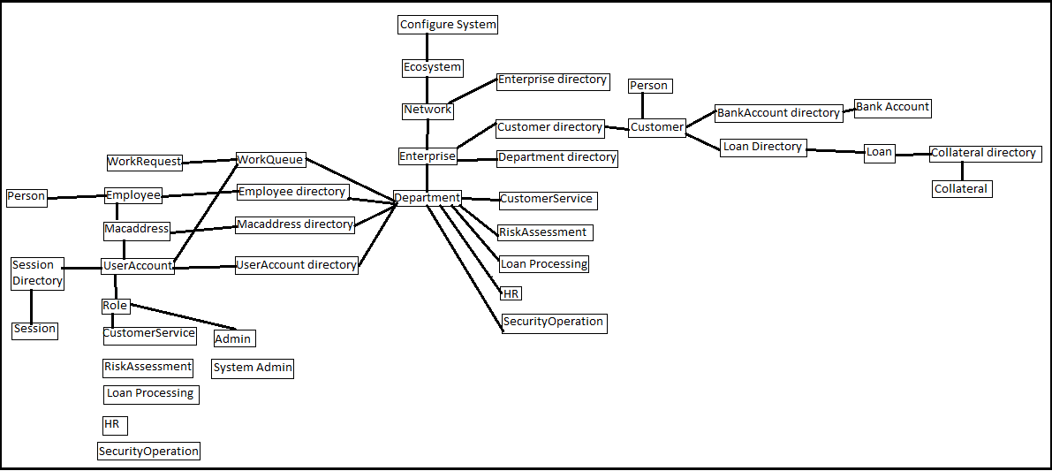
Object Model

Slide 22
Thank you!

