Slide 1
SMART AGRICULTURE SYSTEM BASED ON IOT

Slide 2
Introduction
The Internet of Things (IoT) is the network of physical devices, vehicles, home appliances and other items embedded with electronics, softwares , sensors, actuators, and connectivity which enables these objects to connect and exchange data.

Slide 3
This system works in a manner in which it ﬁrstly does data collection from the farm via the help of sensors, then it sends the data to the server side from where further actions can be taken. The ﬁnal output of this system is displayed after getting processed by the server side and an alert call for notification.

Slide 4
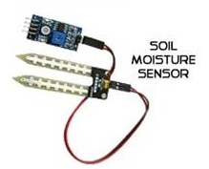
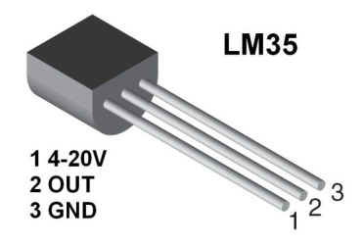
WORKING
LM35 temperature sensor and soil moisture sensor reads the environment temperature and moisture in surrounding respectively.
LM35 temperature reading is in voltage level hence its value is converted to temperature in *Celsius using temp=temp*0.48828125
1 centigrade means 10 millivolts change
1024 steps in 0-5 V
Temp=adc*5/(1024*10*10^-3) i.e. temp=temp*0.48828125

Slide 5
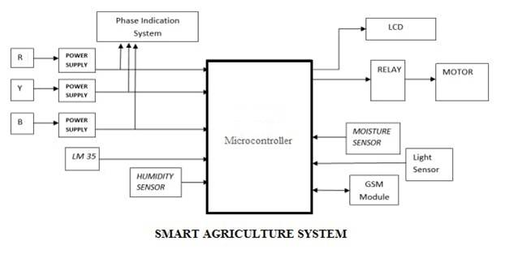

Slide 6
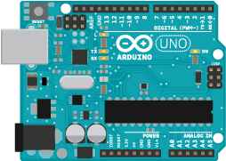
Arduino UNO R3 is used as Microcontroller (small computer in a single integrated circuit)
*Changes -Arduino uno code writing phase uses tx and rx pins hence software serial library is used to change tx and rx pin reading from 0 and 1 to 2 and 3 respectively
Sensor data is send to Arduino board

Slide 7
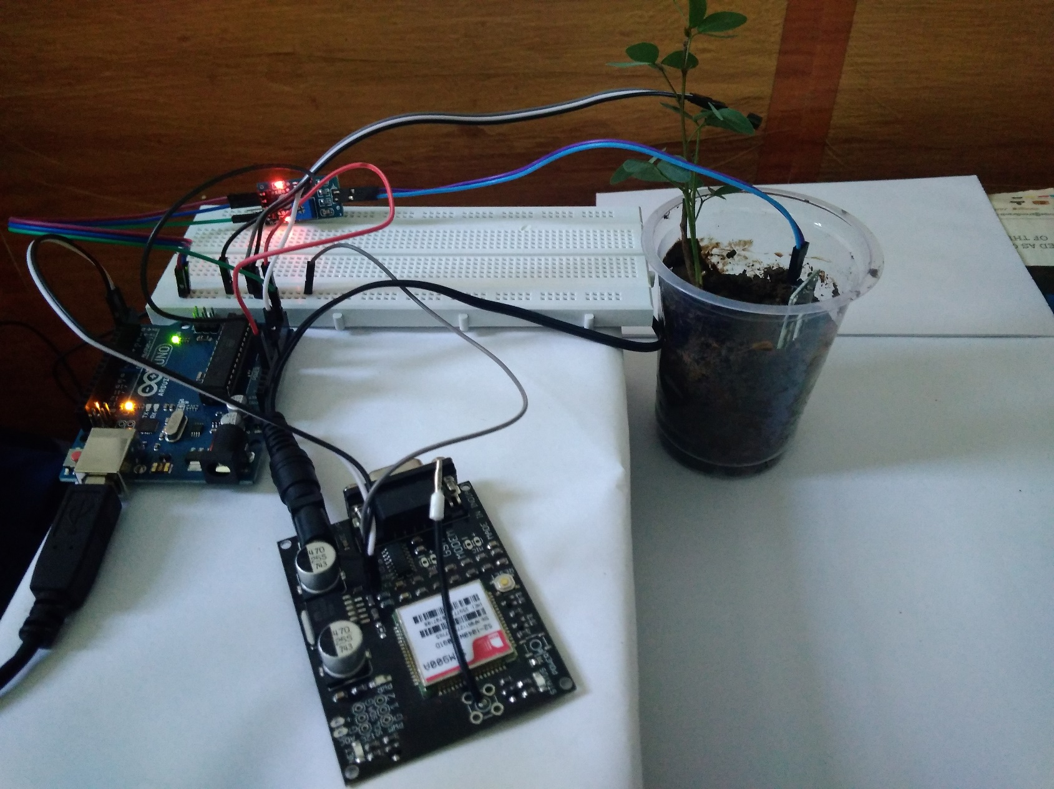

Slide 8
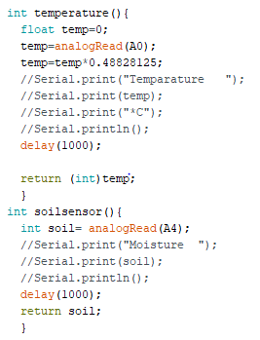

Slide 9
Arduino sends the data to the webpage ( log files) for monitoring purpose. GSM module is used for the internet connectivity ,calls , message.
Arduino code uses AT(Attention) Commands for sending commands to GSM Module

Slide 10
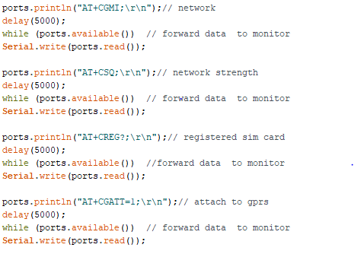

Slide 11
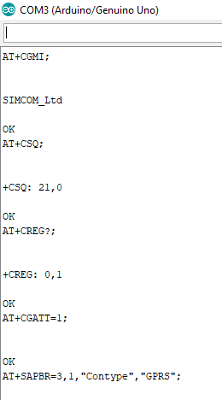

Slide 12
GSM module sends all the data to the webpage by –
Opening the http session
Sending data transfer request to server
Sending data to website
Terminating http session

Slide 13
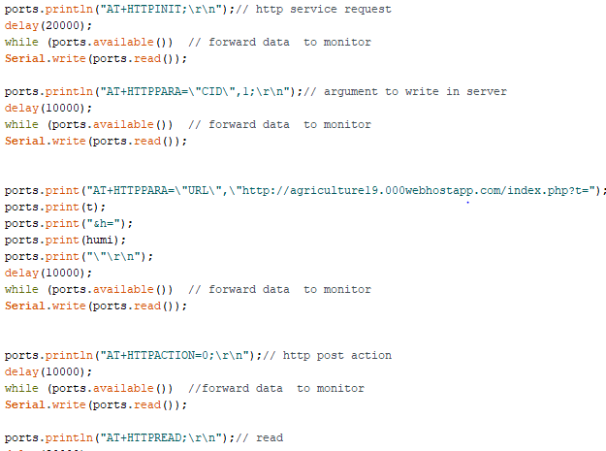

Slide 14
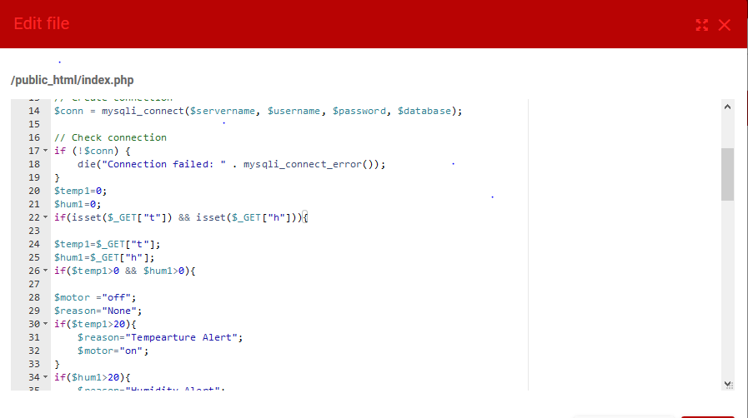
Server side

Slide 15
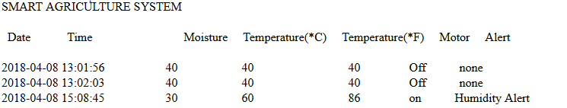
All the data in the webpage is monitored .
Analysis and statistical report is developed for regular evaluation

Slide 16
Initially Threshold value for a crop is set by analyzing the dataset KBS037 from the Kellogg Biological Station.
Monitored water requirement(in mm) in our system is analyzed and then classified according to the land and temperature
Zone | Temperature
 | 15 | 15-20 | Above 25
Desert/arid | 4-6 | 7-8 | 9-10
Semi-arid | 4-5 | 6-7 | 8-9
Semi-humid | 3-4 | 5-6 | 7-8
Humid | 1-2 | 3-4 | 5-6

Slide 17
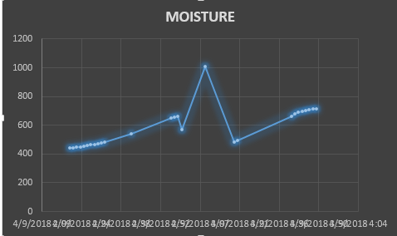

Slide 18
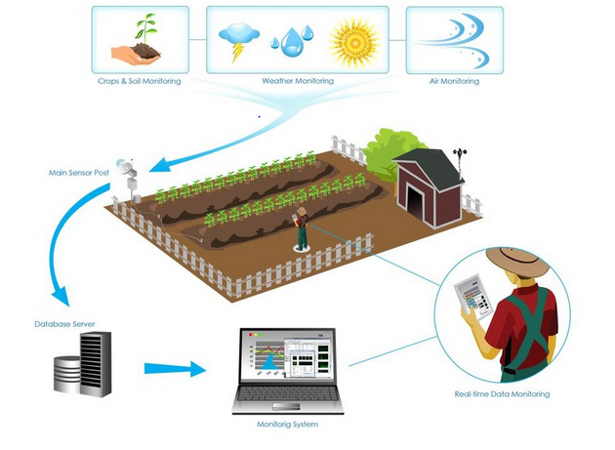

Slide 19
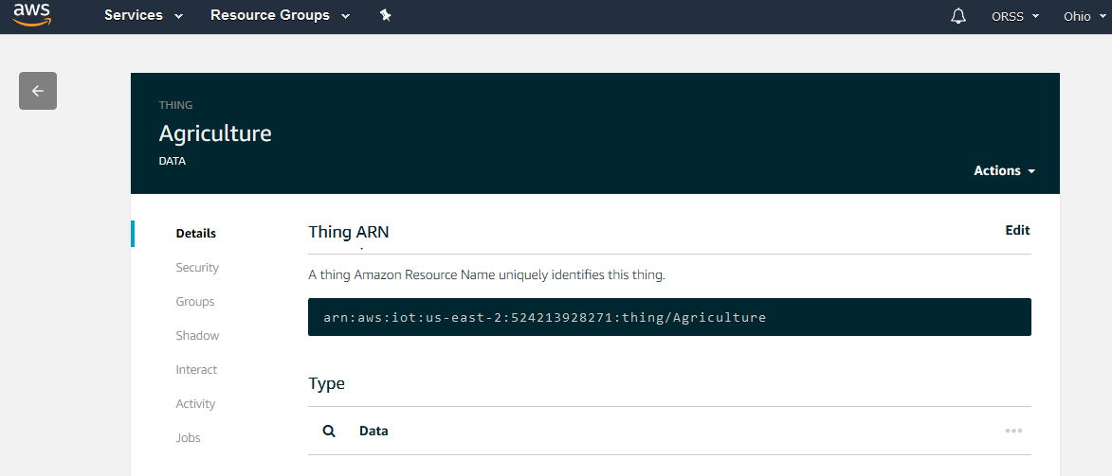
Future scope
Monthly evaluation for developing a prediction system of water needs as per the season.
AWS IoT can be used for large scale implementation where a lot of sensor data is collected ,analyzed and a pin point monitoring and alert system can be developed.

Slide 20
Benefits
Real-Time Data and Production Insight
Increased Production
Water Conservation
Lowered Operation Costs
Increased Quality of Production
Accurate Farm and Field Evaluation
Improved Livestock Farming
Reduced Environmental Footprint
Remote Monitoring
Equipment Monitoring

