Slide 1
ONLINE VOTING SYSTEM

Slide 2
DEVELOPED BY-
JIGYAS CHAUDHARY
SAGAR KUSHWAHA
SHUBHNEET KUMAR
VAISHNAVI SINGH
DEVANSH KUMAR SHARMA
UNDER THE GUIDANCE OF
MD.FARMANUL HAQUE
1

Slide 3
CONTENT
S. NO. CONTENT PAGE NO.
1. ABOUT PARALLEX 03 - 04
2. WHAT IS ONLINE VOTING SYSTEM? 05-06
3. WHAT ARE THE ADVANTAGES OF 07
ONLINE VOTING SYSTEM?
4. WHAT ARE THE DISADVANTAGES OF 08
ONLINE VOTING SYSTEM?
5. BENEFITS OF ONLINE VOTING 09
6. CONCLUSION 10
7. VOTER ACTIVITY 11
2

Slide 4
ABOUT PARALLEX
The parallax scrolling allows the user to perceive an impression of depth.
The website appears as a 3D animation that scrolls down the page.
This operational concept is particularly well adapted to storytelling, as the reading of the contents is encouraged by the scrolling effects, animations and advertising displays.
The parallax scrolling is also found in web design under the terms parallax website, scrolling website or parallax web design.
3

Slide 5
The term parallax scrolling is used to describe websites whose operating concept differs significantly from conventional navigation menus: websites with parallax scrolling are operated using the scroll function of the mouse.
If the user scrolls through the website, the elements of the website move at different rates.
A background image moves slowly, while images or graphic elements in the foreground move faster.
4

Slide 6
WHAT IS ONLINE VOTING SYSTEM ?
An online voting system is a software platform that allows groups to securely conduct votes and elections.
High quality online voting systems balance ballot security, accessibility, and the overall requirements of an organization’s voting event.
5

Slide 7
At their core, online voting systems protect the integrity of your vote by preventing voters from being able to vote multiple times.
As a digital platform, they eliminate the need to gather in-person, cast votes using paper, or by any other means (e.g. email, insecure survey software).
An online voting system being referred to as an online election system, an online e voting system, or electronic voting.
6

Slide 8
What Are The Advantages Of Online Voting Systems?
INCREASED EFFICIENCY
IMPROVED ACCURACY
GREATER TURNOUT VOTER ENGAGEMENT
MINIMIZE MISTAKES
7

Slide 9
What Are The Disadvantages Of Online Voting Systems?
SECURITY
LACK OF TRANSPARENCY
8

Slide 10
Benefit of online voting
Online voting allows people in today’s mobile and digitally advanced society to participate in the democratic process over the internet.
Our online voting system offers the highest levels of transparency, control, security and efficiency of election processes.
Alos, Online votings provide voters with a comfortable and secure voting experience and allow election organizers to save resources in planning their next election.
9

Slide 11
CONCLUSION
OUR PROPOSED SYSTEM ENABLES A VOTER TO CAST THEIR VOTE THROUGH INTERNET WITHOUT GOING TO VOTING BOOTH AND ADDITIONALLY REGISTERING THEMSELVES FOR VOTING IN ADVANCE. HOWEVER, PROXY VOTE OR DOUBLE VOTING IS NOT POSSIBLE.
FAST TO ACCESS, SECURE, EASY TO MAINTAIN ALL INFORMATION OF VOTING, HIGHLY EFFICIENT AND FLEXIBLE.
THERE ARE A FEW CHALLENGES THAT MUST BE OVERCOME IN ORDER THAT THEIR BENEFITS MAY BE FULLY REALIZED. THERE IS A CHALLENGE OF VOTER’S EDUCATION. THE ELECTORATE NEEDS TO BE EDUCATED ADEQUATELY ON THE USE OF ONLINE VOTING.
10

Slide 12
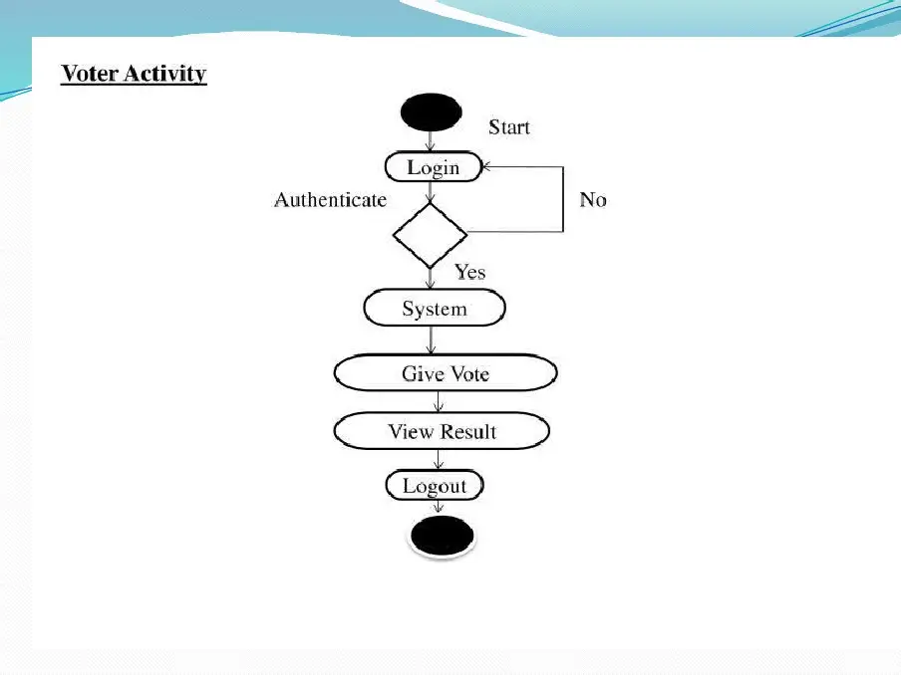
VOTER ACTIVITY

