Slide 1
ATLIQ MEDIA · ELECTION SPECIAL
DECODING THE 2026
TAMIL NADU ASSEMBLY ELECTION
01
02
03
The New Force
The Great Flip
The Closer Fight
TVK wins 108 seats
in its debut election
163 of 234 seats
changed hands
Avg winning margin
fell by 27%
Source: Election Commission of India | Data: ECI Results Portal 2026, TCPD 2021

Slide 2
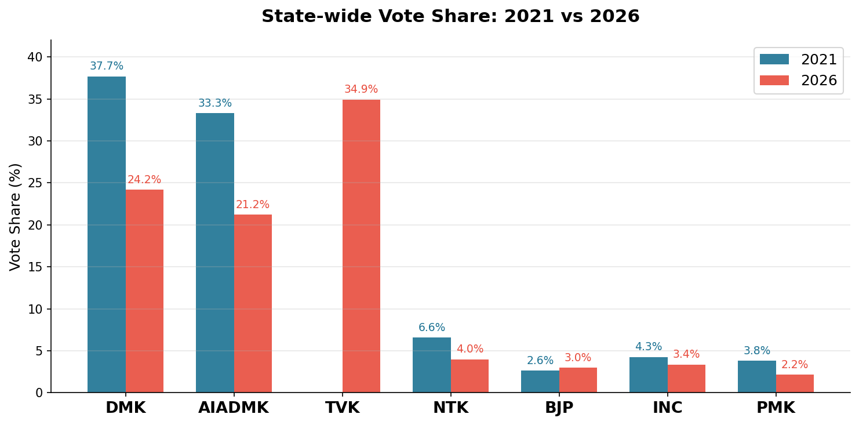
STORY 1 · THE NEW FORCE
A Brand-New Party Won the Most Seats
108
59
47
34.9%
TVK seats
DMK seats
AIADMK seats
TVK vote share
debut election
down from 133
down from 66
largest any party
Source: ECI Results Portal 2026, TCPD 2021

Slide 3
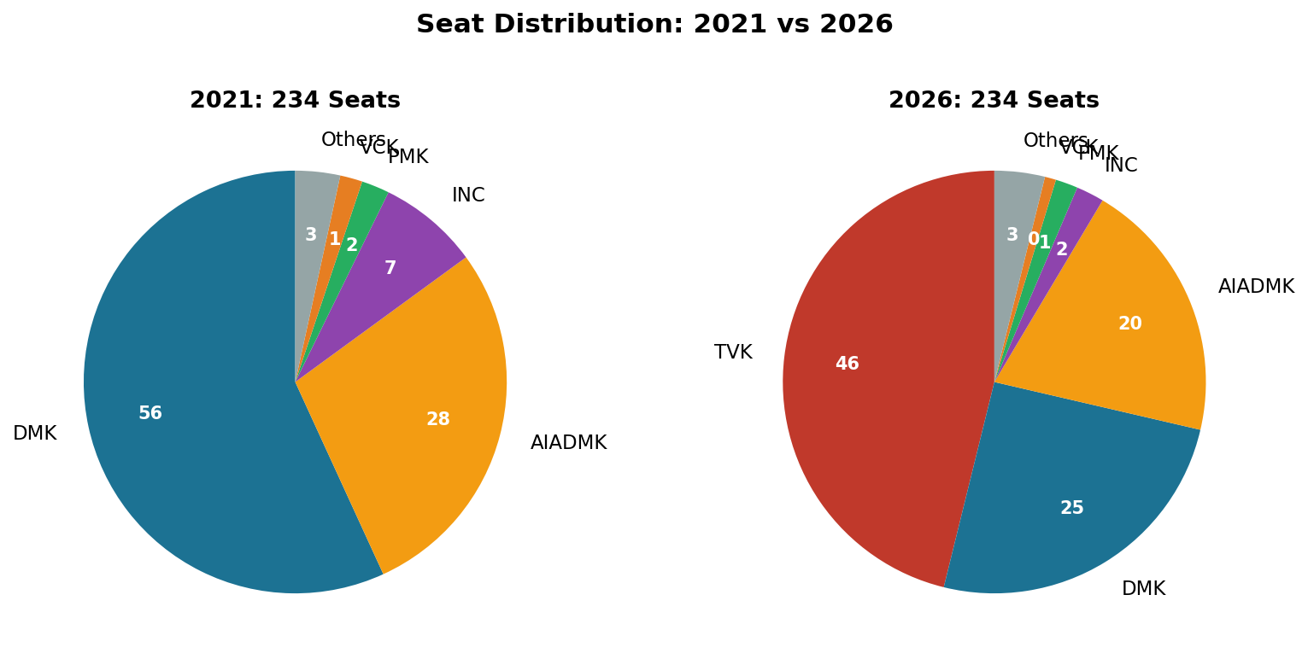
STORY 1 (CONTINUED) · SEAT TALLY
How 234 Seats Were Distributed
In 2021, DMK won 133 seats (57%) — in 2026, no single party crossed 50%. TVK won 108 seats (46%) as a first-time contestant.

Slide 4
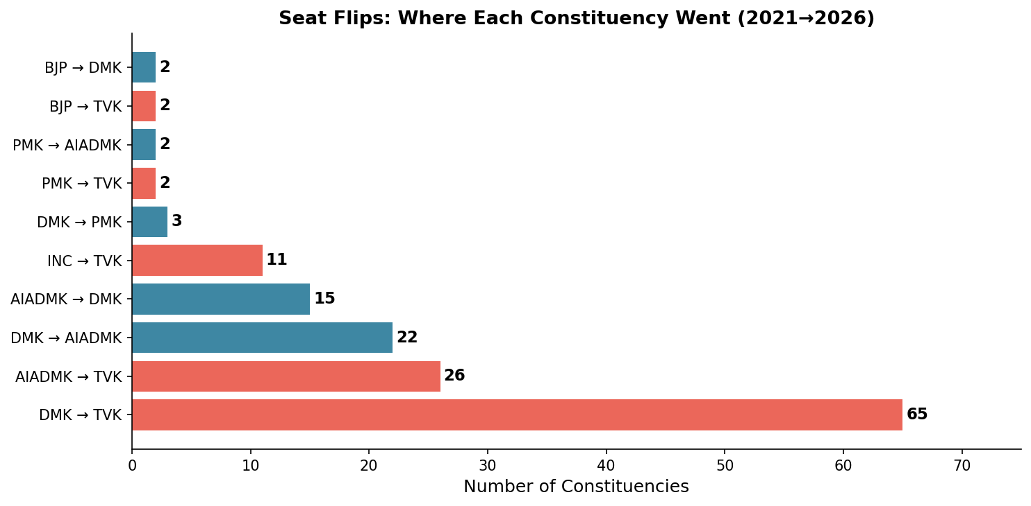
STORY 2 · THE GREAT FLIP
163 of 234 Seats Changed Hands
163
seats flipped
out of 234 (70%)
The biggest single flow: 65 constituencies that DMK held in 2021 flipped to TVK in 2026. AIADMK also lost 26 seats to TVK.

Slide 5
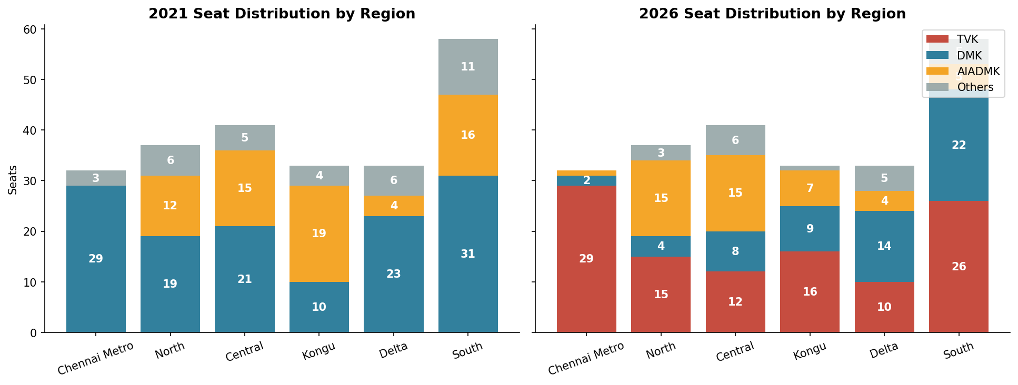
STORY 2 (CONTINUED) · GEOGRAPHY
TVK's Reach Was Statewide, Not Regional
TVK won seats in all 6 regions in its debut, with no single region dominating its tally — suggesting statewide reach rather than a regional base.

Slide 6
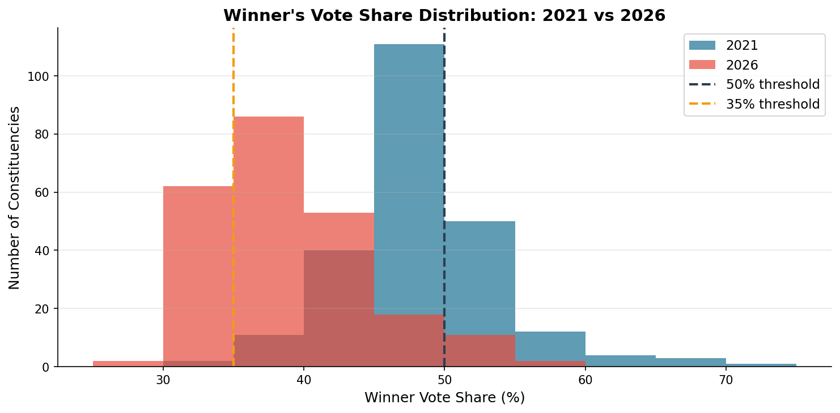
STORY 3 · THE CLOSER FIGHT
Winning Margins Shrank Across Tamil Nadu
Avg winning margin
Won with >50% of votes
Won with <35% of votes
2021: 22,871 votes
2021: 70 seats
2021: 2 seats
2026: 16,784 votes
2026: 13 seats
2026: 64 seats
−27% from 2021
−81% drop
+3,100% rise
Source: ECI Results Portal 2026, TCPD 2021

Slide 7
HOW THE THREE STORIES CONNECT
One Narrative Arc
1
2
3
TVK Entered
Three-way Race
Margins Collapsed
A new party won
34.9% vote share
and 108 seats
DMK + AIADMK + TVK
each took 20–35%
of votes
Avg margin dropped
27%; 64 seats decided
by <35% of votes
"A new entrant fractured a two-party system, turned 70% of seats over, and made victory margins the slimmest Tamil Nadu has seen in decades."

Slide 8
EDITORIAL INTEGRITY
What the Data Can and Cannot Tell Us
What the data shows
Seat counts, vote shares, margins, and constituency-level flips are directly from ECI data. All numbers are verifiable against the official results portal.
What the data cannot answer
Why voters chose as they did. Demographic breakdown of voters. Whether any pattern will continue in future elections. These questions require data the ECI does not publish.
Known limitations
2026 turnout column is blank in the source file — turnout figures used here come from ECI portal cross-checks. Pre-final Form 20 data may have minor vote-count adjustments after audit.

Slide 9
EDITORIAL RECOMMENDATION
For AtliQ Media's One-Hour Show
SEGMENT 1
0–15 min
The New Force
SEGMENT 2
15–35 min
The Great Flip
Open with the seat tally. Use the pie chart split. Three parties, 234 seats. Let the numbers anchor the conversation.
Walk through the flip bar chart. 163/234. DMK's 65-seat reversal. The regional breakdown shows TVK won everywhere.
SEGMENT 3
35–50 min
The Closer Fight
SEGMENT 4
50–60 min
What We Know / Don't Know
The margin collapse is the sleeper story. Show the histogram. 64 constituencies decided by under 35% of votes — nearly triple any prior election.
Close with the limitations slide. Neutral sign-off: the data shows what happened; it does not explain why.
All analysis is based solely on publicly available Election Commission of India data. This presentation does not endorse, criticise, or take any political position.

