Slide 1
Determining Key Molecular Descriptors Associated with the Blood-brain Barrier Entry of Chemical Compounds Using Machine Learning
Subhabrata (Subho) Majumdar
23 January, 2021

Slide 2
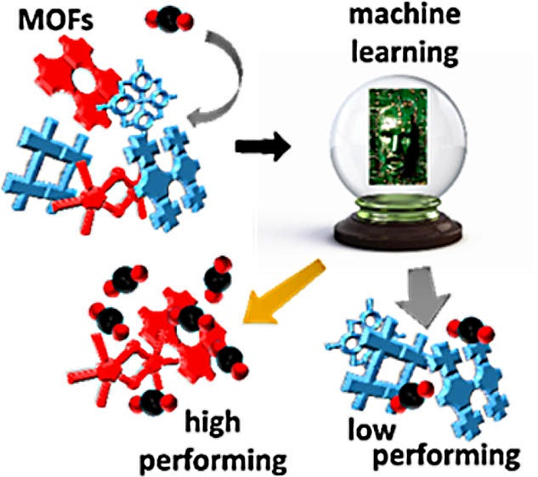
Motivation
Statistical methods and big data are widely used for materials science
Typically involves using many structural features to infer some property of a material
Computational screening of materials entails significant cost-savings
Source: Phys.org https://phys.org/news/2014-09-machine-algorithm-impossible-screening-advanced.html

Slide 3
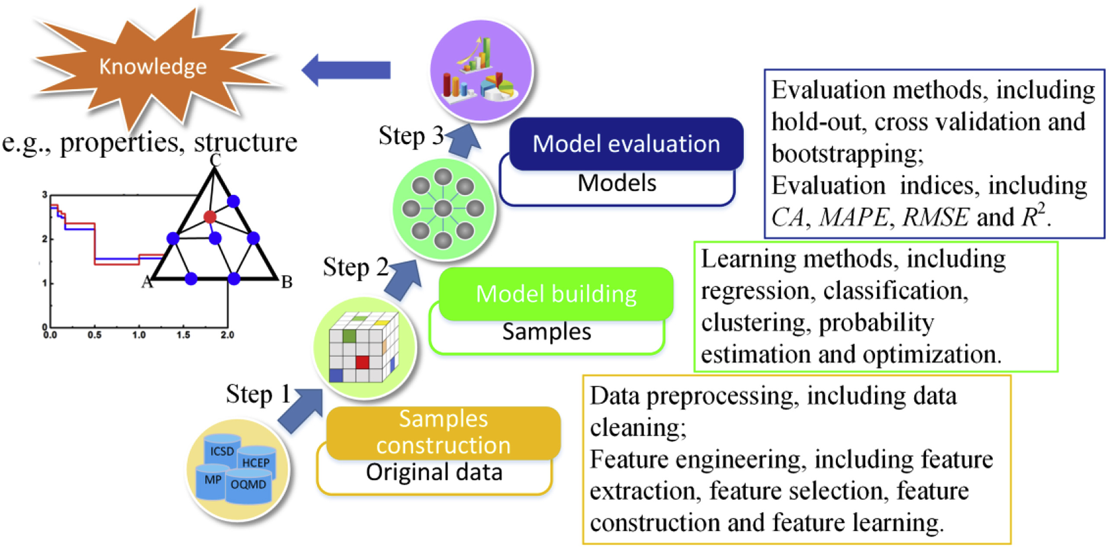
QSAR = Quantitative Structure Activity Relationship
The ‘materials’ we want to screen are chemical compounds that may be candidates for a certain medicine
Process is exactly the same: calculate descriptors of the compounds using software, measure their activity, then fit a model to predict activity of new compounds.
Source: Liu et al, Materials discovery and design using machine learning https://www.sciencedirect.com/science/article/pii/S2352847817300515

Slide 4
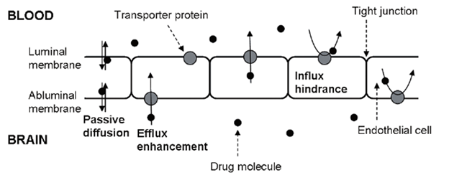
Blood-Brain Barrier
Blood-brain Barrier (BBB) comprises of endothelial cells and tight junctions between them which allow selective entry of solutes from the blood to the brain.
Selective entry of drugs to the brain is mediated by BBB
One quantifier of BBB entry is Brain-Blood ratio (BB), which is the ratio of the concentration of a chemical in the brain to its concentration in the blood.

Slide 5
Problem setup
We would like to build a model to predict BB ratio of chemical compounds
Sample: 415 compounds.
Structure: molecular descriptors calculated by POLLY, APProbe, Triplet, and TopoCluj softwares
Activity: BB Ratio values set at a certain threshold, so 0 below threshold, 1 otherwise. High value means the compound can penetrate BBB.
We specifically want to see that whether variable selection has any positive effect on prediction capability

Slide 6
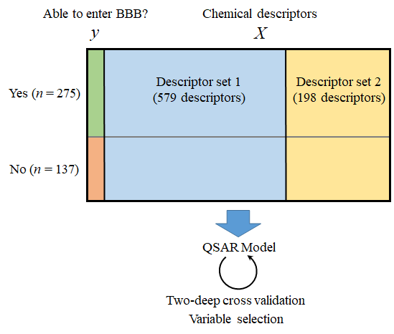
Problem setup

Slide 7
Descriptors
Set 1
Calculated and utilized by the Cluj team of Diudea and collaborators
Uses softwares Schrodinger and TopoCluj
579 descriptors
Set 2
Used frequently by Prof. Basak’s team
Calculated using the softwares POLLY and Triplet
198 descriptors

Slide 8
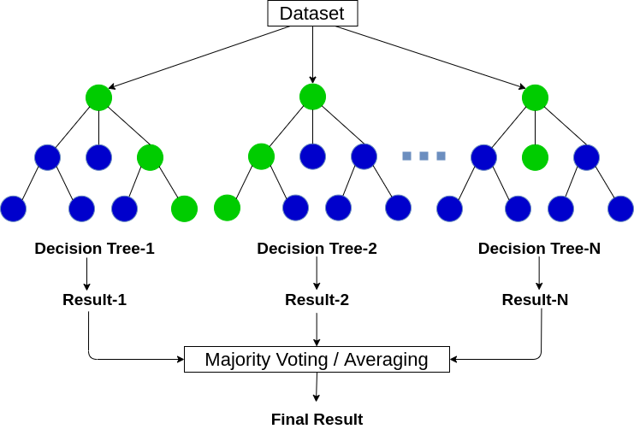
Method: Random Forest
Well-known machine learning method
Combines predictions from multiple decision trees to make final prediction
Has been proven effective in QSAR before
Source: Analytics Vidhya

Slide 9
Descriptors
Set 1
Calculated and utilized by the Cluj team of Diudea and collaborators
Uses softwares Schrodinger and TopoCluj
579 descriptors
Set 2
used frequently by Basak et al
calculated using the softwares POLLY and Triplet
198 descriptors

Slide 10
Variable importance and validation
We want to see that if we take the top most important variables in a model made with all variables (= full model), whether that improves model performance.
Since variable importance depends on the trained model, it changes based on training samples it is trained on, i.e. across different train-test splits of the data.
Thus a separate full model should be trained for each train-test split, and then perform retraining based on the top predictors from the trained model for that specific split.

Slide 11
Metrics
a) Area Under Curve (AUC): area covered under a Receiver Operating Characteric (ROC) curve that plots the precision and recall values from setting different thresholds to predicted probabilities
b) Top 20% lift: The lift metric evaluates performance of classification models at either extreme of the AUC, i.e. the accuracy of predictions with predicted probabilities close to 0 or 1. Specifically, the top x% lift denotes the percentage of positive samples captured by the top x% of predicted probabilities.
This is useful in QSAR situation where limited resources are available for further screening of chemicals, and the QSAR model is used to prioritize among a large number of sample compounds.
Suppose only 20% of our samples can be further screened, i.e. x = 20. To ensure that further screening is highly likely to produce a positive compound, we would like our predictive model to have a high top 20% lift value.
c) Sensitivity,
d) specificity,
e) accuracy,
f) Mathews correlation coefficient

Slide 12
Results
The IC-indices, are related to the overall heterogeneity of atomic neighborhoods in the molecular structure.
ANZ4, AZN4, ANZ5, and DN2N3 are triplet descriptors which encode information for the presence of multiple bonds and/or heteroatoms in the molecular architecture. These LOVIs may represent polarity/ polarizability in the molecules.
Polarity of molecules play important role in the prediction of BBB entry of molecules, and it is inversely correlated with the BBB permeability.
Basak lab
Variable | Importance | Variable | Importance
IC1 | 2.23 | IC4 | 1.32
IC2 | 1.90 | SIC3 | 1.27
ANZ4 | 1.58 | AZN4 | 1.22
SIC1 | 1.56 | ANZ5 | 1.21
DN2N3 | 1.54 | SIC2 | 1.20
Diudea lab
Variable | Importance | Variable | Importance
PSA | 2.51 | PEOE1 | 1.83
Sum.of.topological.distances.between.O..O | 2.35 | E.state | 1.66
E.state.topological.parameter | 2.20 | Superpendentic | 1.49
ALOGP3 | 2.06 | Topological.charge.index.of.order.5 | 1.31
Sum.of.topological.distances.between.N..O | 1.99 | PEOE12 | 1.28
Combined
Variable | Importance | Variable | Importance
Sum.of.topological.distances.between.O..O | 2.30 | E.state | 1.31
E.state.topological.parameter | 2.22 | Sum.of.topological.distances.between.N..O | 1.21
PSA | 1.56 | Molecular.electrotopological.variation | 1.12
Superpendentic | 1.44 | PEOE1 | 0.99
ALOGP3 | 1.37 | PEOE12 | 0.87

Slide 13
Results
Sum.of.topological.distances.between.O..O, E.state.topological.parameter and Sum.of.topological.distances.between.N..O are based on topological distance and detour, then on molecular graph fragmentation and collection of this information as fragmental property indices.
Such indices express the presence of heteroatoms, by atomic radii and Sanderson electronegativities, then converted in topological partial charges on the heavy atoms in the molecule.
ALOGP3 is a quantifier of hydrophobicity and so may aid in passage of chemicals through biological membranes.
Both polar surface area (PSA) and hydrophobicity calculated by the ClogP program have been found to be influential in the prediction of BBB entry of chemicals.
Basak lab
Variable | Importance | Variable | Importance
IC1 | 2.23 | IC4 | 1.32
IC2 | 1.90 | SIC3 | 1.27
ANZ4 | 1.58 | AZN4 | 1.22
SIC1 | 1.56 | ANZ5 | 1.21
DN2N3 | 1.54 | SIC2 | 1.20
Diudea lab
Variable | Importance | Variable | Importance
PSA | 2.51 | PEOE1 | 1.83
Sum.of.topological.distances.between.O..O | 2.35 | E.state | 1.66
E.state.topological.parameter | 2.20 | Superpendentic | 1.49
ALOGP3 | 2.06 | Topological.charge.index.of.order.5 | 1.31
Sum.of.topological.distances.between.N..O | 1.99 | PEOE12 | 1.28
Combined
Variable | Importance | Variable | Importance
Sum.of.topological.distances.between.O..O | 2.30 | E.state | 1.31
E.state.topological.parameter | 2.22 | Sum.of.topological.distances.between.N..O | 1.21
PSA | 1.56 | Molecular.electrotopological.variation | 1.12
Superpendentic | 1.44 | PEOE1 | 0.99
ALOGP3 | 1.37 | PEOE12 | 0.87

Slide 14
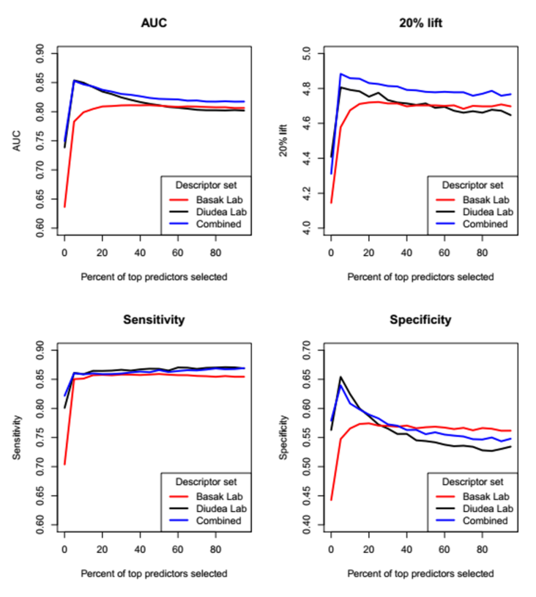
Validation
Two sets of descriptors behave very differently in the prediction curves.
For the Diudea set, the top 5% descriptors are extremely predictive, and the variable selection approach actually manages to give a better-performing model than the full
On the other hand, models corresponding the Basak set of descriptors perform more or less similarly for % top predictors

Slide 15
Discussion
We demonstrate the importance of parsimonious models, i.e. sometimes less is more!
But need to select top descriptors, i.e. which are most effective.
Variable selection is a general technique, so can be applicable to many computational problems in materials science
Further studies on where and how variable selection is effective, and the comparison of resulting models with full models is warranted.

Slide 16
THANK YOU!!

