Slide 1
Identifying Driving Factors Behind Indian Monsoon Precipitation using Model Selection based on Data Depth
Subhabrata Majumdar
Lindsey Dietz
Snigdhansu Chatterjee
University of Minnesota, School of Statistics

Slide 2
Outline
Introduction
Methods
Data and implementation
Results
Future work

Slide 3
Introduction: the problem
Previous studies on Indian Monsoon precipitations have highlighted importance of using random effects in modelling (Dietz and Chatterjee, 2014 and 2015);
No study has been done to collectively identify important factor influencing precipitation levels, i.e. model selection in this scenario;
The reasons are non-robustness of likelihood based methods, strict assumptions of conventional methods of model selection, potentially heteroskedastic error structure

Slide 4
Introduction: our solution
We introduce a novel one-step model selection technique for general regression estimators, and implement it in a linear mixed model setup to identify important predictors affecting Indian Monsoon precipitation;
This technique correctly identifies the set of non-zero values in the true coefficient (of length p) by comparing only p + 1 models.
Wild bootstrap used to estimate the selection criterion;
Rolling validation done for 10 testing years for comparison of full and reduced models

Slide 5

Methods: Data depth
The depth of a point $x∈ℝ^{p}$, is any scalar measure of its centrality with respect to a data cloud $X$ (or equivalently the underlying distribution F) (Zuo and Serfling, 2000)

Slide 6
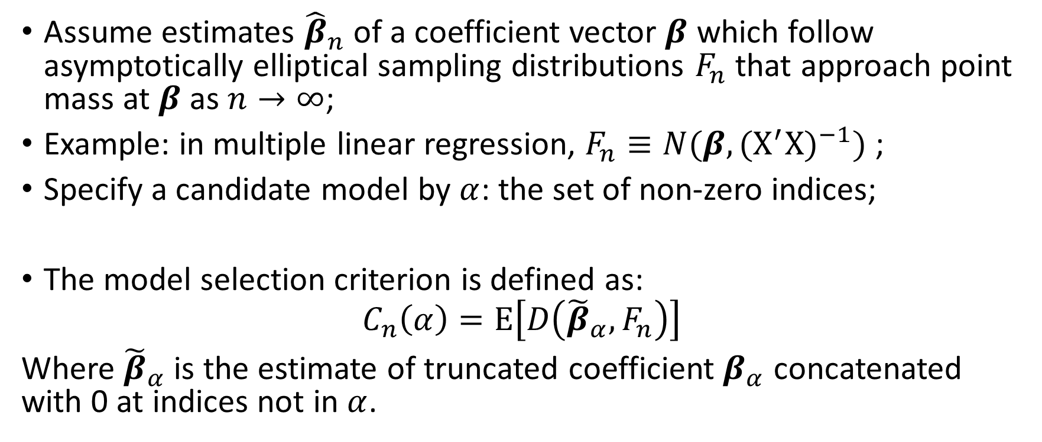
Depth-based model selection
Assume estimates ${\hat{β}}_{n}$ of a coefficient vector $β$ which follow asymptotically elliptical sampling distributions $F_{n}$ that approach point mass at $β$ as $n→∞$;
Example: in multiple linear regression, $F_{n}≡N(β,{(X^{′}X)}^{−1})$ ;
Specify a candidate model by $α$: the set of non-zero indices;
The model selection criterion is defined as:
$$C_{n}\left(α\right)=E\left[D\left({\tilde{β}}_{α},F_{n}\right)\right]$$
Where ${\tilde{β}}_{α}$ is the estimate of truncated coefficient $β_{α}$ concatenated with 0 at indices not in $α$.

Slide 7
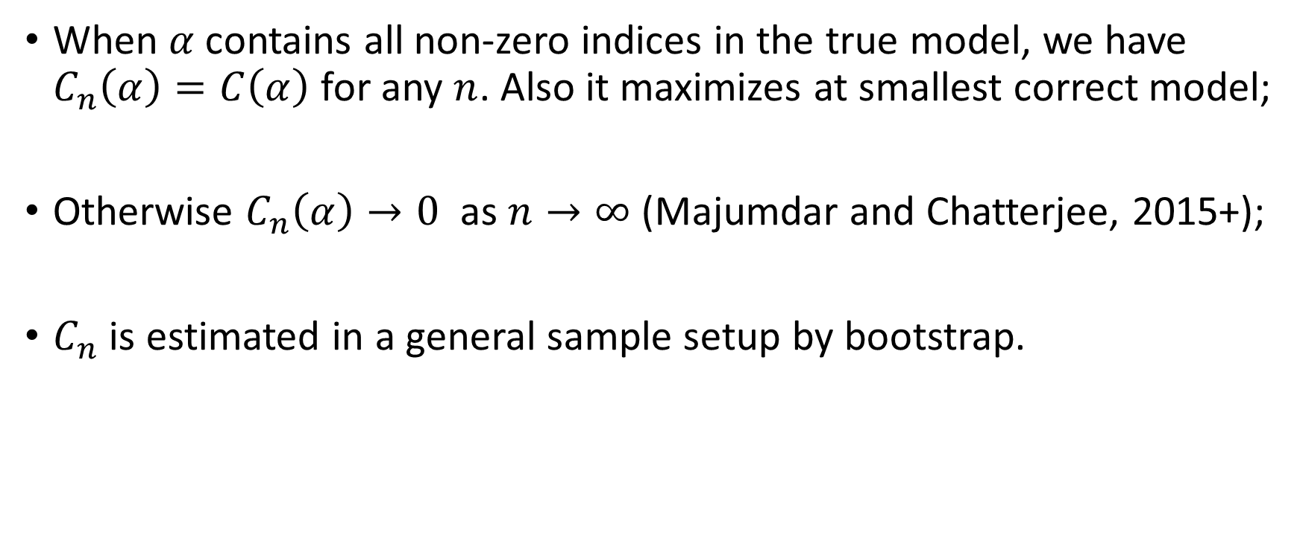
Depth-based model selection
When $α$contains all non-zero indices in the true model, we have $C_{n}\left(α\right)=C\left(α\right)$ for any $n$. Also it maximizes at smallest correct model;
Otherwise $C_{n}\left(α\right)→0$ as $n→∞$ (Majumdar and Chatterjee, 2015+);
$C_{n}$ is estimated in a general sample setup by bootstrap.

Slide 8
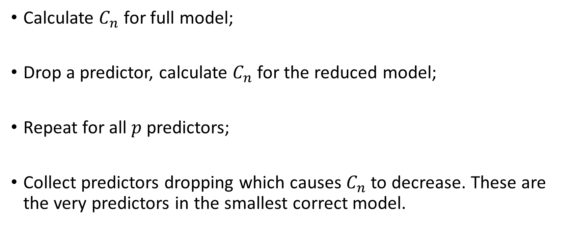

One-step model selection using $C_{n}$
Calculate $C_{n}$ for full model;
Drop a predictor, calculate $C_{n}$ for the reduced model;
Repeat for all $p$ predictors;
Collect predictors dropping which causes $C_{n}$ to decrease. These are the very predictors in the smallest correct model.

Slide 9
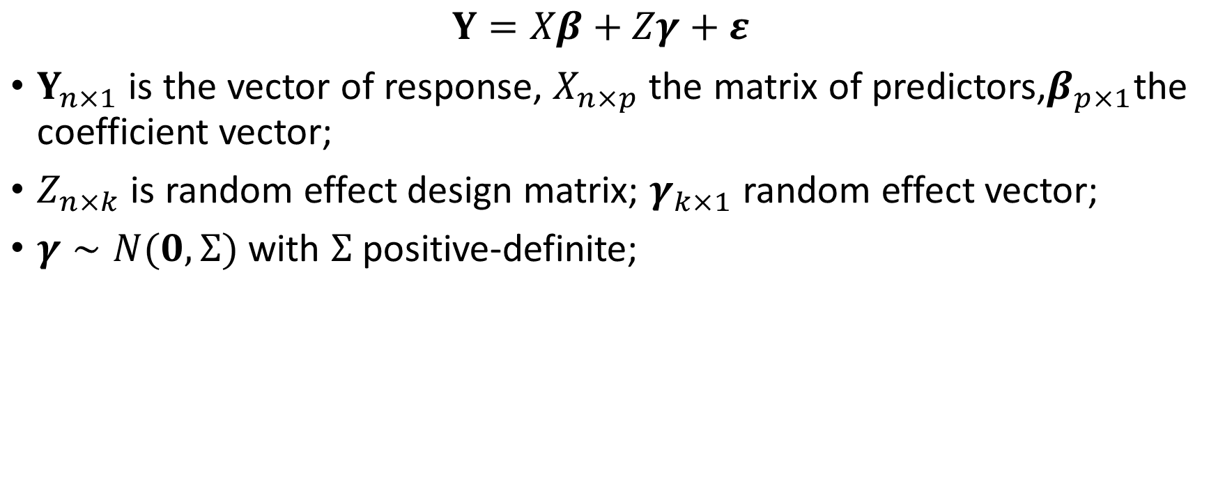
Methods: Linear Mixed Model
$$Y=Xβ+Zγ+ε$$
$Y_{n×1}$ is the vector of response, $X_{n×p}$ the matrix of predictors,$β_{p×1}$the coefficient vector;
$Z_{n×k}$ is random effect design matrix; $γ_{k×1}$ random effect vector;
$γ∼N(0,Σ)$ with $Σ$ positive-definite;

Slide 10
Data
Daily rainfall levels from 36 weather stations during 1978-2012;
Station-specific variables: latitude, longitude and elevation;
Local variables: max and min temperature, tropospheric temperature difference, u- and v- winds at 200, 600 and 850 mb, Nino 3.4 anomaly and Indian Dipole Mode Index (DMI);
Global variables: 10 indices of Madden-Julian Oscillation (MJO), 9 northern hemisphere teleconnection indices, solar flux levels and land-ocean Temperature Anomaly (TA);
Total 35 predictors

Slide 11
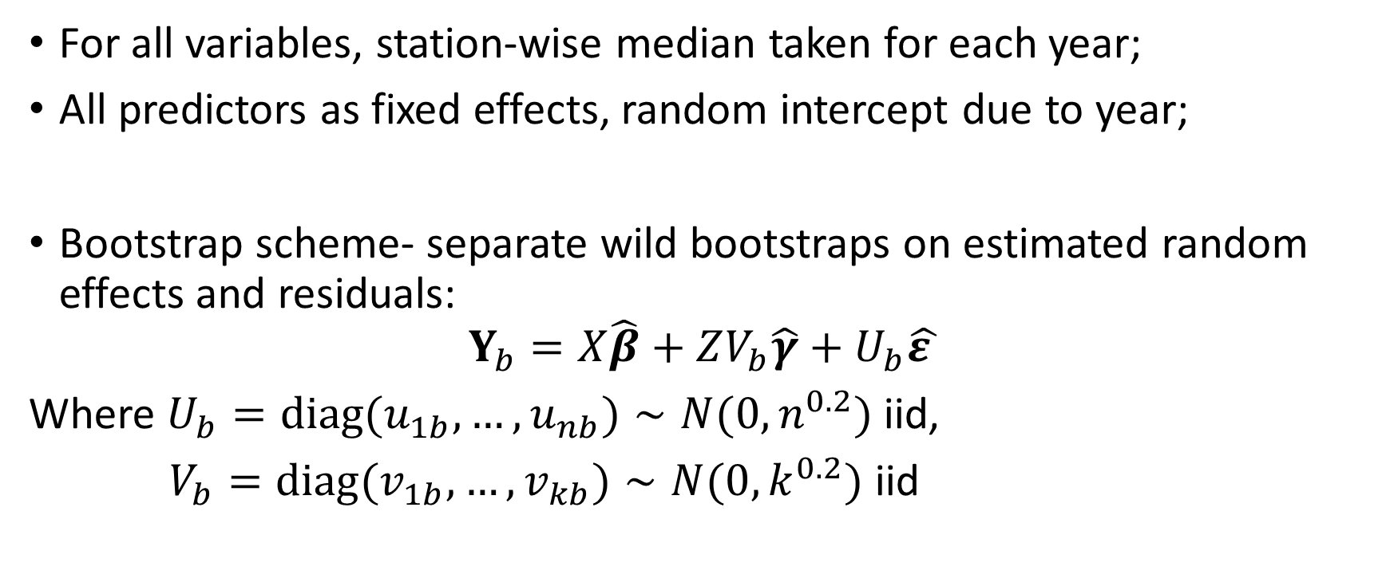
Implementation
For all variables, station-wise median taken for each year;
All predictors as fixed effects, random intercept due to year;
Bootstrap scheme- separate wild bootstraps on estimated random effects and residuals:
$$Y_{b}=X\hat{β}+ZV_{b}\hat{γ}+U_{b}\hat{ε }$$
Where $U_{b}=diag(u_{1b},…,u_{nb})∼N(0,n^{0.2})$ iid,
$V_{b}=diag(v_{1b},…,v_{kb})∼N(0,k^{0.2})$ iid

Slide 12
Results
Among 35 predictors considered, 21 get selected by our model selection procedure;
All selected variables have documented effect on Indian Monsoon, e.g. elevation, longitude, max temperature, Nino3.4 etc;
Temperature Anomaly (TA) has a large influence: several MJO indices are selected when we start from a full model with everything but TA, but get masked and are dropped in favor of TA when it is in the full model

Slide 13
Prediction
Testing years 2003 to 2012
25 year rolling validation scheme: train using past 25 yrs data (e.g. 1978-2002 for 2003, 1979-22003 for 2004, …);
Reduced models predictions have less bias across training years compared to full model predictions, as well as less mean squared error (MSE);

Slide 14
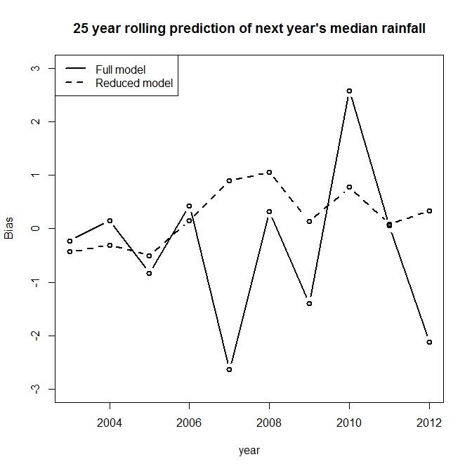
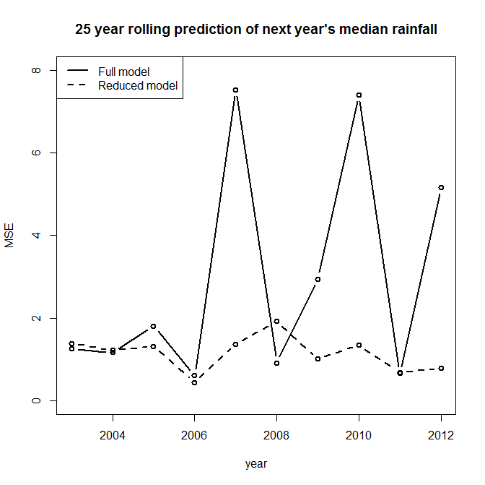
Bias comparison
MSE comparison

Slide 15
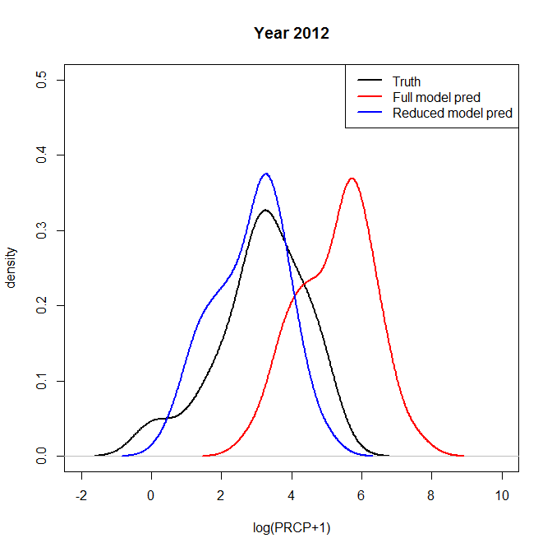
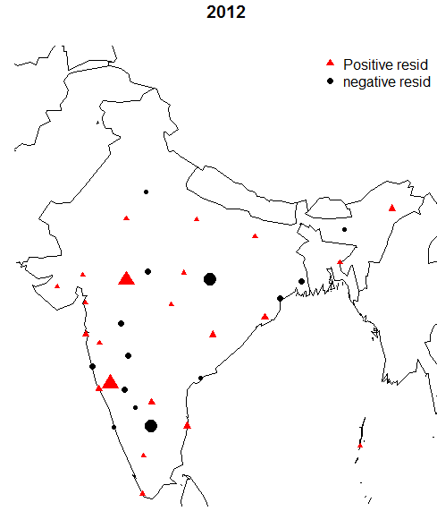
2012 predictions

Slide 16
Future work
Investigating spatio-temporal dependency patterns;
Detailed studies into algorithmic efficiency issues and different bootstrap schemes;
Further development of theoretical properties of the proposed model selection tool

Slide 17
References
L. R. Dietz and S. Chatterjee, “Logit-normal mixed model for Indian monsoon precipitation,” Nonlin. Processes Geophys., vol. 21, pp. 939–953, sep 2014;
L. R. Dietz and S. Chatterjee, “Investigation of Precipitation Thresholds in the Indian Monsoon Using Logit-Normal Mixed Models,” in Machine Learning and Data Mining Approaches to Climate Science: Proceedings of the Fourth International Workshop on Climate Informatics (V. Lakshmanan, E. Gilleland, A. McGovern, and M. Tingley, eds.), pp. 239–246, Springer, 2015;
Y. Zuo and R. Serfling, “General notions of statistical depth function,” Ann. of Statist., vol. 28-2, pp. 461–482, 2000;
S. Majumdar and S. Chatterjee, “A model selection criterion for regression estimators based on data depth.” Working paper, 2015+.

