Slide 1
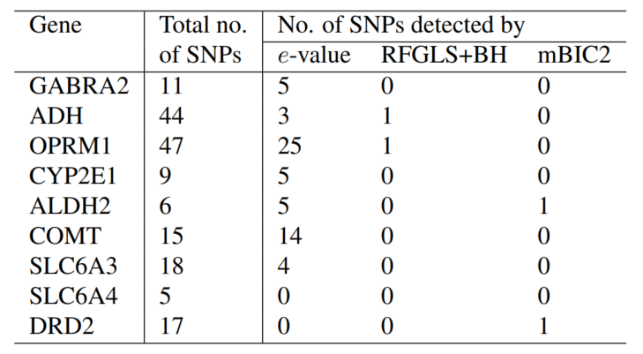
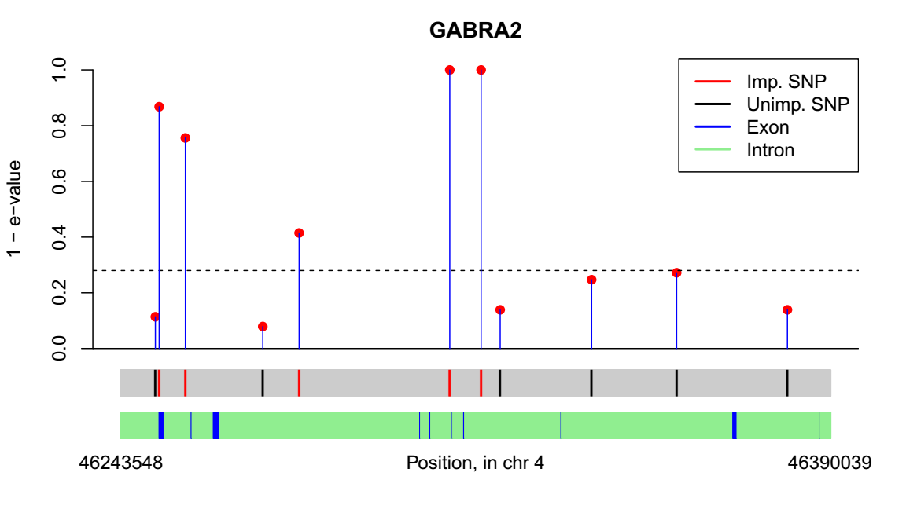
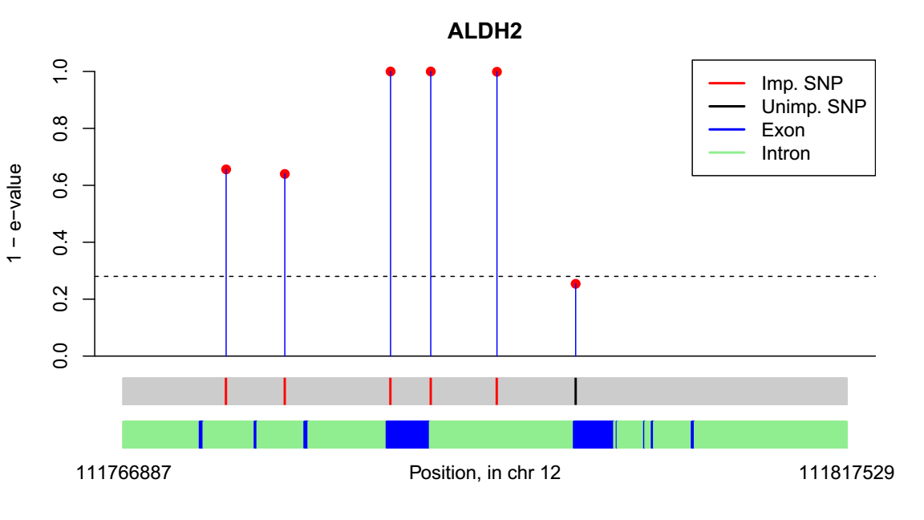
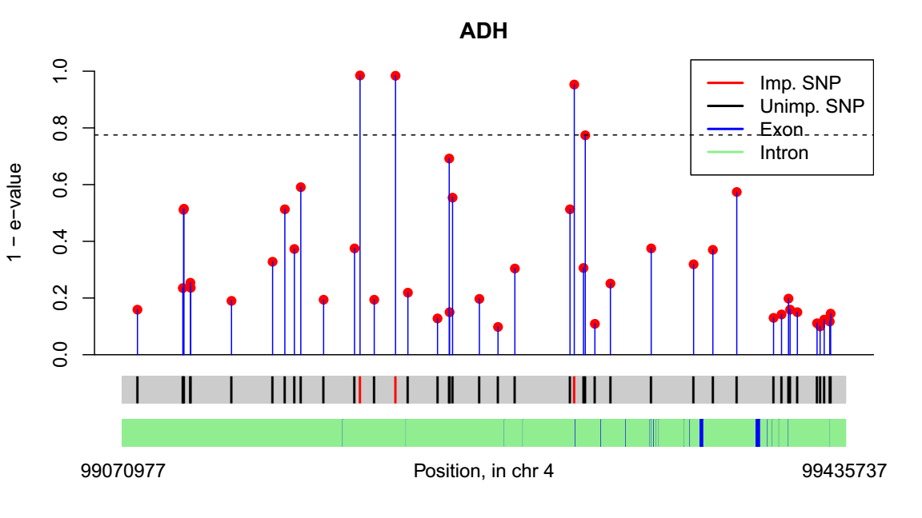
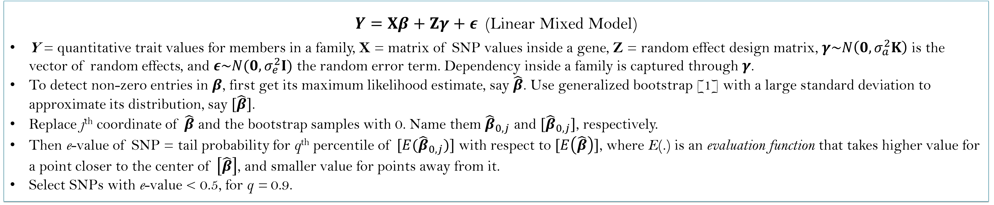
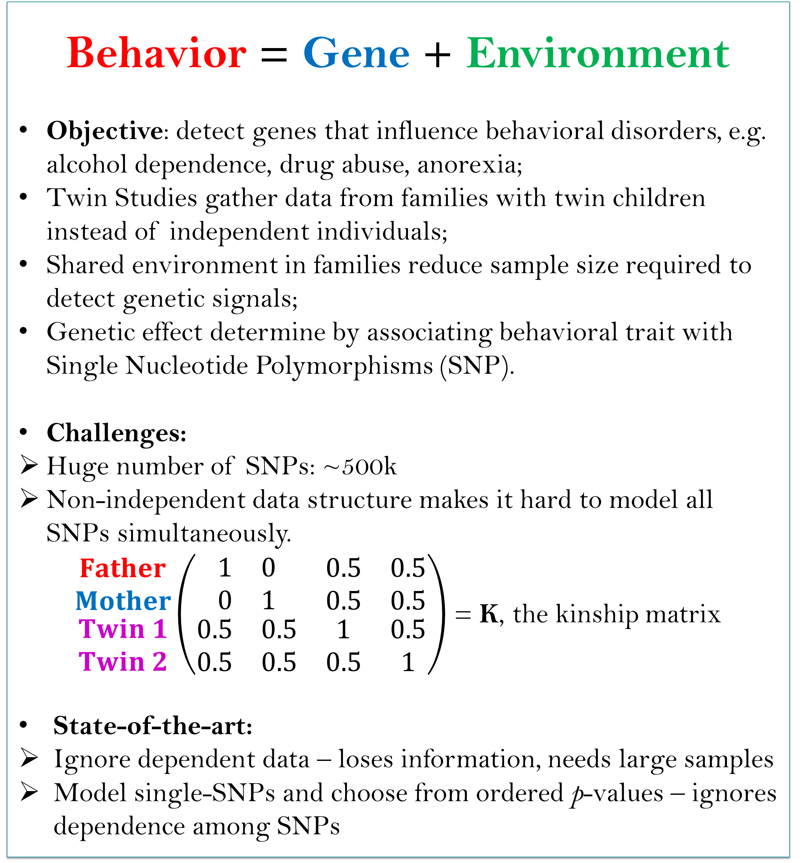
Simultaneous Selection of Multiple Important Single Nucleotide
Polymorphisms in Familial Genome Wide Association Studies Data
Subhabrata Majumdar, Saonli Basu, Snigdhansu Chatterjee, Matt McGue
University of Minnesota Twin Cities
Twin Studies: What and Why
Statistical model
Behavior = Gene + Environment
Objective: detect genes that influence behavioral disorders, e.g. alcohol dependence, drug abuse, anorexia;
Twin Studies gather data from families with twin children instead of independent individuals;
Shared environment in families reduce sample size required to detect genetic signals;
Genetic effect determine by associating behavioral trait with Single Nucleotide Polymorphisms (SNP).
Challenges:
Huge number of SNPs: ~500k
Non-independent data structure makes it hard to model all SNPs simultaneously.
$\begin{matrix}\begin{matrix}Father \\ Mother\end{matrix} \\ \begin{matrix}Twin 1 \\ Twin 2\end{matrix}\end{matrix}\left(\begin{matrix}\begin{matrix}1 & 0 \\ 0 & 1\end{matrix} & \begin{matrix}0.5 & 0.5 \\ 0.5 & 0.5\end{matrix} \\ \begin{matrix}0.5 & 0.5 \\ 0.5 & 0.5\end{matrix} & \begin{matrix}1 & 0.5 \\ 0.5 & 1\end{matrix}\end{matrix}\right)$ = K, the kinship matrix
State-of-the-art:
Ignore dependent data – loses information, needs large samples
Model single-SNPs and choose from ordered p-values – ignores dependence among SNPs
$Y=Xβ+Zγ+ε$ (Linear Mixed Model)
Y = quantitative trait values for members in a family, X = matrix of SNP values inside a gene, Z = random effect design matrix, $γ\sim N\left(0,σ_{a}^{2}K\right)$ is the vector of random effects, and $ε\sim N(0,σ_{e}^{2}I)$ the random error term. Dependency inside a family is captured through $γ$.
To detect non-zero entries in $β$, first get its maximum likelihood estimate, say $\hat{β}$. Use generalized bootstrap [1] with a large standard deviation to approximate its distribution, say $[\hat{β}]$.
Replace j^{th} coordinate of $\hat{β}$ and the bootstrap samples with 0. Name them ${\hat{β}}_{0,j}$ and $[{\hat{β}}_{0,j}]$, respectively.
Then e-value of SNP = tail probability for q^{th} percentile of $[E({\hat{β}}_{0,j})]$ with respect to $[E\left(\hat{β}\right)]$, where E(.) is an evaluation function that takes higher value for a point closer to the center of $\left[\hat{β}\right]$, and smaller value for points away from it.
Select SNPs with e-value < 0.5, for q = 0.9.
Results
Competing methods
RFGLS: Combines single-SNP p-values---from a mixed effect model---using the Benjamini-Hochberg procedure [3].
mBIC2: model selection using a version of BIC---ignores familial structure [2].
Genome-wide Twin Studies application
Data from the Minnesota Center for Twin and Family Research (MCTFR) Genome-Wide Association Study sample: 7188 individuals, 527,893 SNP markers [4]. Response variable is amount of alcohol consumption, consider 9 widely studied genes known to be associated with alcohol consumption.
Move over p-values!
Say we want to detect which of 100 SNPs in a gene are significant.
p-values:
Start with model with no SNPs (null model);
Add an SNP, get p-value with respect to null model;
Repeat for all SNPs. Select SNPs with low p-values.
Bad:
Ignores dependence of SNPs;
Cannot detect weak signals: often the case in SNP studies
Our solution: e-values.
Start from model with all SNPs: takes care of correlation of SNPs;
Fix a SNP effect to 0 in the model, get e-value with respect to full model by comparing two model distributions: this helps detect weak SNP effects.
GABRA2
5 of 11 SNPs have non-zero effect: 4 very close to exons. The SNPs rs1808851, rs279856 are at perfect linkage disequilibrium with rs279858, a known associated SNP.
(2) ALDH2
5 of 6 tested SNPs have effect: rs7398343, rs7297186, rs3803167, rs10219736, rs3742004. Importantly all of them overlap with/ very close to coding regions.
(3) ADH1 to ADH7 genes
6 of 21 tested SNPs have e-values above threshold. Previously detected rs1229984 is in between two of them. First two are possibly novel: in the uncharacterized gene LOC100507053.
References:
[1] Chatterjee, S. and Bose, A. Ann. Statist. 2005, 33, 414-436.
[2] Frommelet, F. et al, Comput. Stat. Data Anal., 2012, 56, 1038–1051.
[3] Li, X. and others, Hum. Hered. 2011, 71, 67–82.
[4] McGue et al, Behav. Genet. 2013, 43, doi:10.1007/s10519-013-9606-x.
Main paper available at: https://arxiv.org/abs/1802.01141

