Slide 1




PARTICIPANT PRESENTATION
Participant Details
Qiskit
Fall Fest
2026
PROJECT TITLE
QuDock: quantum kernels for Alzheimer's drug screening (BACE-1)
TRACK
Quantum ML for drug discovery
TEAM NAME
BlackOut (VTU-QFF-HC-0140)
TEAM LEADER
Shubhodeep Chatterjee
EMAIL / CONTACT
shubhodeepcx@gmail.com
Hackathon · Team Details
TEAM MEMBERS
Shubhodeep Chatterjee, Srijita Banerjee, Rounak Pal
INSTITUTION / ORGANISATION
Techno India University, Kolkata
COUNTRY
India

Slide 2
Problem Statement
THE PROBLEM
Screening is slow and costly: drug discovery tests thousands of molecules to find the few that block a target protein.
Labels are scarce: lab-measured activity is expensive, so models must learn from few examples.
Untested claims: quantum kernels are said to learn more from less data, but are rarely checked against tuned classical models, realistic splits or real hardware noise.
Our question
Can a quantum kernel find BACE-1 inhibitors better than classical ML when data is scarce and hardware is noisy?
1,513
BACE molecules, labelled inhibitor or not
BACE-1
key enzyme behind amyloid plaques in Alzheimer's

Slide 3
Objectives & Novelty
OBJECTIVES
1. Build an open, reproducible quantum kernel pipeline for BACE-1 inhibitor prediction.
2. Compare it fairly with SVM-RBF, Random Forest and Logistic Regression on identical features.
3. Test the small-data claim (25 to 1,210 molecules) and scaling (2 to 10 qubits).
4. Measure how noise affects the kernel, in simulation and on a real IBM quantum computer.
WHAT IS NEW
Realistic split: scaffold split, so test molecules come from unseen chemical families.
Real statistics: multiple seeds and paired Wilcoxon tests, not a single lucky run.
Kernel diagnostics: geometric difference, label alignment and concentration.
Hardware check: simulation compared with ibm_marrakesh, which caught a flaw in our own noise study.

Slide 4
Solution & Quantum Advantage
DATA
1,513 BACE molecules, scaffold split
FEATURES
ECFP4 fingerprint, PCA to one angle per qubit
QUANTUM
ZZ feature map, fidelity kernel
MODEL
Kernel SVM (QSVC) vs 3 classical models
→
→
→
HOW IT WORKS
Each molecule is compressed to a few angles and loaded into a ZZ feature map circuit.
Kernel: k(x, y) = |⟨φ(x)|φ(y)⟩|², the overlap of two molecules' quantum states.
An SVM learns on this kernel; classical models get exactly the same features.
WHERE QUANTUM COULD HELP
Hard to simulate: entangling feature maps become infeasible to compute classically as qubits grow.
A different view of the data: geometric difference vs RBF up to about 100.
Better label alignment: 0.15 to 0.18 vs 0.09 to 0.10 for RBF.

Slide 5
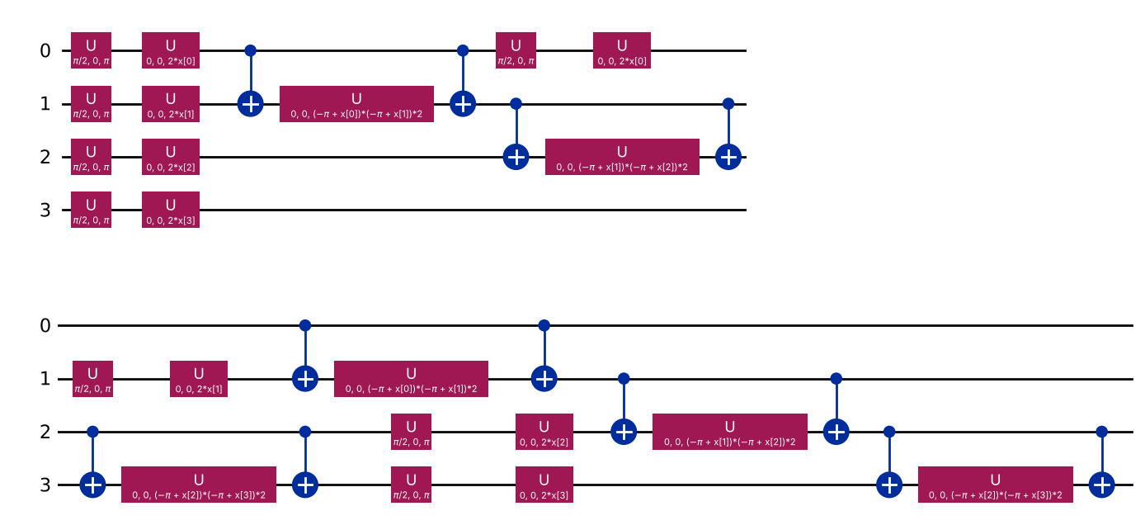
Algorithm & Circuit Design
Encode: ECFP4 (2048 bits), standardise, PCA to n values, scale to [0, π].
Feature map: Hadamard + Z rotations, ZZ entanglers between neighbours; bandwidth tuned.
Kernel: compute-uncompute circuit; k = probability of all zeros. Exact statevector for benchmarks, shots for noise and hardware.
Classifier: SVM on the precomputed kernel; C and bandwidth by inner cross-validation.
ZZFeatureMap, 4 qubits, reps = 2, linear entanglement (Qiskit)

Slide 6
Implementation & Tech Stack
PIPELINE MODULES (SRC/QUDOCK)
data / features: BACE download, cleaning, scaffold split, fingerprints, PCA
quantum / classical: ZZ fidelity kernel + QSVC; SVM-RBF, RF, LogReg
benchmark / sweep / analysis: learning curves, qubit sweep, kernel diagnostics, Wilcoxon tests
noise / hardware: shot-based kernels on FakeTorino and on a real IBM device
cli: qudock benchmark | sweep | noise | hardware
TECH STACK
Qiskit 2.6
Qiskit Aer
Qiskit IBM Runtime
Qiskit ML
RDKit
scikit-learn
NumPy / pandas
Matplotlib
pytest + ruff
GitHub Actions CI
Docker
JupyterLab
Pinned versions, unit tests and CI on every push. Runs on a laptop; hardware run on IBM Quantum open plan.

Slide 7
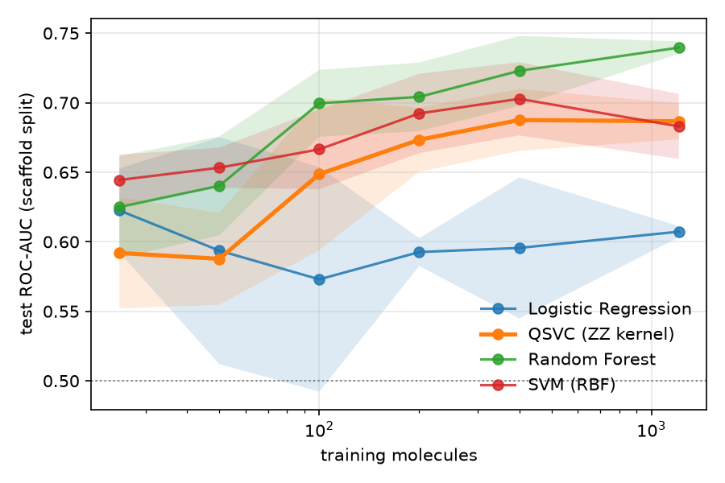
Results: Quantum vs Classical
Sample efficiency (6 qubits, 5 seeds): at 1,210 molecules QSVC 0.687 ROC-AUC vs Random Forest 0.740.
No small-data edge: with 25 to 50 molecules QSVC is the weakest model (0.59).
Qubit sweep: QSVC best at 8 qubits (0.719), above SVM-RBF (0.705), below RF (0.729).
Concentration: kernel variance falls from 0.075 (2 qubits) to 0.005 (10 qubits).
Verdict: competitive with RBF SVM, not better than RF; gaps not significant (p ≥ 0.06).

Slide 8
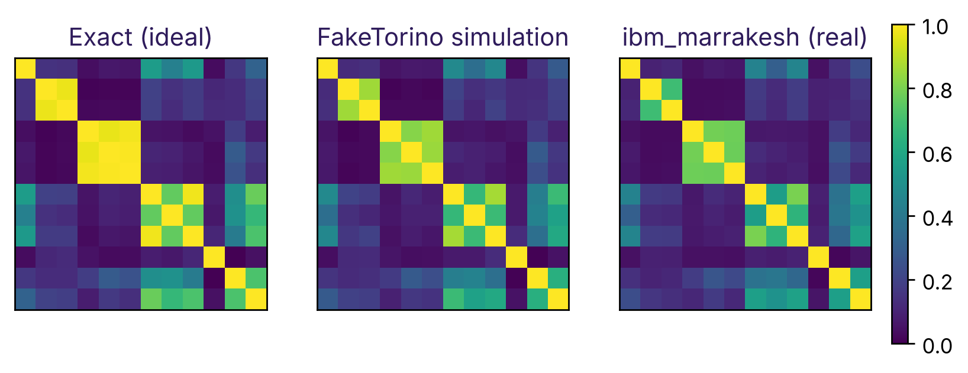
Results: Noise & Real Hardware
Simulated IBM Torino: device noise gives 8 to 13% kernel error (shots alone 1.4 to 6.4%).
Accuracy holds: test ROC-AUC stays 0.62 to 0.66 in every noise setting.
Real ibm_marrakesh: 66 circuits, 1,024 shots, 20 s of quantum time.
Kernel error: 17.5% on hardware vs 10.3% simulated, yet correlation with ideal is 0.996.
Why it works: noise shrinks all values a little, so the ranking of molecules survives.
Kernel for 12 molecules (6 inhibitors first): ideal, simulated and measured on ibm_marrakesh

Slide 9
Impact & Real-World Applications
Drug discovery
Shows when quantum ML is worth trying for virtual screening, and when a Random Forest is still the better tool.
Works for any target with SMILES and activity labels.
Quantum ML research
A fair benchmark template: same features, scaffold split, seeds, significance tests.
Real-hardware evidence that kernel rankings survive noise.
Open science
All code, results and a demo notebook are public.
Runs on a laptop in minutes; the hardware run fits in 20 s of free IBM time.
An honest negative result is useful: it tells researchers where quantum kernels need to improve before they help real drug pipelines.

Slide 10
Challenges & Future Scope
CHALLENGES WE HIT
Crashes on Linux: Qiskit Aer and the Rust transpiler ran out of TLS and stack; fixed with GLIBC_TUNABLES and RUST_MIN_STACK in CI and Docker.
Wrong noise numbers: our first study used a poor qubit layout (25 to 28% error); the real device exposed it, and a corrected run gives 8 to 13%.
Limited quantum time: free plan minutes, so the hardware run uses 12 molecules in one job.
Kernel concentration: values bunch together as qubits grow.
FUTURE SCOPE
Trainable and projected quantum kernels to fight concentration.
Error mitigation (readout, ZNE) and a full QSVC trained on hardware kernels.
More targets from MoleculeNet and richer molecular features.
More seeds and molecules for statistically significant comparisons.

Slide 11
CLOSING
Thank You
Questions?
Inspiring Minds. Shaping Tomorrow.
GITHUB REPOSITORY
github.com/vtu-qiskit-fall-fest-2026/vtu-hc-blackout
DEMO VIDEO LINK
drive.google.com/file/d/17vJ5pzTXjhN4cXxzwQyV3GzaghxDYzhk
LIVE WEB APP
qudock-blackout.streamlit.app

