Slide 1
Incorporating User Feedback into Active Anomaly Discovery
Shubhomoy Das, Weng-Keen Wong, Thomas Dietterich, Alan Fern, and Andrew Emmott
Oregon State University

Slide 2


Introduction
$$?$$
Anomaly
A data instance generated by a different process than the process generating the nominal data
Outlier
A data instance that has low likelihood according to a model
$$=$$
Get expert feedback to make outliers more in line with expert’s idea of an anomaly
Notes:
To understand why we need feedback in anomaly detection, we need to distinguish between two concepts:
Anomaly: These are defined as …
Outlier: These defined as …
Not all outliers are anomalies. But algorithms are good at detecting outliers. If there is a semantic misalignment between what the expert considers an anomaly and what the algorithm considers an outlier, then the algorithm could have so many false positives that it becomes impractical for the expert to analyze.

Slide 3

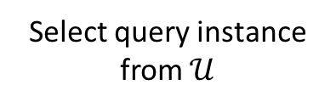
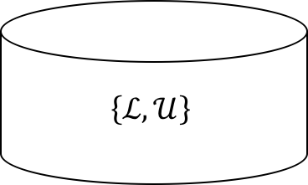
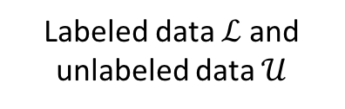

Active Anomaly Discovery (AAD)
Labeled data $ℒ$ and unlabeled data $𝒰$
$$\left\{ℒ,𝒰\right\}$$
Train with $\left\{ℒ,𝒰\right\}$
Learner
Maximize the number of true anomalies presented to the user.
Continue loop until budget expires
Select query instance from $𝒰$
<x,y=A/N>
<x,?>
query
user
Notes:
The feedback cycle we consider in our work is this: We have a training set {L, U} where the vast majority are unlabeled and a few (possibly none) are labeled. We train a learner to assign anomaly scores to all instances. The learner then selects one unlabeled instance and presents to the user to label. The user labels it A/N and it gets added to the train set as a labeled instance. The loop repeats until a budget expires. The goal is to maximize the number of true anomalies presented to the user.
This is very similar to the traditional Active Learning cycle; however, there’s a subtle difference: AL uses feedback to train algorithms to *generalize* to unseen examples (test set / hold out set). However in our context, we consider this to be a data exploration tool that only aims to maximize the number of real anomalies presented to the end user; we do not try to improve performance over unseen data.

Slide 4
Related Work
Active learning
Rare category Detection
Learning to Rank
Notes:
Our work is related to the following:
[skip this as already explained in prev. slide] Active Learning uses feedback to train algorithms to *generalize* to unseen examples (test set). However, our algorithm is a data exploration tool that only aims to maximize the number of real anomalies presented to the end user.
RCD asks users to group unusual (under current model) instances into existing classes or create new classes for groups of anomalies. Whereas we ask for a much simpler anomaly/nominal feedback. Works well when anomalies are clustered, but performs badly for scattered anomalies.
Learning to Rank tries to impose a total or partial ordering over instances. Whereas we only want to assign higher scores to true anomalies than nominal instances. Ranks among anomaly instances and among nominal instances are irrelevant.
Ensembles of anomaly detectors
Ensembles of anomaly detectors use no feedback. Whereas we learn the optimal weights for combining scores from detectors in an ensemble.

Slide 5
Baseline Algorithm: Random Projections
Loda: Lightweight online detector of anomalies [Pevny 2015]
$Score\left(x\right)= \frac{1}{m}[z_{1}\left(x\right)+z_{2}\left(x\right)+⋯+z_{m}(x)$]
m
projection vectors
…
Uniform weights
x
Negative log pdf value for a 1D histogram formed by a sparse random projection of x
$NewScore\left(x\right)=w∙z\left(x\right)$, where $z\left(x\right)≡\left\{z_{1}(x), …, z_{2}\left(x\right)\right\}$
Notes:
The original/baseline algorithm into which we incorporate feedback is based on random projections – specifically: Loda.
First, LODA selects at random a set of m sparse projection vectors. Next, it computes a 1D histogram for each projection. Then, it projects each data instance on each of these projections and computes the corresponding PDF. Finally, the anomaly score for an instance is computed as the average negative log pdf across all projections.
Notice that Loda uses uniform weights. We incorporate feedback by changing the weights so that they aren’t uniform, and are better at identifying anomalies that the user is interested in.

Slide 6


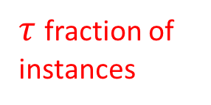
Main Intuition: Accuracy at the Top*
Internally, the algorithm maintains a ranked list
Goal: Rank true anomalies at the top
‘top’ = top $τ$-quantile of the anomaly scores
$$q_{τ}$$
decreasing anomaly scores
anomalies on this side
$τ$ fraction of instances
nominals on this side
*[Boyd et al., 2012]
Notes:
The main intuition behind our algorithm comes from the concept of Accuracy at the top
Internally, the algorithm maintains a ranked list where instances are ranked on descending anomaly score. The algorithm should assign scores such that scores of true anomalies are in the top tau-quantile and those of nominals below tau quantile.
The scores are determined by the projection weights we discussed earlier. So, we need to learn the optimal weights that achieve the intended goal. This is formulated as an optimization problem…

Slide 7
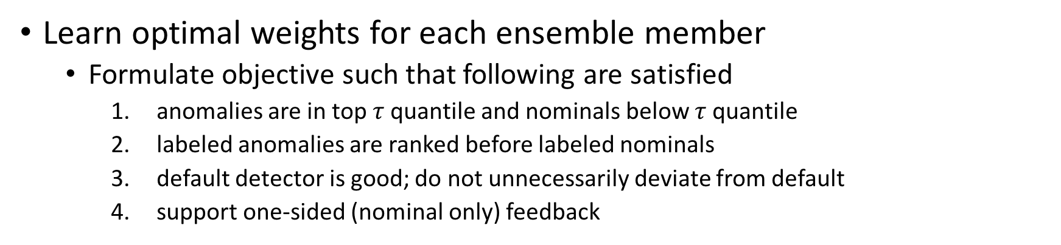
Improving Accuracy at the Top
Learn optimal weights for each ensemble member
Formulate objective such that following are satisfied
anomalies are in top $τ$ quantile and nominals below $τ$ quantile
labeled anomalies are ranked before labeled nominals
default detector is good; do not unnecessarily deviate from default
support one-sided (nominal only) feedback
(1)
quantile hinge loss computed from labeled anomalies and labeled nominals
(3)
(2)
(4) contains proxy
Notes:
This objective for optimization is shown here and has the following parts:
1. First is the quantile hinge loss defined over labeled instances: it says that if a labeled anomaly has a score lower than the top quantile score, then incur a loss; if a labeled nominal has a score higher than the top quantile score, then incur a loss.
2. The second part tries to make sure that each labeled anomaly gets a higher score than every labeled nominal.
3. Third part is a prior that prevents extreme over-fitting since the amount of labeled data is very limited.
4. When there are no labeled anomalies in the feedback set, we use the instance having the tau-quantile score as a proxy anomaly; it forces all labeled nominal instances to be ranked below it.

Slide 8
Experiment setup
Datasets
Construct anomaly datasets from original classification/anomaly datasets
Mammography, Abalone, ANN-Thyroid, Cardiotocography, Covtype, KDDCup99, Shuttle, Yeast
Benchmark algorithms
Loda baseline (queries instances as ordered by default Loda scores)
AAD
AI2 [Veeramachaneni et al. 2016]
SSAD [Gornitz 2013]
ATGP [Grill and Pevny 2016]
Methodology
Metric: number of true anomalies presented to the user

Slide 9
Results (representative subset)
Abalone
Covtype
Mammography
Cardiotocography
KDDCup99
ANN Thyroid 1v3
Notes:
The x-axis is the number of queries presented to the user; y-axis is the number of true anomalies observed. The good algorithms climb quickly. We are consistently one on the top ones.

Slide 10
Future Work: Improvements and extensions
Improving running time: reduce # of pairwise constraints
Extend to other ensembles
Exploring other query selection strategies
Batch query strategies
Notes:
The complexity increases in cubic order of the number of constraints. We do not need all constraints; just sufficient to keep the parameters in good parts of the space in this non-convex optimization.
Extend to ensembles of Gaussian Mixture Models, heterogeneous ensembles, other subspace clustering algorithms (feature bagging?) etc.
Currently we only query the top anomalous instance under the current model. Examples of alternate query strategies (borrowing from existing AL literature): most anomalous, max. variance reduction, uncertainty, most similar to labeled anomalies
Currently we only query one instance at a time. We want to explore querying more than one query at a time (in a batch) so that we can have more opportunity to maximize diversity.

Slide 11
Questions?
email: dassh@oregonstate.edu
Source code / datasets avaiable at: https://github.com/shubhomoydas/aad

