Slide 1

Kaggle Competition
House Prices: Advanced Regression Techniques
David |Neuton | Shubh | Vineet

Slide 2
Feature Engineering
Irreducible Error:
Missing Values
Outliers
Variance:
Normalizing
Removing Columns
Adding Features
Bias:
Transformed features

Slide 3
Examples
Numeric Features:
Missing Values;
Removed 2 outliers on GrLivArea (Above grade (ground) living area square feet) feature;
Transformed GrLivArea using Square Root;
Transformed TotalBsmtSF using Cubic Root;
Transformed the Bathrooms features where half bathroom was inputted with .5 and full bathroom with 1;
Transformed LotArea with Log;
Transformed LotFrontage using Square Root;
Created ShedSF based on the MiscValue feature;
Dropped some features with multicollinearity.

Slide 4
Examples
Categorical Features:
Joined BasementType 1 and 2;
Joined ExternalMaterial;
Created a ”Has Fence” feature;
Joined Fireplaces and Fireplace Quality;
Transformed YearRemodAdd into range of years;
Dropped some features with more than 90% of NA or very high frequency of the same category.

Slide 5
Modeling
Support Vector Regression
Lasso
Ridge
Elastic Net
Random Forest
Gradient Boosting

Slide 6
Hyperparameters
Grid Search
Bayesian Optimization
Graphing
Trial/Error

Slide 7
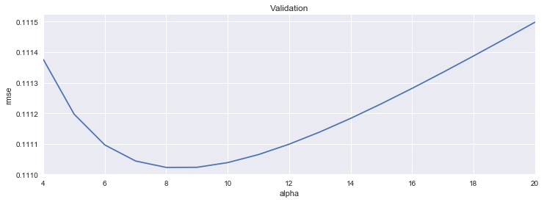
An Example of Parameters Selections
We plotted a range of alpha parameters against the RMSE to find the lowest RMSE for Lasso.

Slide 8
Combining Models
Average
Weighted Average
Stacking

Slide 9
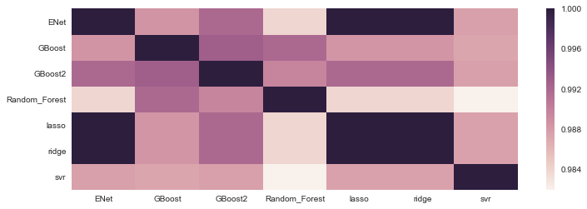
Correlation of the Models

Slide 10
Final Result
To be Datamined
Kaggle Score: 0.11696

