Slide 1
PostgreSQL 16 RAG Q&A Assistant
Infineon Case Study
Streamlit + FAISS + BM25 + Groq + Citation Validation
RAG
Scalability
Robustness
Leadership
What I built
A grounded Q&A system over PostgreSQL 16 docs
A measurable retrieval pipeline, not just a chatbot UI
An engineering workflow with evaluation and guardrails
Shubham Patil
Infineon Case Study
01
Notes:
Opening script: This project is a PostgreSQL 16 RAG Q&A assistant built for technical documentation. My focus was not only building the UI, but proving retrieval quality, grounding answers, validating citations, and designing the system for robustness and scale.

Slide 2
PostgreSQL 16 RAG Q&A Assistant
Introduction: what the project is
A retrieval-augmented Q&A assistant that answers PostgreSQL 16 documentation questions using retrieved official documentation chunks instead of relying only on LLM memory.
1
User asks
2
Retriever finds
3
LLM answers
Natural-language PostgreSQL / SQL question
Relevant chunks from official documentation
Grounded response with source citations
One-sentence positioning
It turns a large technical documentation set into a searchable, grounded assistant with evaluation, citations, and controlled failure behavior.
Infineon Case Study
02
Notes:
Say: In simple terms, the user asks a PostgreSQL question, the system retrieves the most relevant official documentation chunks, and the model generates a concise answer with citations. The key is that the answer is grounded in retrieved context, not free-form model memory.

Slide 3
PostgreSQL 16 RAG Q&A Assistant
Objective: the 8 requirements at a glance
1
Ingest PostgreSQL docs
2
Clean HTML content
3
Chunk with metadata
4
Create vector index
5
Retrieve top-k sources
6
Generate answer with Groq
7
Validate citations
8
Evaluate quality
My interpretation
The case study was not only about producing answers. It was about building a small but complete engineering system with retrieval, grounding, UI, guardrails, and measurable quality.
Infineon Case Study
03
Notes:
Say: I treated the assignment as an engineering system. The 8 requirements map to ingestion, cleaning, chunking, indexing, retrieval, generation, citation validation, and evaluation. This structure made it easier to build, test, and explain.

Slide 4
PostgreSQL 16 RAG Q&A Assistant
Problem statement: accurate answers without hallucination
Why this matters
Risk
Fluent but unsupported answers
PostgreSQL documentation is broad and highly technical.
Many questions depend on exact terms: VACUUM, MVCC, GIN, SAVEPOINT, CONCURRENTLY.
Goal
Grounded answer + valid sources
A normal chatbot may answer confidently but miss the right documentation source.
For technical Q&A, citation quality matters as much as answer fluency.
Method
Measure retrieval before optimizing LLM
Infineon Case Study
04
Notes:
Say: The core problem is that technical documentation questions require accurate grounding. A bigger model is not enough if the retrieved context is wrong or missing. So the project focused on retrieval quality, grounded generation, and citation validation.

Slide 5
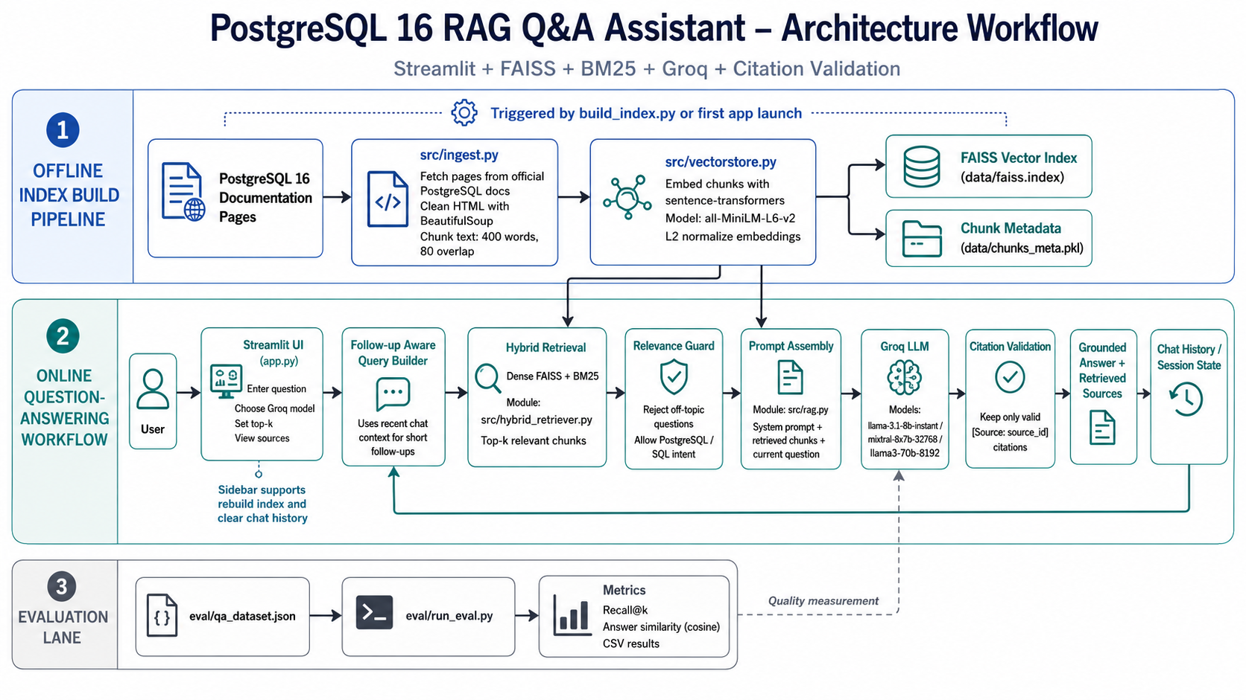
PostgreSQL 16 RAG Q&A Assistant
Architecture overview: offline indexing + runtime pipeline
1 Offline index build
2 Online Q&A workflow
3 Evaluation lane
Infineon Case Study
05
Notes:
Say: The offline pipeline fetches docs, cleans HTML, chunks text, embeds chunks, and stores a FAISS index plus metadata. The online pipeline takes a question through follow-up query building, hybrid retrieval, relevance guard, prompt assembly, Groq LLM generation, citation validation, and session state. The evaluation lane measures quality changes.

Slide 6
PostgreSQL 16 RAG Q&A Assistant
Data handling: fetch, clean, chunk
Official docs
HTML fetch
Clean text
Chunking
Metadata
Fetch
Clean
Chunk
Pulls pages from official PostgreSQL 16 documentation
Removes noisy HTML with BeautifulSoup
Default: 400 words, 80 overlap
Keeps stable source IDs for citation tracking
Keeps text useful for retrieval and prompt assembly
Balances enough context with focused retrieval
Design choice: preserve source metadata early so retrieval, citations, and evaluation all use the same source IDs.
Infineon Case Study
06
Notes:
Say: I kept data handling simple and inspectable. The pipeline fetches PostgreSQL docs, cleans HTML, chunks text, and stores metadata with each chunk. That metadata is important because the citation validator and evaluation scripts depend on stable source IDs.

Slide 7
PostgreSQL 16 RAG Q&A Assistant
Embedding and retrieval strategy: dense + BM25 hybrid
Dense retrieval
BM25 retrieval
Hybrid default
FAISS index over normalized sentence-transformer embeddings
Keyword-based lexical matching
Combines semantic and exact-term signals
Strong for semantic similarity and paraphrases
Strong for exact terms like VACUUM, GIN, MVCC
Improved Mean Recall@5 from 0.878 to 0.933
Weakness: may miss exact technical terms
Weakness: less semantic understanding
Chosen as best recall/latency balance
Why hybrid?
Technical documentation needs both meaning-based retrieval and exact keyword matching.
Infineon Case Study
07
Notes:
Say: Dense retrieval is useful, but PostgreSQL docs contain many exact terms. BM25 captures exact matching, while dense captures semantic matching. Hybrid gave the best practical balance, so I deployed it as the default retrieval method.

Slide 8
PostgreSQL 16 RAG Q&A Assistant
Generation layer: Groq, Llama 3.1 8B, prompt design, citations
Question
Retrieved chunks
System prompt
Groq LLM
Validated answer
Model layer
Prompt design
Citation validation
Groq-hosted LLM generation
System prompt limits answer to retrieved context
Validates [Source: source_id] only against retrieved IDs
Default model: Llama 3.1 8B Instant
Includes current question and selected chunks
Prevents fabricated citation labels
Model selection available in UI
Asks for source citations
Returns grounded answer + sources
Design principle: the LLM writes the answer, but retrieval + prompt + citation validation control what it can safely say.
Infineon Case Study
08
Notes:
Say: I used Groq for fast model inference and Llama 3.1 8B Instant as the default. The prompt includes the retrieved chunks and current question. After generation, citation validation keeps only source IDs that actually came from the retrieved context.

Slide 9
PostgreSQL 16 RAG Q&A Assistant
Guardrails: irrelevant query defense before the LLM call
Why it runs before generation
Off-topic example
“Who won the cricket match yesterday?”
Avoids wasting LLM calls on off-topic questions.
Reduces hallucination risk when retrieval has no good PostgreSQL context.
Allowed example
Keeps the system focused on PostgreSQL / SQL intent.
“How does VACUUM help PostgreSQL?”
Improves demo reliability because failure behavior is controlled.
Question
Intent check
Retrieve
LLM
Best interview line
“I tried to fail safely before calling the model.”
Infineon Case Study
09
Notes:
Say: I put the relevance guard before the LLM call because if the query is irrelevant, the model should not be asked to invent an answer. This saves cost, reduces hallucination, and makes the system fail in a controlled way.

Slide 10
PostgreSQL 16 RAG Q&A Assistant
Chat history design: follow-up aware, but controlled
Need
Design choice
Tradeoff
Support short follow-ups like “what about examples?”
Use recent chat context to rewrite short follow-ups
Too much history can dilute retrieval intent
Avoid losing context after one answer
Still retrieve fresh chunks for the current question
Too little history makes follow-ups weak
Keep a natural Q&A experience
Store session state in Streamlit
I kept history lightweight and query-focused
Principle: use history to clarify the query, not to replace retrieval.
Infineon Case Study
10
Notes:
Say: I used recent chat history for follow-up aware query building. The tradeoff is that too much chat history can pollute retrieval, so I use it mainly to clarify short follow-ups and still retrieve fresh documentation context.

Slide 11
PostgreSQL 16 RAG Q&A Assistant
Evaluation methodology: Recall@k and answer similarity
15
Why these metrics?
Curated QA questions
They measure the two biggest RAG risks:
I created a small QA dataset with expected relevant PostgreSQL source IDs so retrieval quality could be measured instead of guessed.
1. Missing the right context
Recall@5 / Recall@10: did the retriever find the expected sources?
2. Producing a weak answer
Answer similarity: is the generated answer close to reference wording?
CSV outputs: easy to compare across changes
This made optimization evidence-based.
Infineon Case Study
11
Notes:
Say: I used Recall@k because retrieval is the foundation of RAG. If the right source is not retrieved, the answer cannot be properly grounded. I also measured answer similarity to catch cases where retrieval succeeded but the final response still needed improvement.

Slide 12
PostgreSQL 16 RAG Q&A Assistant
Chunk size ablation: why 400 words won
Chunk size
Overlap
Chunks
Mean Recall@5
Interpretation
200
40
473
0.911
200/300: too many small chunks; context may be fragmented.
300
60
323
0.911
500/600: strong recall but larger chunks add prompt noise.
400
80
246
0.944
400: same top recall as 600 with fewer tokens than long chunks.
500
100
198
0.933
Default: 400 words with 80 overlap.
600
120
171
0.944
400
0.944
word default chunk size
best Recall@5 in ablation
Infineon Case Study
12
Notes:
Say: I compared 200, 300, 400, 500, and 600 word chunks. Both 400 and 600 reached 0.944 Mean Recall@5, but 400 was the better default because it kept retrieval focused and reduced prompt noise compared with longer chunks.

Slide 13
PostgreSQL 16 RAG Q&A Assistant
Retrieval strategy comparison: why hybrid is deployed
Strategy
Mean Recall@5
Avg latency
Decision
Dense FAISS
0.878
141.5 ms
Hybrid was the best production default.
BM25
0.800
2.6 ms
Dense was semantically strong but missed exact terms.
Hybrid FAISS + BM25
0.933
11.7 ms
BM25 was very fast but lower recall.
Rerank only
0.911
1487.3 ms
Hybrid gave strong recall with low latency.
Hybrid + rerank
0.944
1328.5 ms
Hybrid + rerank had the highest recall but too much latency for default use.
Reranking kept as optional evaluation strategy.
Infineon Case Study
13
Notes:
Say: The failure story is here. Dense retrieval achieved 0.878 Mean Recall@5. Hybrid improved it to 0.933 with only 11.7 ms average latency. Hybrid + rerank reached 0.944, but the latency was much higher, so I kept reranking optional and deployed hybrid as the default.

Slide 14
PostgreSQL 16 RAG Q&A Assistant
Live demo: what I will show
Demo path
PostgreSQL 16 RAG Q&A Assistant
1
Ask a PostgreSQL technical question
What does VACUUM do in PostgreSQL?
2
Show retrieved sources in the UI
Answer: VACUUM reclaims storage and helps maintain table health...
[Source: sql-vacuum]
3
Ask a short follow-up question
4
Ask an off-topic question to show refusal
sql-vacuum
mvcc
5
Explain the citation validation behavior
Placeholder: replace with real app screenshot if needed
Infineon Case Study
14
Notes:
Say during demo: I will show a normal technical question, the sources, a follow-up, and an off-topic query. This demonstrates not only that the assistant can answer, but also that it retrieves, cites, remembers short context, and refuses safely.

Slide 15
PostgreSQL 16 RAG Q&A Assistant
Limitations: honest weak cases and what they teach
Weak QA case 1
Weak QA case 2
MVCC model and concurrent reads/writes
Transaction error after BEGIN before COMMIT
Retrieval found the expected source, but answer similarity was lower.
Retrieved relevant transaction sources, but final answer needed stronger grounding.
Likely reason: concept needs richer synthesis across MVCC and transaction docs.
Likely reason: answer requires connecting BEGIN, COMMIT, ROLLBACK, SAVEPOINT behavior.
Fix: structure-aware chunking and better answer checklist.
Fix: claim-level citation checks and multi-source synthesis rules.
Leadership point: I would present limitations clearly, attach metrics, and convert failures into the next improvement backlog.
Infineon Case Study
15
Notes:
Say: I want to be honest about limitations. The weaker cases were not complete failures, but they show that retrieval alone is not enough. Some answers require better synthesis across multiple sources. I would use these cases to drive the next round of improvements.

Slide 16
PostgreSQL 16 RAG Q&A Assistant
Future improvements + closing
Future improvements
Closing message
Structure-aware chunking for tables, sections, and SQL syntax blocks.
The main thing I want to show is that I did not build only a chatbot UI.
Intent classifier to separate SQL, PostgreSQL docs, and off-topic queries.
I built a complete RAG workflow with ingestion, retrieval, generation, citations, guardrails, and evaluation.
Claim-level citation checks, not only source-ID validation.
I solved a real retrieval failure using measured Recall@5 and latency tradeoffs.
Production path: FastAPI backend, pgvector/managed vector DB, Docker, CI/CD, logging.
I designed it like an engineering project: modular, testable, scalable, and easy for juniors to contribute to.
Questions?
Infineon Case Study
16
Notes:
Closing script: The main thing I want to show is that I did not build only a chatbot UI. I built a complete RAG workflow with ingestion, embedding, hybrid retrieval, grounded generation, citation validation, follow-up handling, irrelevant-query refusal, and evaluation. I also treated this like an engineering system: I tested what failed, compared alternatives, selected hybrid retrieval based on Recall@5 and latency, and created a structure that can scale and support junior developers.

