Slide 1

COTIVITI · GENERATIVE AI INTERNSHIP ASSESSMENT
Healthcare Policy Intelligence Assistant
AI-Powered Healthcare Content Management for Treatment, Payment & Operations
Shubham Suryakant Patil
Notes:
Open by introducing the project as a response to a real operational challenge Cotiviti faces: the volume and velocity of healthcare policy content. Set the tone as a strategic consulting-style assessment, not an academic report.

Slide 2











What Is Healthcare Content Management?
Every clinical and financial decision is governed by dense, constantly evolving documentation
Billing & Coding Policies
Clinical Guidelines
Payer-Provider Contracts
CMS Regulations
ICD-10, CPT, HCPCS rules
Evidence-based care pathways
Reimbursement & network terms
Federal coverage determinations
Why It's Difficult to Manage
High Velocity
Dense Language
Fragmentation
Hundreds of revisions yearly
Complex legal & clinical text
Varies by payer & jurisdiction
Cotiviti Generative AI Internship Assessment
2
Notes:
Walk through the four categories of healthcare content and emphasize why each is uniquely difficult — volume, density, and constant revision. This sets up the case for AI intervention.

Slide 3




Industry Trends Reshaping Policy Management
Four converging forces are making AI-driven content management viable today
Large Language Models
Retrieval-Augmented
Generation (RAG)
AI Rule Extraction
AI Governance
Now match expert-level performance on medical summarization tasks.
Grounds AI answers in verifiable, citable source documents.
Converts narrative policy text into structured, executable logic.
Audit trails and human oversight ensure compliant, trustworthy use.
Cotiviti Generative AI Internship Assessment
3
Notes:
Briefly explain each trend in one sentence. Emphasize that these are not speculative — LLMs, RAG, and rule extraction are deployed in production healthcare settings today.

Slide 4


Opportunities & Challenges
Significant upside, balanced by risks that must be actively managed
Opportunities
Challenges
Faster policy review & summarization
Hallucination & output reliability risk
Stronger payment integrity & accuracy
Privacy & PHI protection (HIPAA)
Reduced administrative effort
Compliance & auditability requirements
Improved knowledge management
Frequent policy updates require maintenance
Cotiviti Generative AI Internship Assessment
4
Notes:
Use this slide to show balanced thinking. Don't oversell AI — acknowledge the real risks, especially hallucination and compliance, which directly justifies the human-in-the-loop recommendation on the next slide.

Slide 5



Strategic Recommendation
Invest in an AI-Assisted Policy-to-Edit Pipeline
Healthcare
Policy
Policy
Parsing
Policy
Understanding
Rule
Extraction
Human
Review
Claim Edit
Generation
Payment
Integrity
AI Should Not Replace Healthcare Professionals
AI should eliminate repetitive document interpretation — reading, summarizing, and drafting candidate rules — while leaving every final coverage and payment decision in the hands of clinical experts. Human reviewers remain the approval gate before any rule reaches production.
Cotiviti Generative AI Internship Assessment
5
Notes:
This is the core strategic recommendation. Walk through the pipeline left to right. Pause on 'Human Review' — emphasize this is the central differentiator of the proposal: AI augments, never replaces, clinical and coding judgment.

Slide 6



Proof of Concept
A working prototype demonstrating the foundational capabilities of the strategy
PDF
Upload
Parsing
Semantic
Retrieval
Question
Answering
Rule
Extraction
Future:
Claim Edit
Implemented in Prototype
Future Strategic Capability
Technology Stack
Python
Streamlit
PyMuPDF
TF-IDF Retrieval
JSON Export
Cotiviti Generative AI Internship Assessment
6
Notes:
Introduce the proof of concept as validation of the foundational layers of the pipeline — parsing, retrieval, question answering, and rule extraction. Be explicit that claim edit generation is a future capability, not built yet.

Slide 7
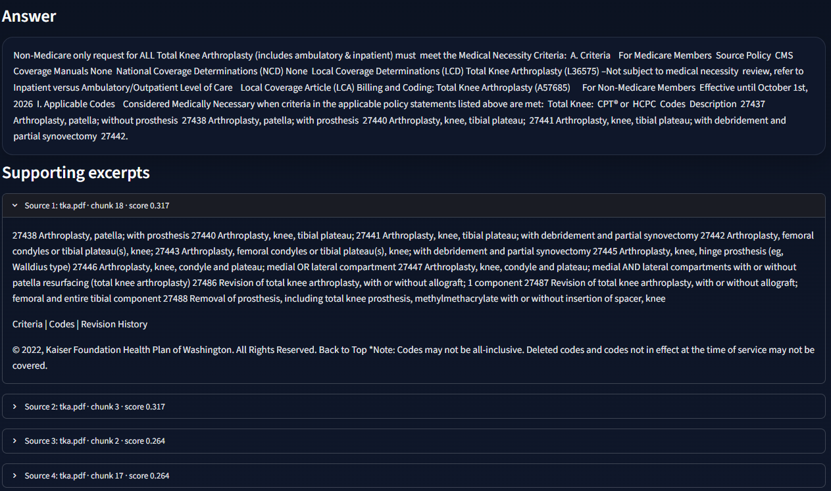


Feature 1: Policy Question Answering
Ask natural-language questions and receive evidence-backed answers
Upload Policy
User uploads a healthcare policy PDF document
Ask Question
User types a natural-language question about coverage or rules
Retrieve Evidence
[ Screenshot: Policy Q&A Interface ]
System retrieves the most relevant policy sections
Evidence-Backed Answer
Response generated with direct source citations
Cotiviti Generative AI Internship Assessment
7
Notes:
Walk through the actual demo flow: upload a policy PDF, ask a natural language question, and show how the system retrieves and cites the relevant policy section before answering.

Slide 8
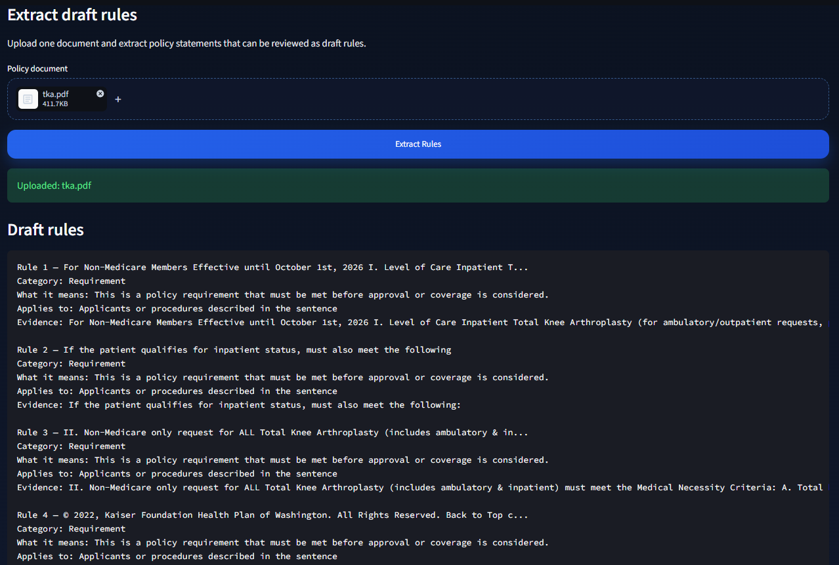


Feature 2: Rule Extraction
Converting policy statements into structured, analyst-reviewable draft rules
How It Works
The system parses raw policy text and identifies condition-action statements — for example, coverage criteria tied to diagnosis codes or frequency limits.
These are converted into structured draft rules in a standard if/then format, exported as JSON for downstream review.
Every extracted rule is explicitly intended for analyst review before adoption — not automatic deployment.
Policy
Statement
Structured
Draft Rule
Analyst
Review
Future Claim
Rule
Cotiviti Generative AI Internship Assessment
8
Notes:
Show how a raw policy statement becomes a structured draft rule. Emphasize the JSON export and that every rule is explicitly intended for human analyst review — not automatic deployment.

Slide 9
Prototype Alignment to Strategic Vision
The prototype validates the foundational steps of the full pipeline
Strategic Vision | Prototype Capability | Status
Policy Parsing | PDF ingestion & text extraction (PyMuPDF) | Implemented
Question Answering | TF-IDF semantic retrieval + evidence-backed answers | Implemented
Rule Extraction | Structured draft rule generation with JSON export | Implemented
Human Review | Manual analyst review workflow integration | Future
Claim Edit Generation | Production claim editing engine integration | Future
Implemented in prototype
Future strategic capability
Cotiviti Generative AI Internship Assessment
9
Notes:
This is the most important slide — be very clear about what is implemented today versus what remains a future capability. Transparency here builds credibility with technical reviewers.

Slide 10

Conclusion
AI can substantially reduce manual healthcare policy review burden.
This strategy directly aligns with Cotiviti's payment integrity mission.
The prototype proves foundational capabilities that can evolve into enterprise-scale policy automation.
Thank You
Notes:
End with the three takeaways stated clearly and confidently. Reinforce the central theme: AI eliminates repetitive work, not professional judgment. Thank the reviewers and invite questions.

