Slide 1
Evaluating Graph-Based Retrieval-Augmented Generation
Dissertation project overview
Student: Shubhra Gadhwala · BITS ID: 2023AA05750 · Supervisor: Darshan Derasari · Organization: WeblineIndia, Ahmedabad

Slide 2
Feasibility Study
The project is feasible within the given timeline based on the following
Factors:
▪ Dataset Availability: The selected synthetic dataset is publicly available,
lightweight, and well-suited for rapid experimentation and benchmarking.
▪ Tool Maturity: LangChain and Neo4j are stable, well-documented tools
that significantly reduce development overhead for RAG and graph-
based systems.
▪ Model Choice: Use of pretrained LLMs and embedding models avoids
the need for expensive training or fine-tuning, keeping computational
requirements manageable.
▪ System Scope: The project focuses on prototype-level systems rather
than production-scale deployment, keeping complexity controlled.
▪ Frontend Simplicity: A streamlit frontend is sufficient for evaluation
and demonstration purposes.
▪ Compute Constraints: The systems are designed to run on local or
modest compute resources, aligning with academic timelines.

Slide 3
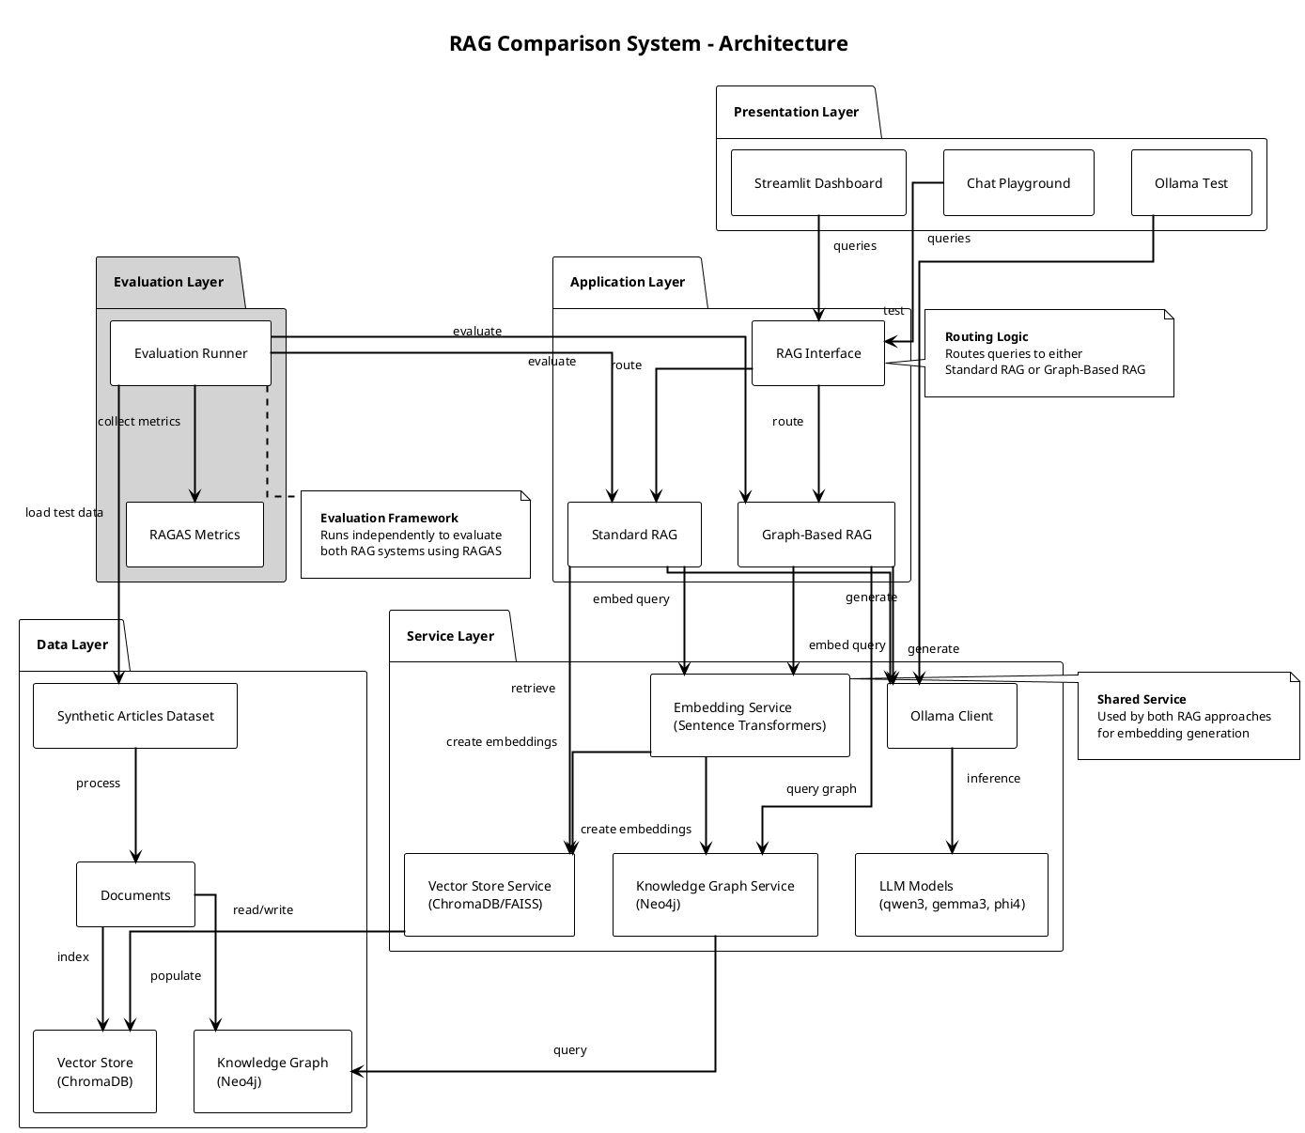
System Architecture for Retrieval-Augmented Workflows

Slide 4
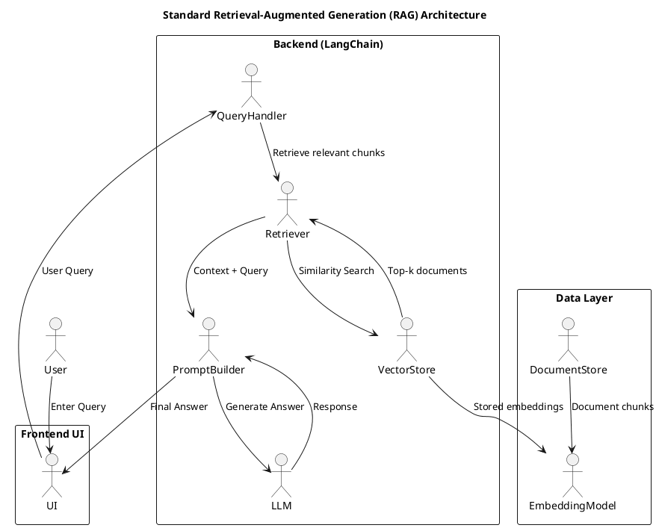
Standard RAG Pipeline Overview

Slide 5
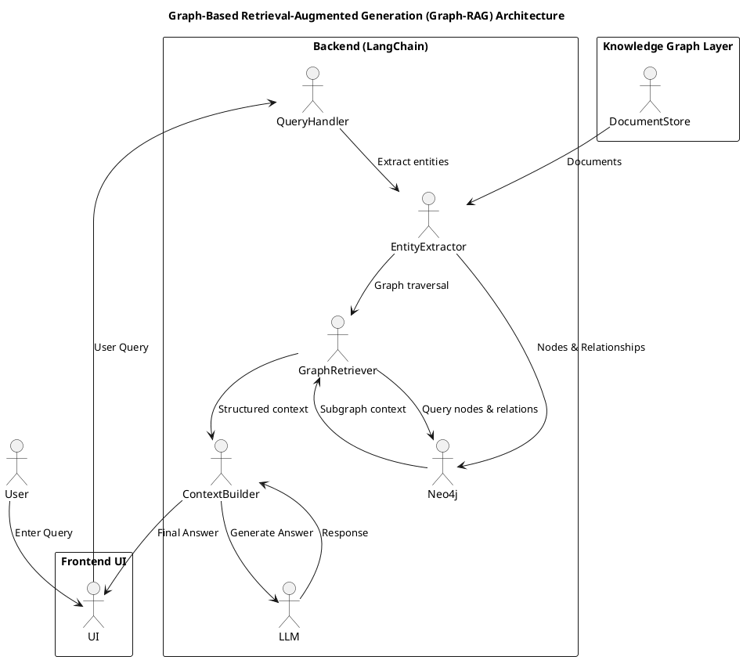
Graph-Based RAG Pipeline

Slide 6
Dataset and Tools for Multi-hop Research
Dataset
Synthetic Articles Dataset
Research articles with structured information
Suitable for multi-hop reasoning
Lightweight for rapid experimentation
Technology Stack
Framework: LangChain
Vector Store: ChromaDB
Graph Database: Neo4j
LLMs: Local models (Qwen2, Gemma, Phi) via Ollama
Embeddings: Sentence Transformers (all-MiniLM-L6-v2)
Frontend: Streamlit
Evaluation: RAGAS metrics

Slide 7
Current Progress
✅ Completed
Literature review and problem statement finalization
Codebase setup and environment configuration
Dataset selection and validation
Standard RAG system implementation
Graph-Based RAG system implementation (in progress)
Streamlit dashboard with chat playground
🔄 Ongoing
Graph RAG pipeline refinement
Query evaluation set preparation
📋 Pending
Comprehensive testing and evaluation
Comparative analysis
Results documentation

Slide 8
Data Flow
Flow Overview:
Documents → Preprocessing → Two parallel paths
Path 1: Chunking → Embeddings → Vector Store
Path 2: Entity Extraction → Graph Construction → Neo4j
User Query → Retrieval (Vector/Graph) → Context → LLM → Answer

Slide 9
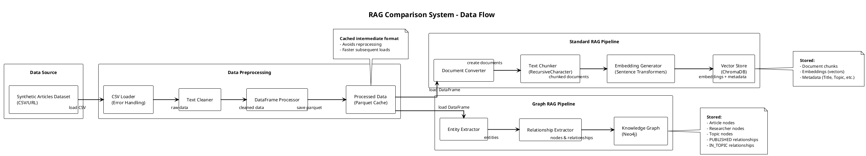

Slide 10
Evaluation Framework
Metrics (RAGAS)
Faithfulness: Answer grounded in retrieved context
Answer Relevancy: Answer relevance to question
Context Precision: Quality of retrieved context
Test Scenarios
Single-hop queries
Multi-hop queries
Complex relational queries
Edge cases and error handling

Slide 11
Live Demo
[SWITCH TO APPLICATION]

Slide 12
Thank You

