Slide 1

Bank Customer Segmentation
PRESENTED BY:
Dr. SHUBHRA GOYAL

Slide 2
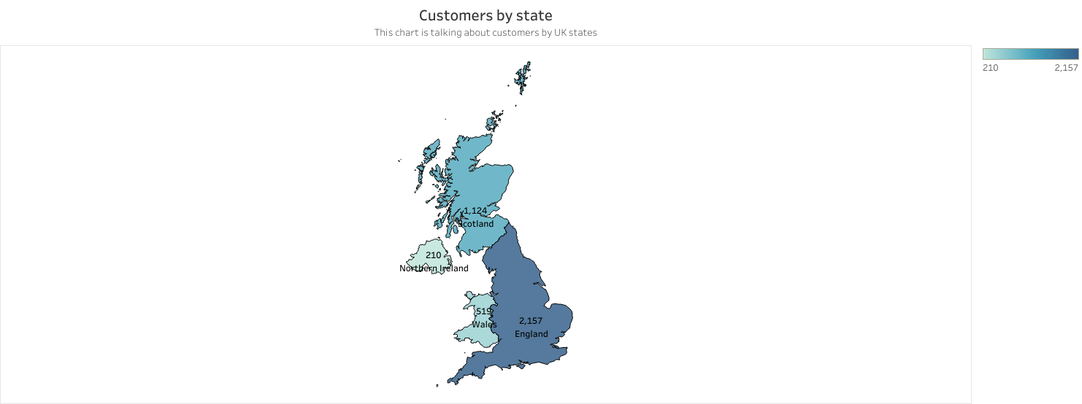
Maximum Customers are from England followed by scotland, wales and Northern Ireland

Slide 3
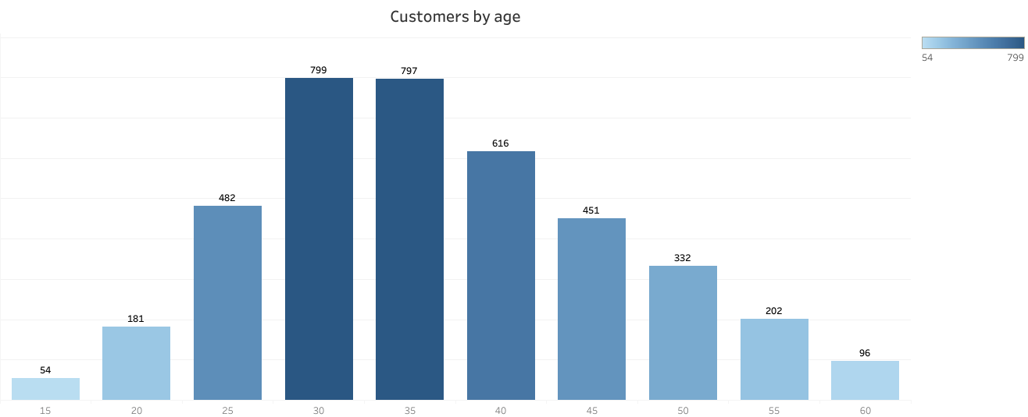
Maximum customers are between age segment of 30-39

Slide 4
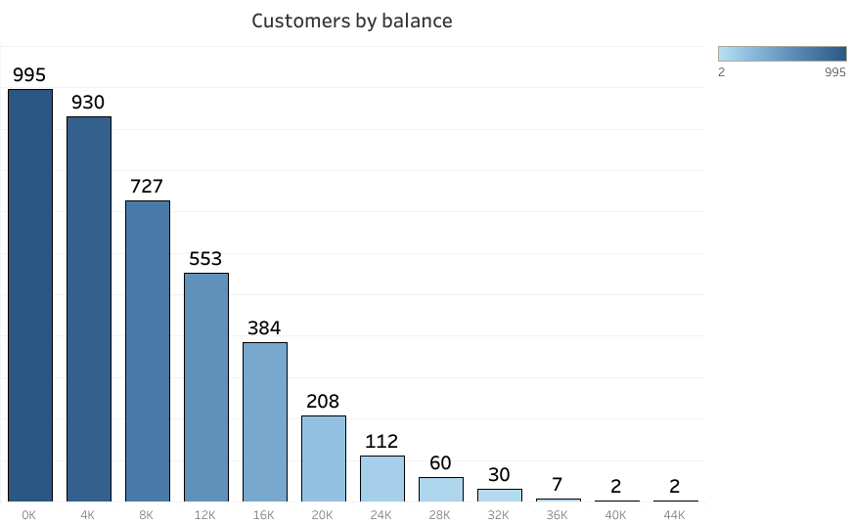
Most of the customers have bank balance between 0k to 15k.Although,there are a few outliers present

Slide 5
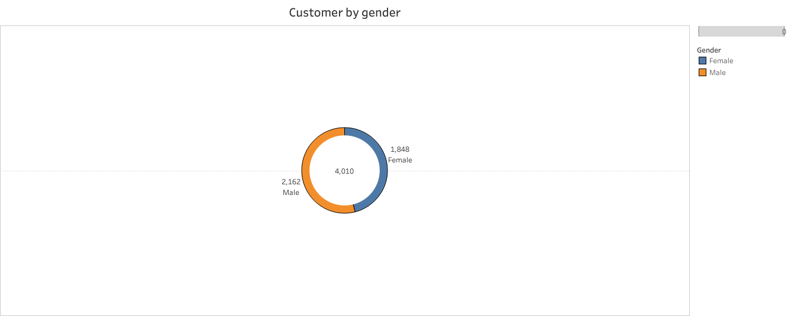
Gender distribution is almost equal. Male count is slightly higher than female count

Slide 6
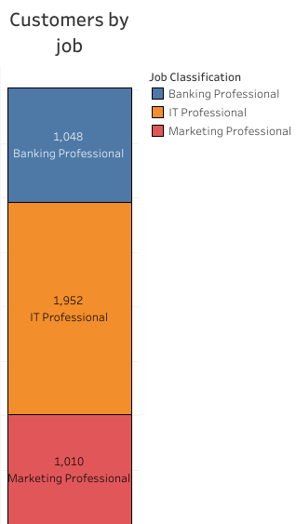
Maximum customers are IT professionals followed by Banking and Marketing Professionals

Slide 7
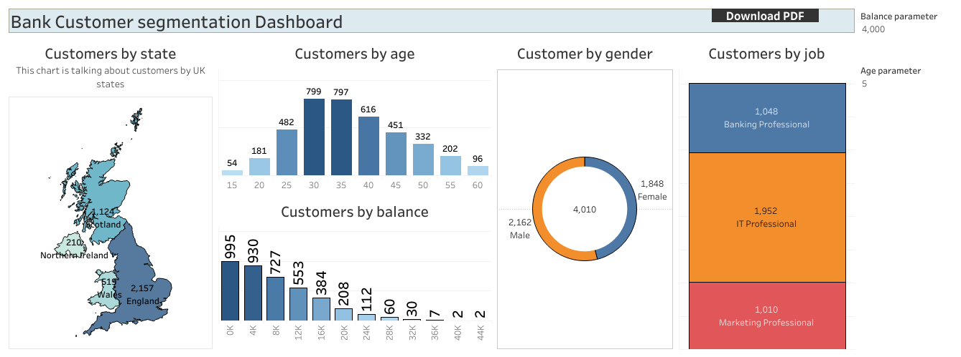
This is the Dashboard representing the entire dataset without any filters

Slide 8
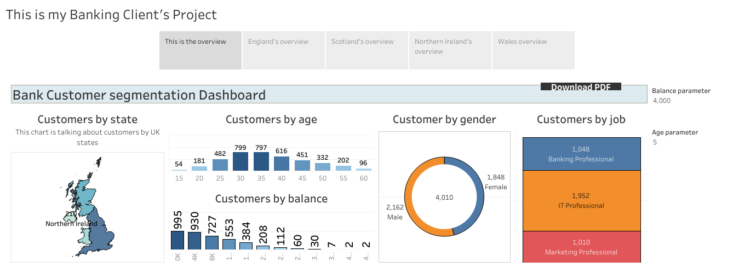
Story representing entire data

Slide 9
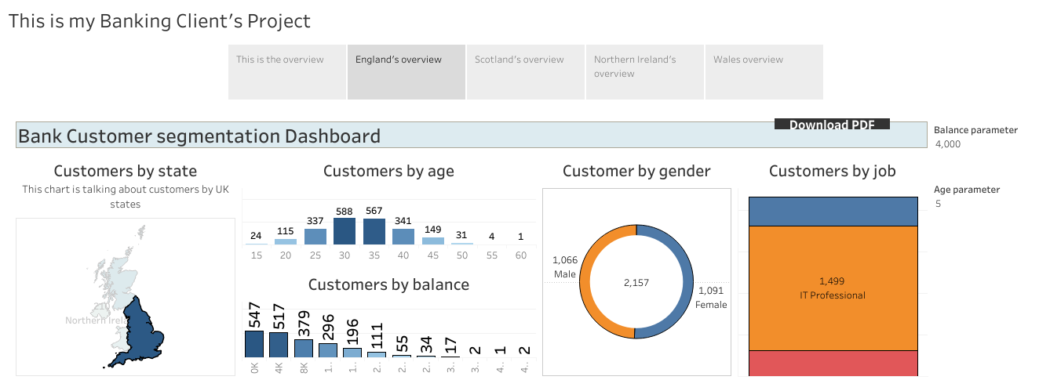
England with largest customer base has Highest number of IT professionals.
Gender proportion is equal.
Most customers are between 30-40 and Bank can target these customers with Children plans

Slide 10
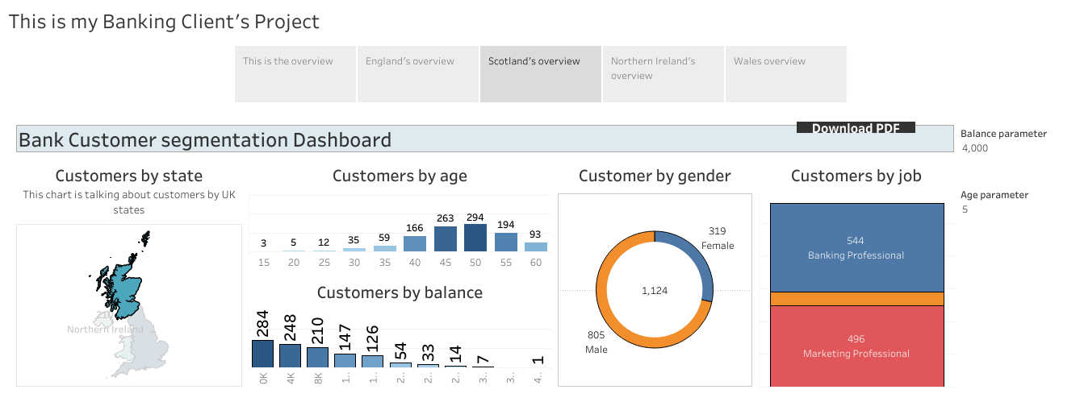
Scotland,on the other hand has High Males working in Banking and Marketing .
The highest age distribution in scotland is between 40 to 50 which is different than England.
Hence Bank can offer custom tailored Retirement Plans to their customers.

Slide 11
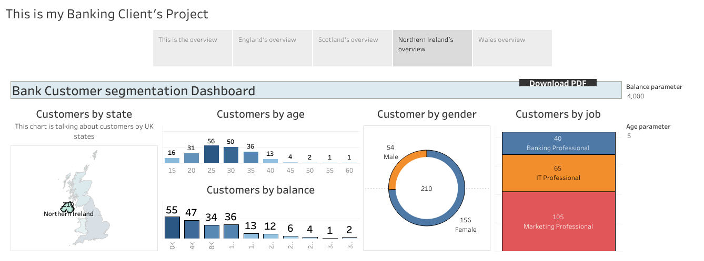
Northern Ireland has very high female customers who are between age group of 20-30.
More customers are working in Marketing followed by IT and Banking.
Hence Bank can offer Customer tailored Female youth Banking products.

Slide 12
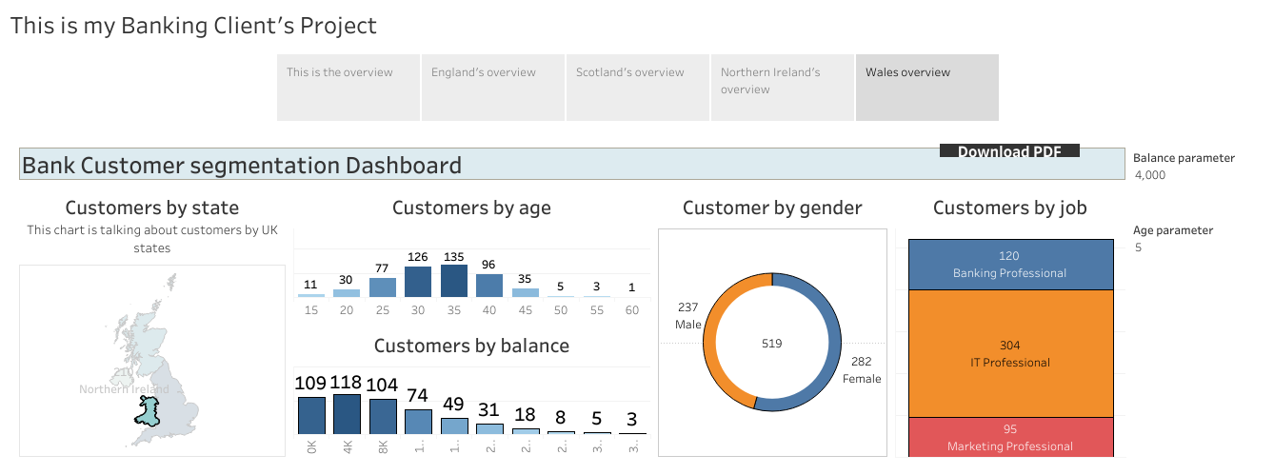
Wales Has equal Male and female customers.
Most customers are between age of 30-40 .
Most are working in IT followed by banking and Marketing.

