Slide 1
Microsoft Azure
[Use case – II (Chicago Weather)]
Submitted by
Shubhra Karmahe

Slide 2

Brief Synopsis
The Chicago Park District maintains weather sensors at beaches along Chicago's Lake Michigan lakefront. These sensors generally capture the indicated measurements hourly while the sensors are in operation during the summer. Company CloudHub captures this sensors data and uses the same for weather predictions and other analytics. A cloud ecosystem is built in Azure to process the data and create rich visuals for analytics.

Slide 3
Azure Stack
Azure Blob Storage
Azure Blob Storage is a service for storing large amounts of unstructured object data, such as text or binary data.
Azure Data Factory
Azure Data Factory service is a fully managed service for composing data storage, processing, and movement services into streamlined, scalable, and reliable data production pipelines.
Azure SQL DB
Microsoft Azure SQL Database is a managed cloud database provided as part of Microsoft Azure.
Power BI
Power BI combines state-of-the-art interactive visualizations, with industry-leading data query and modeling built-in

Slide 4
1. Setup the Lab Environment i.e create Azure account and BLOB,SQL DB and ADF resources.
2. Upload Data to Azure Blob Storage
3. Move Data with Azure Data Factory
Create a table in the Azure SQL Database, then create an Azure Data Factory pipeline to integrate and move data from Azure blob storage to the table in Azure SQL DB.
4. Create visualizations and explore data with Power BI.
5. Code is available at https://github.com/shubhrakarmahe/azure
Solution architecture

Slide 5
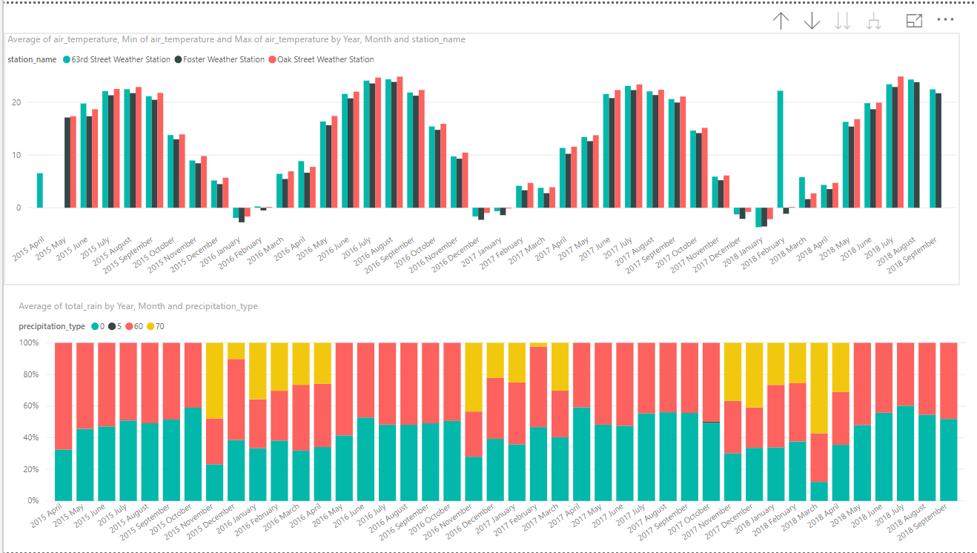
Visuals - I

Slide 6
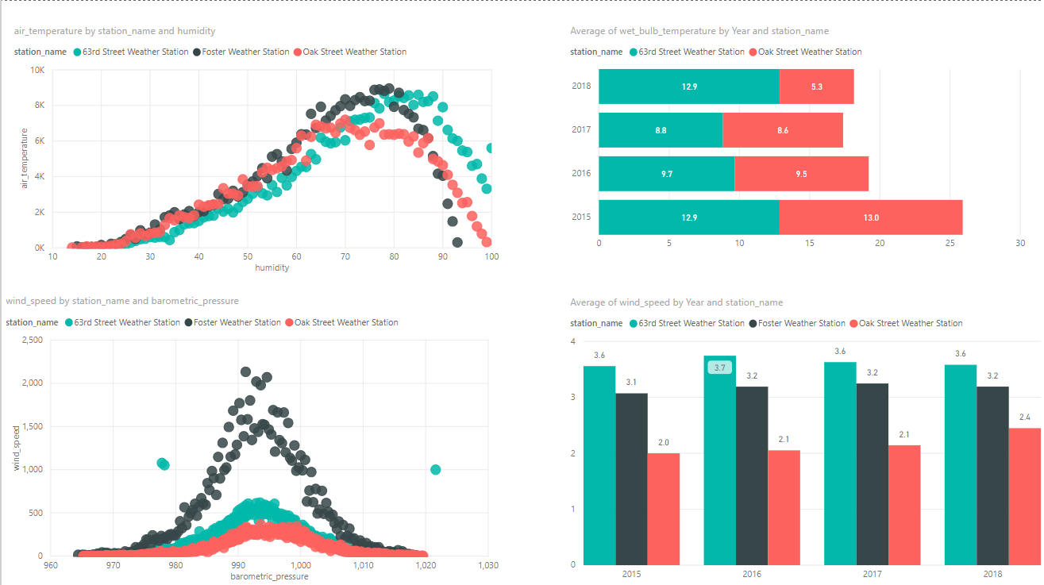
Visuals - II

Slide 7
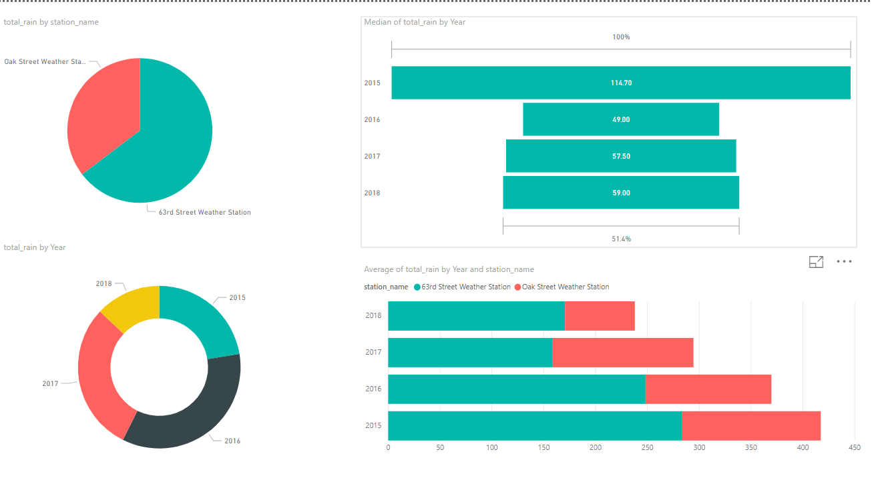
Visuals - III

Slide 8
Outliers detected for the below mentioned variables.
Format of timestamp column for Measurement_timestamp and measurement_timestamp_label is dd-mm-yyyy hh:mi. It was converted to desirable format during data load to DB.
Challenges faced - I
Variable | Value
Maximum wind speed | 999.9
Wind Speed | 999.9
Solar Radiation | -10000

Slide 9
3. Missing values for the below mentioned variables.
Challenges faced - II
Variable | Station | Year | Month | Total records
Air temperature | Oak Street Weather Station | 2015 | May | 75
Wet bulb temperature | Foster Weather Station | * | * | 27545
Rain intensity | Foster Weather Station | * | * | 27545
Total Rain | Foster Weather Station | * | * | 27545
Precipitation Type | Foster Weather Station | * | * | 27545
Barometric Pressure | Foster Weather Station | 2015 | May | 73
 | Oak Street Weather Station | 2015 | May | 73
Heading | Foster Weather Station | * | * | 27545
Note: - * means multiple year and month values

Slide 10
Possible Improvement
01
Data Cleaning Required
For weather forecasting statistical models are required and to build them data cleaning is needed to handle missing values and outliers
02
Power BI Report – Addition of Weather KPI’s

Slide 11


