Slide 1

SpaceX Falcon 9First Stage Launch Outcomes
Shubhra Mishra
04-JUL-2023

Slide 2




OUTLINE
Executive Summary
Introduction
Methodology
Results
Visualization – Charts
Dashboard
Discussion
Findings & Implications
Conclusion
Appendix

Slide 3

EXECUTIVE SUMMARY
The success of SpaceX is based on comparatively lower pricing which is due to recovery of Falcon 9 first stage
This study evaluates SpaceX's Falcon 9 first stage launch success parameters and outcomes
Collection and analysis of data from SpaceX API's
Identifies parameters that impact the outcome of a successful launch of first stage
Visualizes the correlation of parameters for successful outcome of launch
Evaluates prediction of successful outcome of fist stage launch

Slide 4

INTRODUCTION
Space X is the most successful of commercial space age.
The Space X rocket launches are relatively inexpensive
Mainly because SpaceX can reuse the first stage
To determine the success of the first stage landing we need to identify parameters for successful launch of first stage, thereby reduce overall cost.

Slide 5

METHODOLOGY – Data Collection
The Falcon 9 specification data is collected using SPACEX REST API url https://api.spacexdata.com/v4/
The Falcon 9 historical launch records are retrieved from Wikipedia page https://en.wikipedia.org/wiki/List_of_Falcon_9_and_Falcon_Heavy_launches
Relevant attributes are selected for further analysis
Data is filtered to exclude multiple cores, booster version Falcon 1 and dates later than 13th Nov 2020
Handle the missing values in the data
Landing outcomes are separated into unsuccessful and successful outcome and stored into Class attribute

Slide 6
METHODOLOGY – EDA and Visual Analytics
For Exploratory Data Analysis (EDA)
Collected data is loaded to a corresponding table in a DB2 database
Data is analyzed using SQL
Visually analyze data for key categories, like Flight Number, Payload Mass, Launch Site, Orbit
Apply Features Engineering using one-hot encoding to identify attributes required for Prediction analysis
Use folium to study Launch Site location and facilities
Create a dashboard to analyze success rate of key attributes

Slide 7
METHODOLOGY – Predictive Analysis
Training labels are created for determining success of a launch and added to the dataset for prediction
Data is standardized using StandardScalar function
Data is split into Train and Test subsets, with 20% data in Test subset
ML model will be trained and tested using Logical Regression, Support Vector Machine(SVM), Decision Trees classification and k-nearest neighbor clustering
All the models are evaluated using score function for accuracy

Slide 8
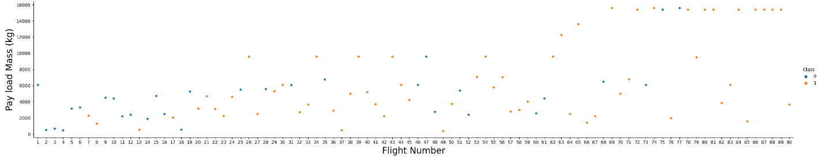
EDA-FALCON 9 FLIGHT NUMBER TRENDS
This chart identifies Flight Number by Payload Mass

Slide 9
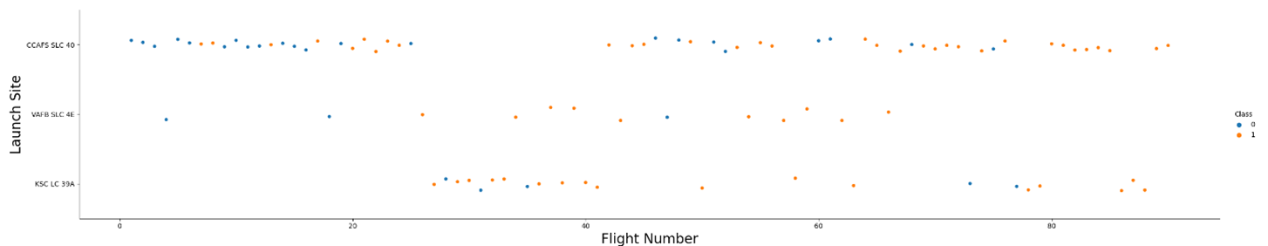
FALCON 9 FLIGHT NUMBER TRENDS
This chart identifies Flight Number by Launch Site

Slide 10
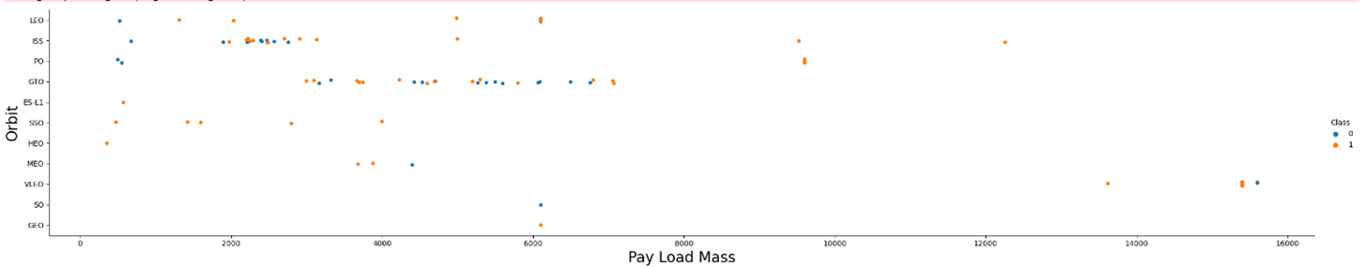
EDA-FALCON 9 FLIGHT NUMBER TRENDS
This chart identifies Flight Number by Orbit

Slide 11
FALCON 9 FLIGHT NUMBER TRENDS - FINDINGS & IMPLICATIONS
Findings
As the flight number increases, the first stage is more likely to land successfully
Higher Payload Mass for higher flight number seems to land successfully
Launch Sites CCAFS SLC 40 and KSC LC 39A have been more successful for higher flight number
In LEO orbit the Success appears related to the number of flights
There seems to be no relationship between flight number when in GTO orbit.
Implications
Flight Number can be used as a parameter for successful outcome
Payload Mass can be used as a parameter for successful outcome
Launch site can be used as a parameter for successful outcome
Orbit on it's own seems to have a lower correlation to successful outcome

Slide 12
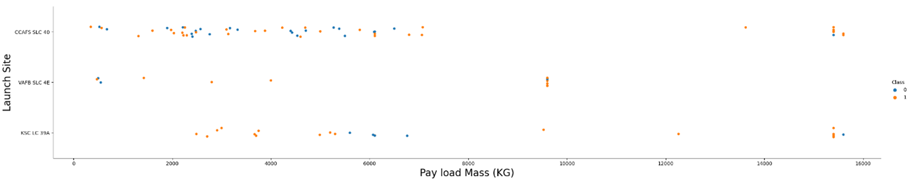
FALCON 9 PAYLOAD TRENDS
Correlation between Payload Mass and Launch sites

Slide 13
FALCON 9 PAYLOAD TRENDS
Correlation between Payload Mass and Orbit

Slide 14
FALCON 9 PAYLOAD TRENDS - FINDINGS & IMPLICATIONS
Findings
VAFB-SLC launch site there are no rockets launched for heavy payload mass(greater than 10000)
Launch Sites CCAFS SLC 40 and KSC LC 39A have had successful launch for heavy payload mass
Heavy payloads have more successful landing for Polar, LEO and ISS orbits
Implications
Launch site can be used as a parameter for successful outcome
Payload Mass can be used as a parameter for successful outcome
Orbit can be used as a parameter for successful outcome

Slide 15
FALCON 9 SQL Analysis
Launch Site Analysis
Names of unique launch sites in the SpaceX Mission are:
CCAFS LC-40
VAFB SLC-4E
KSC LC-39A
CCAFS SLC-40
None

Slide 16
FALCON 9 SQL Analysis
Payload Mass Analysis
The total payload mass carried by boosters launched by NASA (CRS) is 45596.0
The average payload mass carried by booster version F9 v1.1 is 2928.4

Slide 17
FALCON 9 SQL Analysis
Mission Outcome Analysis
The earliest date for successful landing outcome in group pad is
01-Aug-2018
Identify the total number of successful and failure mission outcomes
Mission Outcome Count
None 898
Failure (in flight) 1
Success 98
Success 1
Success (payload status unclear) 1

Slide 18
FALCON 9 SQL Analysis
Booster Analysis for Maximum Payload Mass
The names of the Booster Versions which have carried the maximum payload mass are:
F9 B5 B1048.4 F9 B5 B1049.4
F9 B5 B1051.3 F9 B5 B1056.4
F9 B5 B1048.5 F9 B5 B1051.4
F9 B5 B1049.5 F9 B5 B1060.2
F9 B5 B1058.3 F9 B5 B1051.6
F9 B5 B1060.3 F9 B5 B1049.7

Slide 19
FALCON 9 SQL Analysis
Mission Outcome Analysis for Specific periods
List all month names, failure landing outcomes in drone ship ,booster versions, launch site for the months in year 2015.
Month Landing Outcome Booster Version Launch Site
10 Failure (drone ship) F9 v1.1 B1012 CCAFS LC-40
04 Failure (drone ship) F9 v1.1 B1015 CCAFS LC-40

Slide 20
FALCON 9 SQL Analysis
Mission Outcome Analysis for Specific periods
The count of successful landing outcomes between the date 04-06-2010 and 20-03-2017 in descending order is:
Landing Outcome Count
Success 20
Success (drone ship) 8
Success (ground pad) 7

Slide 21
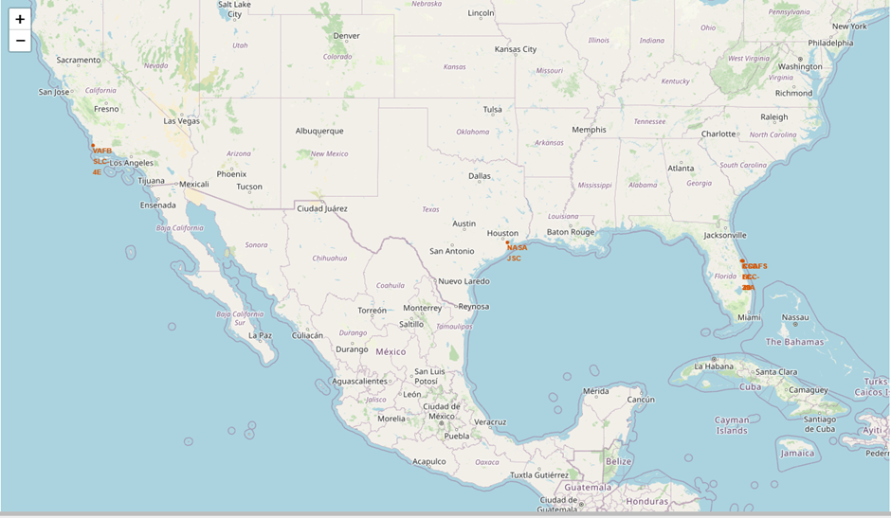
FALCON 9 Launch Site Map Analysis
Map with each Launch Site

Slide 22
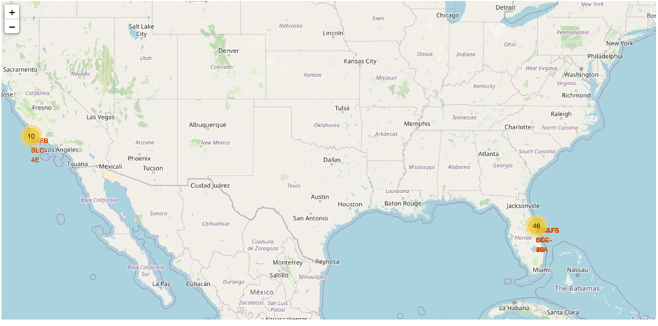
FALCON 9 Launch Site Map Analysis
Map with Launch Site Cluster Marker

Slide 23
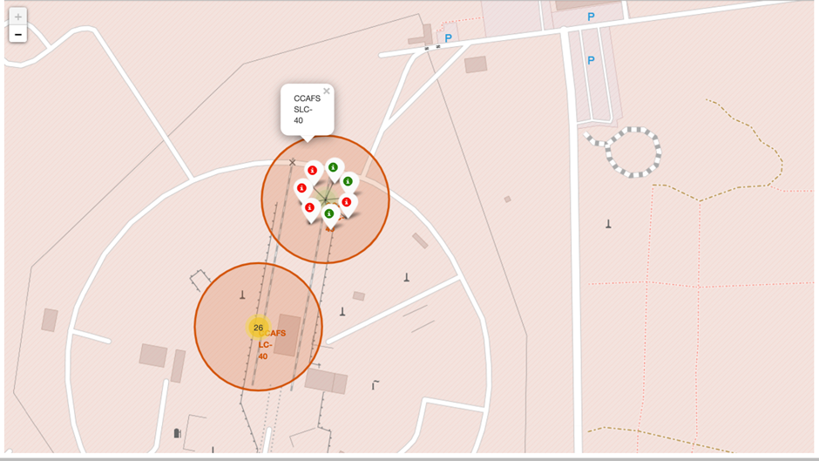
FALCON 9 Launch Site Map Analysis
Map with Launch Site Cluster detail

Slide 24
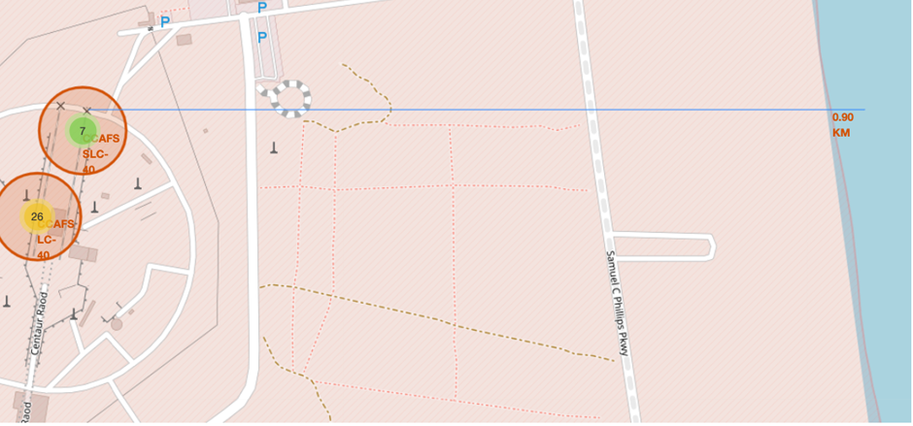
FALCON 9 Launch Site Map Analysis
Map with Launch Site Coastline distance

Slide 25
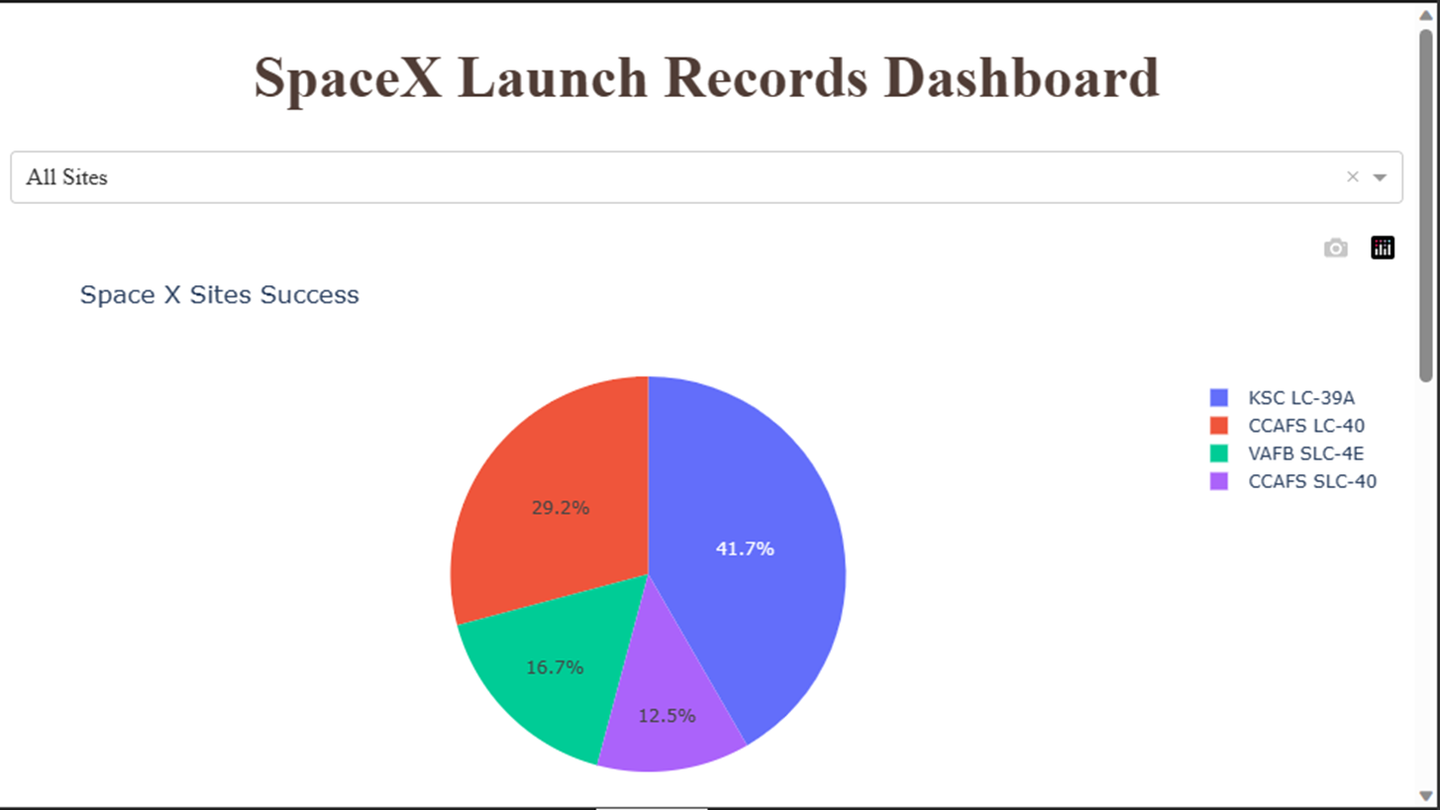
DASHBOARD TAB 1

Slide 26
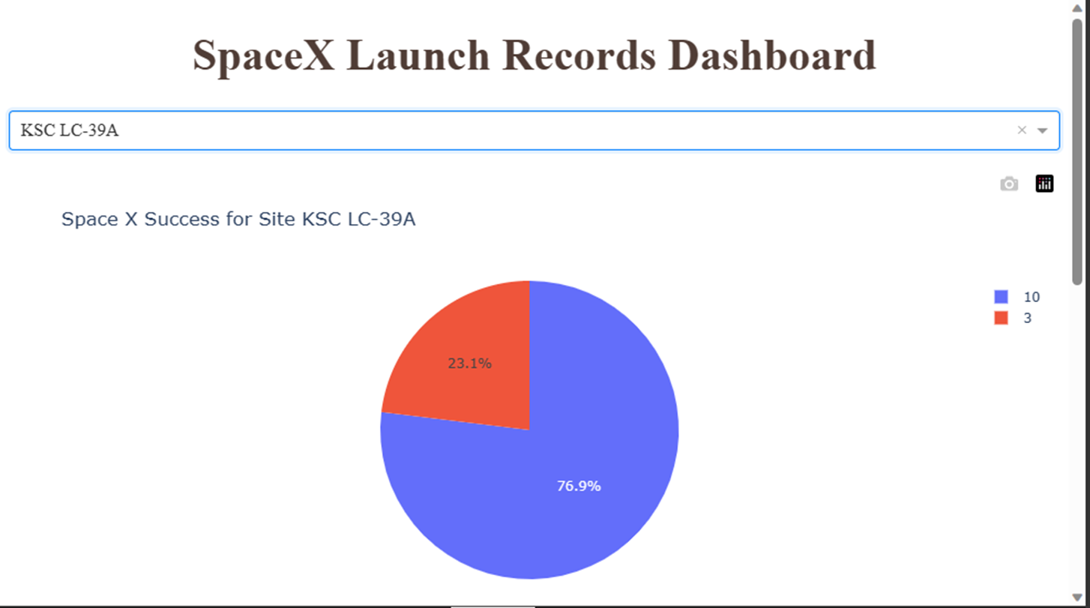
DASHBOARD TAB 2

Slide 27
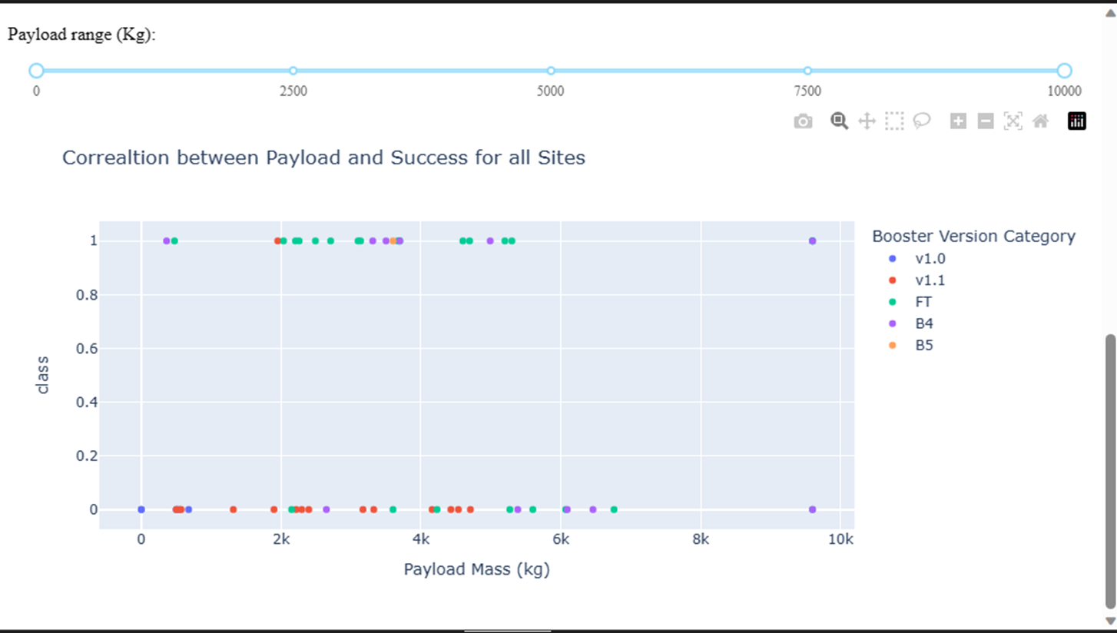
DASHBOARD TAB 3

Slide 28
OVERALL FINDINGS & IMPLICATIONS
Findings
Recent launches have higher success rate
Specific launch sites have a higher success rate
Booster Version Category of FT has been very successful with Payload Mass between 2000kg and 6000kg
Implications
Successful landing of first stage has increased over time
Combination of Launch site, Payload Mass and Booster Version category can be used for improving success rate of landing first stage

Slide 29
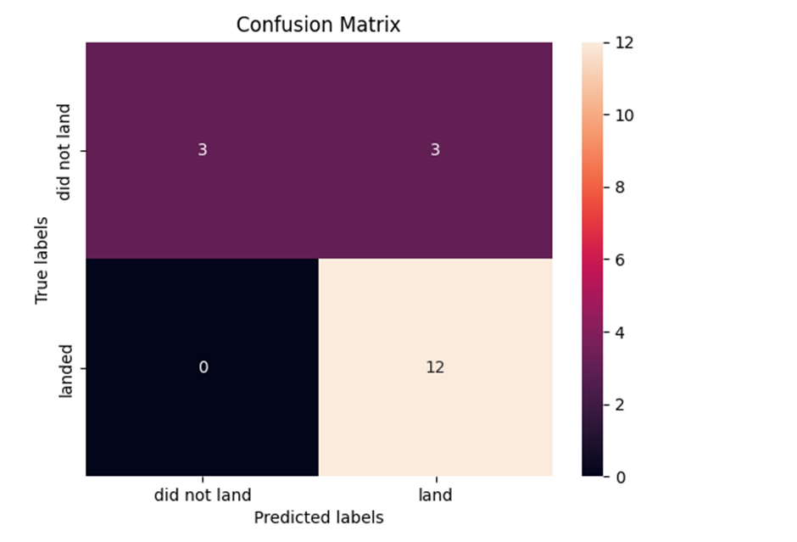
RESULTS – Predictive Analysis
Findings
Applying Logistic Regression using best parameters leads to 83.33% accuracy score for prediction
As per confusion matrix there are no false negatives and three false positives

Slide 30
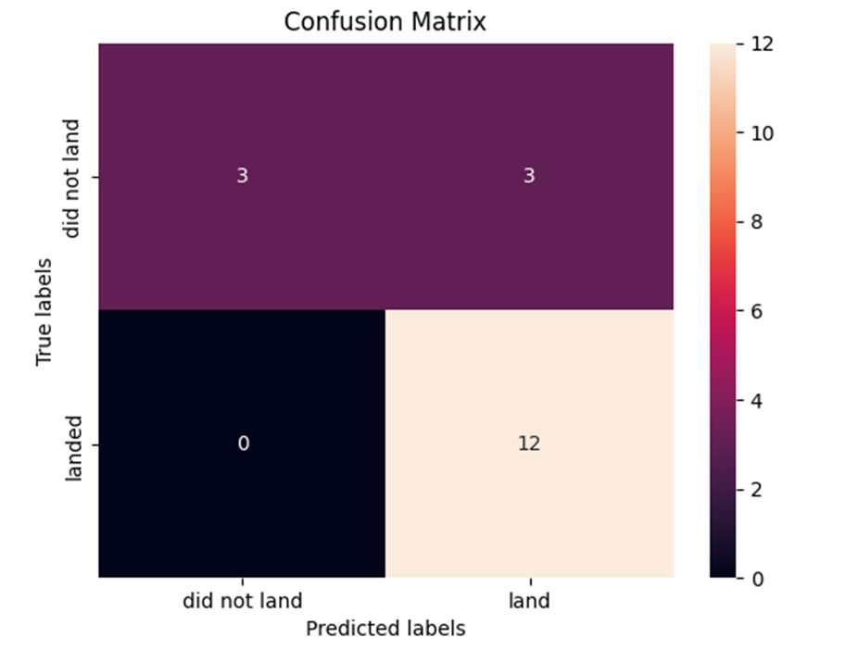
RESULTS – Predictive Analysis
Findings
Applying SVM using best parameters leads to 83.33% accuracy score for prediction
As per confusion matrix there are no false negatives and three false positives

Slide 31
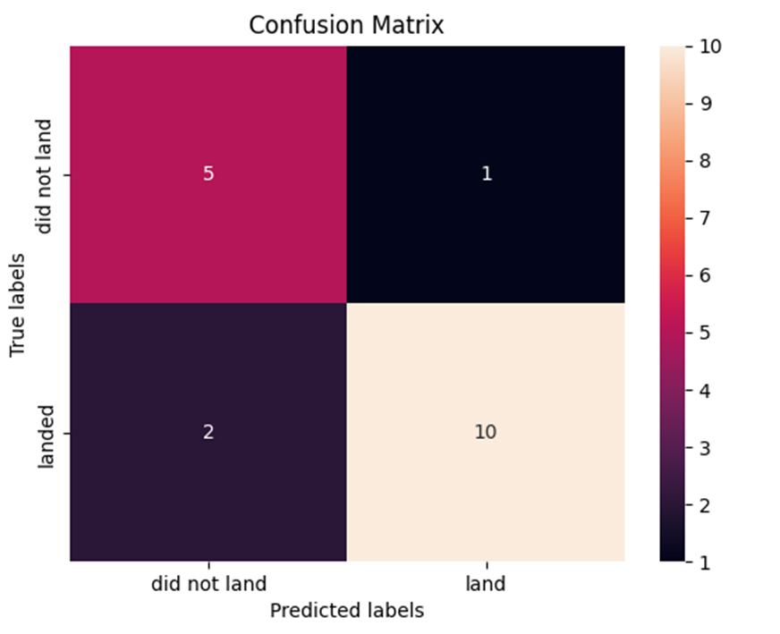
RESULTS – Predictive Analysis
Findings
Applying Decision Tree classification using best parameters leads to 83.33% accuracy score for prediction
As per confusion matrix there are two false negatives and one false positive

Slide 32
RESULTS – Predictive Analysis
Findings
Applying k-nearest neighbor using best parameters leads to 83.33% accuracy score for prediction
As per confusion matrix there are no false negatives and three false positives

Slide 33

DISCUSSION
There is evidence of higher Payload Mass for recent flights has had a successful outcome for launch site CCAFS SLC 40.
There could be more investigation into parameters for GridFins, Reused flag and Legs.

Slide 34

CONCLUSION
Most successful launch sites are CCAFS SLC 40 and KSC LC 39A
Most recent flights for LEO orbit have been successful
Successful launch of first stage outcome can be predicted with 83% accuracy

Slide 35

APPENDIX
Screenshot of Source data insights provide from wikipedia page:
https://en.wikipedia.org/wiki/List_of_Falcon_9_and_Falcon_Heavy_launches

Slide 36
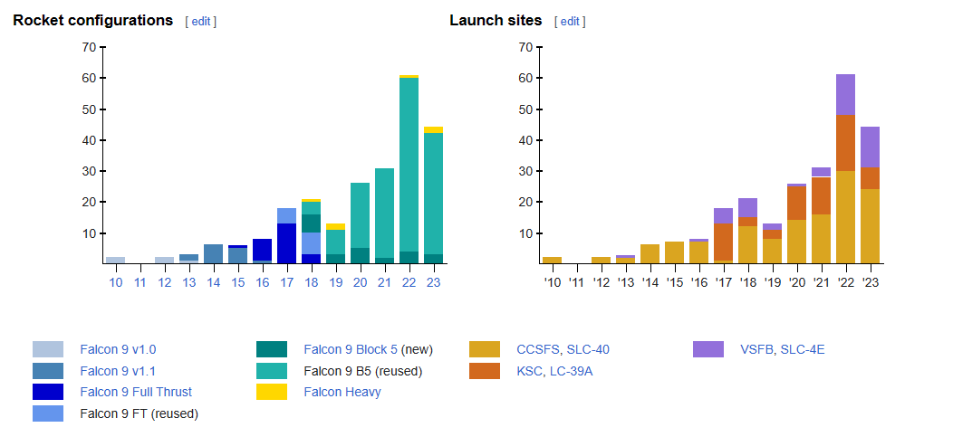
APPENDIX – Source data Insights

Slide 37
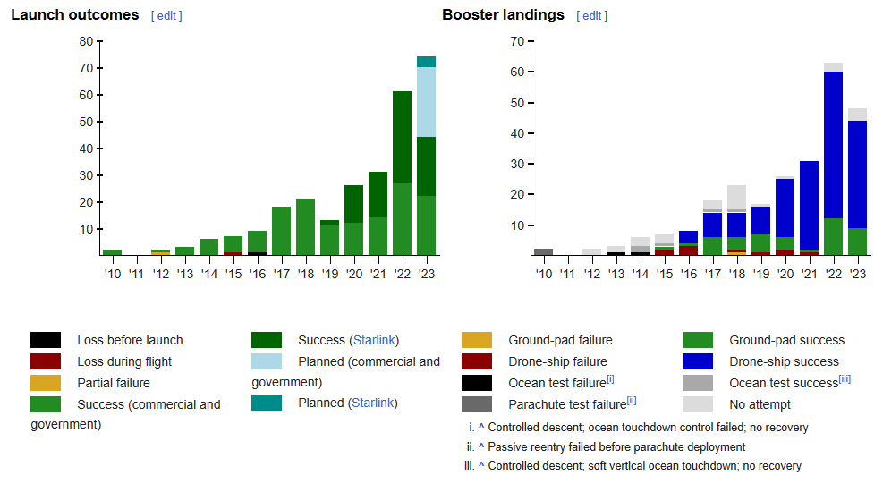
APPENDIX – Source data Insights

