Slide 1

Explore Zomato restaurants dataset in the city of Pune

Slide 2
Introduction
Pune, is a bustling metropolis in the Indian State of Maharashtra and the eighth most populous city in India, with an estimated population of 7.4 million as of 2020.It has been ranked as "the most livable city in India" several times. Pune is widely regarded as the second major "IT hub of India" and the top "automobile and manufacturing hub of India". It is also known as the "Oxford of the East" due to the presence of several well-known educational institutions.
With its diverse culture, come diverse food items. There are many restaurants in Pune City, each belonging to different categories like Chinese, Italian, and French etc. apart from wide variety of Indian cuisines. So as part of this project, we will list and visualize all major parts of Pune City.

Slide 3
Objectives
Questions that can be asked using the above mentioned datasets
• Which places have best restaurants in Pune? • Which places have worst restaurants in Pune? • Which place has highest number of restaurants in Pune City? • Which place has lowest number of restaurants in Pune City? • What area has most number of Italian restaurants in Pune? • What area has highest rating of Italian restaurant in Pune?

Slide 4
Data
For this project we need the following data :
1. Pune Resturants data that contains list Locality, Resturant name,Rating along with their latitude and longitude. • Data source : Zomato kaggel dataset • Description : This data set contains the required information. And we will use this data set to explore various locality of Pune city.
2. Nearby places in each locality of Pune city. • Data source : Fousquare API • Description : By using this api we will get all the venues in each neighborhood.

Slide 5
Approach
Collect the Pune city data from Zomato kaggel dataset.
Using FourSquare API we will find all venues for each neighborhood.
Filter out all venues that are nearby by locality.
Using aggregative rating for each resturant to find the best places.
Visualize the Ranking of neighborhoods using folium library(python).

Slide 6
Analysis

Slide 7
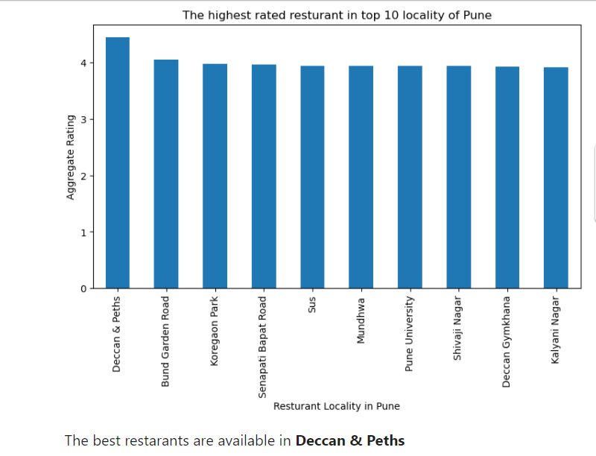

Slide 8
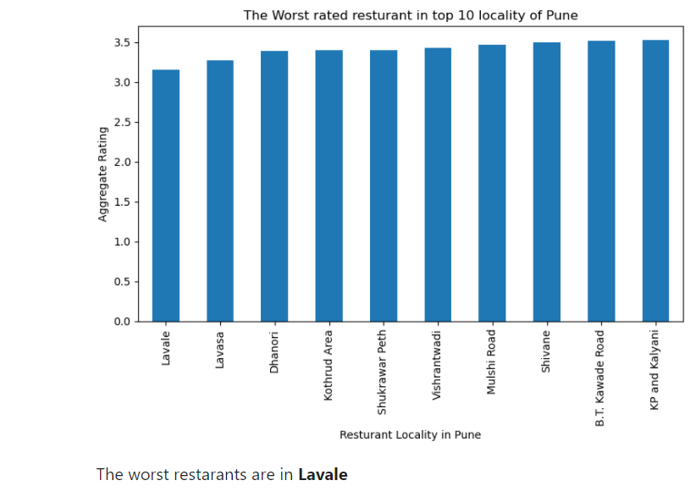

Slide 9
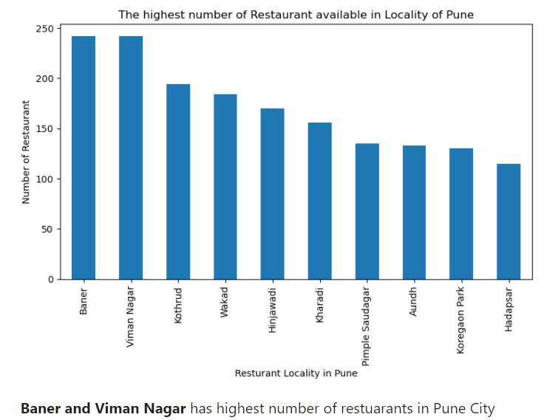

Slide 10
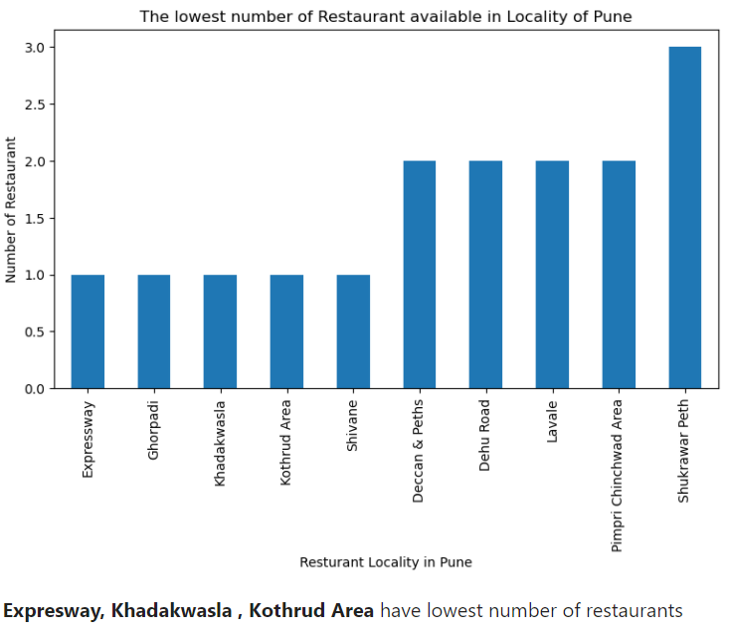

Slide 11
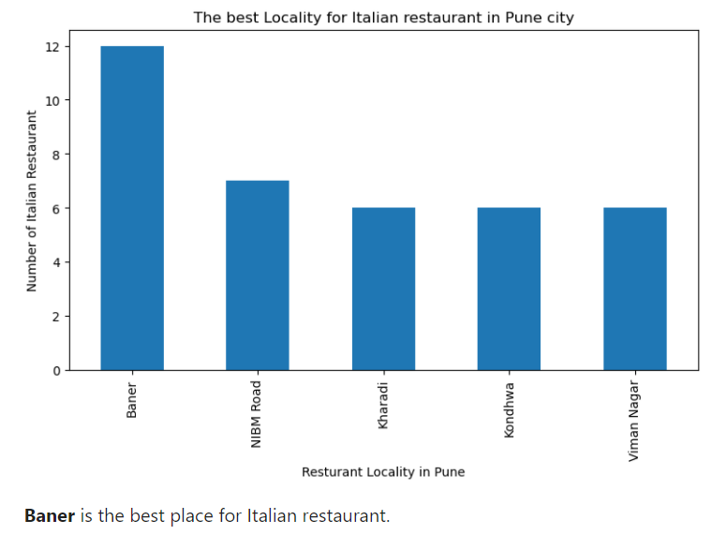

Slide 12
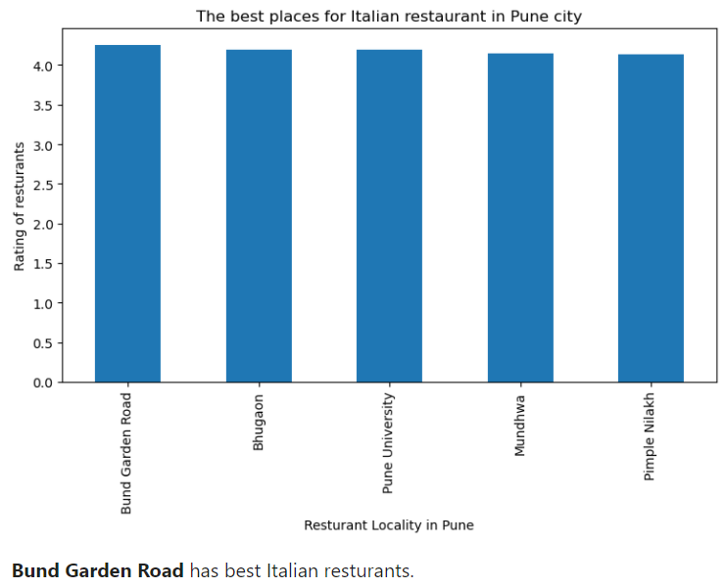

Slide 13
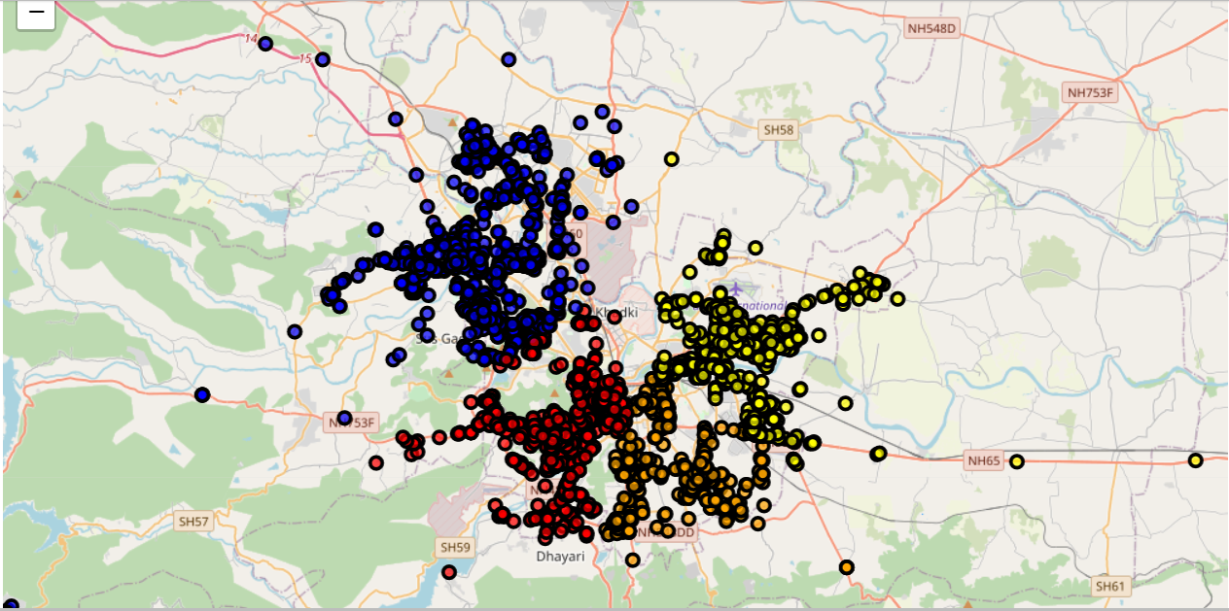
1. Map to show the restaurant clusters in Pune

Slide 14
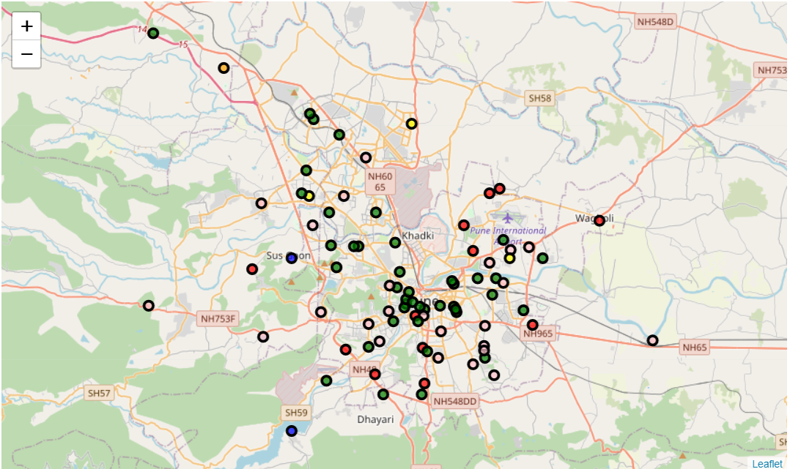
2.Map to show clusters of Pune localities based on various venues

Slide 15
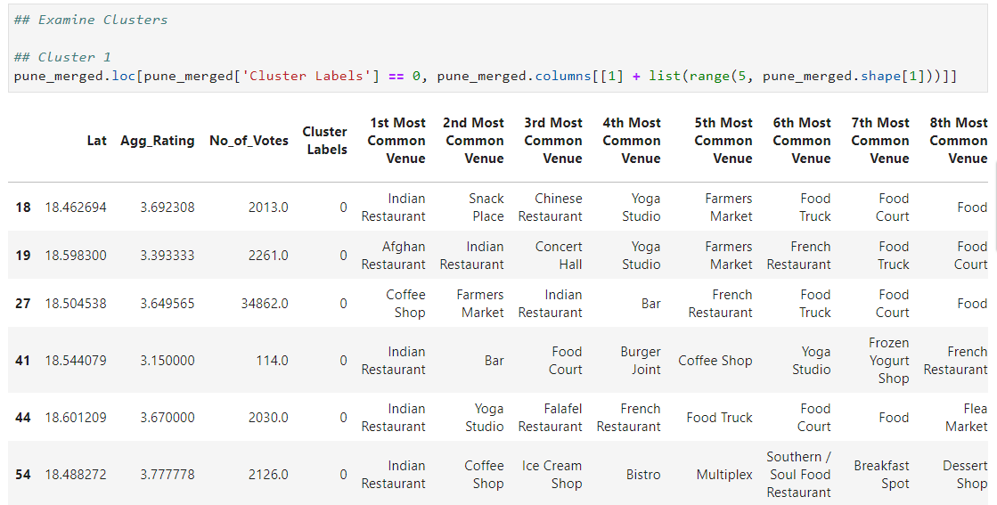
Cluster 1:

Slide 16
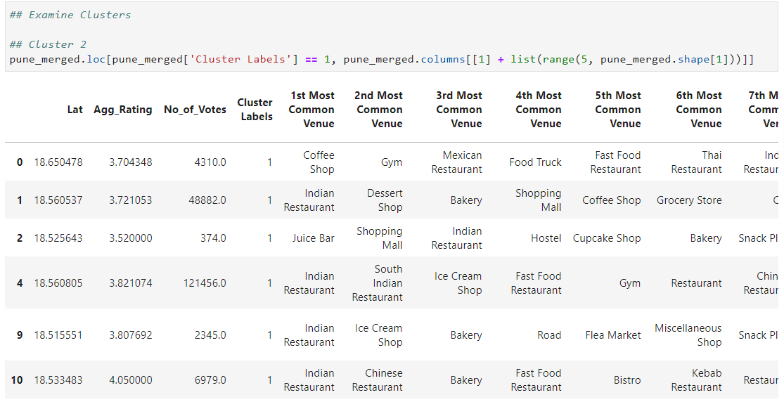
Cluster 2:

Slide 17
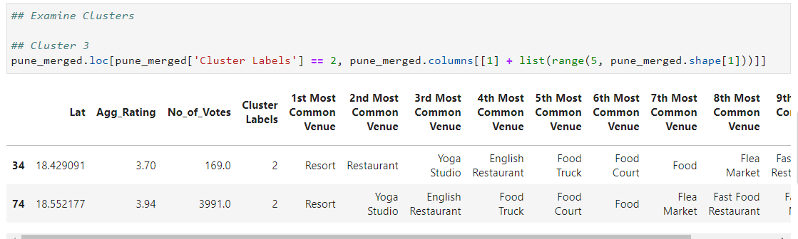
Cluster 3:

Slide 18
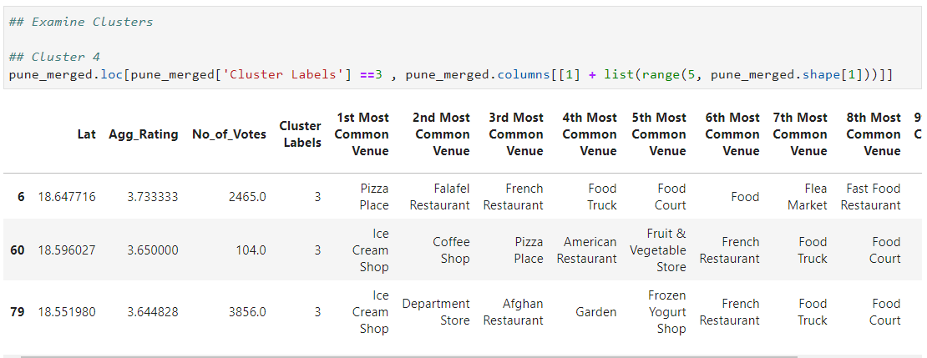
Cluster 4:

Slide 19
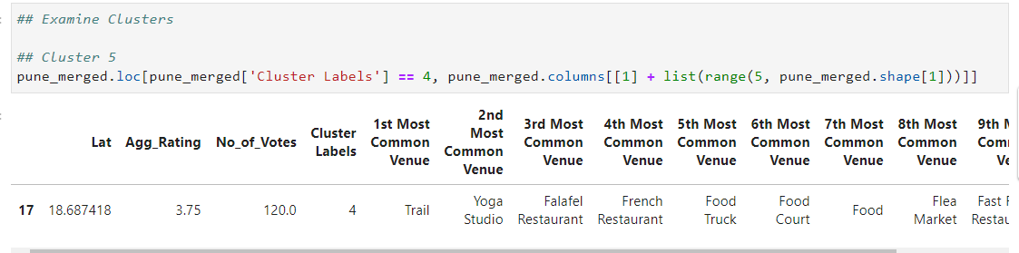
Cluster 5:

Slide 20
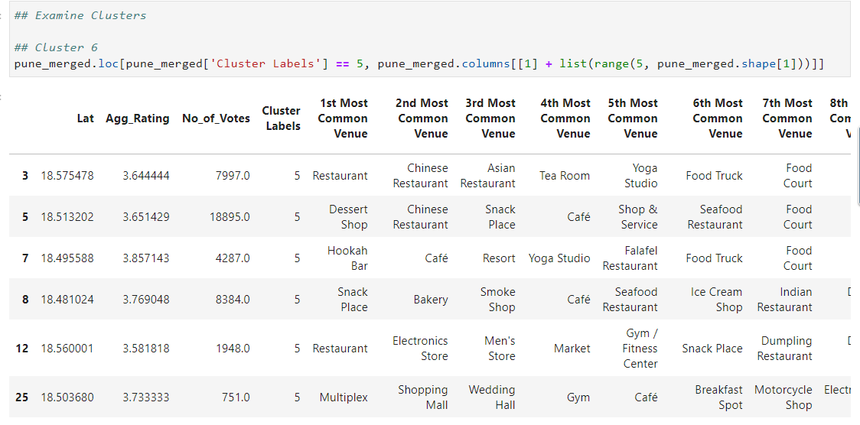
Cluster 6:

Slide 21
Results
Upon different analysis, I was able to discover the best neighborhood on the criteria of highest number of restaurants and quality of restaurants. Also, I have tried to identify most livable neighborhood that have most of the basic venues. Let’s review the analysis made in this project and then we I will summarize the project findings in the conclusion area.

Slide 22
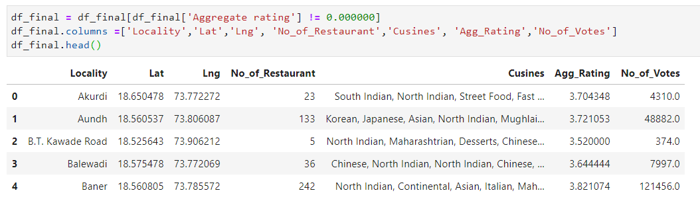
1. Finding aggregate rating of all restaurants in each neighborhood/locality.

Slide 23
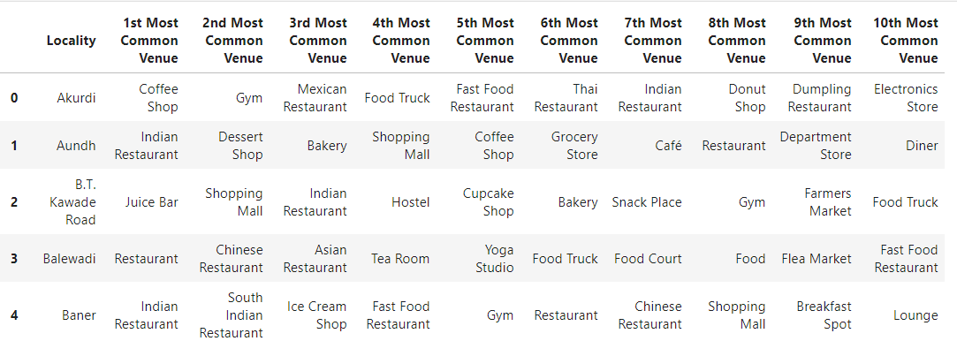
2.Exploring 10 common venues in each neighborhood/locality.

Slide 24
Conclusion
1. The best restaurants are available in Deccan & Peths. 2. The worst restaurants are in Lavale. 3. Baner and Viman Nagar have highest number of restaurants in Pune City. 4. Expresway, Khadakwasla , Kothrud Area have lowest number of restaurants. 5. Baner has the most number of Italian restaurants. 6. Bund Garden Road has best Italian restaurants according to ratings. 7. Places in Cluster 1 & 2 has many Indian restaurants. 8. Places in Cluster 2 has many cafes, coffee shops and dessert shops. 9. Places in Cluster 3 has resorts and yoga studios. 10. Places in Cluster 6 is most livable as it has - restaurants, dessert shops, hotels, cafes , shopping malls etc.

