Slide 1

The Game of Thrones
By- The Motion Sensors ;)

Slide 2
Team Members:
Muthu Mohan
Shubhra Rajadhyaksha
Vinaya Chandiramani
Vincent Troy Ibanez

Slide 3
Why do we need this app?
*cue video*

Slide 4
Outline
Project has all the components mentioned : Physical Web , Cloud/Traditional Web, Mobile Web
Introduction
Hardware side
Backend and Frontend
Demo

Slide 5

Problem :
Issues with bathroom
Always full when needed
Not Clean
No air freshner
No Paper Napkins
Waste of time

Slide 6
Goals
To develop a System which can help solve the above problems.
Check status of stalls (available or busy) from website or mobile device
Have a fresh toilet with air freshner by just pressing a button on screen
Know status of cleanliness and toilet papers beforehand
Request maintenance to clean the stalls in advance by button click
Reserve a stall
Save time

Slide 7
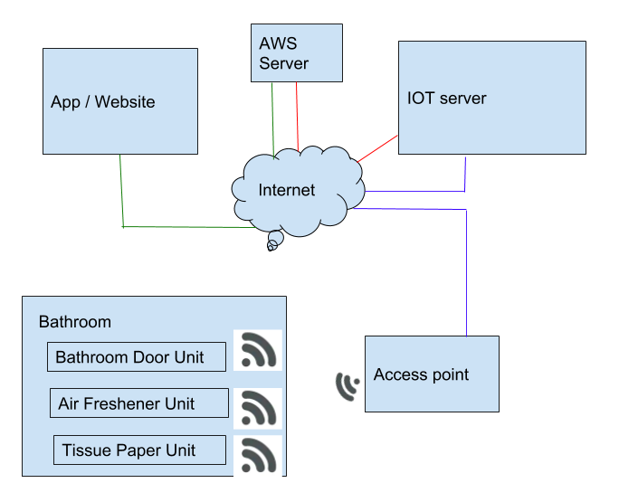

Slide 8
Market Comparison
 | App-based | Modular | Reservation System | Does not require proprietary HW
Good2Go | x | ? | x
Hackster Toilet Management System | x |  | x
Game of Thrones | x | x | x | x
What’s the Business Value of our product?
https://www.hackster.io/taifur/toilet-management-system-8e2786
https://www.good2go.global/aboutus

Slide 9
Hardware Development

Slide 10
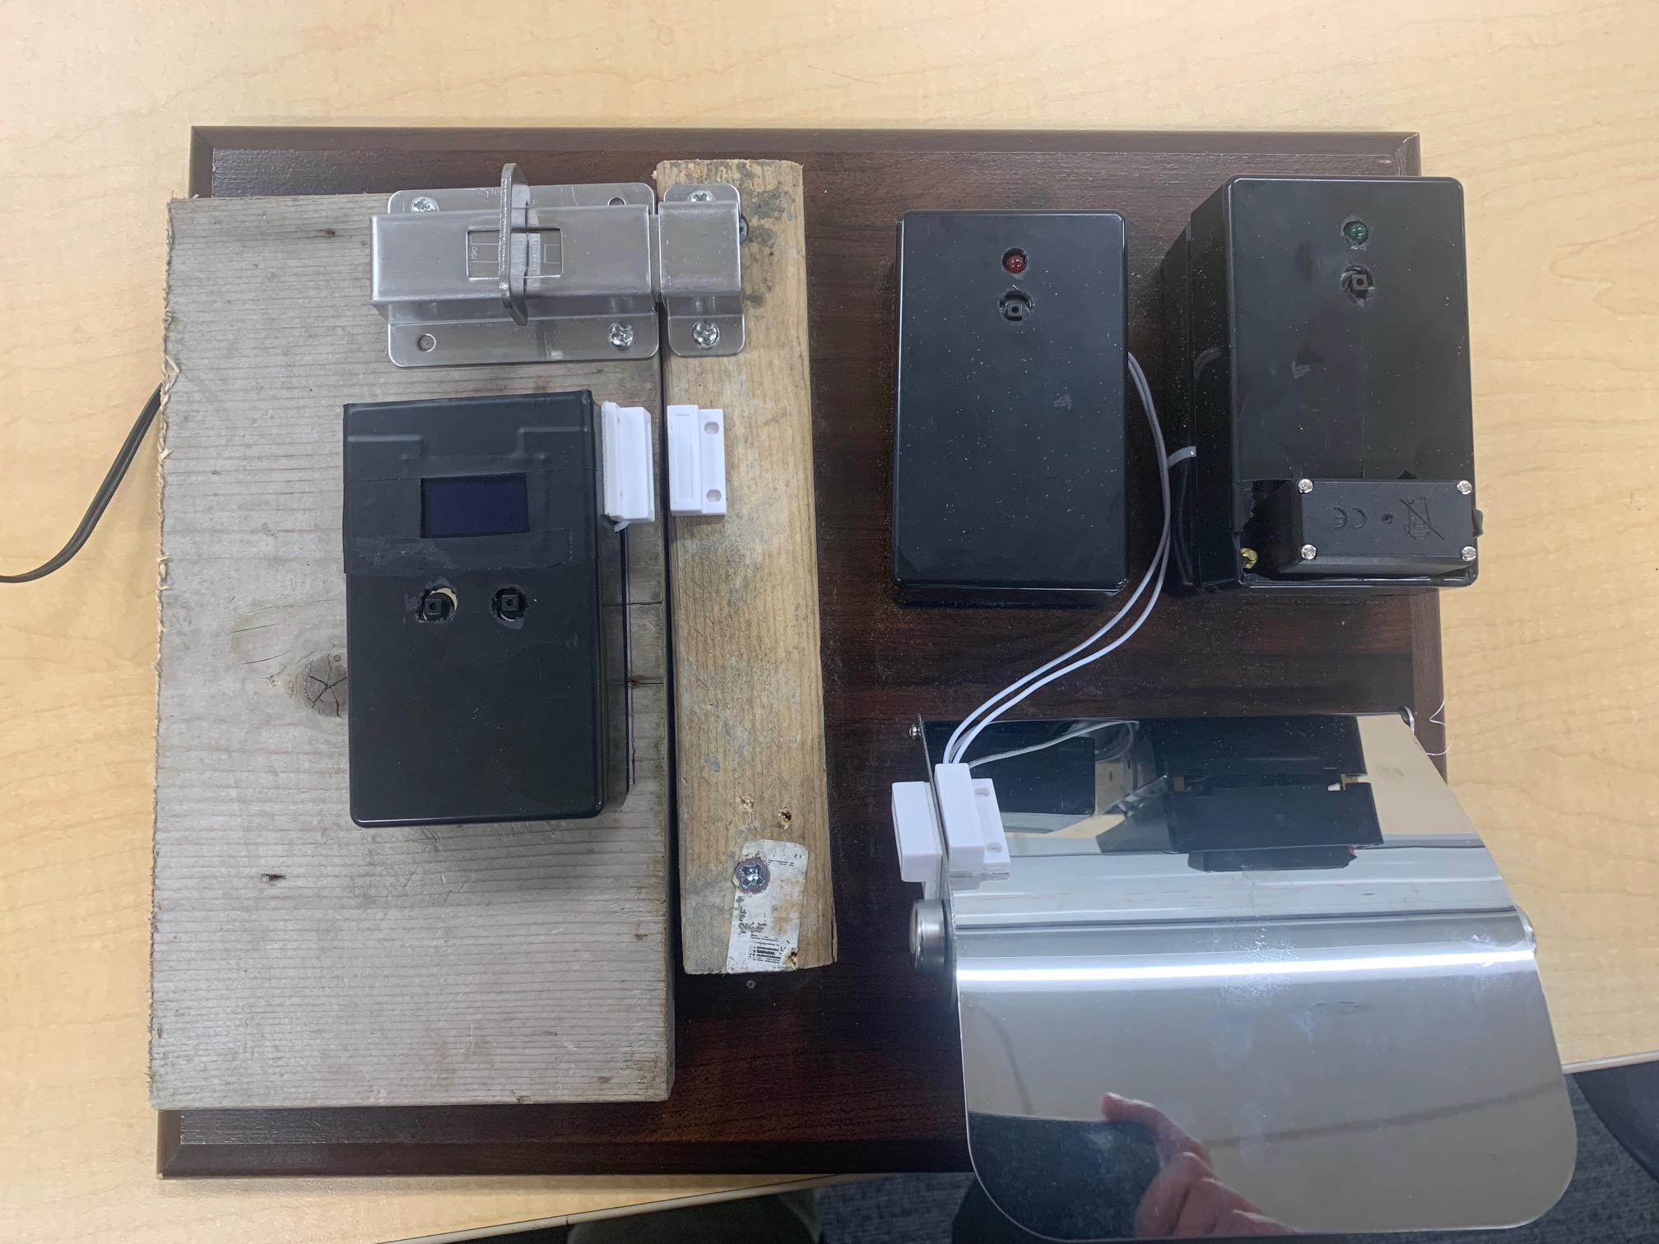
Modular Components
Main Bathroom Door Unit
Main brains
Display Statuses
Buttons for requests
Toilet Paper Unit
Buttons for TP request
Air Freshener Unit

Slide 11
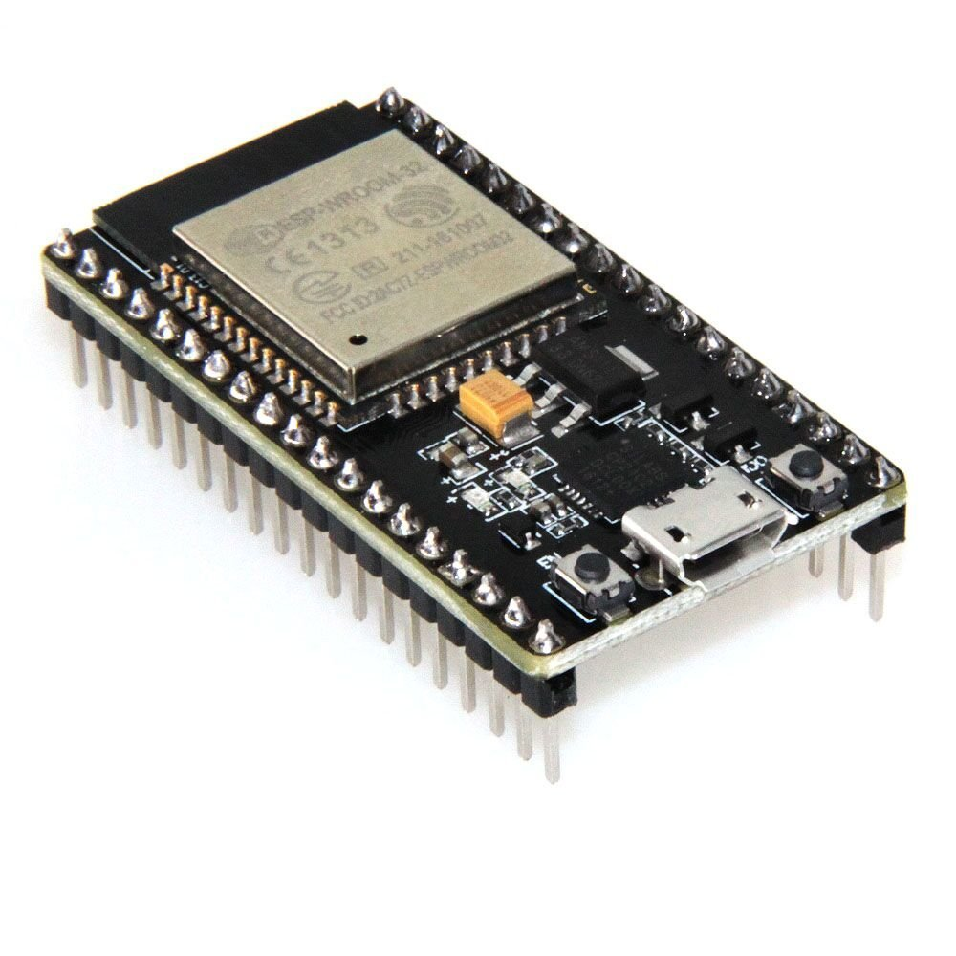
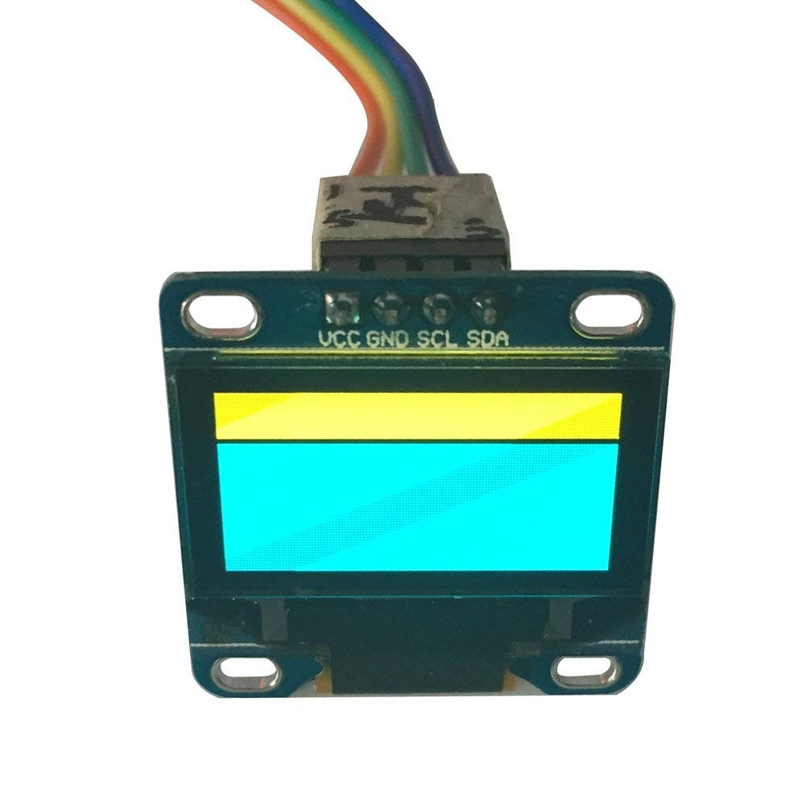
Hardware Inventory :
HiLetgo ESP32
https://www.amazon.com/HiLetgo-ESP-WROOM-32-Development-Microcontroller-Integrated/dp/B0718T232Z
Diymall 128x64 OLED LCD
https://www.amazon.com/gp/product/B00O2LLT30

Slide 12
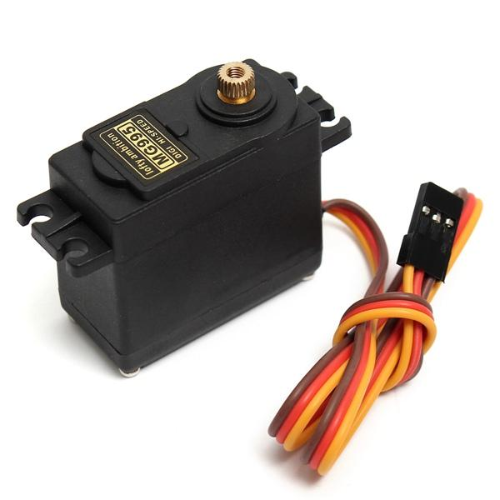
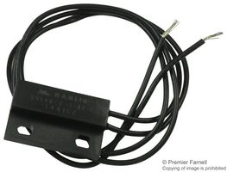
Hardware Inventory :
TowerPro MG995 Digital Servo
https://www.amazon.com/REES52-MG995-TowerPro-Digital-Servo/dp/B0156059W2
Reed Hall Sensor
https://www.ebay.com/itm/5-12V-Door-Magnet-Relay-Module-Normally-Closed-Reed-Control-Switch-For-Arduino/401466037070

Slide 13
Hardware Design Challenges
Sensor selection : Reed hall sensor
Non-contact sensor, very durable and low power
Power Considerations
Servo motor stalling with Hi Letgo power regulator
Solution: Add capacitor

Slide 14
Backend
NodeJS (Used to get IoT updates)
Backbone of IoT Server
PHP
Used to send GET requests to IoT server
Javascript
Used for Document Object Manipulation

Slide 15
Web and mobile :
HTML5
Bootstrap
Javascript
Phonegap

Slide 16
Demo Time!

Slide 17
Future Plans
Add notifications and an email service to notify when you’re first on the queue
Statistical Reporting for maintenance view to see how often cleaning is needed, how many toilet paper requests were served.

Slide 18
Conclusion/ Lessons learnt
Integration is the most difficult part and so is coming to common decisions
It is not as easy as it looks
Always make a product which you would have loved to use.

Slide 19
Thank you :
God :D : For everything
Professor and Aditya - For answering our doubts asap
Filled bathrooms- For giving us this idea
Google

Slide 20
References:
How to setup interrupts:
https://techtutorialsx.com/2017/09/30/esp32-arduino-external-interrupts/
Debounce circuit:
https://www.arduino.cc/en/tutorial/debounce

Slide 21
References
OLED Drivers
https://startingelectronics.org/tutorials/arduino/modules/OLED-128x64-I2C-display/
https://learn.adafruit.com/monochrome-oled-breakouts/arduino-library-and-examples
I2C Setup
https://docs.espressif.com/projects/esp-idf/en/latest/api-reference/peripherals/i2c.html
Servo Driver
https://randomnerdtutorials.com/esp32-servo-motor-web-server-arduino-ide/

Slide 22
Picture URLs
https://www.signs.com/blog/when-you-gotta-go-funny-bathroom-signs/
http://uberhumor.com/just-relax

