Slide 1

Fake Job Postings Detection Model

Slide 2
Objective
Goal
Benefits
Develop a machine learning solution to detect fake job postings.
Ensure platform integrity and user trust in job marketplaces.

Slide 3

Model Overview
Problem
Solution
Models
Fake job postings harm companies and job seekers.
Leverage machine learning models to identify fraudulent postings.
Random Forest and XGBoost were evaluated.

Slide 4
Random Forest
Performance
Strengths
Accuracy: 98.07% ROC-AUC: 0.98
Reliable and interpretable baseline. Balances recall and precision. Quick to deploy and efficient.

Slide 5
XGBoost
Performance
Strengths
Accuracy: 98.35% ROC-AUC: 0.98
Advanced optimization capabilities. Superior performance on structured data. High flexibility for hyperparameter tuning.

Slide 6
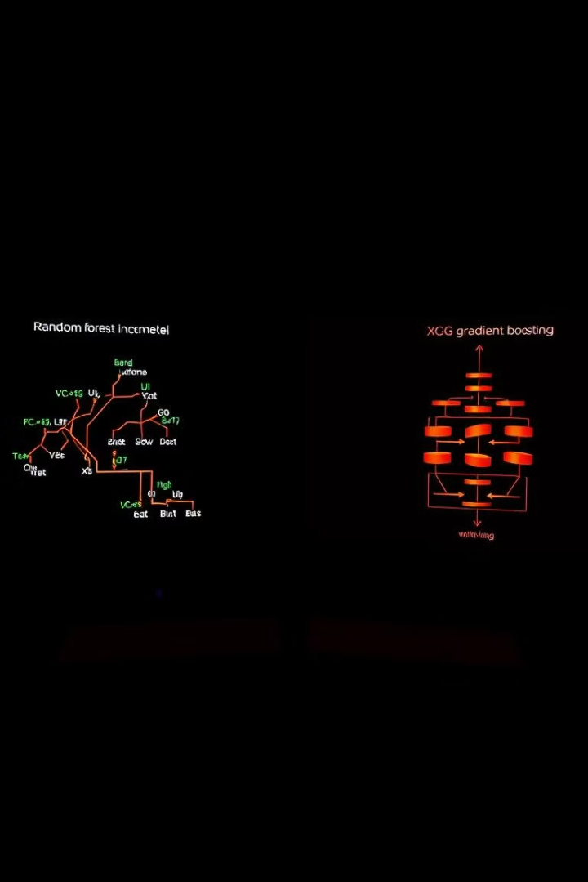
Model Insights
Random Forest
XGBoost
Suitable for quick and reliable baseline models. Interpretability makes it ideal for initial exploration.
Excels in handling complex data patterns. Recommended for production systems where performance is crucial.

Slide 7




Recommendations
Primary Deployment
Backup Model
Deploy XGBoost as the primary model.
Use Random Forest as a secondary model.
Future Enhancements
Explore ensemble methods. Incorporate domain-specific features.

Slide 8



Business Value
1
Trust
2
Integrity
3
Leadership

Slide 9
Conclusion
1
Performance
2
Foundation
3
Value

