Slide 1

Scramblox: A Web-Based Word Scramble Game
By- Shubh Saraswat

Slide 2

Problem Statement-104
Many word games focus mainly on entertainment and do not effectively help users improve their vocabulary or thinking skills.
Users often lack engaging platforms that combine learning with interactive gameplay.
Therefore, there is a need for a simple and accessible web-based word scramble game that challenges users to rearrange scrambled words, improve vocabulary, and track their performance in an engaging way.

Slide 3
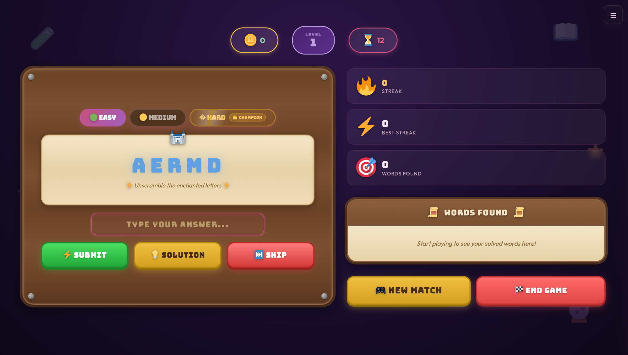
My Solution
Develop Scramblox, an interactive web-based word scramble game that helps users improve their vocabulary skills.
The game presents scrambled words that players must rearrange correctly within a time limit.
It includes easy, medium and hard difficulty levels, scoring, and an engaging user interface.
The game is built using HTML, CSS, and JavaScript, making it lightweight and easily accessible through a web browser.

Slide 4
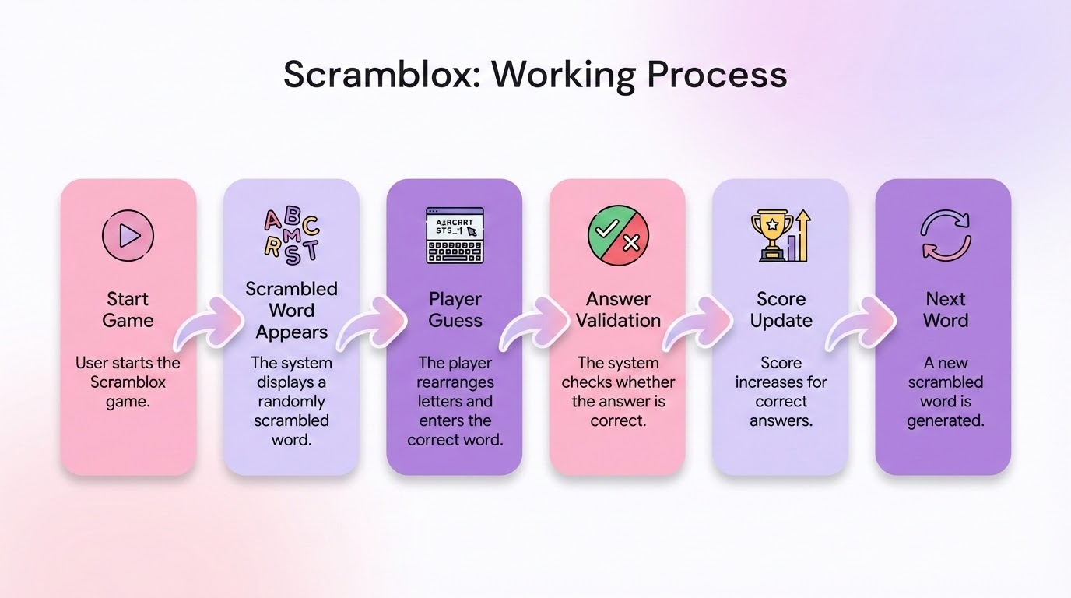
Working
The game displays a scrambled word to the player.
The player must rearrange the letters and enter the correct word within the given time.
The system checks the answer and updates the score accordingly.
After each correct answer, a new scrambled word is generated based on the selected difficulty level.
The game continues until the timer ends, and the final score is displayed.

Slide 5
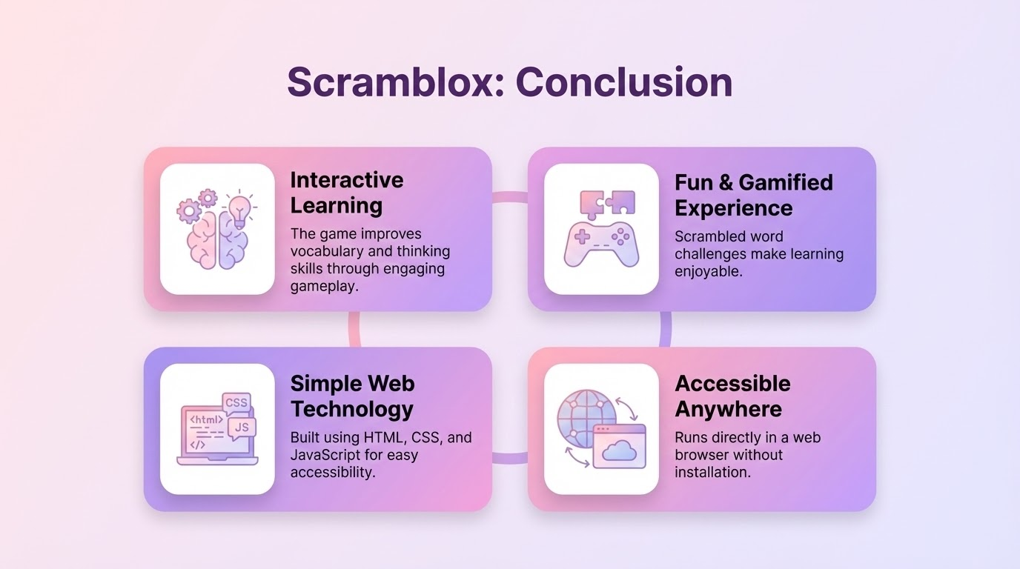
Conclusion
Scramblox is an interactive word scramble game designed to improve vocabulary and thinking skills.
The game makes learning fun through scrambled words, time-based challenges, and scoring.
Built using HTML, CSS, and JavaScript, it is lightweight and easily accessible through a web browser.
The project demonstrates how simple web technologies can create an engaging and educational gaming experience.

Slide 6
Thank You

