Slide 1
Analyzing Sales of Games on Steam Final Project Presentation Varisht Raheja Shubham Sharma Sobhagya Singh Jamwal Hemanya Tyagi

Slide 2
Agenda
Introduction
Motivation
Measuring Success of game industry
Data Overview
Hypothesis
Methodology
Recommendation
Limitation

Slide 3


Project analysis slide 2
Introduction
Steam: a video game distribution channel
In this project analyzed the sales of video game on Steam.
Steam is essentially an online channel which facilitates buying and selling of video games.
It is relevant to game developers planning proprietary software projects.

Slide 4
Project analysis slide 2
Motivation
$36.9 Billion
$43.4 Billion
18%
Revenue of Video Games in US
2017
2018
Of every 100 video games released on Steam
Only, 14 cross 50,000 owners

Slide 5

Project analysis slide 2
Measuring Success of Videogames
Owners*Price
Reviews
Owners
Does not take into account DLC and in-app purchases.
Price drives sales.
Ambiguous.
Reviews do not correlate with success or sales.
Reasonable proxy of sales.
Further optimization can be done by pricing strategies.

Slide 6
Project analysis slide 2
Data - Overview
Data Source
Kaggle
Scraping from Steam
Calculating Owners
Owners divided into bins
Estimated owners on the basis of number of reviews
Preprocessing
Log-transformation
Dummy Creation. Example: multi-player

Slide 7
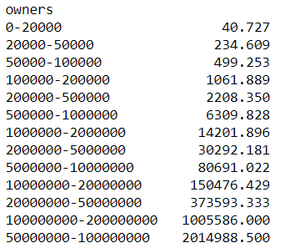
Project analysis slide 2
Data - Overview
The average number of reviews per game increases with increase in the number of owners.
We assume that the same pattern following within the bins.
We approximate the number of owners using min-max normalization according to the total number of reviews

Slide 8
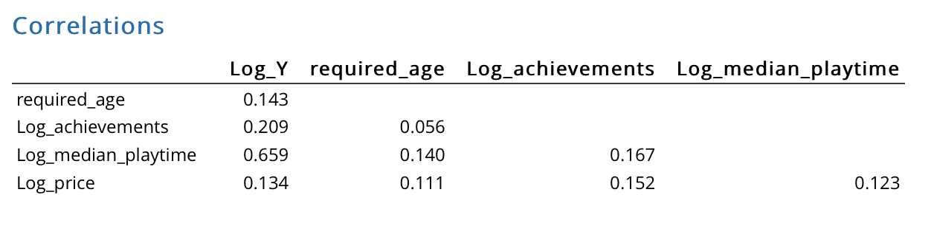
Project analysis slide 2
Data - Overview
Correlations of Log y (y= number of downloads), Required age to play the game, Achievements within a game, median playtime of a game
Correlation of playtime with number of download is high

Slide 9
Project analysis slide 2
Hypothesis
Are the number of downloads dependent upon…?
Numerical Factors: Required Age, Achievements, Median Playtime, Price, Positive Reviews(%).
Categorical Factors: Platform (Windows vs Mac Vs Linux), Multi-player, single-player, local vs online, in-app purchases, DLC, action
Description Text Analysis:
Through the review of the games, modelled top-6 topics : 1. card simulation empire train 2. girls objects questions children 3. units vehicles single-player arena 4. island house magical forest 5. ball racing button color 6. ships zombies defense tower
Icon Image Analysis:
Contrast and brightness of the icon image.

Slide 10
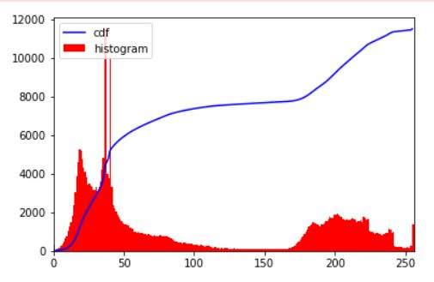
Project analysis slide 2
Methodology
Image Processing
Create histograms
Normalize
Text Processing
Tokenizing
Stop Words Removal
Transformation
Lemmatization
LDA
From this intensity histogram of a sample image it is evident that it has low contrast
Using Topic Modelling LDA we got the following topics
card simulation empire train
girls objects questions children
units vehicles single-player arena
island house magical forest
ball racing button color
ships zombies defense tower

Slide 11
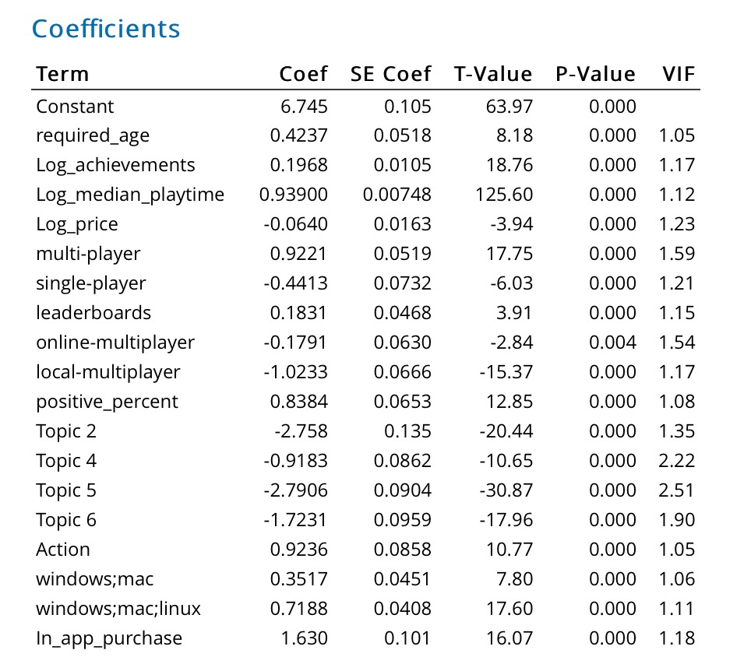
Project analysis slide 2
Methodology
Image Processing
Create histograms
Normalize
Text Processing
Tokenizing
Stop Words Removal
Transformation
Lemmatization
LDA

Slide 12
Project analysis slide 2
Methodology
Insights from Multivariate Regression Analysis
Game downloads is positively related to factors such as achievements and leaderboards
The number of owners are negatively related to price.
The topics that we extracted through text analysis are negatively correlated with number of owners
Most popular topics are not related to the most successful game
For image features we found no significant relationship

Slide 13
Project analysis slide 2
Recommendations
Case 1: Design Choice
Action vs Non-Action
Recommendation system for Game developers
Determining if Action genre is profitable or not
Using T test ( Refer to appendix 1), Demand Action > Demand Non-Action

Slide 14
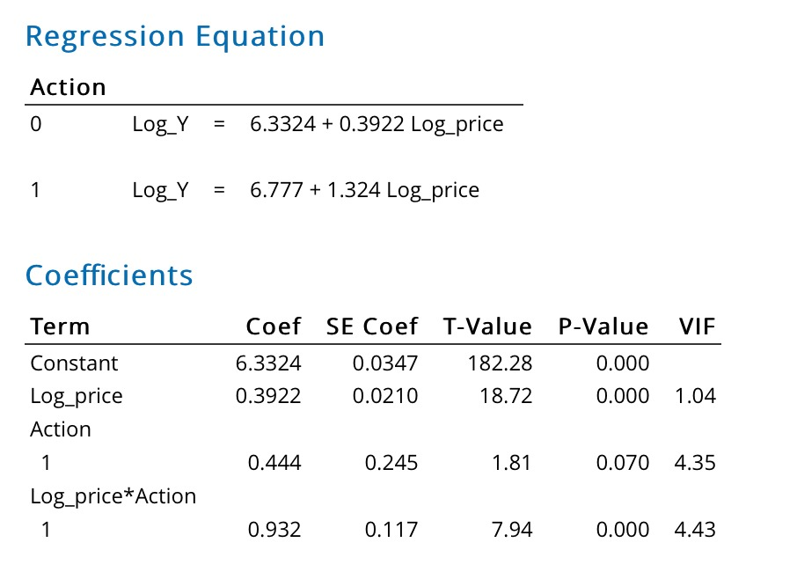
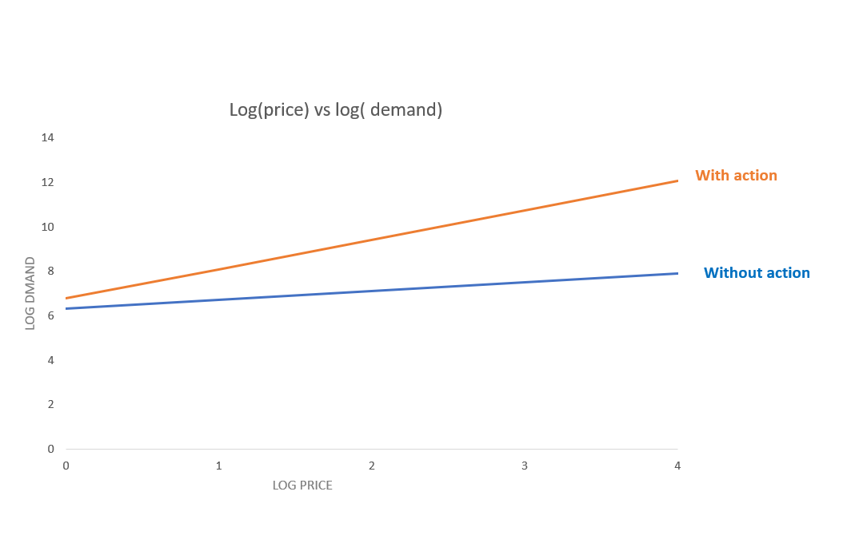
Project analysis slide 2
Recommendations
Case 1: Design Choice
Action vs Non-Action
From the regression equation we found that we can place action games with higher price as there is a positive interaction of action/non action games with price

Slide 15
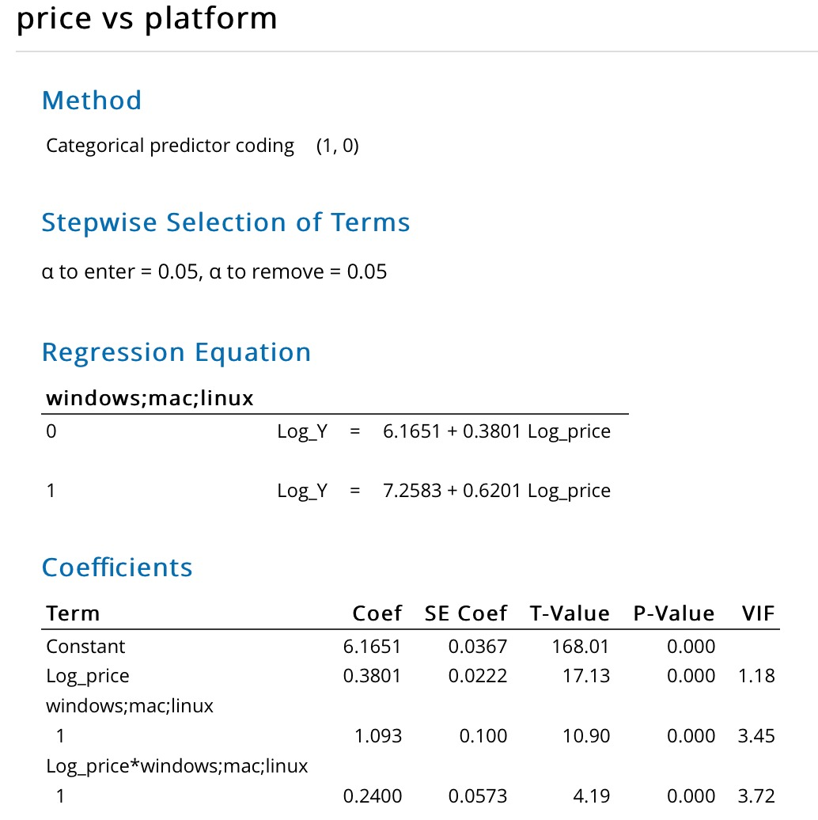
Project analysis slide 2
Recommendations
Case 1: Design Choice
Only Windows vs All Platforms
Whether to develop game only for windows or windows + Linux + Mac.
Developing a game in single platform will have different cost compared to launching it in multiple platforms.
Regression equation showing relation of price and demand with all platform as a dummy variable.

Slide 16
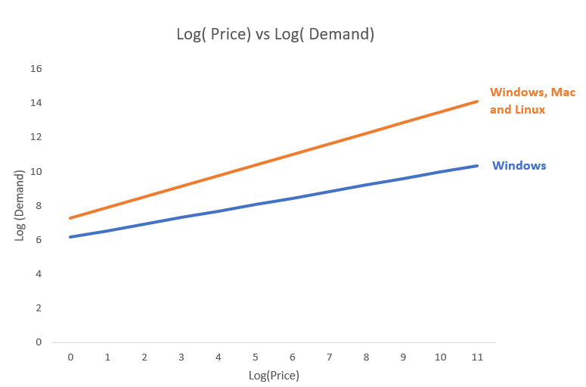
Project analysis slide 2
Recommendations
Case 1: Design Choice
Only Windows vs All Platforms
For a given price it turns out cross-platform games generate more than single-platform games

Slide 17
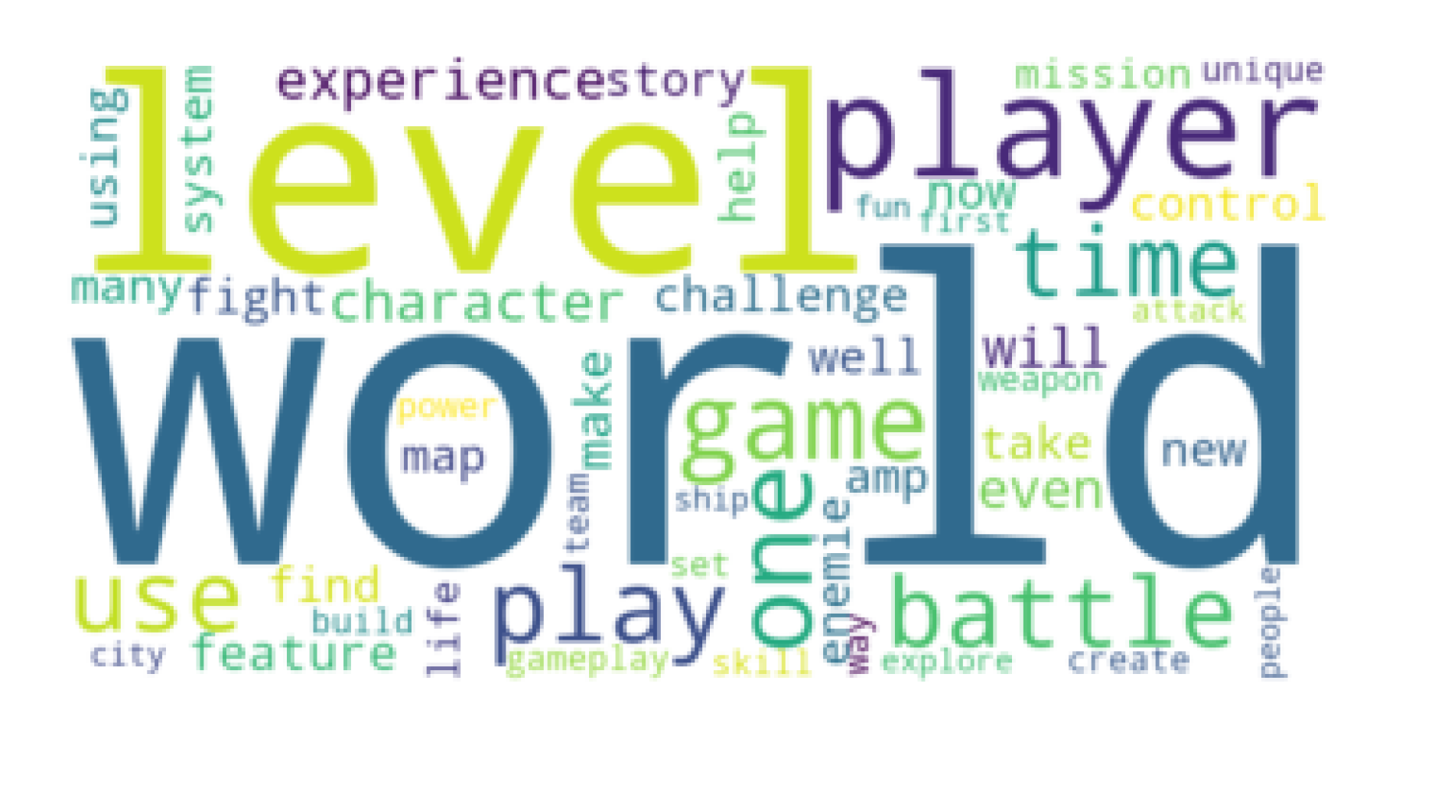
Project analysis slide 2
Recommendations
Case 1: Design Choice
Words description in Action game
Analysis describing prominent kind of descriptions in top action game
Word cloud of successful action game was created
From this word cloud, the developer can know what users look for in a game
Words like World, Battle, mission, experience are prevalent in a successful action game

Slide 18
Project analysis slide 2
Recommendations
Case 2: Go-to-market Strategy
Free vs. Paid
Whether to go for a free game or a paid game
T-test( Refer to appendix 2) shows us that free video games have more demand than the paid video games.
A further analysis for just free games can be done to strategize how to get monetary benefit from even free apps as well

Slide 19
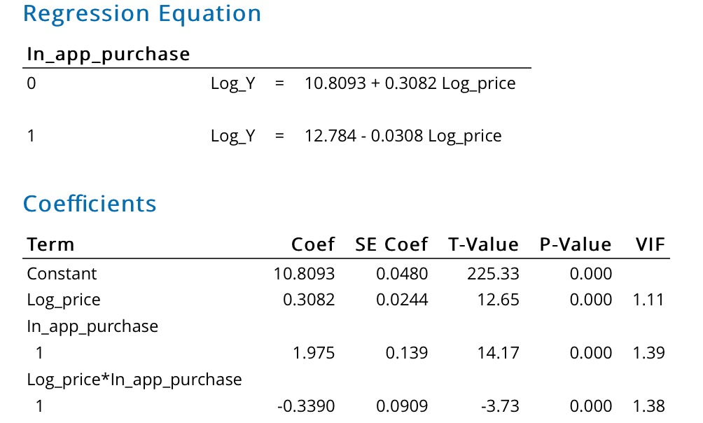
Project analysis slide 2
Recommendations
Case 2: Go-to-market Strategy
In-App Purchases or Not
Another choice we need to address is whether we should include in-app purchases or not in the video game
For this, we run a regression analysis including relevant interaction terms
Using in-app purchase we can monetize a free game

Slide 20
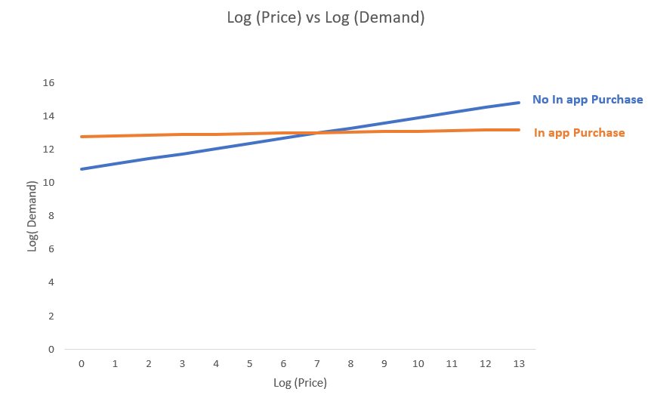
Project analysis slide 2
Recommendations
Case 2: Go-to-market Strategy
In-App Purchases or Not
From the graph output, we can see that it is okay to add in-app purchases up till a particular price amount, which is the point of intersection in the graph
If we are pricing higher than that price amount, it is wise to not include any in-app purchases
In our dataset, all the prices are below the point of intersection, which is around 450 dollars
Company must have in-app purchase in the game

Slide 21
Project analysis slide 2
Recommendations
Case 2: Go-to-market Strategy
DLC Downloadable content
DLC is an additional content like weapons or maps that can be added in an existing game
It is a paid package that can be downloaded from steam
Games are first launch with no price and then an attractive option of DLC is added to monetize the game
Using DLC packages we can monetize even free games as well

Slide 22
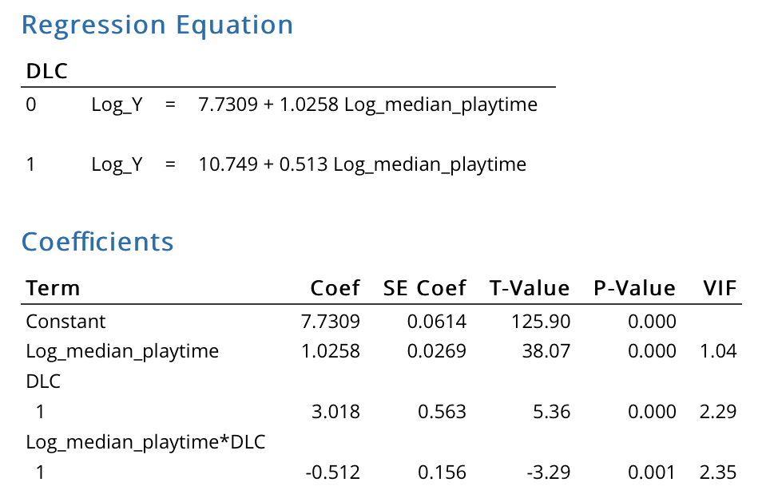
Project analysis slide 2
Recommendations
Case 2: Go-to-market Strategy
DLC Downloadable content
Let's look at what relation we have of a DLC with number of downloads in free games
Regression analysis of owners and median playtime with DLC as dummy is shown
From equations we can deduce that demand for DLC=1 is higher for lower median playtime
Hence for a free game we can launch DLC packages if playtime of a game is anticipated to be lower

Slide 23
Project analysis slide 2
Limitations
Game-industry is driven by graphics. No attribute to measure the quality of graphics.
Mobile-integration. Social media-integration
Only limited to Steam.

Slide 24
Project analysis slide 5
References
References:
https://www.theesa.com/press-releases/u-s-video-game-sales-reach-record-breaking-43-4-billion-in-2018/
Data Source:
https://www.kaggle.com/nikdavis/steam-store-games

Slide 25
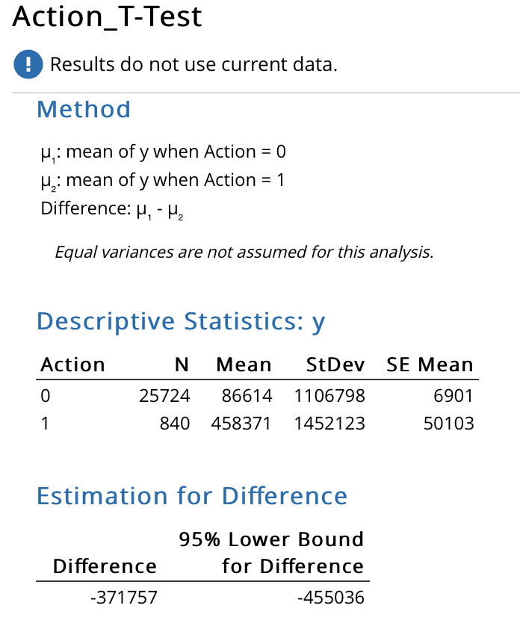
Appendix 1

Slide 26
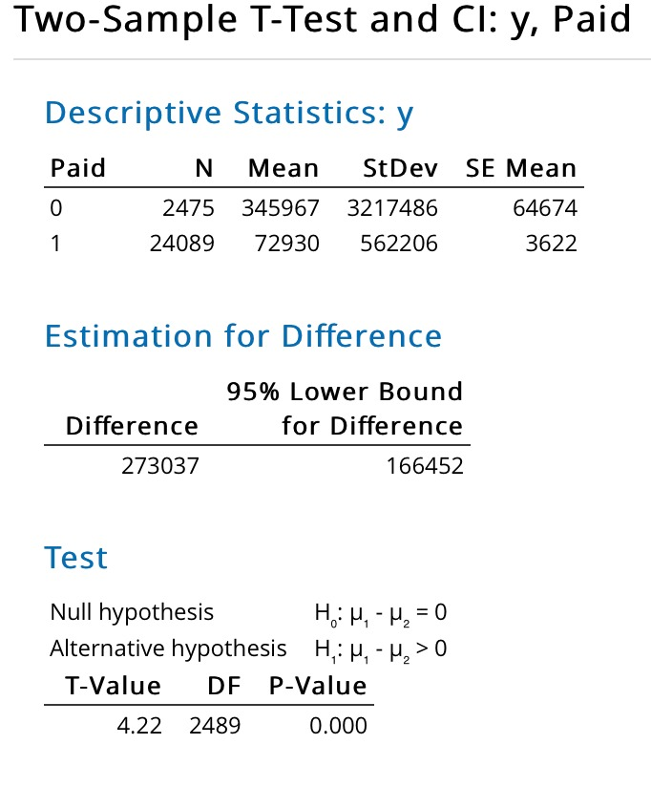
Appendix 2

