Slide 1




2026
THE CODE
CREW
TEAM
CODE - UOC016L9
INNOVX
INNOVX
INNOVX
PRESENTED BY:
Shubh Shrivastava
Abhijeet Bisen
Suryansh Sharma
Harsh Shrivastava
Sarthak Jain

Slide 2





THE PROBLEM
Exams that are secure, fair, and intelligently monitored
🛒
Cheating - Tab switching, Copy/Paste, External devices
📍
Poor Monitoring - Invigilators can't monitor every student effectively
📉
Security Gaps - Multiple monitors, Task switching, Unauthorized applications

Slide 3


One Platform.
Three Layers.
Online Exams Have a Trust Problem
AI Face Detection
Violation Detection
Real-Time Monitoring
Secure Browser
Invigilator
Live seat map
Student status
Instant cheating alerts
Camera verification
Secure exam environment
Identity verification
Continuous proctoring
Traditional online exams verify answers — SAMADHAN X verifies the entire examination environment.

Slide 4




OUR SOLUTION
How SAMADHAN X Works
From Login to Exam — A Secure Journey
Show this as a 5-step horizontal timeline:
🏪 Action
Every suspicious action becomes a real-time incident.
👤 Working
Real-Time Monitoring
Login
Secure Exam
Environment
Scan
Identity Verification
Firebase Authentication
Face captured & matched
360° room verification
Electron Kiosk + Proctoring

Slide 5

PLATFORM FEATURES
What Makes SAMADHAN X Different?
📋
📍
🚩
AI Proctoring
Secure Browser
Environment Verification
Face verification
Live face detection
Identity mismatch alerts
Kiosk mode
Always-on-top
Keyboard shortcut blocking
360° room scan
Camera & microphone permissions
Multi-monitor detection
📊
⭐
🛡️
Real-Time Alerts
Smart Seat Management
Role-Based Access
Tab switching
Window blur
Cheating incidents
Instant Socket.IO updates
Live 3D seat map
Student allocation
Attendance status
Student
Invigilator
Admin

Slide 6
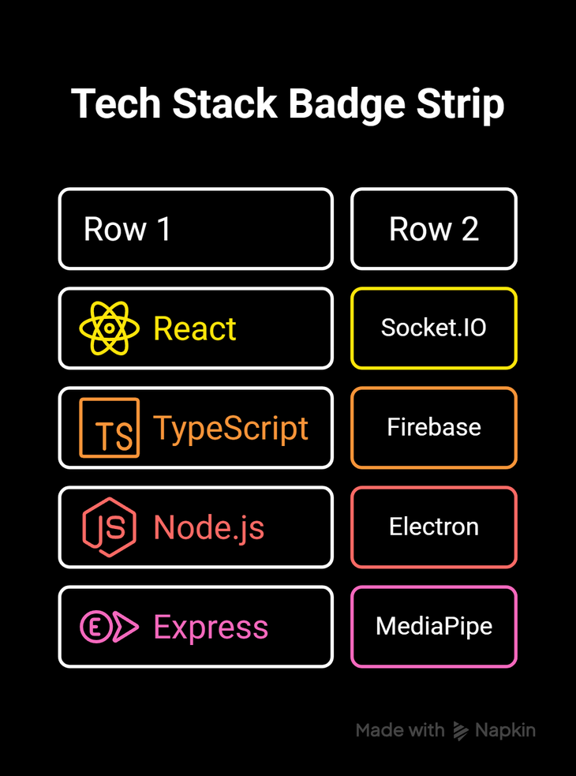
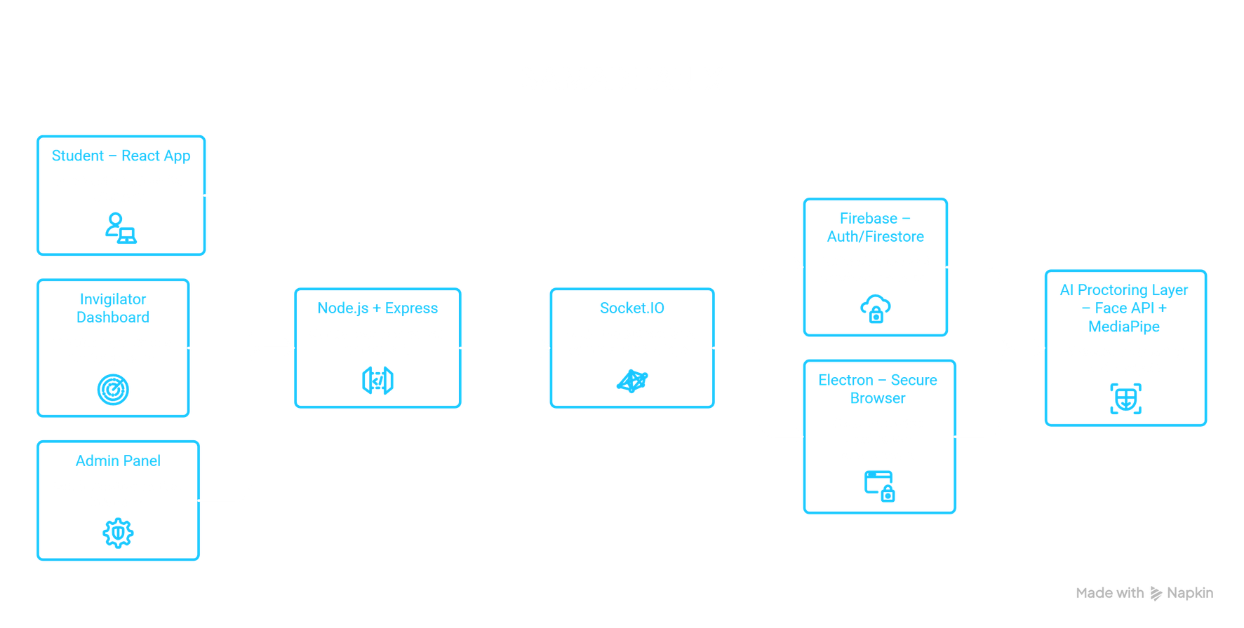
HOW IT WORKS
System Architecture & Technology
Architecture Diagram

Slide 7

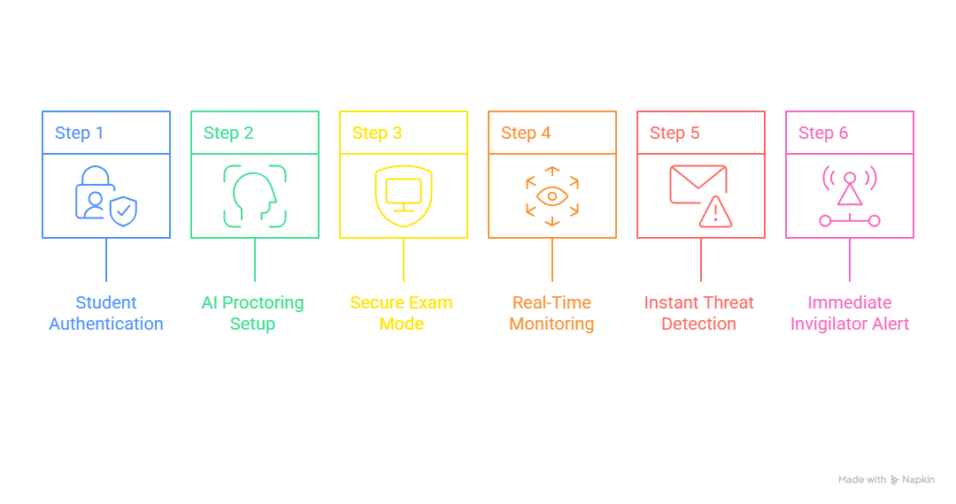
HOW IT WORKS
See SAMADHAN X in Action
DEMO / EXPERIENCE

Slide 8
Intent & Completion System
Captures the student's examination intent and journey progress
Connects student actions with meaningful exam states
COMPLETE — Journey successfully finished
🟢COMPLETED - All The Stats are completed.
🟡 PARTIAL — Progress still pending
🔴 BLOCKED — Security/system restriction
⚪ UNRESOLVED — Intent needs clarification
Smart Navigation — Guides the next action
🤖 AI Integration — Linked with proctoring
⚡ Real-Time Updates — Instant invigilator visibility
📝 Exam Completion — Connected to submission flow
🔌 Electron Integration — Secure browser events included

Slide 9




Impact + Future 💡
🏪 Impact Today
👤 What's Next?
Fairer examinations
Reduced manual monitoring
Real-time intervention
Stronger exam security
Scalable for institutions
Advanced AI behavior detection
Voice/audio anomaly detection
Automated incident scoring
Centralized examination analytics
Cloud deployment & scalability
Institution-wide exam management

Slide 10

For your attention
THANK YOU

