Slide 1

Predicting Customer Default at Verizon
Team 3 Consulting, Fridays 9am-12pm
Brittany Creel
Shubhankar Kumar
Jacky Lin
Steven Luo
Dheeraj Maroju

Slide 2
Agenda
Problem Definition
Model Selection
Model Performance
Business Value

Slide 3
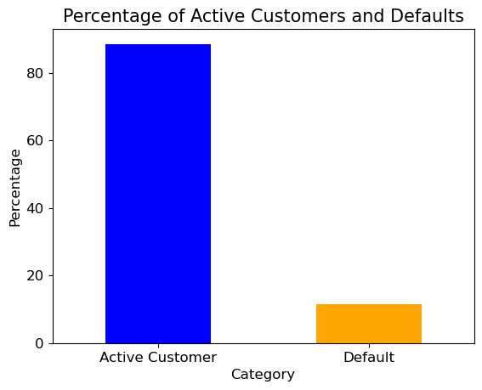

Currently, 12% of customers default on their contracts
Problem Definition
Model Selection
Model Performance
Business Value

Slide 4
Verizon needs to determine whether to grant contracts or not to maximize profit and minimize revenue loss
Profit Potential of Denied Contract / Would Pay
$250 per 36-month contract
Revenue Loss From Defaulted Contracts
$1000 per customer
Problem Definition
Model Selection
Model Performance
Business Value

Slide 5
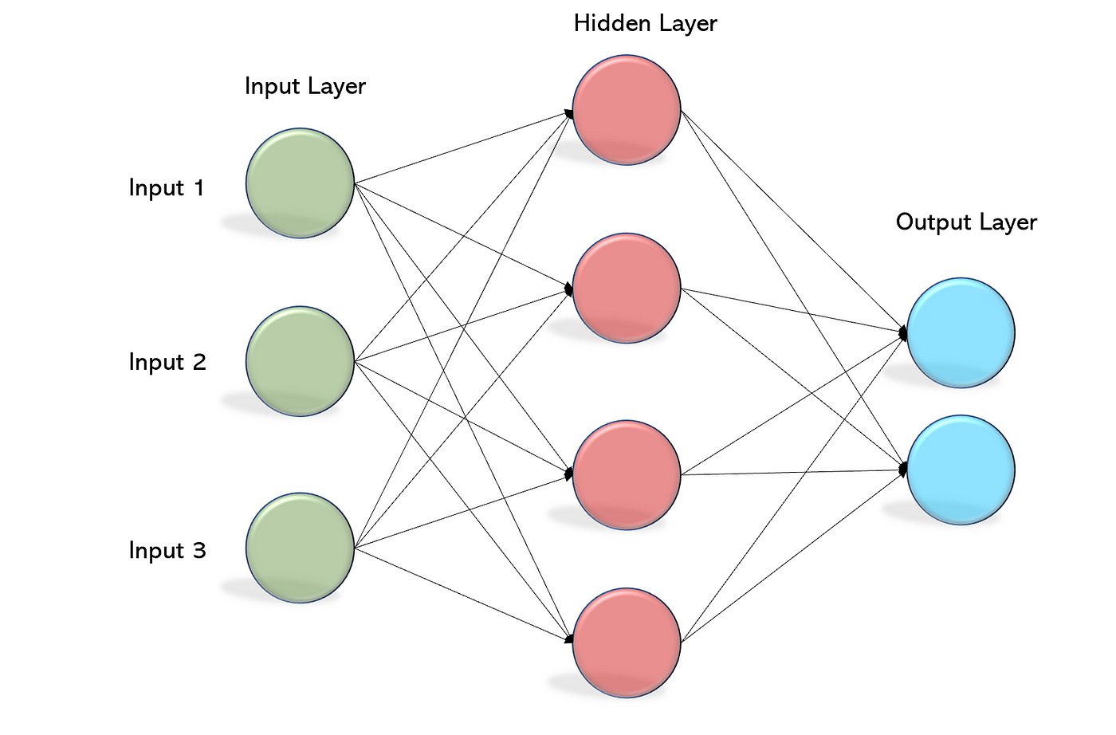
Verizon can use the Multi-layer perceptron (MLP) model to address its problem
The MLP model would be a suitable choice:
Good for classification problems
Ability to handle "imbalanced data"
Capable of modeling complex (non-linear) relationships in the data
Adaptable to various data types, including structured data and sequences
Multi-layer perceptron
Problem Definition
Model Selection
Model Performance
Business Value

Slide 6
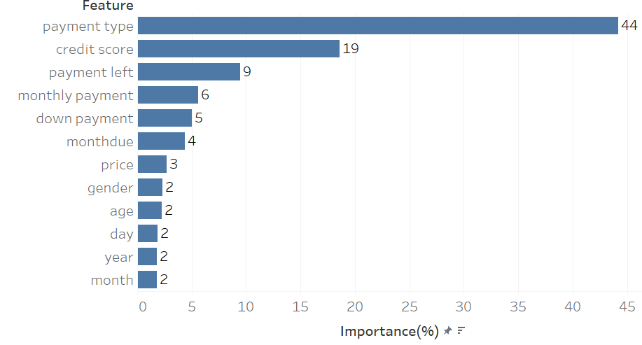
Payment type is the strongest predictor of default in the model
Problem Definition
Model Selection
Model Performance
Business Value
Notes:
This slide outlines the top predictors of default based on our model

Slide 7
To assess the model, we look at the model’s predictions compared to Verizon’s historical data
 | Customers who pays their bills | Customers who Default
Contract Accepted | 80% | 8%
Contract Declined | 3% | 9%
Of the 12% of contracts that were declined, the model correctly identified that 75% of the customers defaulted.
Of the 88% of contracts that were accepted, the model correctly identified that 91% of the customers would pay their bill
Problem Definition
Model Selection
Model Performance
Business Value

Slide 8
The business value of our model is approximately $200M per million applicants
 | Customers who pays their bills | Customers who Default
Contract Accepted | Profit Gained 80% of 1M @ $250 $200,926,113 | Loss Incurred 8% of 1M @ $1000 $84,356,750
Contract Declined | Profit Missed 3% of 1M @ $250 $5,737,870 | Loss Avoided 9% of 1M @ $1000 $88,987,320
Value = Profit Gained + Loss Avoided – Loss Incurred – Profit Missed
= $199,818,813 per million applicants
Problem Definition
Model Selection
Model Performance
Business Value
Notes:
Assumptions used for this estimate:
Profit per paying customer: $250
Loss per default: $1000
Model used: MLP Model

Slide 9
Appendix

Slide 10
Why MLP is a suitable choice for the Verizon Case
Non-linear Relationships: MLPs are capable of modeling complex, non-linear relationships in the data. In the context of predicting customer defaults, relationships between customer attributes (e.g., age, gender, credit score) and default behavior are often not linear, making MLPs effective at capturing these intricate patterns.
Flexibility and Expressiveness: MLPs consist of multiple layers and neurons, allowing them to learn and represent a wide range of functions. This flexibility enables them to adapt to various data distributions and feature interactions, making them well-suited for the heterogeneous and multifaceted nature of customer data.
Scalability: MLPs can handle both small and large datasets efficiently. As Verizon's customer base grows, having a scalable model is crucial to accommodate increasing volumes of data without sacrificing predictive accuracy.
Problem Definition
Model Selection
Model Performance
Business Value

Slide 11
Model Performance comparisons
 | MLP Classifier | XGBoost Classifier | Isolation Forest | OneClass SVM
Class | Supervised |  | Anomaly Detection
Accuracy | 0.90 | 0.89 | 0.59 | 0.57
Precision | 0.59 | 0.51 | 0.04 | 0.05
Recall | 0.69 | 0.79 | 0.130 | 0.15
F1 Score | 0.65 | 0.62 | 0.07 | 0.07
ROC-AUC | 0.94 | 0.94 | 0.37 | 0.45
Problem Definition
Model Selection
Model Performance
Business Value

Slide 12
Asymmetric Costs in the context of the MLP model for predicting customer defaults
True Positives (TP):
These are cases where the model correctly identifies applicants who will default.
Action: When a TP occurs, Verizon can take steps to reject the applicant, preventing potential losses. The phone can be retained and possibly sold to other customers.
Model Focus: The model will be designed to have high sensitivity (recall) to capture as many true positives as possible while still maintaining reasonable specificity.
False Positives (FP):
These are cases where the model incorrectly rejects applicants who would have honored their contracts.
Action: Verizon should aim to minimize false positives to prevent lost profits. Strategies could include providing alternative payment options or special offers to these applicants.
Model Focus: The model will be tuned to reduce the occurrence of false positives, possibly by adjusting the classification threshold.
Problem Definition
Model Selection
Model Performance
Business Value

Slide 13
Asymmetric Costs in the context of the MLP model for predicting customer defaults
True Negatives (TN):
These are cases where the model correctly approves applicants who will make every payment.
Action: Verizon benefits from these customers as they are likely to generate profits over time. Special attention can be given to retaining and nurturing these customers.
Model Focus: The model will ensure that it correctly identifies these cases while allowing some flexibility for false negatives to avoid overly conservative decisions.
False Negatives (FN)
These are cases where the model incorrectly approves applicants who will default.
Action: FN cases result in potential losses for Verizon, both in terms of missed monthly payments and the phone's unrecoverable or diminished value. Mitigating these losses is crucial.
Model Focus: While minimizing false negatives is important, it may require a balance with false positives. Setting the classification threshold too low to catch all potential defaulters could lead to too many false positives.
Problem Definition
Model Selection
Model Performance
Business Value

