Slide 1
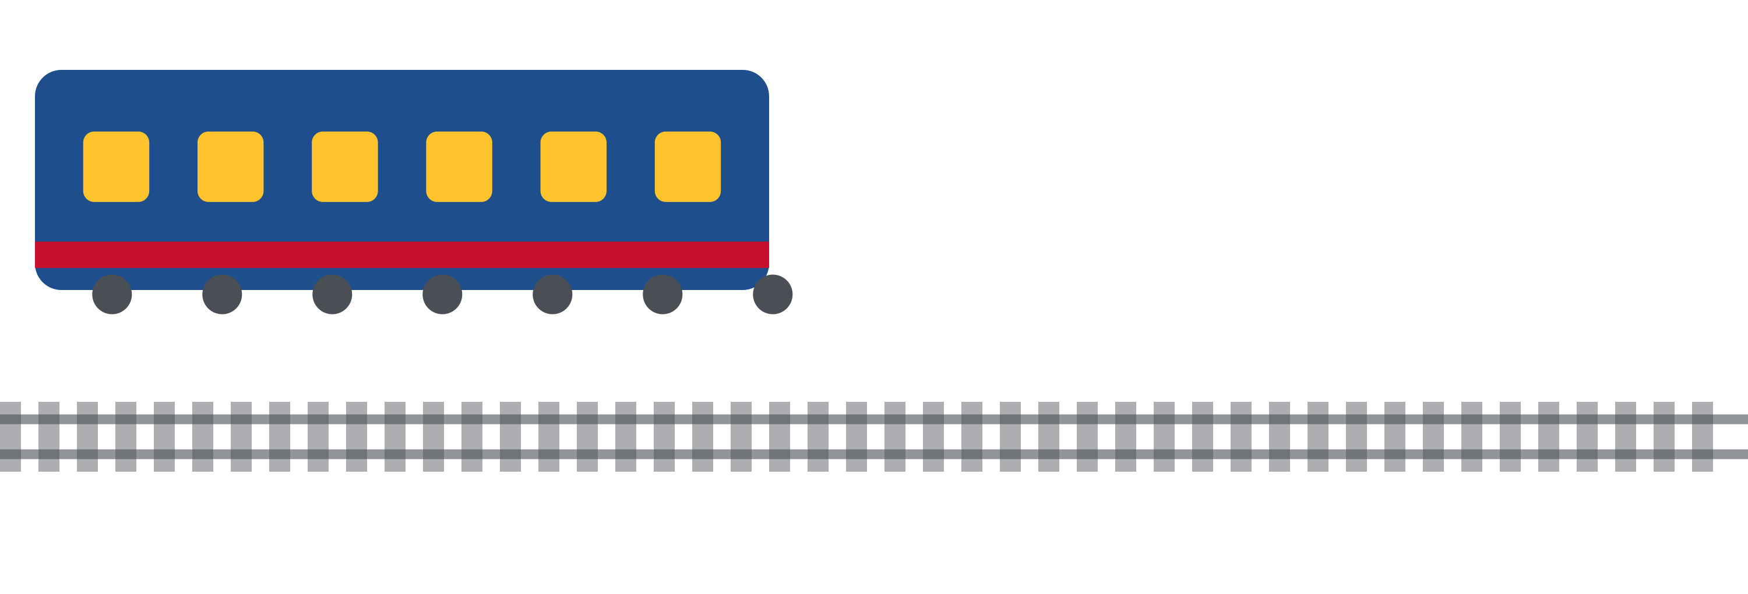
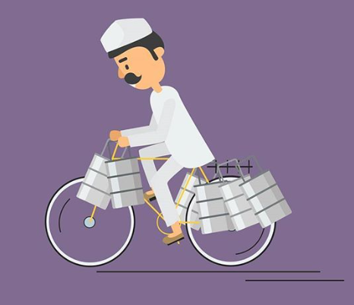
DABBAWALA DELIVERY
TIME PREDICTION
SYSTEM
Machine Learning Based Delivery Time Prediction
Presented by Shubham R. Pote
Batch — PGA 32

Slide 2




Introduction
Mumbai Dabbawalas deliver thousands of lunch boxes every day
Delivery timing is extremely important
Unexpected delays affect customer satisfaction
Predicting delivery time helps improve operational planning
Machine Learning can estimate delivery time using historical data
This project builds an intelligent prediction system for delivery duration
A Dabbawala handing over a lunchbox — trust delivered daily.
02

Slide 3

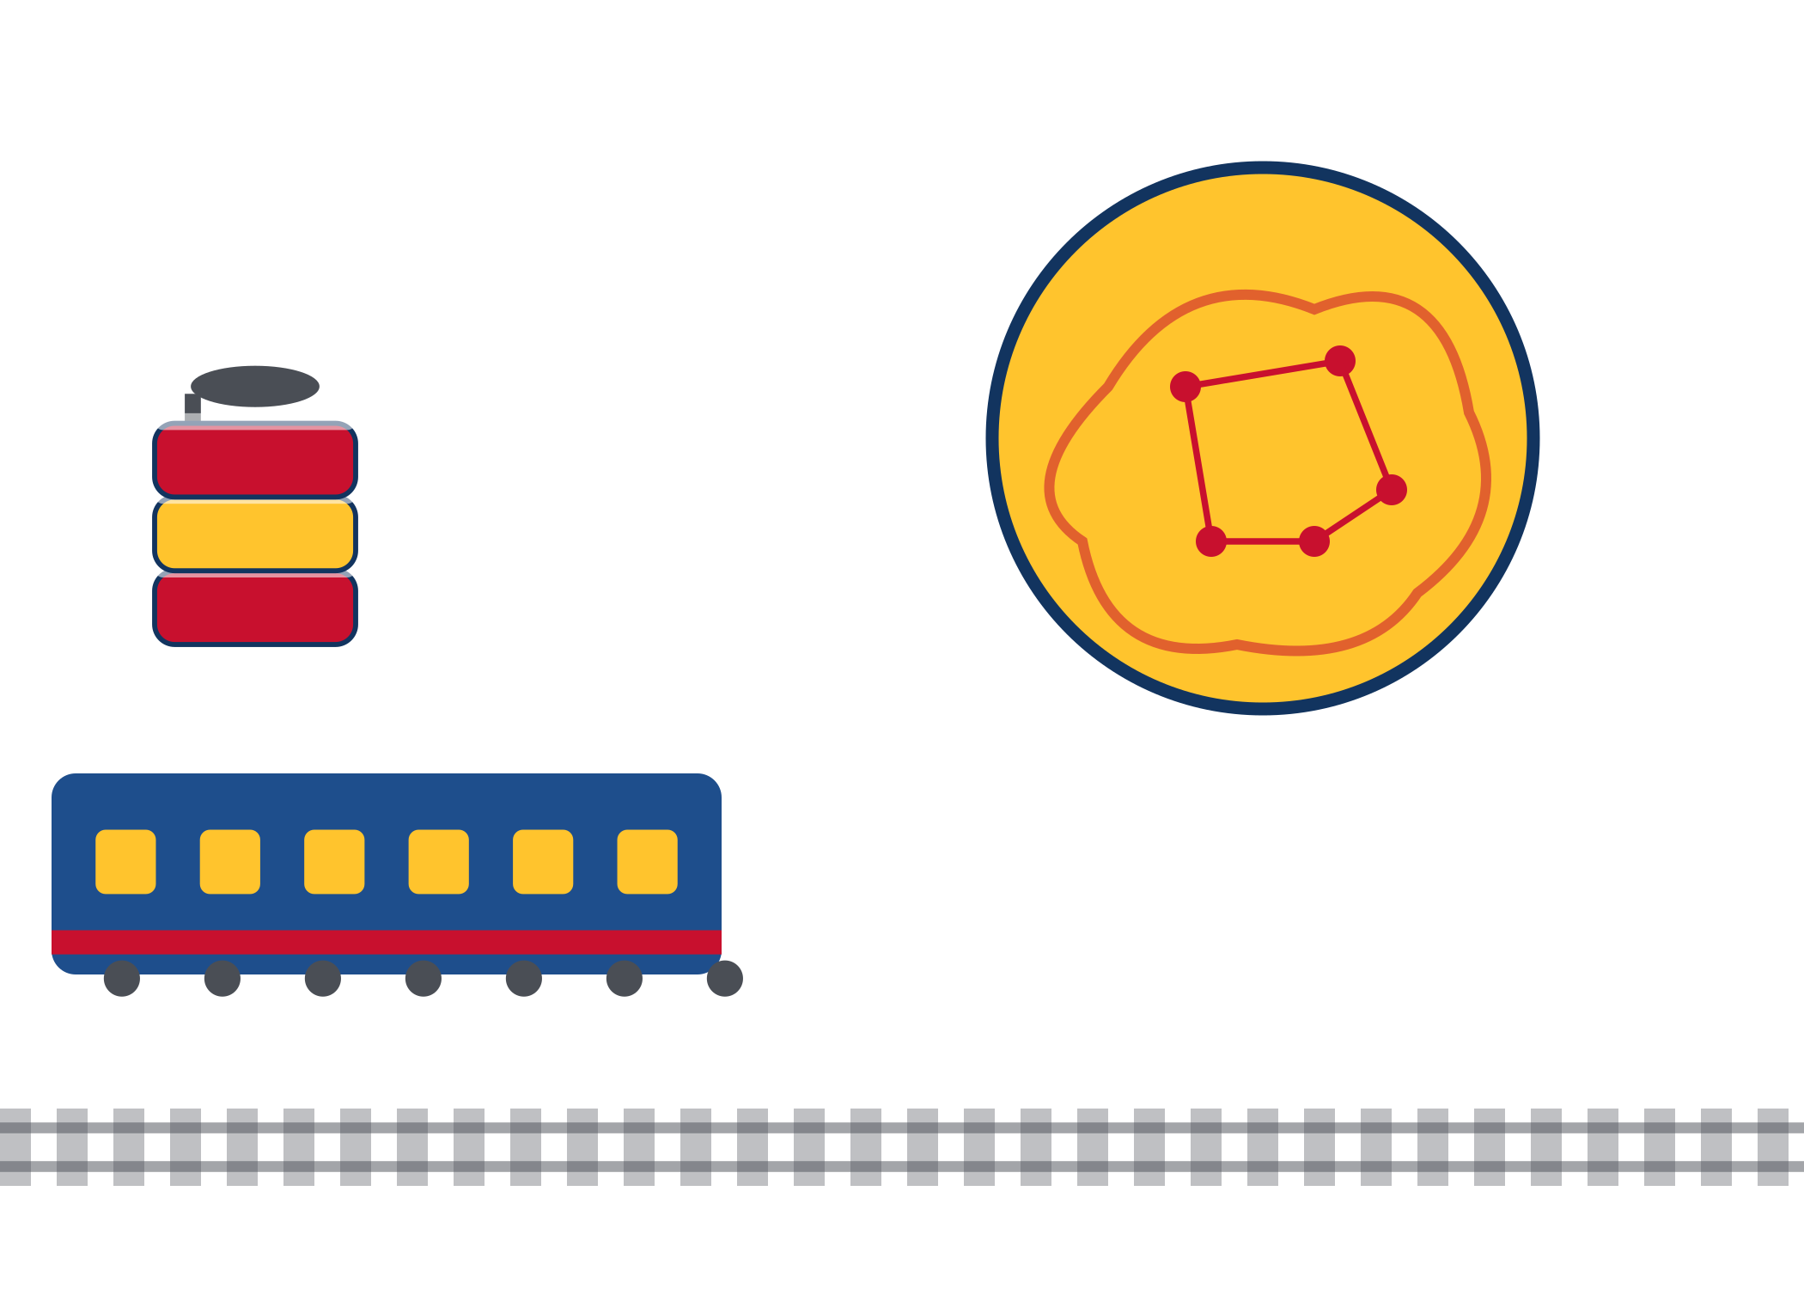
Literature Review
Delivery prediction is widely used across logistics
Companies like Swiggy, Zomato and Amazon use predictive analytics
Earlier studies applied Regression and Machine Learning techniques
Distance, traffic, delivery route and workload affect delivery time
This project adapts similar concepts for the Mumbai Dabbawala network
Train · Route · Tiffin · Machine Learning Brain
03

Slide 4
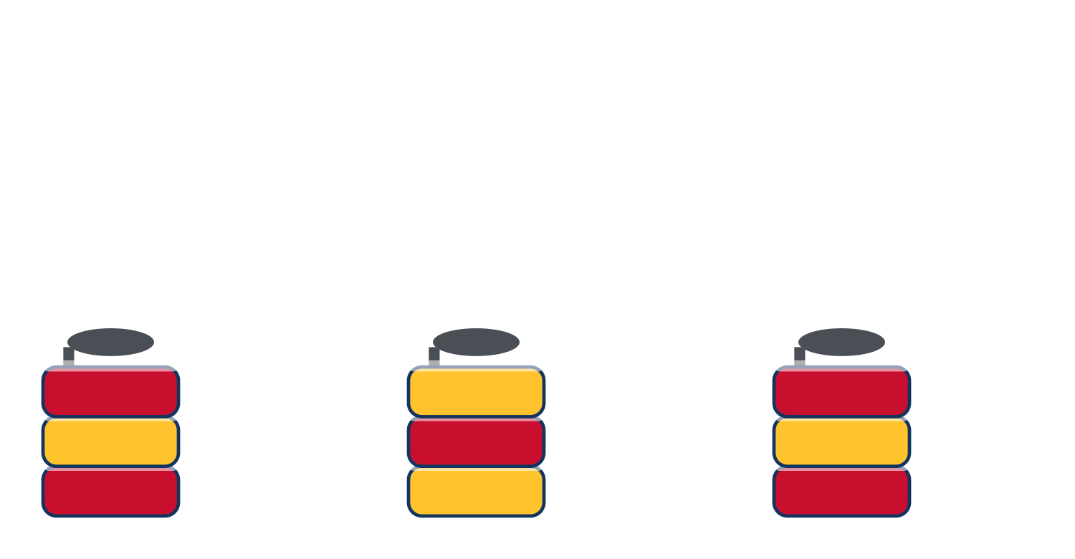
Methodology — Part 1
From raw data to model-ready features
1
Dataset
↓
2
Data Cleaning
↓
3
Missing Values
↓
4
Remove Duplicates
↓
5
Feature Engineering
↓
6
Encoding
↓
7
Scaling
04

Slide 5
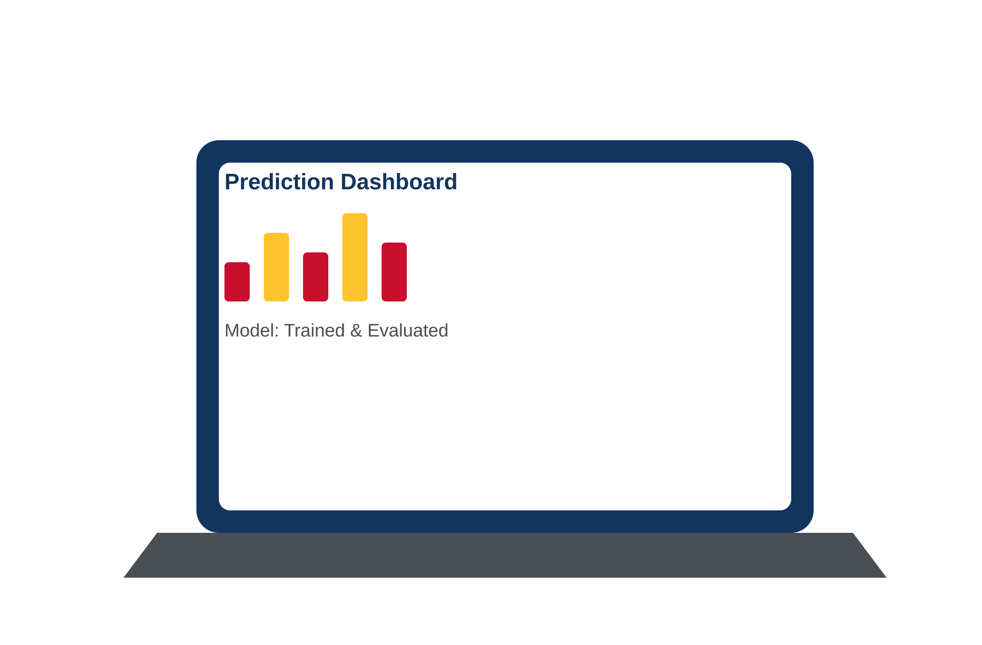
Methodology — Part 2
From trained model to a live web application
1
2
3
Train-Test Split
→
Machine Learning Model
→
Prediction
4
5
6
Model Evaluation
→
Flask Deployment
→
Web Application
Data divided into training and testing sets
Features scaled before prediction
Model evaluated using regression metrics
Flask used for deployment with an interactive interface
05

Slide 6
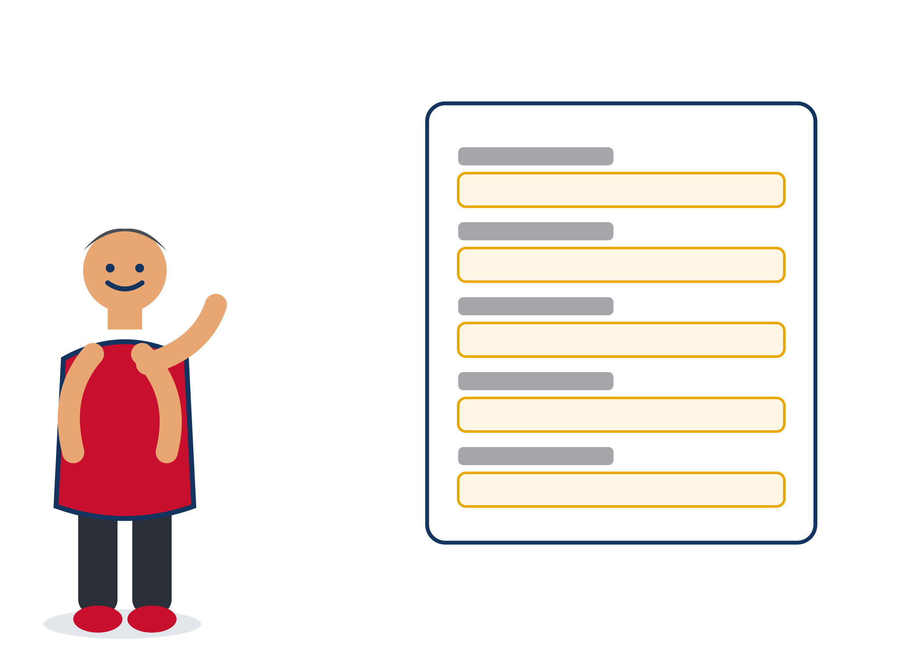

Input
What the application asks for
Order Date
Pickup Area
Delivery Area
Distance
Tiffin Weight
Charge
Customer Type
Payment Mode
Subscription
Customer Feedback
Dabbawala ID
Status
06

Slide 7


Output
ESTIMATED DELIVERY TIME
34.7 min
Prediction generated instantly
Uses the trained ML model
Helps estimate expected delivery duration
Easy to understand output
07

Slide 8
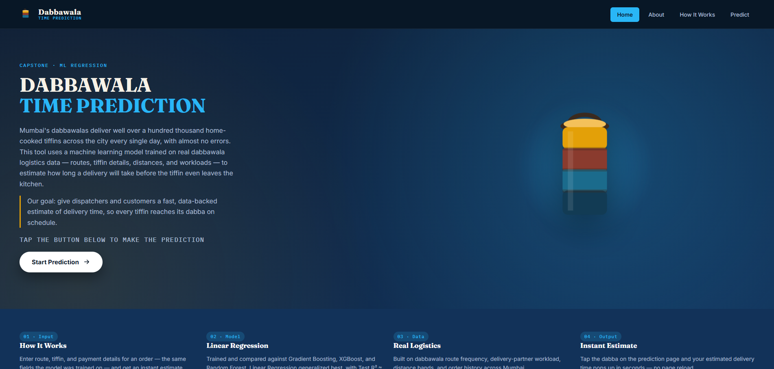
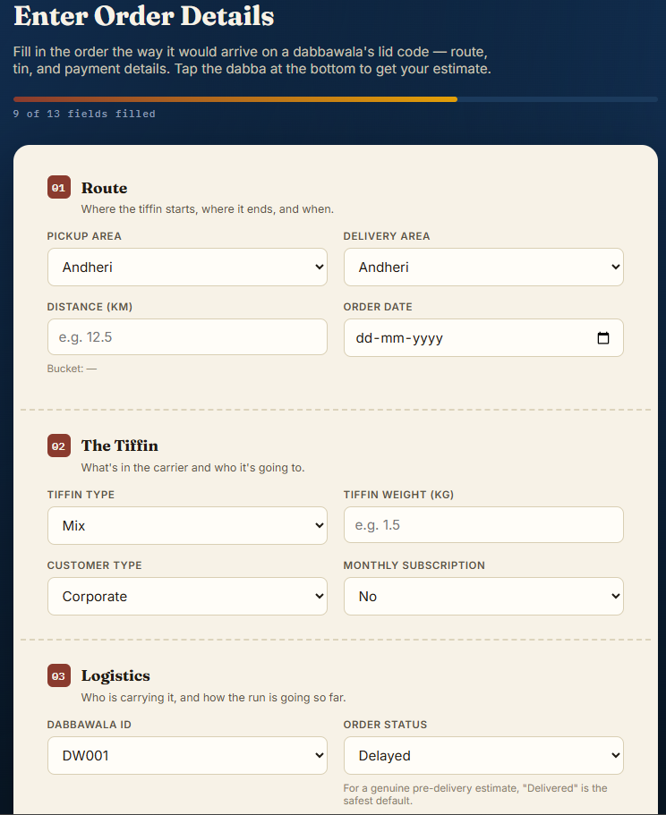
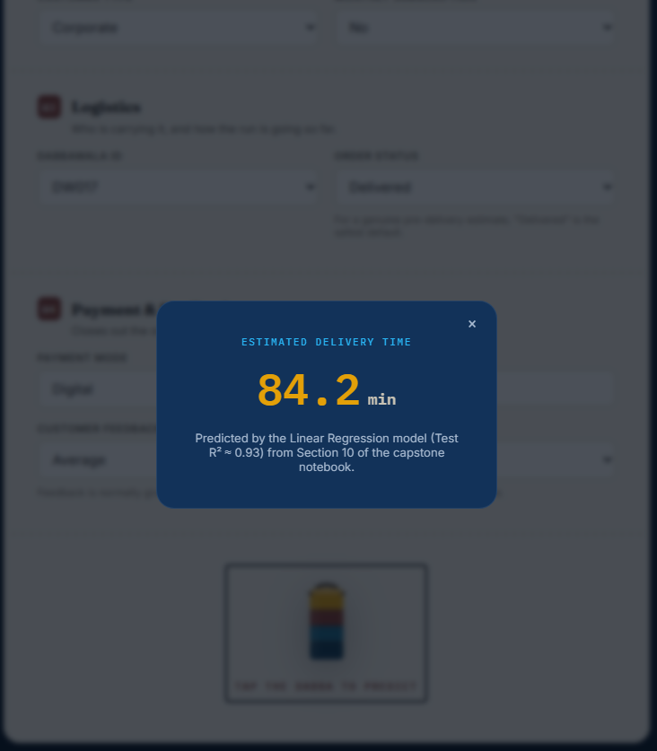
Deployment Architecture
From trained model to a live application on the cloud
BACKEND
Connected the trained ML model with the Flask backend
Loaded the saved model.pkl file for real-time predictions
FRONTEND
Designed user-friendly HTML forms for entering delivery details
Integrated Flask templates for smooth interaction
Displayed predicted delivery time instantly
Home Page
CLOUD DEPLOYMENT
Hosted the Flask application on an AWS EC2 Linux instance
Configured the server to run the application continuously
Enabled remote access through the EC2 public IP
Input Form
Prediction Result
08

Slide 9
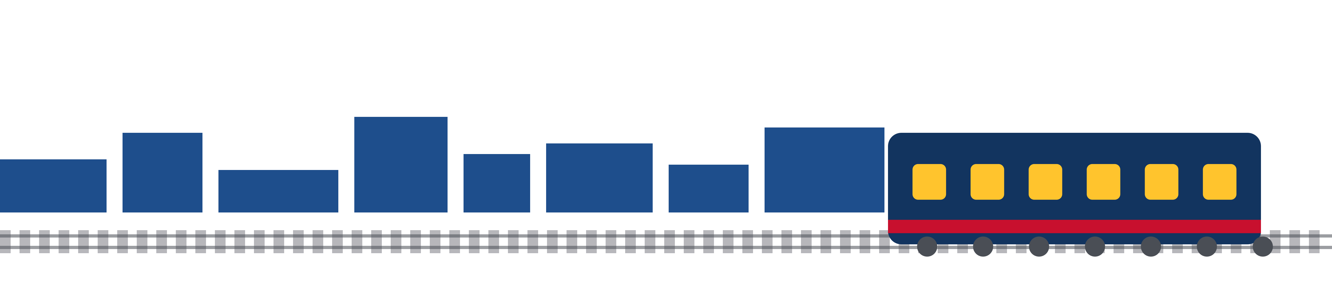
Conclusion & Future Scope
CONCLUSION
FUTURE SCOPE
Developed a machine learning-based Dabbawala delivery time prediction system
Performed EDA, preprocessing, feature engineering, encoding, and scaling
Compared Linear Regression, Random Forest, Tuned Random Forest, and XGBoost models
Deployed the best-performing model using Flask on AWS EC2
Predict Delivery timings during train cancellations to improve delivery planning accuracy
Estimate train delays for more reliable delivery predictions
Develop a mobile application for easier user accessibility
Build a real-time dashboard for delivery tracking and monitoring
09

Slide 10
THANK YOU
Questions?
Dabbawala Delivery Time Prediction System
Shubham R. Pote · Batch PGA 32

