Slide 1
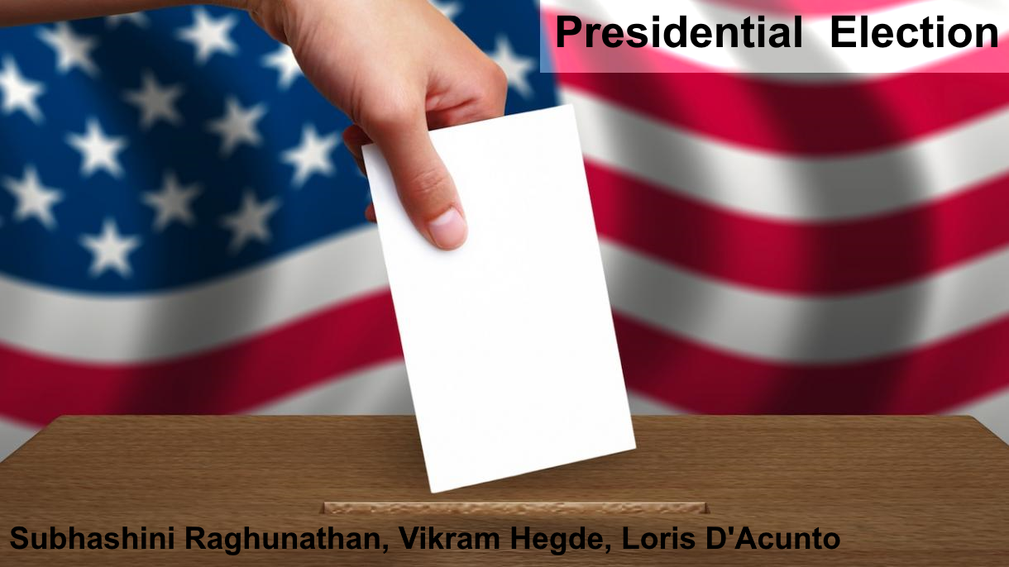

Slide 2
US Presidential Elections 2016
Vikram Hegde, Loris D’Acunto, Subhashini Raghunathan

Slide 3
THE VIZ
Past years’ presidential election results
Past few election cycles
County-level detail
Interactive: filter by age, gender, race, etc.
Build your own 2016 election results
Filter by demographics at the county level
Simulate winning party for counties
Watch it impact state results (EC count) and the national result.
Notes:
Prediction based on typical factors that influence results - Population, Gender, Race, Income, Education, Age, Urban vs. Rural, Red state vs. Blue State
The real composition of the electorate is fixed but unknown

Slide 4
TARGET AUDIENCE
Online newspaper/magazine reader (e.g Business Insider)
Curious but casual reader
Likes pictures and interactivity
Designing for the target audience
Engage attention (more graphics, less text)
Pictures tell a story
Don’t overwhelm the interaction with too many controls

Slide 5
DATASETS
Election Results
County level demographics
2012, 2008 results
Votes per county for democrat/republican candidates
Electoral college counts per candidate
US census data
County population brodown down by – age, gender, race, educational attainment, poverty level, median income, unemployment.

Slide 6
INITIAL PROTOTYPE

Slide 7
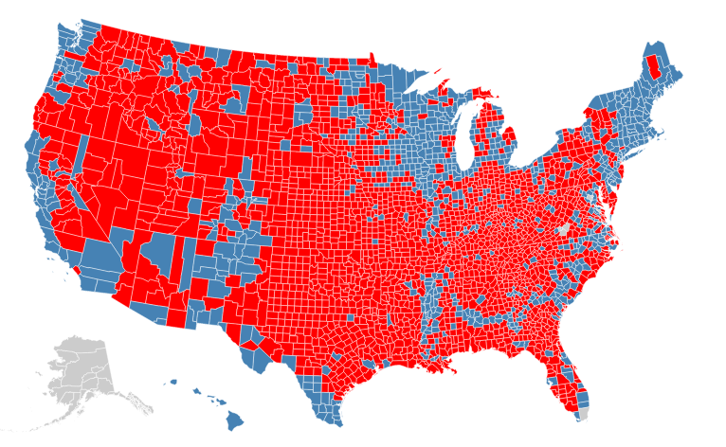
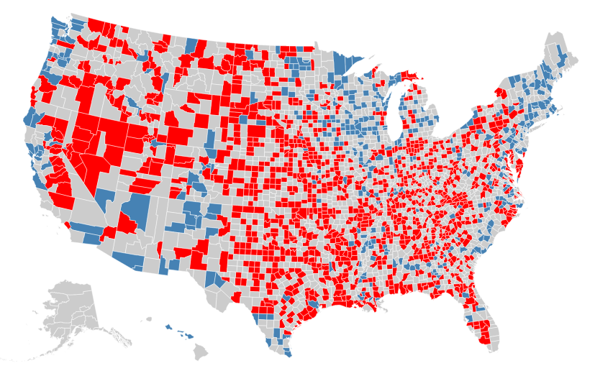
MOCKUP
%White
Average Income
Educational
level

Slide 8
2004
2008
2012
%Hispanic
Average Income
Population

Slide 9
TEST PLAN
(TBD – refine)
Feedback from friends and family - at least 15 people
Collect information with a notebook
Verifing
How long they spend using the viz
What makes them feel the viz is good
What confuses them
What questions they ask after they are done
We assign tasks to ensure potentially indifferent user explores the viz fully

Slide 10
CONTACTS
Subhashini R : subhashini.r@ischool.berkeley.edu
Vikram Hegde (vikhegde@ischool.berkeley.edu)
Loris D’Acunto (ldacunto@ischool.berkeley.edu)

