Slide 1
US Presidential Elections 2016
Vikram Hegde, Loris D’Acunto, Subhashini Raghunathan

Slide 2
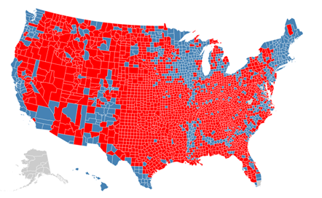


1st ITERATION
Click on the county to change the party
2008
2012
2016
Move the sliders to the filters the counties
H
H
H
H
L
L
L
L
Population
% Hispanic
Avg income
Educ level
332
206

Slide 3
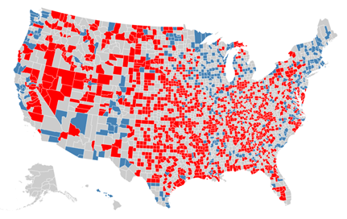
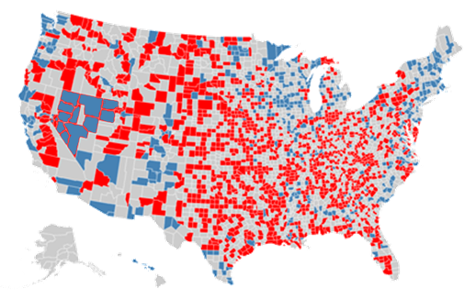
1st ITERATION (contd.)
Click on the county to change the party
2008
2012
2016
Move the sliders to the filters the counties
H
H
H
H
L
L
L
L
Population
% Hispanic
Avg income
Educ level
337 √
201

Slide 4
ISSUES WITH 1st VERSION
Required users to change results of one county at a time – laborious and lot of county changes needed
County level not aligned with electoral college – state level is better
Size of county misleading
Focus the viz on one dimension like race – too many degrees of freedom
Not clear who is the winner – red color more evident than the blue
Required lots of text to explain the visualization
Instructors feedback to include supporting viz - bar charts
Notes:
Highlight the winner

Slide 5
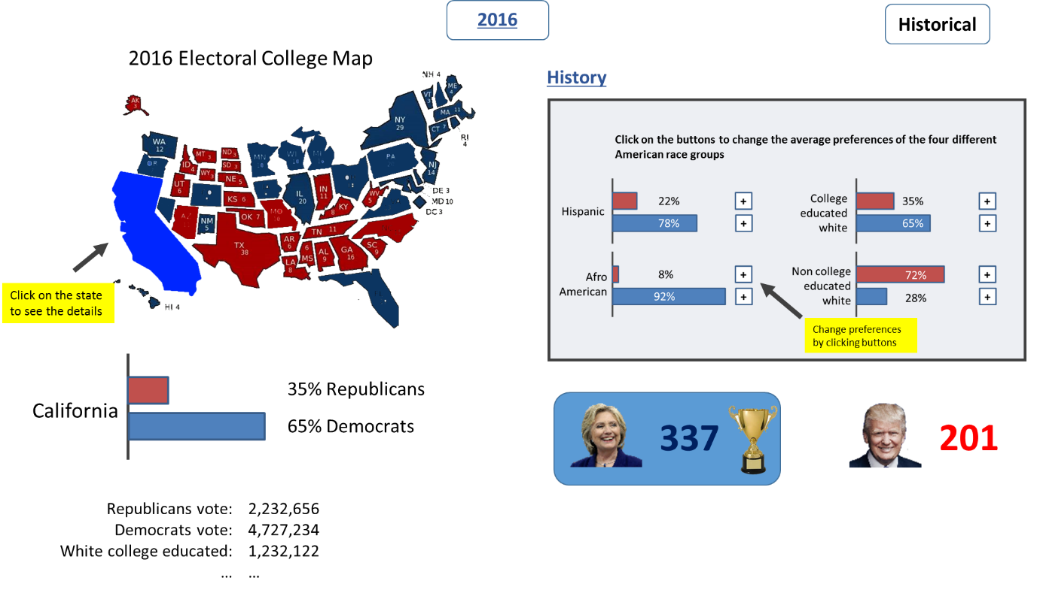
2nd ITERATION
Notes:
Usage of a state level map with size of states related to the number of electoral

Slide 6
ISSUES WITH 2nd Version
Instructor feedback - Impossible to scale states in proportion to their EC tally without states that are too small (Idaho, North Dakota) and states that are too large (California).
Proportional symbol map:
https://bl.ocks.org/mbostock/4342045
Issues: Some symbols (circles) overlap (on the east coast)
Cartogram heat-map: https://github.com/hrbrmstr/statebins
Issues: Too abstract, we wanted something more map like.
Finally decided on proportional symbol map with symbol jittering

Slide 7
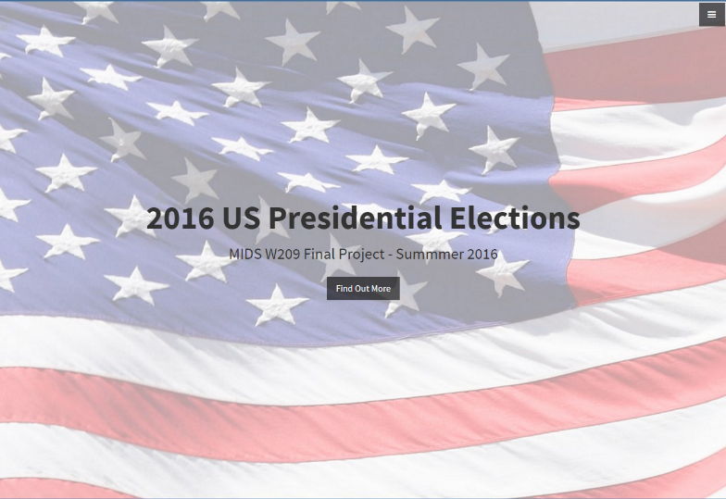
3rd ITERATION (Pre-Usability)

Slide 8
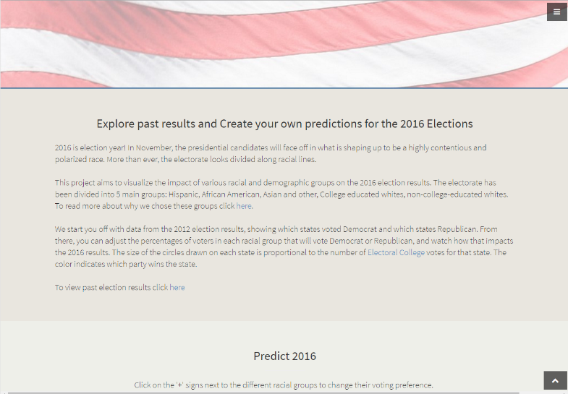
3rd ITERATION (Pre-Usability)

Slide 9
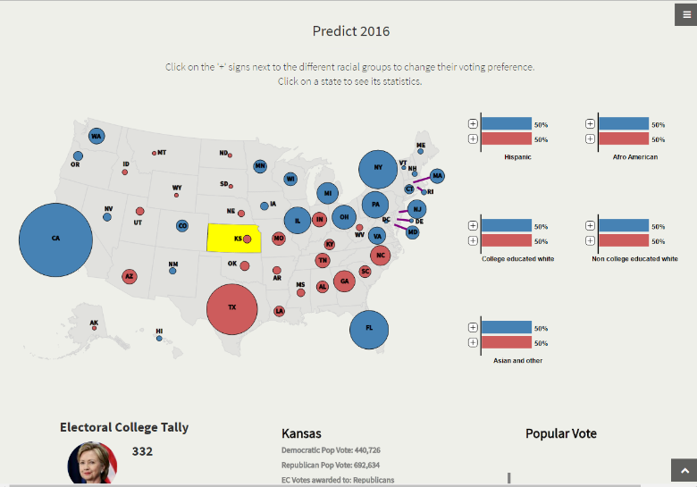
3rd ITERATION (Pre-Usability)

Slide 10
USABILITY TEST
15 users tested the visualization
Major Findings:
Navigation is complex with a single page scrolling
Users don’t like/read large block of text at beginning
Purpose of race controls is not obvious
Meaning of colors is unclear
Red and blue for which party?
Yellow for the selected state
Winner is not evident

Slide 11
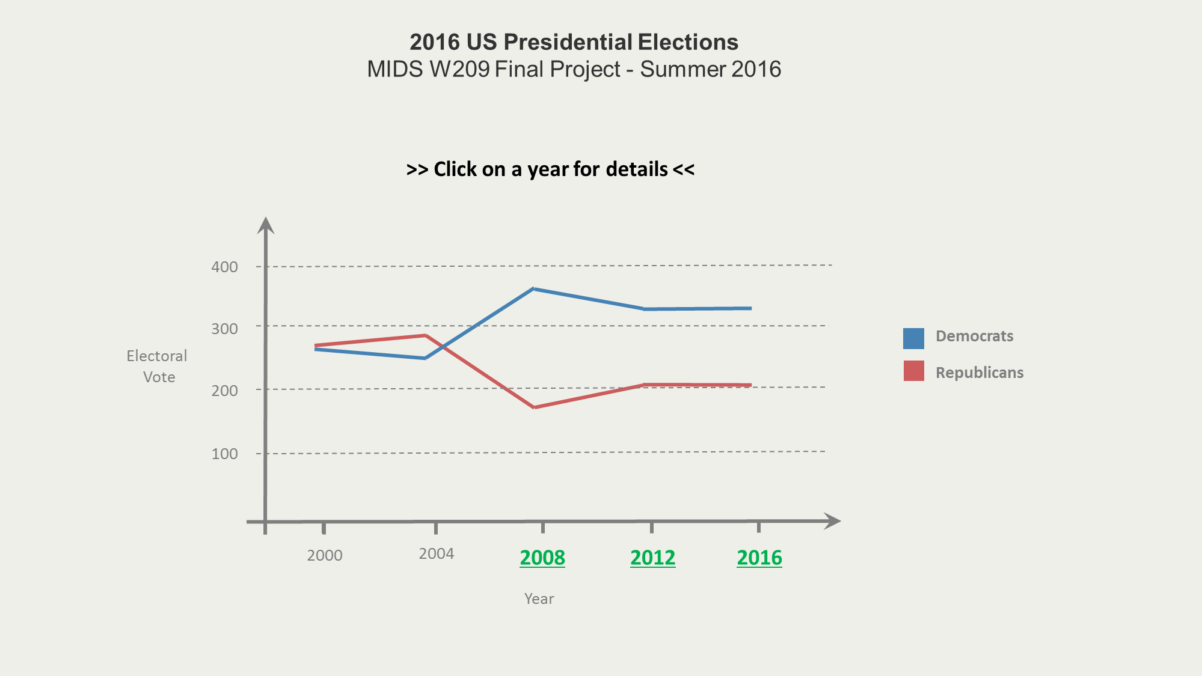
USABILITY IMPROVEMENTS - Home

Slide 12
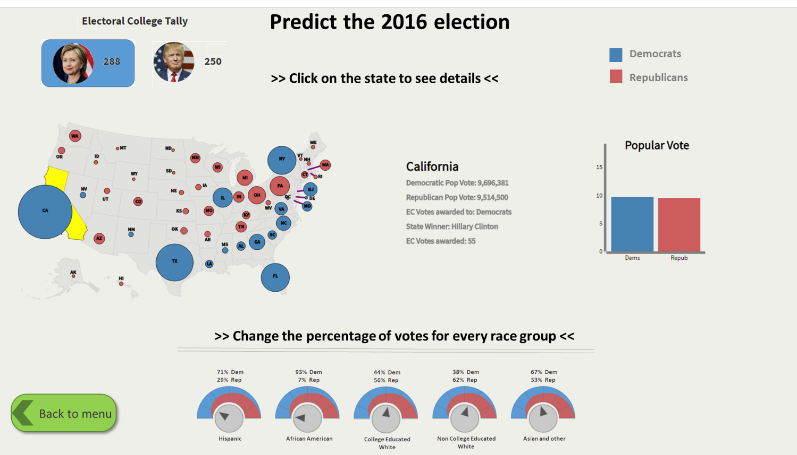
USABILITY IMPROVEMENTS

Slide 13
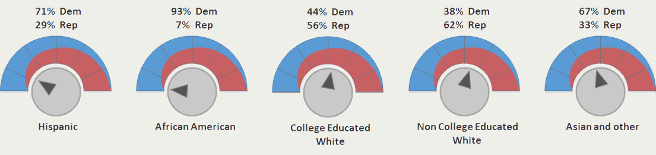
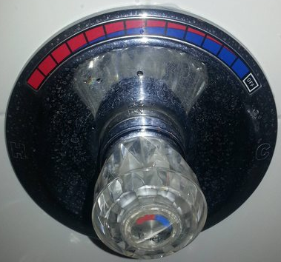
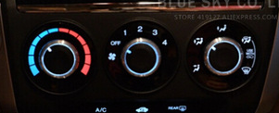
USABILITY IMPROVEMENTS

Slide 14
USABILITY IMPROVEMENTS
Remove the initial flag and the text
Add an initial menu with the shape of a line chart showing Democratic vs Republican performance over the years
For 2008, 2012 and 2016 observations – a link to the visualization
Add explicit navigation buttons rather than scrolling
Small snippets of text integrated with the visualization
Legend for colors
Change the shape of the race controllers to catch attention
Winner is more evident with a highlighting box

Slide 15
Choice of Technology
D3 + Javascript + SVG/CSS/HTML + Bootstrap
Why ?
Point and click software like Tableau too limiting - not all visualizations supported
Need more flexible ways of linking data to visual elements - D3’s binding data to SVG elements very natural.
All three of us are programmers
Prefer fine grained control over canned coarse grain
Prefer programming to point and click

Slide 16
DEMO
LIVE DEMO
http://people.ischool.berkeley.edu/~subhashini.r/

Slide 17
Q & A and contact information
lorisdcnt@gmail.com
vikhegde@gmail.com
shubi4@hotmail.com

