Slide 1
WS205 Project: Identifying toxic chemicals in products
- Subhashini Raghunathan

Slide 2
Project proposal
I wanted a project that would allow me to work with multiple datasets.
Browsed the applications on www.data.gov for inspiration
Project modeled after the Good Guide application
Thousands of consumer products are rated on a scale of 1-10 for their impact on Health, Environment and Society.
My goal is to use the datasets from data.gov to come up with a rating scheme for consumer products, modeled along the GoodGuide.com ratings
Modified this goal; coming up with a ratings scheme was getting quite complicated.
Instead, focusing on analyzing data on commonly used chemicals and their toxicity in various product categories and products

Slide 3
Datasets
Chemical database (CPCat)
43,000 chemicals
1,000+ categories
10,000+ products
Toxic chemicals lists
US Dept of Labor
Tool for the Reduction and Assessment of Chemical Impacts (TRACI)
Risk Screening Environmental Indicators (RSEI)
MN Dept of Health - Chemicals of High Concern
CalSAFER
Some datasets had to be cleaned (e.g. bad formatting) before importing

Slide 4
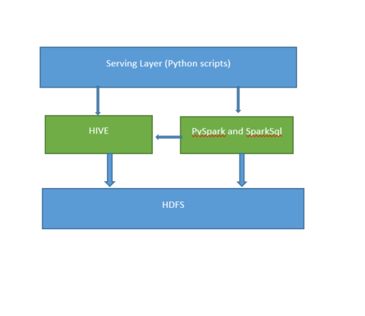
Architecture

Slide 5
Storage, Processing and Scale
Dataset used in the project is not large (few hundred MBs)
But, potential for expansion to other related datasets (e.g. chemical properties, toxicity reports, product information, etc)
Not likely to get in the realm of big data even with this.
Processing requirements could get intensive
Combining multiple datasets
Different ways to slice and dice data
Scale could become a major issue with increasing number of users
Flexible serving layer will place more processing and scale requirements on the system (e.g. a visualization dashboard similar to Tableau)

Slide 6
Some data analysis

Slide 7
Data analysis (contd.)

Slide 8
Data analysis (contd.)

Slide 9
Data analysis (contd.)

Slide 10
Data analysis (contd.)

Slide 11
Asking questions of the data
What are the chemicals most frequently found in categories related to childcare products, and how many of these are toxic
What chemicals have unknown toxicity. How many of these unknown chemicals are found in food products
Which toxic chemicals are common to the categories “pesticides” and “personal_care cosmetics hair_dye”

Slide 12
Improvements
Create a dashboard-style serving layer for easy visualizations
Provide a REST interface for easy querying and extensibility
Incorporate more datasets to improve the quality of information presented
Implement a ratings scheme for products
Machine learning could help to identify chemicals of concern based on similarity to known toxic chemicals

