Slide 1

Heart Attack Analysis and Prediction
Submitted by
Ayush Rathi
Submitted to Mentor Deepanshu mahajan
Cdac Noida Ms.priti bhardwaj Shubham lanjewar

Slide 2


INTRODUCTION
Heart disease remains one of the leading causes of mortality worldwide. A heart attack occurs when blood flow to a section of the heart muscle becomes obstructed, leading to tissue damage or necrosis.
It is difficult to identify heart diseases
because of several contributory risk
factors such as diabetes,high blood
pressure,high cholesterol,abnormal
pulse rate and many other factors.
The diagnosis of heart disease is usually
based on signs,symptoms of the patient.
Chest pain,back pain,anxiety are some
of the symptoms of heart attack.

Slide 3
PROBLEM STATEMENT
To check whether the patient is at risk of having a cardiovascular heart diseases based on their medical attributes such as gender, age, chest pain, fasting sugar level, etc.
This project involves analysis of the heart disease patient dataset with proper data processing.
Then, different models were trained and predictions were made with different algorithms like Decision Tree, Random Forest, Logistic Regression.
I've used a variety of Machine Learning algorithms, implemented in Python, to predict the presence of heart disease in a patient.
This is a classification problem, with input features as a variety of parameters, and the target variable as a binary variable, predicting whether heart disease is present or not

Slide 4
WORK FLOW OF PROJECT
Loading the Dataset
Data Processing
Features extraction based on dataset attributes
Final Result
Heart Disease Prediction
using Machine Learning Algorithm

Slide 5
DATA COLLECTION AND FETCHING
Data collection is the process of gathering and measuring information from countless different sources to use the data.
We have taken this dataset from kaggle for our project.
The predictions made by ML systems can only be as good as the data on which they have been trained. Following are some of the problems that can arise in data collection:
Inaccurate data.
Missing data.That could take the form of empty values in columns or missing images for some class of prediction.
Data imbalance.

Slide 6
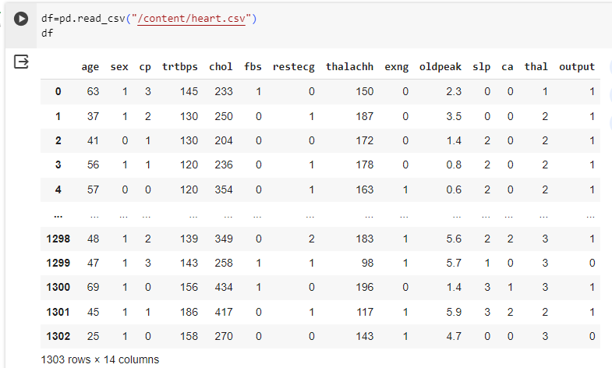
The dataset we are using contains 14 attributes.

Slide 7
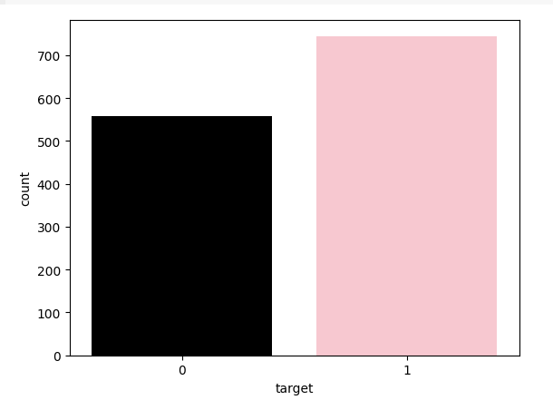
DATA PRE-PROCESSING
Data pre-processing and storage are essential steps in our project to ensure that we work with clean and structured data.
Checking the Distribution of the Data :

Slide 8
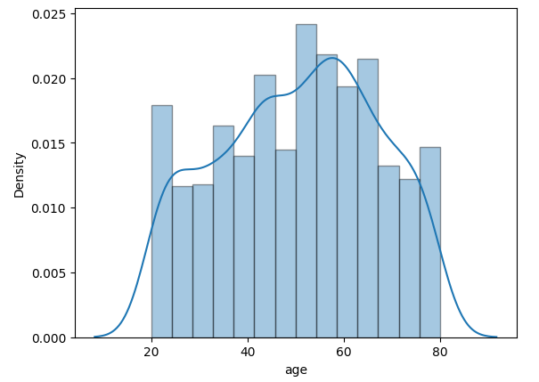
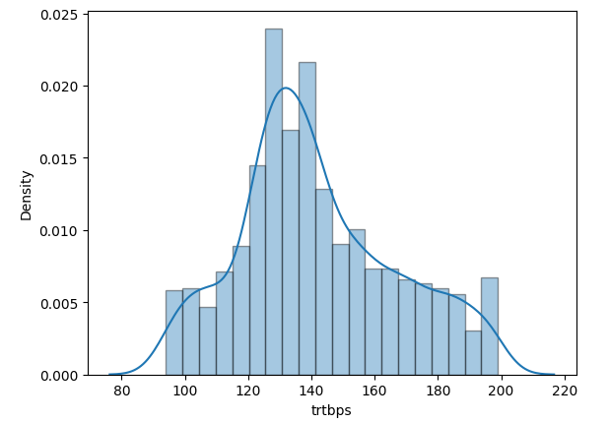
Checking the Skewness of the Data.

Slide 9
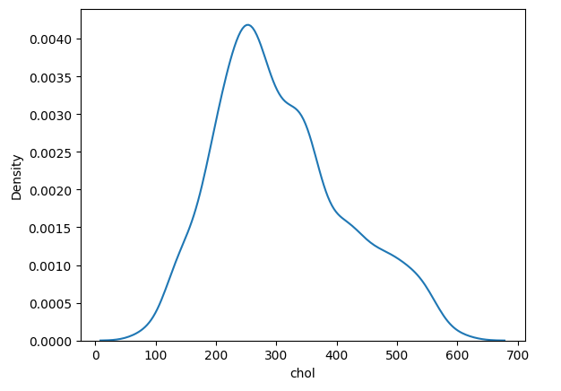
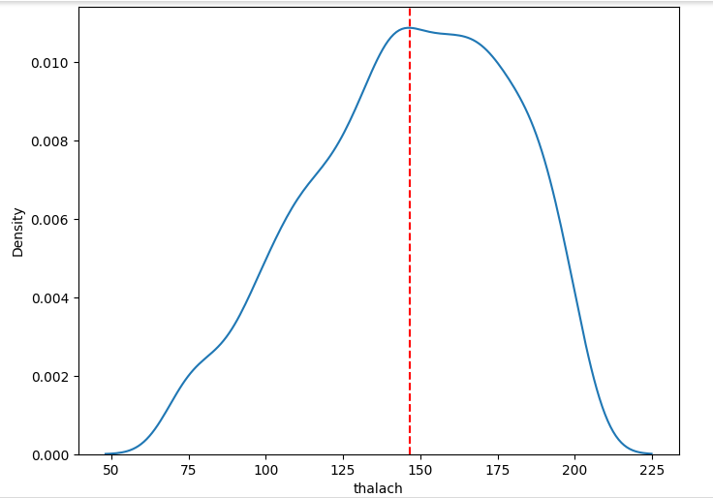
Checking the Skewness of the Data.

Slide 10
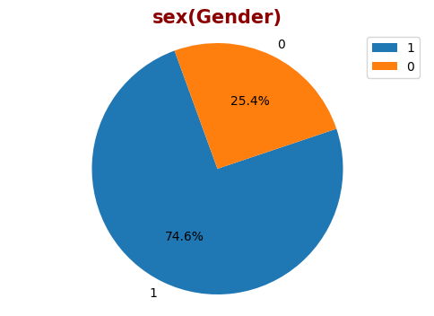
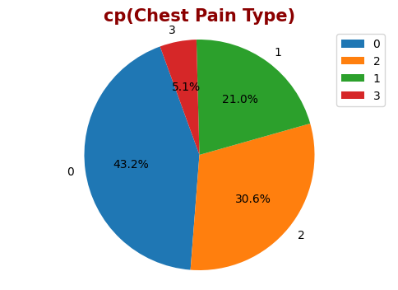
EXPLORATORY DATA ANALYSIS
Exploratory data analysis (EDA) is used by data scientists to analyze and investigate data sets and summarize their main characteristics, often employing data visualization methods.
The main purpose of EDA is to help look at data before making any assumptions. It can help identify obvious errors, as well as better understand patterns within the data, detect outliers or anomalous events, find interesting relations among the variables.
Studying some of the Categorical Variables:

Slide 11
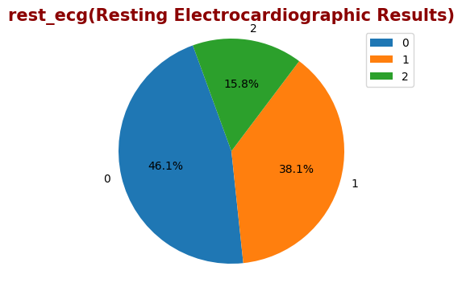
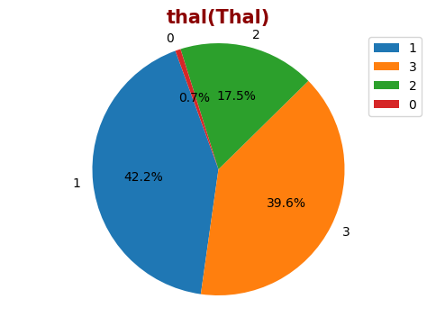

Slide 12
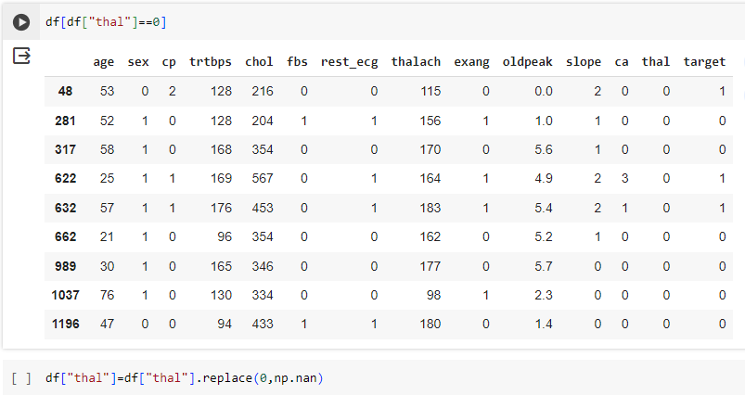
Examining the Missing Data According to the Analysis Result :

Slide 13
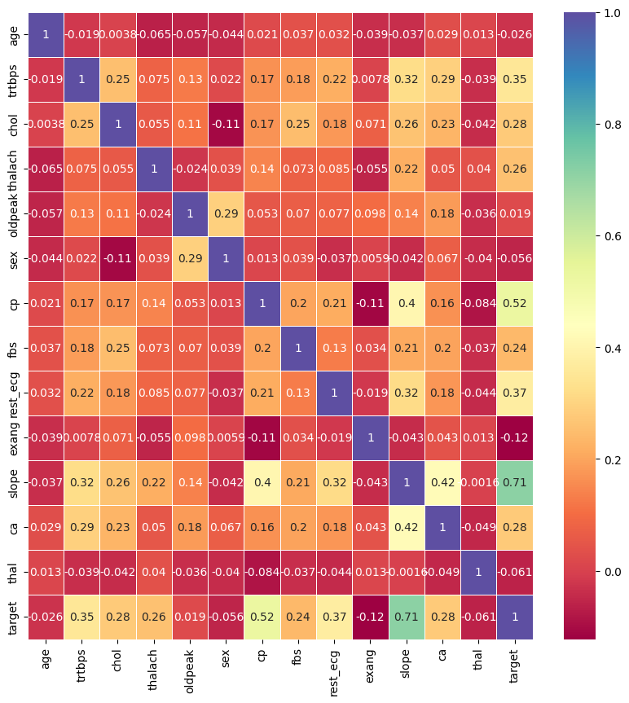
Relationships between variables(Analysis with Heatmap)

Slide 14

DATA PREDICTION
In this phase of our project we employ
various machine learning techniques to
predict the heart disease.
Prediction in machine learning allows
organizations to make predictions about
possible outcomes based on historical
data.
It can be done using different machine
learning algorithms for prediction. These
prediction algorithms include –
Classification Algorithms, Clustering Algorithms,
and Time Series Algorithms.

Slide 15
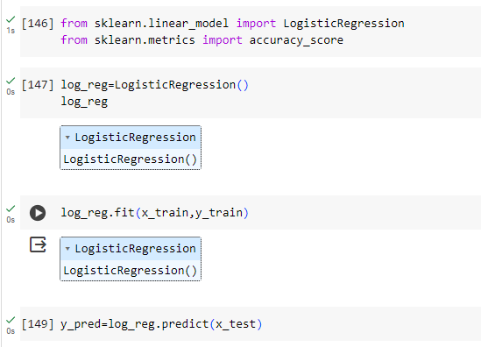
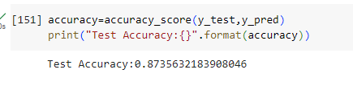
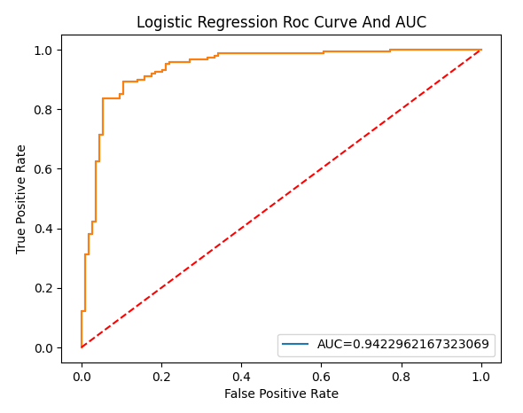
In this project we applied 3 machine learning models to analysis the data and predict the outcome.
1.Logistic Regression Algorithm :-

Slide 16
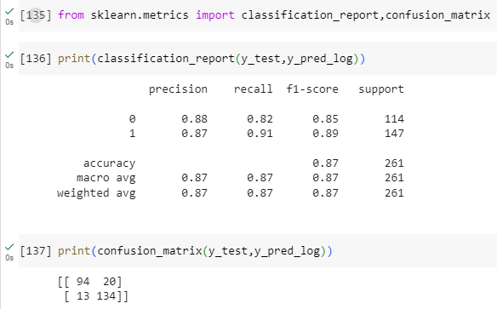
Classification Report for Logistic Regression model :

Slide 17
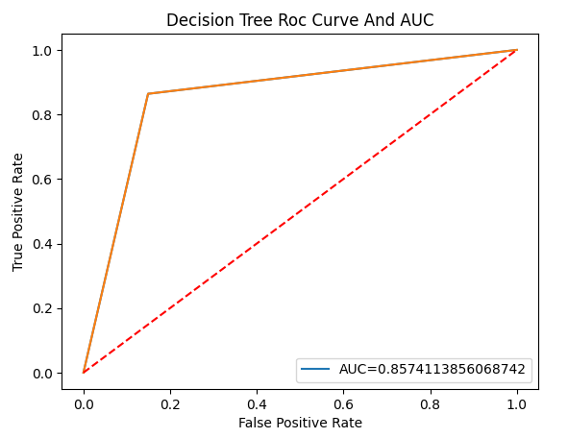
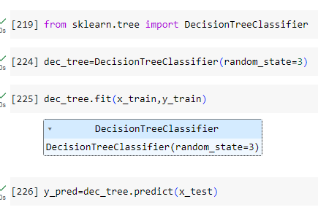

2.Decision Tree Algorithm :-

Slide 18
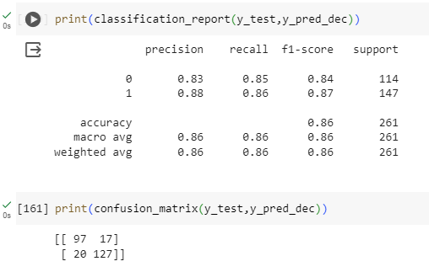
Classification Report for Decision Tree model :

Slide 19
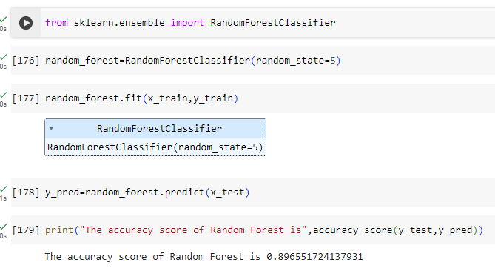
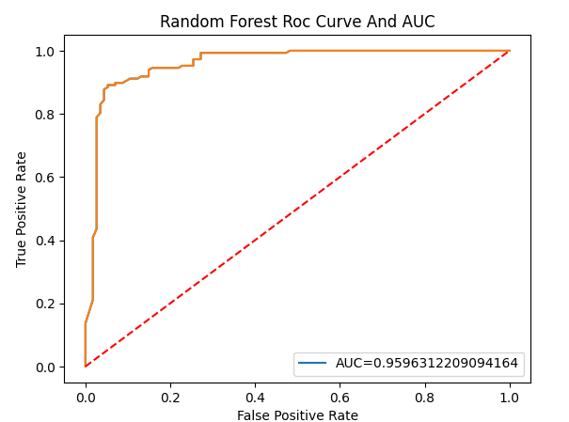
3.Random Forest Algorithm :-

Slide 20
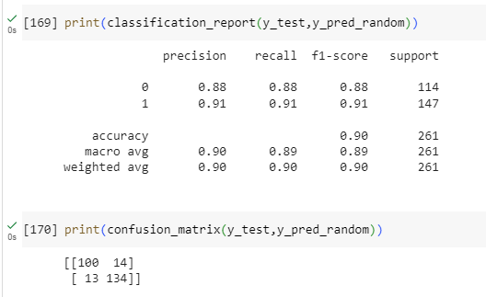
Classification Report for Random Forest model :

Slide 21
CONCLUSION
Within the scope of the project, we first made the data set ready for Exploratory Data Analysis(EDA)
We analyzed numerical and categorical variables within the scope of univariate analysis by using Distplot and Pie Chart graphics.
We made the data set ready for the model. In this context, we struggled with missing and outlier values.
We used three different algorithms in the model phase.
We got 87% accuracy and 94% AUC with the Logistic Regression model.
We got 85% accuracy and 85% AUC with the Decision Tree Model.
And we got 89% accuracy and 95% AUC with the Random Forest Classifier Model.
When all these model outputs are evaluated, we prefer the model we created with the Random Forest Algorithm, which gives the best results.

Slide 22
THANK YOU

