Slide 1
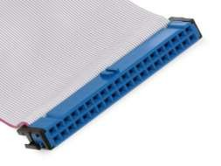
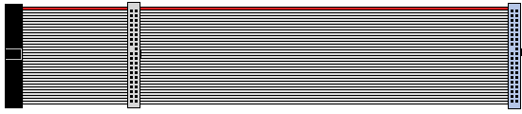
ATA/IDE Interface
•
AT Attachment (ATA), is an interface standard for the connection
of storage devices such as hard disk drives, floppy disk drives,
and optical disc drives in computers. The standard
by the X3/INCITS committee.
is
maintained
•
•
Parallel ATA developed by Western Digital
Also called “IDE”
• Integrated Device Electronics

Slide 2
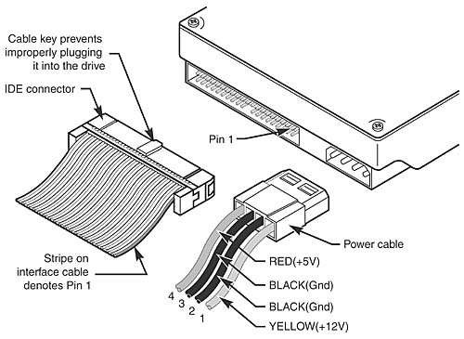
ATA I/O Connector
•
The ATA interface connector is normally a 40-pin
header-type connector with pins spaced 0.1 inches
apart and generally keyed
to
prevent
the
possibility
of
installing it upside
Plugging in an IDE cable backward usually won’t cause any permanent damage, however, it can lock up the system and prevent it from running at all.
down.
•

Slide 3
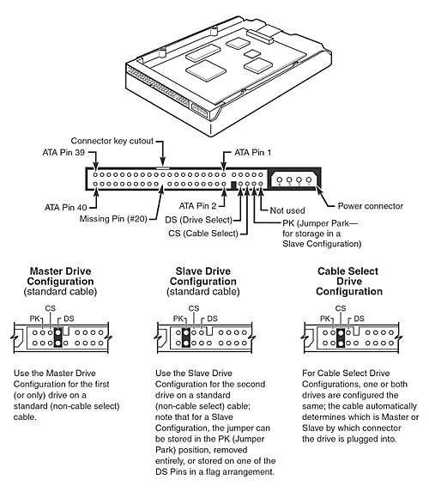
Dual Drive Configurations
•
Most IDE drives can
be configured with
three settings.
•
The diagram
illustrates the settings
of master, slave, and
cable select

Slide 4
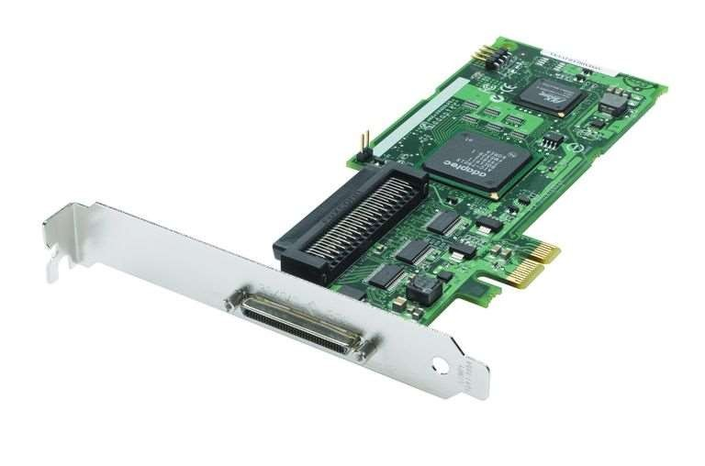
Small Computer System Interface (SCSI)
•
SCSI refers to the types of cables and ports used to
connect certain types of hard drives, optical drives,
scanners, and other peripheral devices
Fast SCSI: 10 MBps; connects 8 devices
Fast Wide SCSI: 20 MBps; connects 16 devices
Ultra Wide SCSI: 40 MBps; connects 16 devices
Ultra3 SCSI: 160 MBps; connects 16 devices
Ultra-640 SCSI: 640 MBps; connects 16 devices
to
a
computer.
•
•
•
•
•

Slide 5

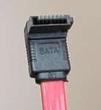
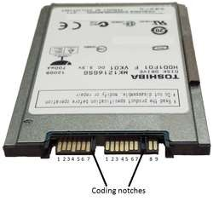

Serial ATA (SATA)
•
Serial ATA (SATA) is a computer bus interface that
connects host bus adapters to mass storage
devices such as hard disk drives, optical
and solid-state drives.
Compared to PATA/IDE
drives,
•
•
reduced cable size and cost
• seven conductors instead of 40 or 80
native hot swapping
faster data transfer
• through higher signaling rates
• through an I/O queuing protocol
•
•

Slide 6
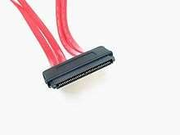
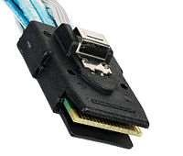
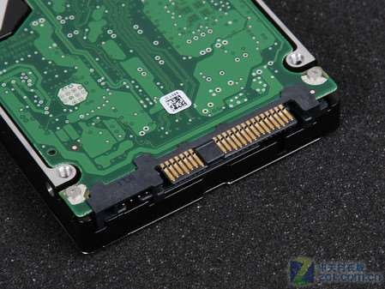
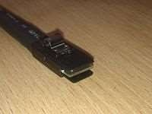
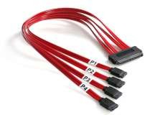
Serial Attached SCSI (SAS)
• Serial Attached SCSI (SAS) is a point-to-point serial protocol that moves data to and from computer storage devices such as hard drives and tape drives.
• SAS replaces the older Parallel SCSI bus technology.

Slide 7

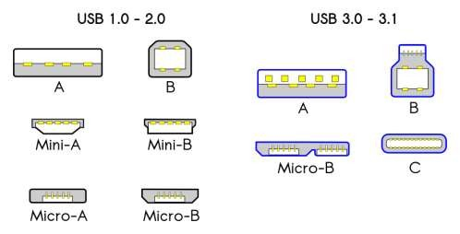
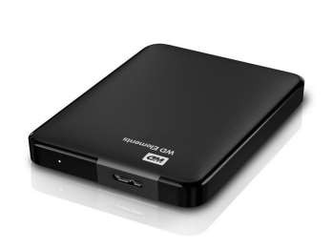
USB
• Universal Serial Bus (USB), is an industry standard initially developed in the mid-1990s that defines the cables, connectors and communications protocols used in a bus for connection, communication, and power supply between computers and electronic devices.

Slide 8

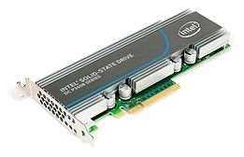
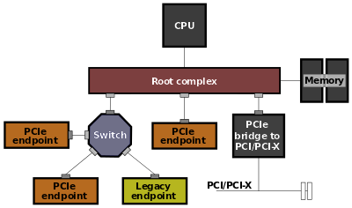
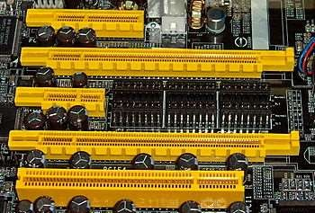
PCI Express (PCIe)
•
PCI Express (Peripheral Component Interconnect
Express) is a high-speed serial computer expansion
bus standard, designed to
replace the older PCI, PCI-X,
and
AGP
bus
standards.
•
Intel
NVMe
SSD
with
PCIe
• PCI Express 4/16/1/16
• Typical PCI

Slide 9
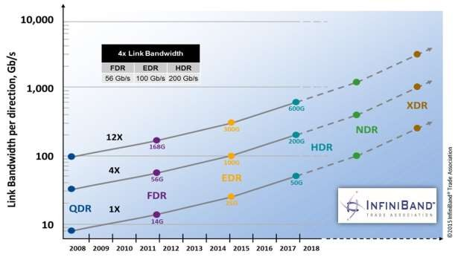
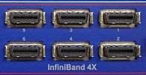
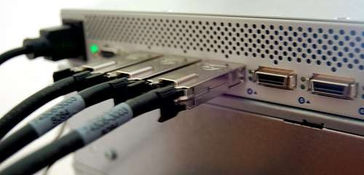
Infiniband (IB)
• InfiniBand (IB) is a computer-networking communications standard used in high-performance computing that features very high throughput and very low latency.
• Support RDMA

Slide 10
iSCSI (Internet SCSI) (1)
•
Why iSCSI?
• Storage Area Networks (SANs) based on serial gigabit transports overcome the distance, performance, scalability and availability restrictions of parallel SCSI implementations.
What is iSCSI?
•
•
•
•
Internet SCSI (iSCSI) protocol
Defined by the IP Storage work group of the IETF
IETF RFC 3720

Slide 11
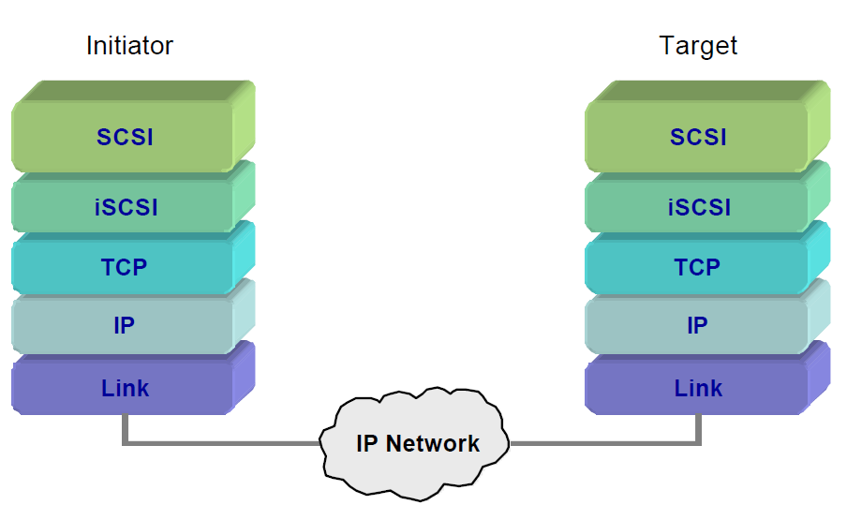
iSCSI (Internet SCSI) (2)
• iSCSI Protocol Layering Model

Slide 12
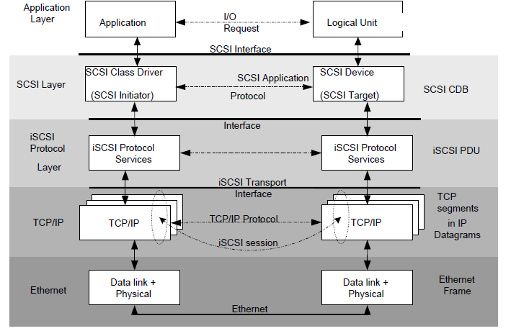
iSCSI (Internet SCSI) (3)

Slide 13
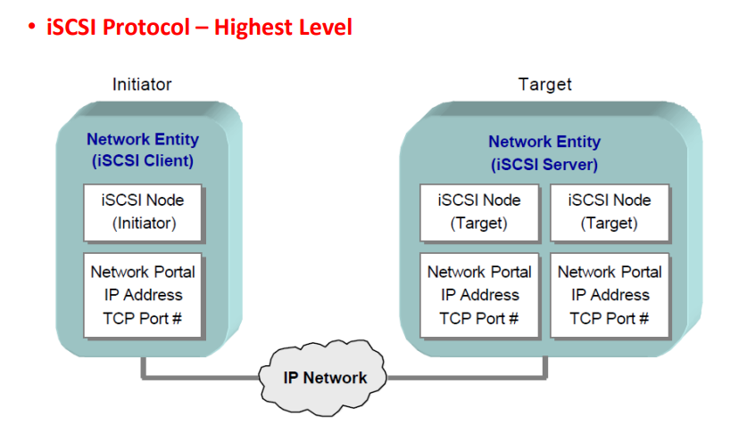
iSCSI (Internet SCSI) (4)

Slide 14
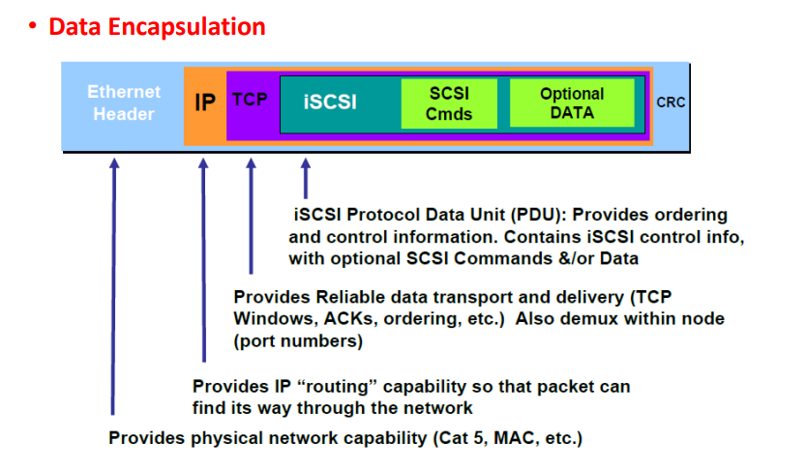
iSCSI (Internet SCSI) (5)

Slide 15
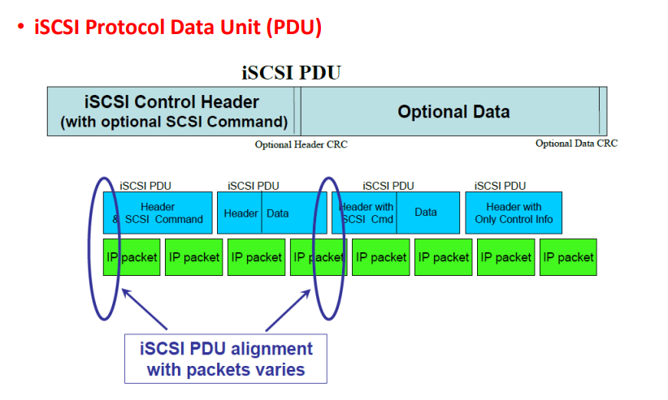
iSCSI (Internet SCSI) (6)

Slide 16
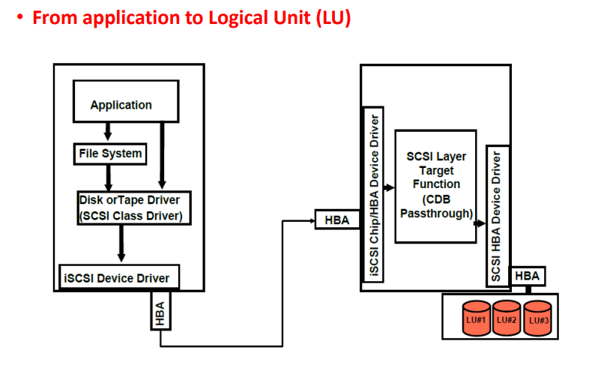
iSCSI (Internet SCSI) (6)

Slide 17
FC (Fiber Channel)
•
Fiber Channel, or FC, is a high-speed network
technology (commonly running at 1, 2, 4, 8, 16,
128 gigabit per second rates) primarily used to
connect computer data storage to servers.
Fibre Channel is mainly used in Storage Area
Networks (SAN) in commercial data centers.
32, and
•

Slide 18

FC Node Ports
•
•
Provide physical interface for communicating with other
Exist on
• HBA (Host Bus Adapter) in server
• Front-end adapters in storage
nodes
•
Each port has a transmit (Tx) link and
a receive (Rx) link
Node
Port 0
Tx
R
x
Port 0
Link
Port 1
Port n

Slide 19
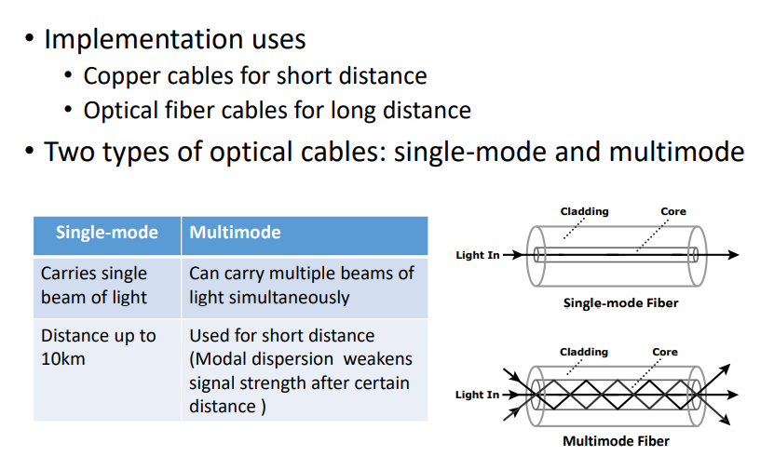
FC Cables

Slide 20
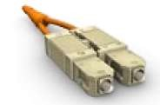
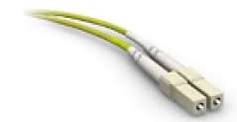
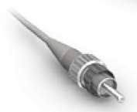
FC Connectors
•
•
Attached at the end of a cable
Enable swift connection and disconnection of the cable to and from a port
Standard Connector
•
Commonly used connectors
optic cables are:
for
fiber
•
Standard Connector (SC)
•
Duplex connectors
Lucent Connector
•
Lucent Connector (LC)
•
Duplex connectors
•
Straight Tip (ST)
•
•
Patch panel connectors
Simplex connectors
Straight Tip Connector

Slide 21
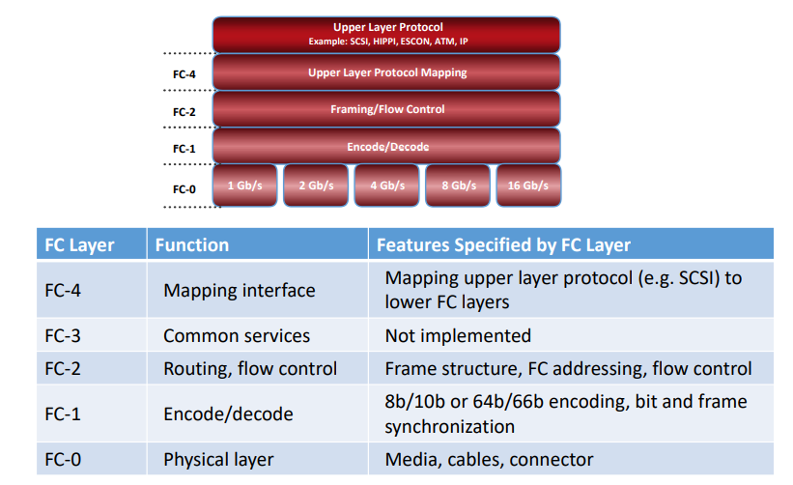
Fiber Channel Protocol Stack

Slide 22
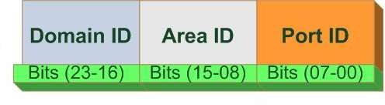
FC Addressing in Switched Fabric
•
FC Address is assigned to nodes during fabric login
• Used for communication between nodes within FC SAN
Address format
•
•
Domain ID is a unique
in the fabric
number provided to each switch
• 239 addresses are available for domain ID
Maximum possible number of node ports in a switched
fabric:
• 239 domains X 256 areas X 256 ports = 15,663,104
•

Slide 23
FCIP (IP SAN Protocol)
•
IP-based protocol that is used to connect distributed FC
SAN islands
Creates virtual FC links over existing IP network that is used to transport FC data between different FC SANs
Encapsulates FC frames onto IP packet
Provides disaster recovery solution
•
•
•

Slide 24
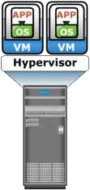



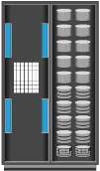
FCIP Topology
Servers
Servers
Server
Server
FCIP Gateway
FCIP Gateway
FC SAN
FC SAN
IP
Storage Array
Storage Array

Slide 25
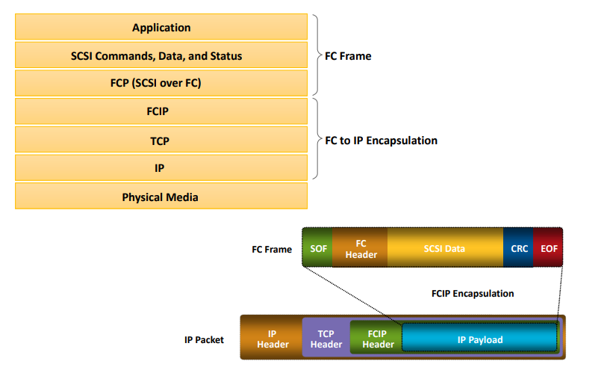
FCIP Protocol Stack

Slide 26

Block Storages

Slide 27








The SNIA shared storage model (1)
Application
File/record
File/record layer
Database
File system
(dbms)
(FS)
Host
Network
Block
aggregation Device
Storage devices (disks, …)
Block layer

Slide 28
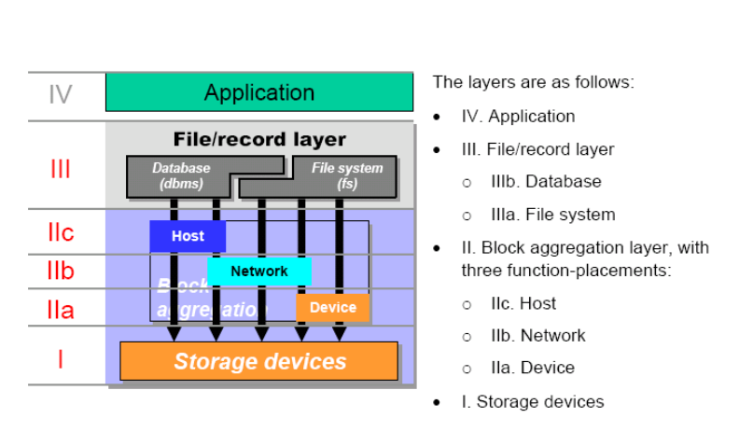
The SNIA shared storage model (2)

Slide 29
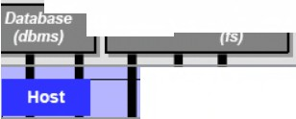
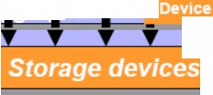
IV
Application
The layers are as follows:
rt.=::::::::U• -~
•
•
IV.
Ill.
o
o
II.
Application
File/record layer
lllb. Database
Illa. File system
Block aggregation layer,
File/
¹¹¹ I •
I le
I lb ^{Netw}
.. ,~ - -
11 a
1
File/record
layer
iii
I
•
with
I lb
-.:,
Network
I
I
three function-placements:
o lie. Host
y-
-
o
o
llb. Network
Ila. Device
•
I. Storage devices

Slide 30
Typical Block Devices
•
•
•
•
Hard Disk Drives (HDDs)
Solid State Drives (SSDs)
Storage Arrays (RAID)
Storage Area Network (SAN)
• Dedicated high speed network
devices
of servers and shared storage

Slide 31
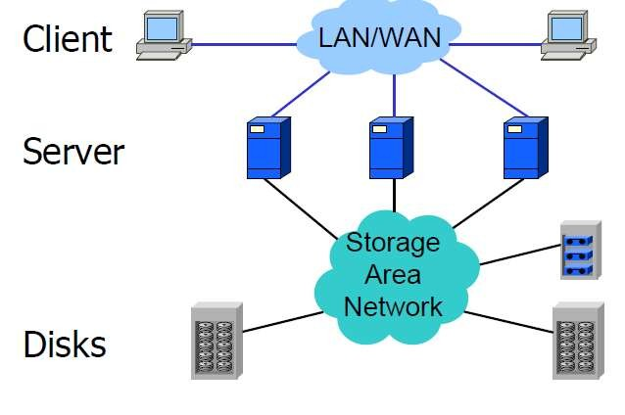
Storage Area Network (SAN)

Slide 32


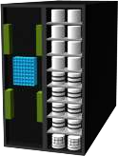
Features of a SAN
Servers
•
•
Provide block level data access
Resource Consolidation
• Centralized storage and management
Scalability
•
• Theoretical limit:
million devices
Secure Access
Appx.
15
FC
SAN
•
Storage Array
Storage Array

Slide 33
Types of SANs in Data Centre
•
•
•
•
•
Storage Area Network
IP SAN FC
SAN FCoE
SAN
Infiniband SAN??
(SAN)

Slide 34
Drivers for FCoE
•
FCoE is a protocol that transports FC data over Ethernet
network (Converged Enhanced Ethernet)
FCoE is being positioned as a storage networking option because:
•
•
Enables consolidation of FC SAN traffic and Ethernet traffic
onto a common Ethernet infrastructure
•
•
•
Reduces
Reduces
Reduces
the number of adapters, switch ports, and cables
cost and eases data center management
power and cooling cost, and floor space

Slide 35


Data Center Connectivity layout with FC
Servers
Servers
Server
Server
FC
Switches
IP
Switches
FC
Switches
LAN
Storage Array
Storage Array

Slide 36

Data Center Connectivity layout with FCOE
Server
Server
FCoE
Switches
FC
Switches
LAN
Storage Array
Storage Array

Slide 37
Components of an FCoE Network
•
•
•
Converged Network Adapter (CNA)
Cable
FCoE switch

Slide 38
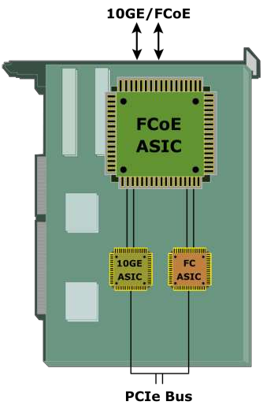
Converged Network Adapter-(CNA)
•
Provides functionality of both – a
standard NIC and an FC HBA
• Eliminates the need to deploy separate adapters and cables for FC and Ethernet communications
Contains separate modules for 10
Gigabit Ethernet, FC, and FCoE
ASICs
• FCoE ASIC encapsulates FC frames into Ethernet frames
•

Slide 39
Connectivity
• Two options are available for FCoE cabling
• Copper based Twinax cable
• Standard fiber optical cable
Twinax Cable Fiber Optical Cable
Suitable for shorter distances (up to Can run over longer distances
10 meters)
Requires less power and are less Relatively more expensive than expensive than fiber optical cable Twinax cables
Uses Small Form Factor Pluggable Uses Small Form Factor Pluggable
Plus (SFP+) connector Plus (SFP+) connector

Slide 40
FCoE Switch
•
Provides both Ethernet
and FC switch
functionalities
Consists of FCF, Ethernet
bridge, and set of CEE
ports and FC ports
(optional)
• FCF encapsulates and de-
encapsulates FC frames
Forwards frames based on Ethertype
FC Port
FC Port FC Port FC Port
•
Fibre Channel Forwarder (FCF)
Ethernet Bridge
Ethernet
Port
Ethernet
Port
Ethernet
Port
Ethernet
Port
•

Slide 41
FCoE frame Mapping
OSI Stack
7 - Application
FCoE Protocol Stack
FC Protocol Stack
6 - Presentation
FC - 4
FC - 4 Protocol map
5 - Session
FC Layers
FC - 3
FC - 3 Services
4 - Transport
FC - 2
FC - 2 Framing
3 - Network
FCoE Mapping
FC - 1 Data enc/dec
2 - Data Link
IEEE 802.1q
Layers
2 - MAC
FC - 0 Physical
1 - Physical
1 - Physical
Ethernet

Slide 42
Converged Enhanced Ethernet
•
•
Provides lossless Ethernet
Lossless Ethernet requires following
functionalities:
•
•
•
•
Priority-based flow control (PFC)
Enhanced transmission selection (ETS)
Congestion notification (CN)
Data center bridging exchange protocol(DCBX)

Slide 43
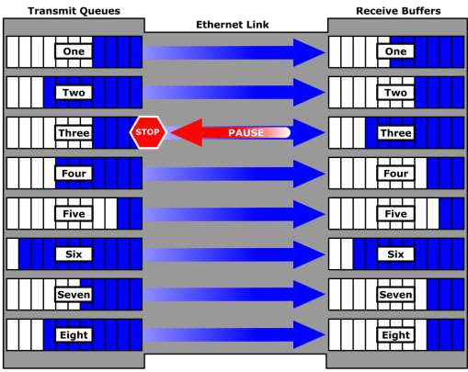
Priority-Based Flow Control
•
Creates eight virtual
links on a single
physical link
Uses PAUSE capability
of Ethernet for each
virtual link
•
•
A virtual link can be
paused and restarted
independently
PAUSE mechanism is based on user priorities or classes of service
•

Slide 44
Enhanced Transmission Selection (ETS)
• Allocates bandwidth to different traffic classes such as
LAN, SAN, and Inter Process Communication (IPC)
• Provides available bandwidth to other classes of traffic when a particular class of traffic does not use its allocated bandwidth

Slide 45
Congestion Notification (CN)
• Provides a mechanism for detecting congestion and
notifying the source
• Enables a switch to send a signal to other ports
that
need
to
stop or slow
Rate limiting to avoid
packet loss
FCoE Switch
down
their transmissions
FCoE
Switch
FCoE
Switch
Host
(Node A)
Congestion
Notification Message
Congestion
Storage Array
(Node B)

Slide 46
Data Center Bridging Exchange Protocol (DCBX)
•
Enables Convergence Enhanced Ethernet (CEE) devices
to convey and configure their features with other CEE
devices in the network
• Allows a switch to distribute configuration values to attached
adapters
Ensures consistent configuration across network
•

Slide 47

File Storage

Slide 48
File Sharing Environment
•
•
File sharing enables users to share files with other users
Creator or owner of a file determines the type of access
to be given to other users
File sharing environment ensures data integrity when
multiple users access a shared file at the same time
Examples of file sharing methods:
•
•
•
•
•
File Transfer Protocol (FTP)
Distributed File System (DFS)
Network File System (NFS) and Common Internet File System
(CIFS)
Peer-to-Peer (P2P)
•

Slide 49






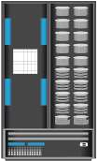

File Sharing Technology Evolution
Portable Media
for File Sharing
Networked PCs
File Sharing using File Servers
Stand Alone PC
File
Servers
File Sharing using NAS
NAS
Device

Slide 50
What is NAS (Network-Attached Storage)?
NAS
It is an IP-based, dedicated, high-performance file sharing and storage device.
•
•
•
Enables NAS clients to share files over IP network
Uses specialized operating system that is optimized for
file I/O
Enables both UNIX
and
Windows
users
to
share
data
Clients
NAS De
LAN
Application
Servers
vice
Print Server

Slide 51
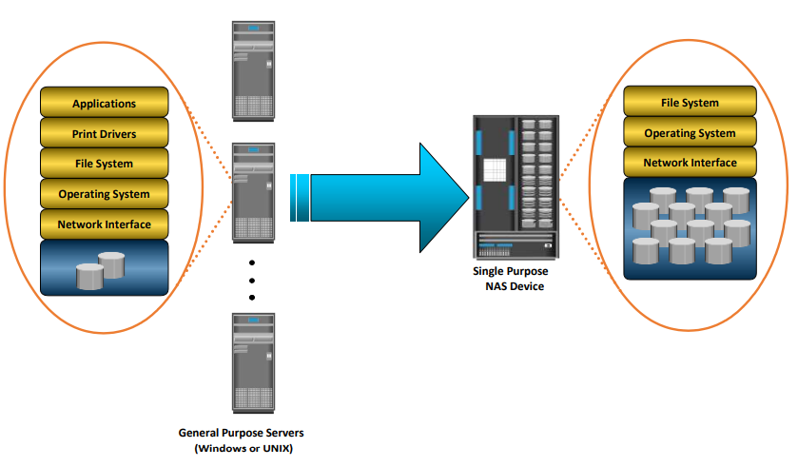
General Purpose Servers Vs. NAS Devices

Slide 52
Benefit of NAS
efficiency
flexibility
•
•
•
•
•
•
Improved
Improved
Centralized storage
Simplified management
Scalability
High availability – through
replication
native clustering and
•
Security – authentication, authorization, and file
locking in conjunction with industry-standard security
Low cost
Ease of deployment
•
•

Slide 53
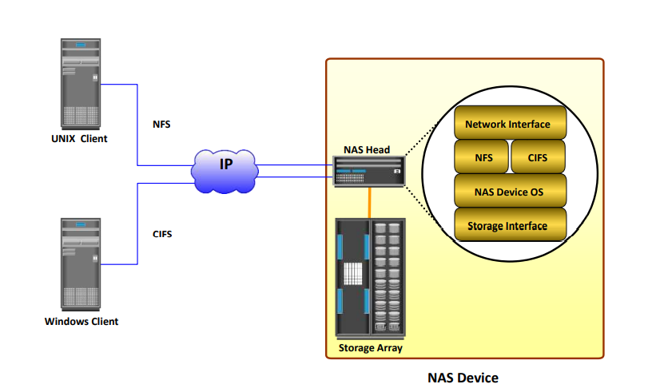
Components of NAS

Slide 54
NAS File Sharing Protocols
• Two common NAS file sharing protocols are:
• Common Internet File System (CIFS)
• Network File System (NFS)

Slide 55
Common Internet File System (CIFS)
•
Client-server application protocol
• An open variation of the Server Message Block (SMB)
protocol
Enables clients to access files that are on a server over
TCP/IP
Stateful Protocol
• Maintains connection information regarding every connected client
• Can automatically restore connections and reopen files that
were open prior to interruption
•
•

Slide 56
Network File System (NFS)
•
•
•
Client-server application protocol
Enables clients to access files that are on a server
Uses Remote Procedure Call (RPC) mechanism to provide access to remote file system
Currently, three versions of NFS are in use:
•
•
•
NFS v2 is stateless and uses UDP as transport layer protocol
NFS v3 is stateless and uses UDP or optionally TCP as transport layer protocol
NFS v4 is stateful and uses TCP as transport layer protocol
•

Slide 57
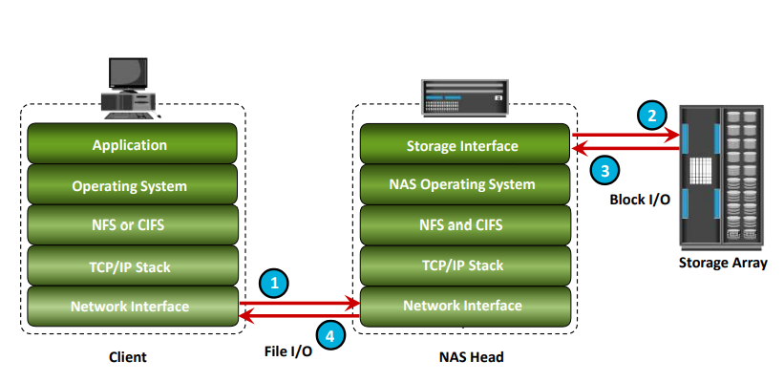
NAS I/O operations

Slide 58
NAS Implementation – Unified NAS
•
Consolidates NAS-based (file-level) and SAN-based
(block-level) access on a single storage platform
Supports both CIFS and NFS protocols for file access
and iSCSI and FC protocols for block level access
Provides unified management for both NAS head and storage
•
•

Slide 59
Unified NAS
FC SAN
Block Data Access
FC Hosts
Block Data Access
FC Port
iSCSI SAN
iSCSI Port
Ethernet
Port
iSCSI Hosts
Unified NAS
File Access
Ethernet
NAS Clients

Slide 60
NAS Implementation – Gateway NAS
•
Uses external and independently-managed storage
• NAS heads access SAN-attached or direct-attached storage
arrays
NAS heads share storage with other application servers that perform block I/O
Requires separate management of NAS head and
storage
•
•

Slide 61

Gateway NAS connectivity
Application Servers
Client
IP
FC SAN
Applic
Client
Application Server
Storage Array
Client
Gateway NAS

Slide 62
NAS Implementation – Scale-out NAS
•
Pools multiple nodes together in a cluster that works
a single NAS device
• Pool is managed centrally
Scales performance and/or capacity with addition of
nodes to the pool non-disruptively
as
•
•
Creates a single file system that runs on all nodes in the
cluster
• Clients, connected to any node, can access entire file system
• File system grows dynamically as nodes are added
Stripes data across all nodes in a pool along with mirror or parity protection
•

Slide 63


Scale-out NAS Connectivity
External Switch
Node 1
Node 2
Node 3
Internal Switch 1
Internal Switch 2
InfiniBand Switches

Slide 64
Server with NAS Consolidation
Traditional File Server Environment
NAS Environment
_{UNIX} Windows File
IP
UNIX Client Windows Client
NAS Device
IP
UNIX Client Windows Client
with NAS
File Server
Server

Slide 65
NAS Use Case 2 – Storage Consolidation with NAS
Traditional File Server Environment
NAS Environment
Internal Users
Business Clients Surfers, Shoppers
IP
Web and Database Servers
Windows UNIX File
Server _{FC SAN} File Server
Storage
Internal Users
Business Clients Surfers, Shoppers
IP
NAS Head
Web and Database Servers
FC SAN
Storage

Slide 66
File-level Virtualization
•
Eliminates dependency between data accessed at the
file-level and the location where the files are physically
stored
•
Enables users to use a logical path, rather than
physical path, to access files
a
•
Uses
global namespace that maps logical path
of file
resources to their physical path
Provides non-disruptive file mobility across file
or NAS devices
•
servers

Slide 67

File-Level Virtualization
Before File-level Virtualization
After File-level Virtualization
Clients
Clients
Clients
Clients
Virtualization
Appliance
NAS Head
NAS Head
NAS Head
NAS Head
Storage Array
Storage Array
File Sharing Environment
File Sharing Environment
•
•
•
Dependency between client access
and file location
Underutilized storage resources
Downtime is caused by data
migrations
•
•
•
Break dependencies between
client access and file location
Storage utilization is optimized
Non-disruptive migrations

Slide 68
Network File System (NFS)
client
server
user programs
syscall layer
VFS
syscall layer
NFS
server
VFS
*FS
*FS
NFS
client
RPC over UDP or TCP

Slide 69
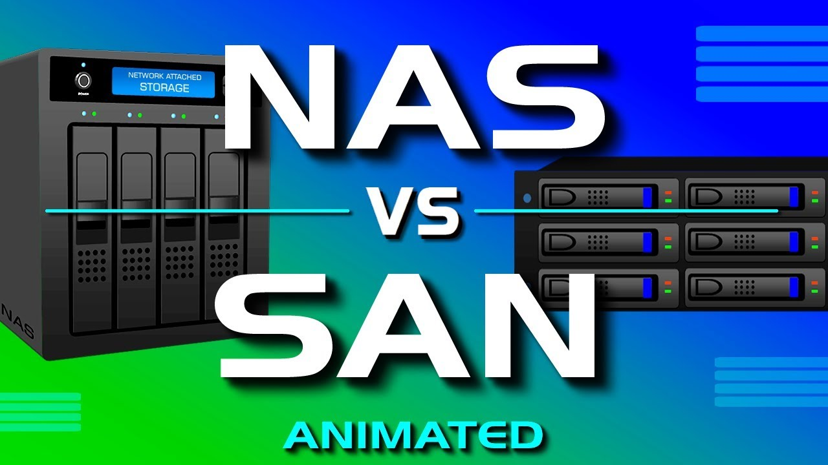
SAN-vs-NAS

Slide 70
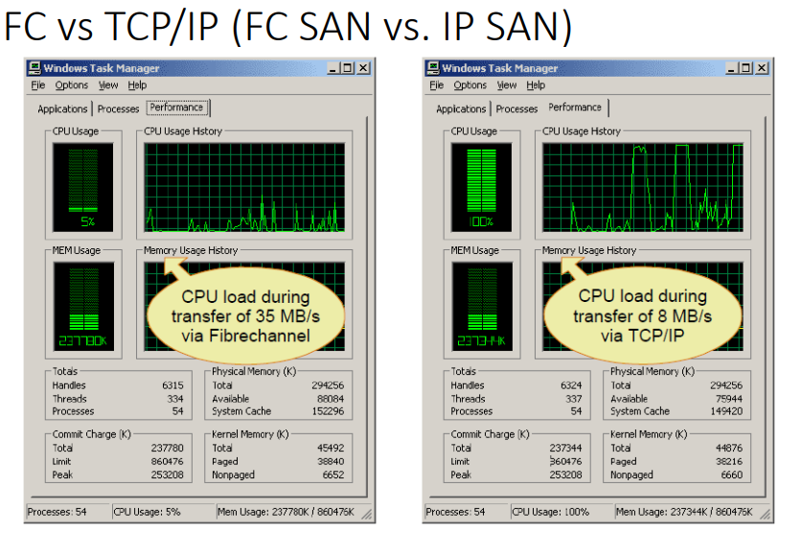

Slide 71
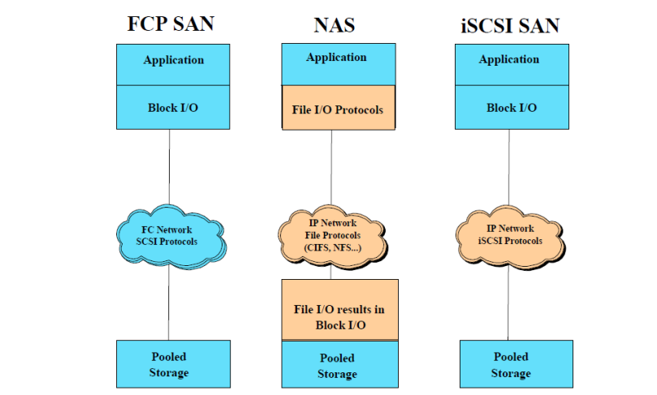
Application Protocol Support

Slide 72
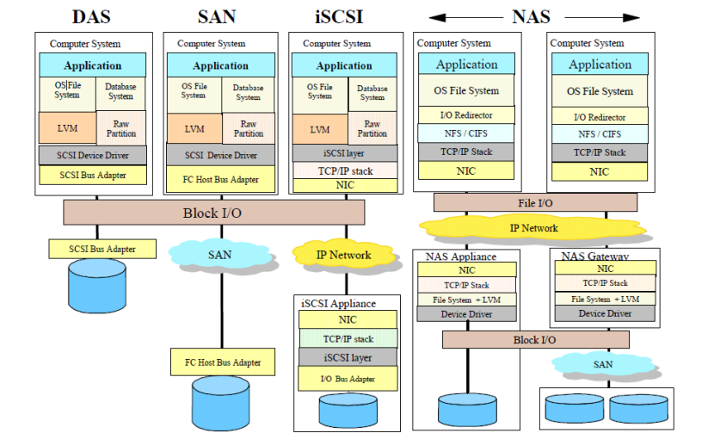
Transporting Application Data

Slide 73
Cloud Storage Clients
•
Characteristics
•
•
•
•
•
•
Hybrid: Web+Local (App)
RESTful HTTP
Disconnected Operations
Local Caching
Data Synchronization
Data as Objects with Metadata
•
Examples
•
•
•
•
•
Mac & iPhone: Apple iDisk/iCloud
Windows: Microsoft Live Sync
Linux: Ubuntu One
Google Docs
Social apps

Slide 74

Cloud
NAS
Architecture
•
•
•
Azure StorSimple
•
Global management
namespace
Lock management
on
•
•
•
•
Privilege management
Cache Optimization
Deduplication

Slide 75

Microsoft Azure File Storage (1)
• Support SMB/RESTful Protocols
• File share for a VM region

Slide 76



Microsoft
Azure
File
Storage
(2)
VM
Cloud Service
Web Site
SMB 2.1
REST
SMB 2.1
REST
REST
Azure Files

Slide 77

EMC Isilon

