Slide 1
Logical
Volume
Management

Slide 2
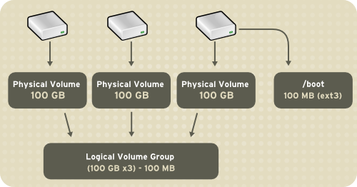
LVM is a tool for logical volume management which includes allocating disks, striping, mirroring and resizing logical volumes.
With LVM, a hard drive or set of hard drives is allocated to one or more physical volumes. LVM physical volumes can be placed on other block devices which might span two or more disks.
Since a physical volume cannot span over multiple drives, to span over more than one drive, create one or more physical volumes per drive.

Slide 3
The volume groups can be divided into logical volumes, which are assigned mount points, such as /home and / and file system types, such as ext2 or ext3. When "partitions" reach their full capacity, free space from the volume group can be added to the logical volume to increase the size of the partition. When a new hard drive is added to the system, it can be added to the volume group, and partitions that are logical volumes can be increased in size.

Slide 4
Common
problems
●
Resize partition?
Use space on separated disks? Use speed of multiple devices?
●
●
●
Write same data on more
devices?
●
Backup
used
filesystem?
2/29

Slide 5
LVM
●
Flexible capacity - multiple disks/partitions
●
Resizeable storage pools -
Online data relocation
extend/reduce
●
●
Convenient device
Disk striping
Mirroring volumes
Volume Snapshots
naming
-
names/tags
●
●
●
3/29

Slide 6
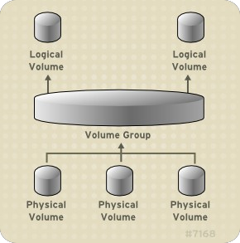
Concept
4/29

Slide 7
PV
●
partition, disk, LUN
LVM label - 2nd sector
0, 1 or 2 copies of ASCII
●
●
metadata
●
More
PV
on
one
disk?
# pvcreate /dev/sd[a-c]1
5/29

Slide 8
VG
●
Pool of PVs
extent
●
●
fixed for whole VG
smallest allocable space
●
●
Size
Map
of logical extent = Size
of physical
extent
●
logical
extents
to
physical
extents
# vgcreate -s 4M vg_test /dev/sd[a-c]1
6/29

Slide 9
LV
●
Linear
Striped
Mirrored
Snapshot
Virtual
●
●
●
●
7/29

Slide 10
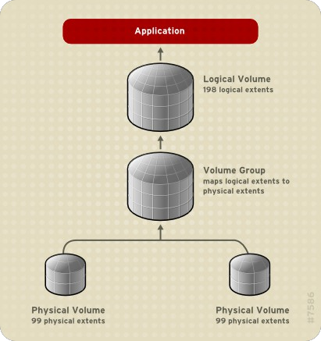
Linear
concatenate physical extents to logical volume
flexible space allocation
●
●
●
Example:
●
2x99 physical
extents
●
198 logical extents
8
# lvcreate -L 50G -n lv_linear vg_test
# lvcreate -l 100%FREE -n lv_linear vg_test
/29

Slide 11
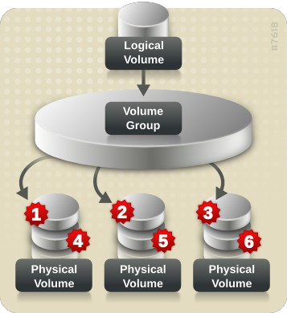
Striped
●
round robin
●
effective
for
large
I/O
9
# lvcreate -L 50G -i 3 -I 128 -n lv_linear vg_test
/29

Slide 12
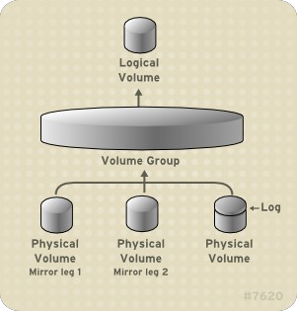
Mirrored
●
Identical copies
Mirror log on another device or in memory
Mirror != backup mirror_image_fault_p
olicy
●
●
●
●
allocate
remove
●
10/29

Slide 13
Mirror
creation
# lvcreate -m1 -L 1G -n lv_mirror vg_test
# lvcreate -m1 -L 2T -R 2 -n lv_mirror vg_test
# lvcreate -m1 -L 1G --mirrorlog core -n lv_mirror vg_test
# lvcreate -m1 -L 1G -n lv_mirror -alloc anywhere vg_test
# lvcreate -m1 -L 1G --mirrorlog mirrored -n lv_mirror vg_test
# lvcreate -m1 -L 1G -n lv_mirror vg_test /dev/sda1 /dev/sdb1
/dev/sdc1
# lvcreate -m1 -l 5 --mirrorlog mirrored -n lv_mirror vg_test /
> /dev/sda1:0-4 /dev/sdb1:0-4 /dev/sda1:5 /dev/sdb1:5
# lvcreate -m1 -i2 --mirrorlog core -n lv_lvm vg_four
11/29

Slide 14
Snapshot
●
stores only differences
origin and snapshot, both are
●
RW
●
snapshot
100% full
Use
!=
is
backup
●
lost
completely
●
●
backup
fsck test/rollback on
●
●
production data
“--merge”
●
virtual machines
12
lvcreate --size 100M --snapshot --name lv_snap /dev/vg0/lv0
/29

Slide 15
Virtual
●
--virtualsize VirtualSize
●
sparse
device
13/2
$ lvcreate --virtualsize 1T --size 100M --snapshot --name sparse vg1
9

Slide 16
Device
mapper
●
linear
striped
mirror
snapshot
error
zero
multipath
crypt
●
●
●
and
snapshot-origin
●
●
●
●
14/29

Slide 17
Thank
you
Questions
30/29

Slide 18
RHEL 6
●
mirror_image_fault_policy=allocate/remove
data_alignment_detection udev integration
●
●
●
lvconvert
lvconvert lvconvert
--repair
--merge
--splitmirrors
●
●
●
lvcreate --mirrorlog mirrored
lvextend --alloc cling
multiple --addtag and --deltag
●
●
31/29

