Slide 1
MILITARY RADAR
Carried out by
SHUBODAYA H N
Under the guidance of
SUREKHA T P
Professor
Dept. of ECE
Department of Electronics and Communication Engineering
Vidyavardhaka College of Engineering, Mysuru
Vision Processing Unit
May, 2020
1 / 18

Slide 2
INRODUCTION
What is a radar?
Radar is a detection system that uses radio waves to determine the range, angle, or velocity of objects. It can be used to detect aircraft, ships, spacecraft, guided missiles, motor vehicles, weather formations, and terrain.

Slide 3
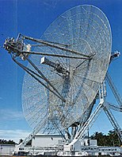
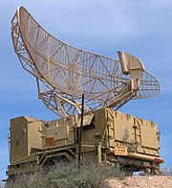
INTRODUCTION
Long range radar antenna
Radar for detection of aircraft

Slide 4
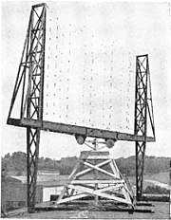
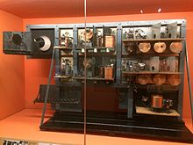
HISTORY
1) Experimental radar
2) First workable unit built by Robert watson

Slide 5
LITERATURE SURVEY
In paper one MIMO radar is used to improve the performance of joint estimation of direction of arrival and departure.
In paper two short range application is used which has sufficient time to switch between antenna elements as an alternative for more complex implementations.
In paper three ultra spread linear systems is used whose response lie within a unit area region in the delay-Doppler space.
In paper four research for various radar application is discussed such as medical, airborne, automobile and much more.
In paper five military activities such as administrating in arranging, coordinating, planning, and controlling the game plan, through strategic photo of fight space and interchanges availability.
In paper six, development of parametric OFDM radar model by reformulating the target detection problem as the task of sparse signal spectrum estimation.

Slide 6
LITERATURE SURVEY
7) In paper seven, radar data are used to locate areas of interest on images. Two different statistics, frame-based and event-based, are computed to evaluate the method efficiency.
8) In paper eight, a sparsity-based approach to track multiple targets in a region of interest using an orthogonal-frequency-division multiplexing (OFDM) radar.

Slide 7
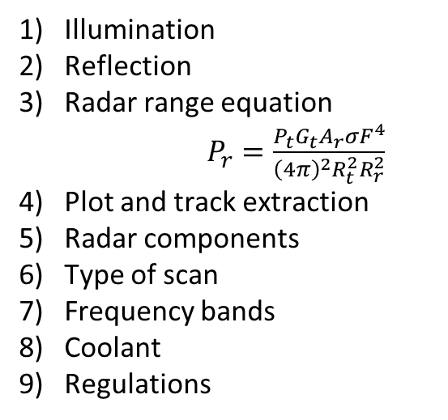
IMPLEMENTATION
Illumination
Reflection
Radar range equation
$P_{r}=\frac{P_{t}G_{t}A_{r}σF^{4}}{{\left(4π\right)}^{2}R_{t}^{2}R_{r}^{2}}$
4) Plot and track extraction
Radar components
Type of scan
Frequency bands
Coolant
Regulations

Slide 8
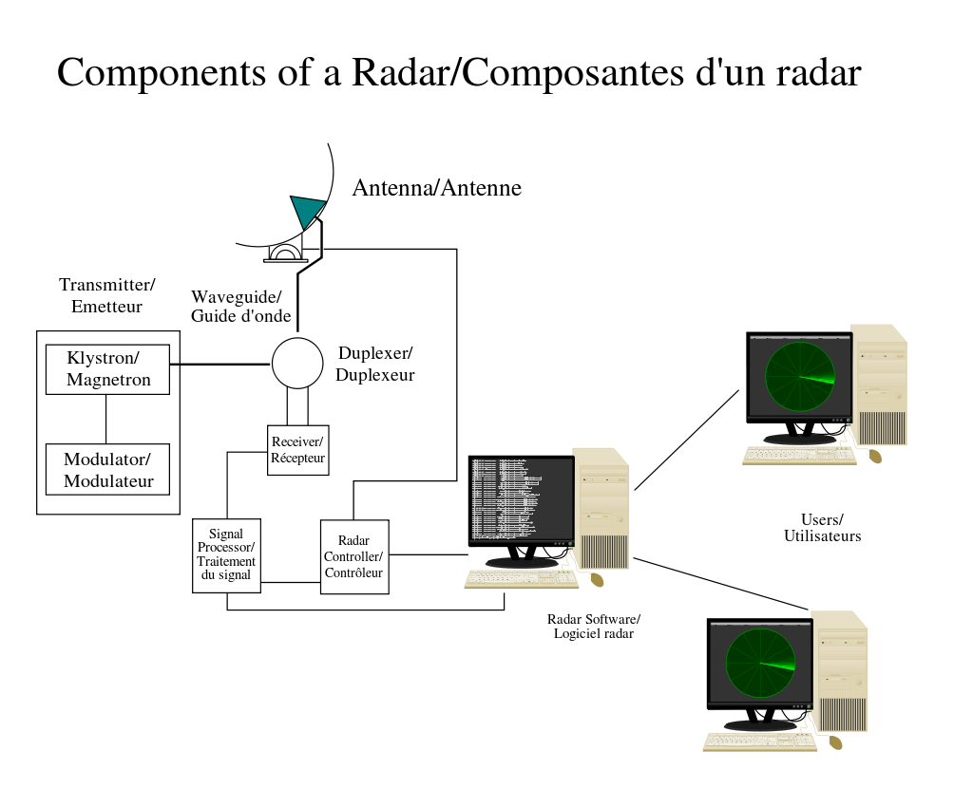
IMPLEMENTATION

Slide 9
APPLICATION
Terrain following radar
Imaging radar
Radar navigation
Wave radar
Ground surveillance
Missile guidance
Fire control radar
Air traffic control
Moving target indication
Weapon locating radar

Slide 10
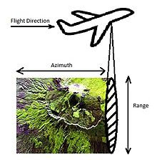
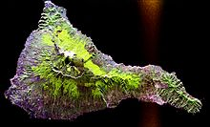
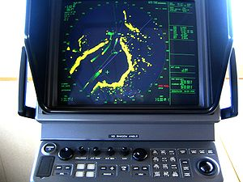
APPLICATION
Radar imaging
Radar navigation
Radar using motion platform

Slide 11
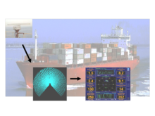
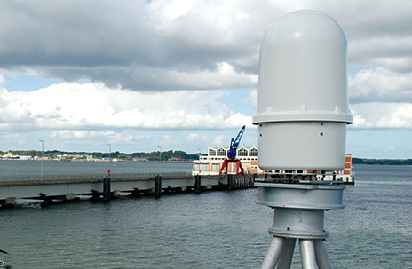
APPLICATION
Wave radar
Ground surveillance radar

Slide 12
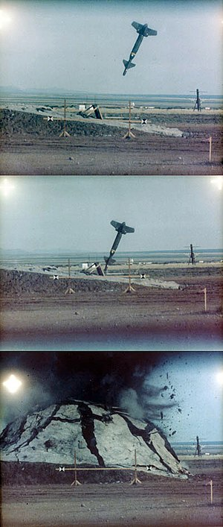
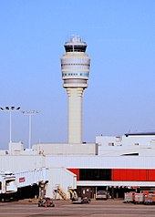
APPLICATION
Missile guidance
Air control

Slide 13
EVALUATION
Doppler effect
Polarization
Limiting factor
Noise
Interference
Clutter
Jamming
Radar signal processing
Frequency modulator
Speed measurement
Pulse Doppler signal processing
Reduction of interference effects

Slide 14
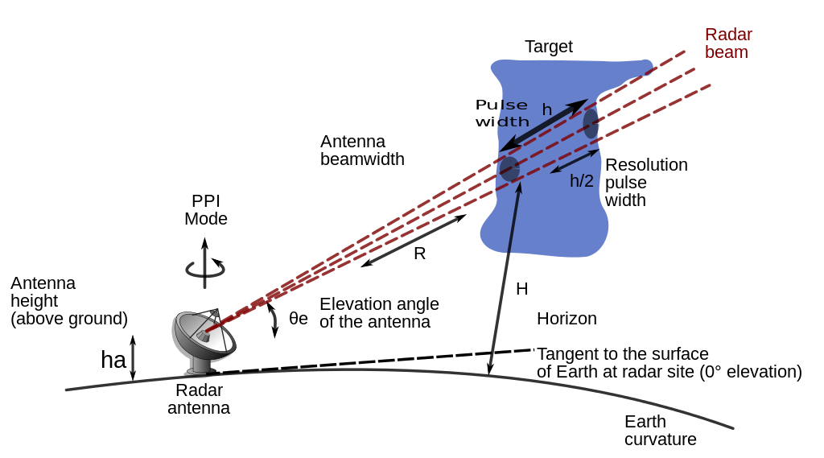
EVALUATION
Fig. Echo height above ground

Slide 15
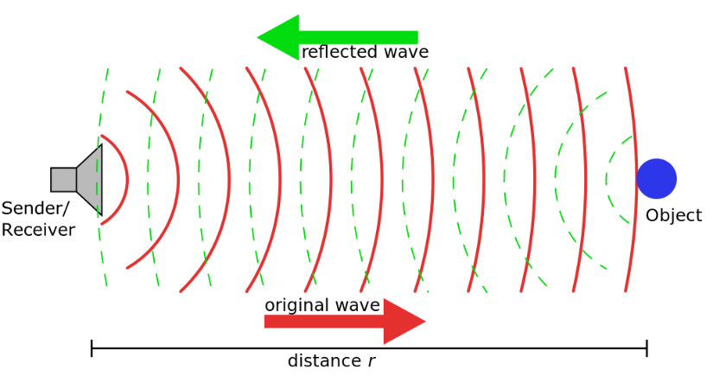
EVALUATION
Fig. Continuous wave radar

Slide 16
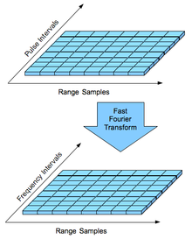
EVALUATION
Fig. Pulse Doppler signal processing

Slide 17
ADVANTAGE
RADAR can penetrate mediums such as clouds, fogs, mist and snow.
RADAR signal can penetrate insulators.
It can give the exact position of an object.
It can determine the velocity of a target.
It can measure the distance of an object.
It can tell the difference between stationary and moving targets.
RADAR signals do not require a medium of transportation.
RADAR signals can target several objects simultaneously.
It allows for 3D Imaging based on the various angles of return.
It is economical when doing small-scale map revision.

Slide 18
DISADVANTAGE
RADAR takes more time to lock on an object.
RADAR has a wider beam range (Over 50ft Diameter).
It has a shorter range (200ft).
It can be oversensitive.
It is not very accurate.
It requires specialized training to analyze the data.
It cannot distinguish or resolve multiple targets.
Readings may be falsified if the object is handheld.
It cannot differentiate the color of the object.
It cannot resolve the type of the object.

Slide 19
CONCLUSION AND FUTURE WORK
1) Using Ultra broadband multifunctional RF-system capabilities.
2) Connectivity via network capable operations up to orthogonal waveforms.
3) There is an emerging trend of MIMO antenna aperture set-ups.
4) MIMO approach has the general advantage that an instantaneous Field of View.
5) The variety of new possibilities provided by the future radar trends needs to be optimized by a flexible and modern radar resource management

Slide 20
BIBLIOGRAPHY
1) M.L.Bencheikh and Y.Wang,”Combined Esprit rootmusic for doa-doad estimation in polarimetric bistatic MIMO radar” IREENA laboratory, Polytech Nantes, Nantes, France. Vol.22,109-117,2011
2) Y.Huang and P.V.Brennan,”FMCW based MIMO imaging radar for martime navigation”, Department of electronics and electrical engineering, University college London. Vol.115,327-342,2011
3) Waheed U.Bajwa, Member, IEEE, Kfir Gedalyahu, and Yonina C.Eldar, Senior member, IEEE,”Identification of parametric underspread linear systems and super-resolution radar”, December 2010
4) W.Wiesbeck, Marwan Younis,”Radar 2020: future of radar systems”, conference paper. July2015.
5) Vinay Jangir, Manish kumawat, Manish kumar sharma,”Military radar system”, IJTSRD paper. Vol.3, Mar-Apr 2019.
6) Satyabrata Sen, Member IEEE,”Multiobjective optimization of OFDM radar waveform for target detection”, IEEE transaction of signal processing. Vol.59, No.2, February 2011.
7) Luca Bombini, Paolo Medici, ”Radar-Vision fusion for vehicle detection”,University de parma. June 2004
8) Satyabrata Sen and Arye Nehorai, Fellow, IEEE, “Sparsity-Based multi tracking using OFDM radar”, IEEE transaction on signal processing, Vol.59, No.4, April 2011.

