Slide 1
An Analysis of the Price Change in Online Mobile Shopping
Shubo Zhang
December 12th

Slide 2
Table of Contents
Introduction and Background
Data Description and Methodology
Data Analysis
Conclusion and Recommendation

Slide 3
Introduction and Background
Online shopping has become one of the most prevailing shopping patterns in recent years.
However, the qualities of online products are invisible to some extent.
Three external factors that affect online shopping:
Ratings and comments from other users
Logistic affairs
Choices of platforms

Slide 4
Introduction and Background
Customers unlikely bargain with the producers in the process of online shopping.---Price takers
Providers and platforms are profit-seekers
The prices of commodities may be adjusted frequently for either clearance or profit making purposes

Slide 5
Introduction and Background
Dependent Variable: whether the price increases or not in the next sale time period
Customer Side: fully realize the trends of price change of the target products to make a wise purchasing decision
Producer Side: by investigating the effect of many factors along with the nature of the product itself, the electronics producers will be able to find out the driving forces of the price changes

Slide 6
Data Description and Methodology
Dataset: price change prediction of electronics in Online shopping
Published by Kaggle
Web: https://inclass.kaggle.com/c/price-change-prediction-of-electronics-in-onlineshopping/data
Mobiles and cameras on Indian online shopping websites from 2011 to 2012
7765 observations
Variables: brands, color, shipping methods, stock status, rating, websites where sold, category and price information of the products

Slide 7
Data Wrangling(Basic)
Drop all the cameras, since the area of interest is mobile
Fill in the blanks with NA, and then employ the na.omit command to remove all the missing values out of the dataset
Create standard dummy variables for stock status and whether having free delivery service
Out of Stock and no free shipping service are recorded as two instead of one in the dataset

Slide 8
Data Wrangling (Color)
Remove the outliers and some “minorities” in the dataset to ensure the validity of the estimation
Color brown, dark tarnish and stealth black show low frequency in this dataset ( less than 10)
Note: Variables with low frequency are not representative and hence may mislead the analysis ---Dummy Trap related

Slide 9
Why ? Dummy Trap
Color will be treated as a categorical data in the estimation, in order to avoid dummy trap and perfect multicolinearity problems, one category of the categorical data will be omitted. When interpreting the results, the coefficients of the other categories illustrates the effect of the specific categories on the dependent variable compared to the omitted one. Thus, in case the low-frequency categories, which may lead to unfaithful results, are chosen as the omitted one, I remove the categories whose frequency are lower than ten. As well, this policy applies to other variables in this project.

Slide 10
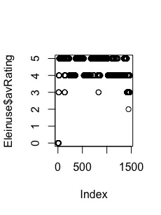
Data Wrangling (average rating)
R treats it as a continuous variable with values lying in the domain of [0,5].
it is a categorical variable indeed
No value for average rating= 1
Only 1 observations on average rating =2
Hence, remove the “2” observation
IMPORTANT: convert it from continuous to categorical

Slide 11
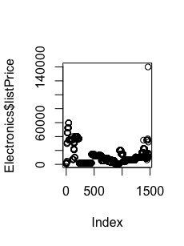
Data Wrangling ( List Price)
Apparently, 140000 is one outlier, so I remove it

Slide 12
Data Wrangling ( Shipping period)
zero shipping day, 5-7 working days and 7-8 working days are lower than 10
Remove these three variables
After data wrangling, there still exist 1445 Observations

Slide 13
Exploratory Analysis (OLS V.S. Logistic Regression)
OLS :
OLS is commonly used when the dependent variable is continuous
Convenient to interpret the marginal effect of each independent variable on the outcome
Logistic Regression:
Binary dependent variable
Similar to ascertain the probability of price increase in this case
Note: OLS may predict values less than zero or greater than one under some scenarios, which are meaningless. Because probability must lie in [0,1]
Logistic Regression is preferred in this case

Slide 14
Creating Training and Test sets
set.seed(345)
index_train <- sample(1:nrow(Electronics),2/3*nrow(Electronics))
trainingset <- Electronics[index_train,]
testset <- Electronics[-index_train,]
Training set: 2/3 of data – 980 observations
Test set: 1/3 data --- 491 observations

Slide 15
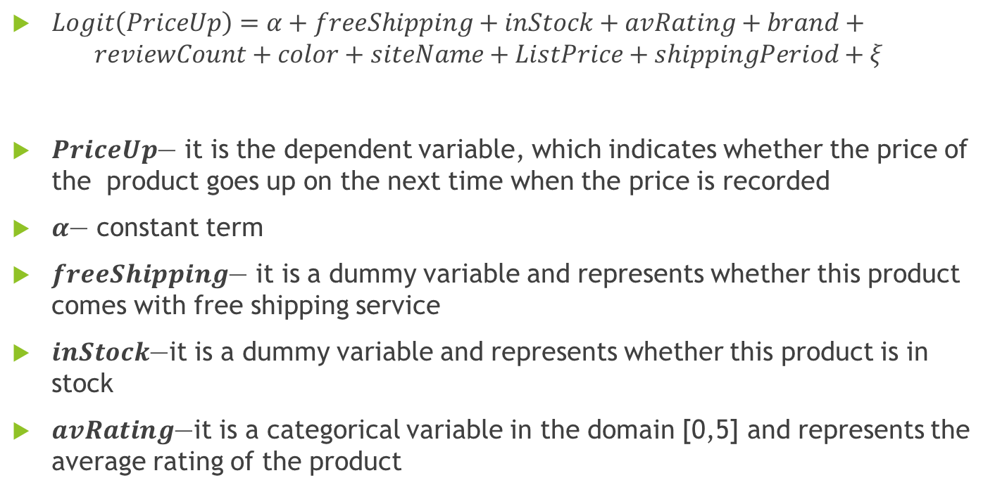
Model
$Logit\left(PriceUp\right)=α+freeShipping+inStock+avRating+brand+$
$$reviewCount+color+siteName+ListPrice+shippingPeriod+ξ_{}$$
$PriceUp$— it is the dependent variable, which indicates whether the price of the product goes up on the next time when the price is recorded
$α$— constant term
$freeShipping$— it is a dummy variable and represents whether this product comes with free shipping service
$inStock$—it is a dummy variable and represents whether this product is in stock
$avRating$—it is a categorical variable in the domain [0,5] and represents the average rating of the product

Slide 16
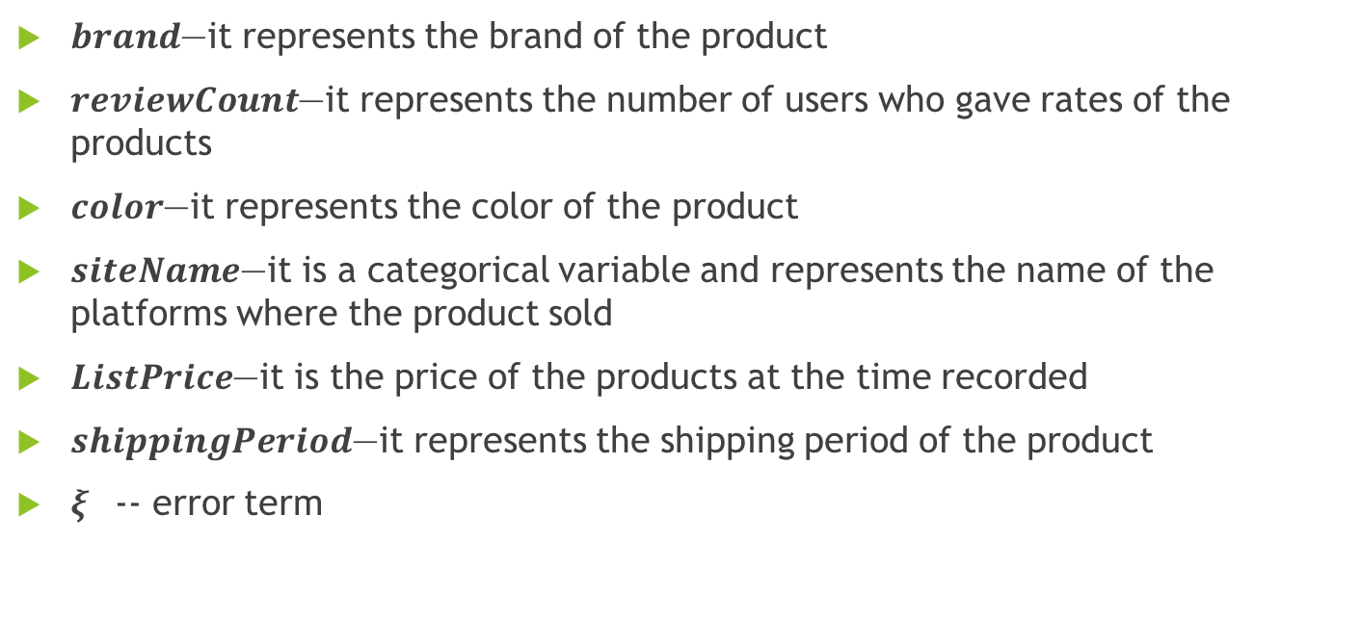
Model
$brand$—it represents the brand of the product
$reviewCount$—it represents the number of users who gave rates of the products
$color$—it represents the color of the product
$siteName$—it is a categorical variable and represents the name of the platforms where the product sold
$ListPrice$—it is the price of the products at the time recorded
$shippingPeriod$—it represents the shipping period of the product
$ξ_{}$-- error term

Slide 17
Data Analysis
Two Parts: Marginal Effects analysis and Predictions
Strategy for Marginal effects analysis:
I would take the three features into consideration progressively, and make efforts to figure out the validity of these in-theory significant variables.
Include all useful variables available in the dataset

Slide 18
Marginal Effects-1
Independent variables: average rating and reviewCount
Variable represents the average rating is 5 is omitted
Compared to the products with the highest level average rating, those are rated zero on average have a 1.5% lower probability of increasing the products’ prices.
No difference from 3-5 on average rating
The number of rating-- it imposes no impact on the price change

Slide 19
Marginal Effects-2
Independent variables: Average rating, reviewCount, Free shipping, shipping period

Slide 20
Marginal Effects-2&3
1-3 working days in the shipping period variable is omitted
None of them is significant
Rating of the products and the shipping methods are not determinants of the price increase in the next period
Surprisingly, the results by including siteName are identical to the results in Model 2
siteName is highly correlated to the existing variables of rating and logistic stuff. Due to perfect multicolinearity, siteName is omitted in this regression.
Conclusion: the rating system, logistic affairs and the platform where the product sold are potentially affect the sales of the product, they are not the driving forces of price change in the next time period

Slide 21
Marginal Effects 4
Independent Variables: all the variables listed in Page 15 & 16

Slide 22
Marginal Effects 4
Aim: deal with omitted variable bias
brand loyalty and color preferences (brand and color)
Stock Status: Being out of stock may be due to a high sales volume, and the price of that product is more likely to raise in the next sales period
List Price: if the list price is low, then the likelihood of increasing the price is high generally
AirTyme (Brand)&Black (Color) are omitted
Arise, Blackberry, HTC and Sony matter in this case

Slide 23
Prediction
Goal: in order to make wise decisions in mobile purchase, customers need to know the likelihood of having a higher price of the target product in the next sale period.
Once consumers notice that the price will go up in the next time period, then it will be better to purchase at the current stage
Choose Regression 2 ( three factors, note: 2 and 3 are identical) and 4 (full regression)
predictions_2 <- predict(my_result_2,newdata=testset,type="response")
predictions_4 <- predict(my_result_4,newdata=testset,type="response”)

Slide 24
Choice of Cut-offs
First, Generate 101 cutoffs, and then plot the relationship between accuracy rate and the value of cutoffs.
cutoffs<- quantile(predictions_4,seq(0,1,by=0.01))
M <- length(cutoffs)
pred <- matrix(data=NA, nrow=M, ncol=length(predictions_4))
m=1
for (m in 1:M){pred[m,] <- ifelse(predictions_4>cutoffs[m],1,0)
m=m+1}
my_table <- vector("list",101)
for (m in 1:M) { my_table[[m]] <- cbind(rep(NA,2), NA)}
for (m in 1:M){my_table[[m]] <- table(testset$PriceUp,pred[m,]) }
accuracy <- length(M)
for (m in 1:M) {accuracy[m] <- sum(diag(my_table[[m]])/nrow(testset))}

Slide 25
Choice of Cut-offs
summary(predictions_4)
Plotting the relationship:
plot(cutoffs,accuracy,xlab= "Value of Cut-offs",
ylab="Accuracy Rate",lwd=2, main="Figure 3: Cut-offs V.S. Accuracy Rate")

Slide 26
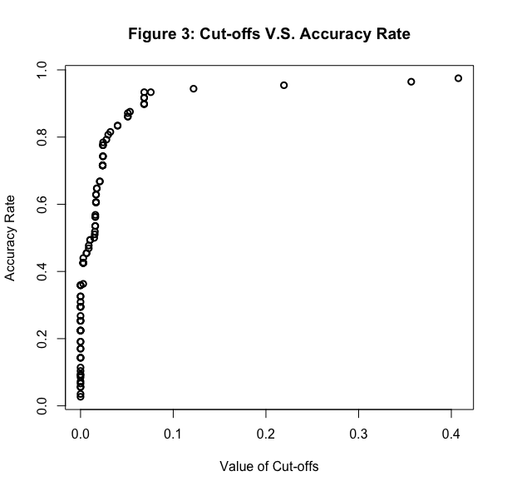
Choice of Cut-offs
cut-offs move from 0 to 0.028, the accuracy rate raises sharply from 0 to 80 percent.
Going beyond 0.028, the growth rate of accuracy rate tends to be gentle and gradually approach to 100 percent
summary statistics of predictions_4 illustrates the distribution of cut-offs contains big jumps in the right tail
a positive relationship between the cut-offs and the accuracy rates
the 91th quantile of the prediction is chosen as the cut-off in this analysis, and the corresponding accuracy rate is 90 percent.

Slide 27
ROC and AUC
ROC: Receiver Operating Characteristic Curves
AUC: Areas under the curves
AUC is commonly used to determine which of models predicts the classes with the highest precisions. The models with higher AUCs are preferred.

Slide 28
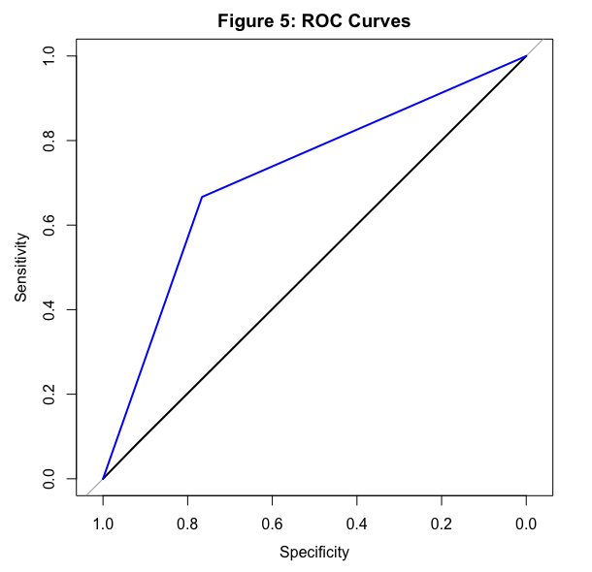
ROC Curves
AUC calculated for the full regression is only slightly higher than 0.5
second regression shows a much higher value, which is 0.7163
the regression only contains the proxies of consumer rating and logistic affairs where the products sold is strongly preferred in terms of predicting the price change
Black line: full regression
Blue line: second regression

Slide 29
Conclusion and recommendations
Business Perspective :
the three features mentioned above fail to explain the price change, even though they may be the determinants of from the sales promotion perspective.
stock status, color and list prices of the products fail to explain the dependent variable
mobile devices produced by Arise, Blackberry, Sony and HTC are more likely to increase their prices.
this analysis provides no guidance for producers on how to improve the chance of charging higher prices other than the brand itself.
Recommendations: customers who are looking for products from these four companies will be better off, if they make purchasing decision at the current time period.
Recommendations in Predictions: average rating, number of users who rated the products, whether having free delivery service and time spent on shipping are necessary to be taken into consideration

Slide 30
Conclusion and recommendations
Technical Perspective:
Omitted variables
Omitted variables of this analysis threatens the accuracy , Ex: edition of the products and the frequency of the new products
Important factor: internal competition fail to be included ( no Data)
Predictions
AUC instead of z-values should be our primary focus
The nature of the regression allows us to interpret the coefficients by including “benchmarks”
the coefficients reported are interpreted as the effects on the price change compared to the omitted variables
insignificance of the variables is not equivalent to zero effects on price change to some extent
Model is imperfect but acceptable
Overall: we need a more comprehensive dataset

